Slide 1
Accessibility Overview
Carolyn Speer, Ph.D.
Manager, Instructional Design and Technology
Fall, 2017

Slide 2

Agenda
WSU’s Agreement
Accessibility/Accommodations
Digital Accessibility
Face-to-Face Accessibility

Slide 3
Wichita State’s NFB Agreement
Hire an Accessibility Coordinator
Adopt and disseminate policies and procedures
Provide ADA training and consider other training for staff, faculty, and students
Undergo a full technology audit
Remediate the website to full accessibility
All course content, including face-to-face content must be accessible.
Notes:
In July 2016, WSU entered an agreement with the National Federation of the Blind. This agreement touches most areas of the university, including in-class instruction and face-to-face staff and faculty training and the creation and use of all digital materials.
[WSU Audiences: WSU must have all course content meeting accessibility guidelines by July 29, 2020.]
[Non-WSU Audiences: WSU’s agreement is important to you because it gives you insight into the accessibility standards that higher education institutions are being held to by the Office of Civil Rights. While this agreement is technically specific to WSU, it is very similar to two additional OCR-related agreements, one with Atlantic Cape Community College, and the other with Southern Oregon University.]

Slide 4
Accessibility versus Accommodations
Accessibility: proactive for populations.
Accommodations: reactive for individuals
Accessibility
  Create accessible content
  Build accessible websites
  Purchase accessible technology
Accommodations
  Adjust for individual needs
Notes:
Accessibility issues are those that are proactive and pave the way for all populations of users. Accommodations are made after the fact where necessary on an individual basis. On campus, the Office of Disability Services is the accommodations office for students and Human Resources is the accommodations office for faculty/staff. Accessibility, on the other hand, is everyone's responsibility.
[For WSU Audiences: The Media Resources Center is an important resource for the accessibility issues, although it works in partnership with many other offices on campus. If you have an accessibility question, it probably makes sense to begin with the Media Resources Center, and if we can’t help you, we can direct you to the office that can.]

Slide 5
Digital Rules of Thumb
Avoid handwritten documents
Find digital versions of photocopied documents, or recreate them
Use Microsoft products to produce new content for your class when possible
Use your Microsoft accessibility tools when creating content (styles sheets, bullet/numbers, checker)
Notes:
Digital standards are based on the WCAG 2.0 AA standards, which are the standard of the industry. Recent changes in federal regulations, especially in Section 508, has functionally incorporated the WCAG 2.0 standards into federal regulation. That means the guidelines for digital accessibility are clear, extensive, and enforced by the rule of law.
What follows here are rules of thumb that we hope will help you create and use content that is in line with these regulations:
Handwritten documents can’t be read by a screen reader
Photocopied documents can’t be read by a screen reader, but many documents can be found online in accessible formats. If they are not available in an accessible format, it may be possible to convert them to an accessible format, but typically remediating documents is very technically challenging and time consuming. It is often much quicker and easier to recreate the document.
Microsoft products have built in tools that make creating accessible documents much easier. If you use your tools, your documents will be much more accessible, and you will save time in their creation too.

Slide 6
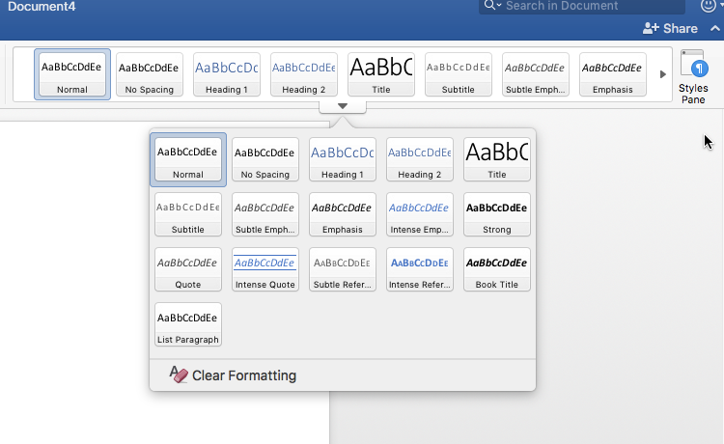
Your Microsoft Tools: Style Sheets
Notes:
The style sheets tool will allow you to differentiate between headings, normal text, emphasis text, and lists. The advantage of using these tools is that you only have to click on the title, for example, and call it “heading 1” and the entire title will be changed to heading one. If you click anywhere in a paragraph and choose “normal” it will all become tagged as normal. Once you get used to these tools, you will find that they save you a great deal of time. If you would like to change the default look of your styles, you can easily do that in your “styles pane”.

Slide 7

Your Microsoft Tools: Bullets, Spacing, Etc.

Slide 8

Your Microsoft Tools: Accessibility Checker
Notes:
Once you are finished with your document, go to the “review” tab in Word and choose “check accessibility.” The system will then make sure that your document is accessible to people using screen readers as well as checking for other accessibility issues.

Slide 9
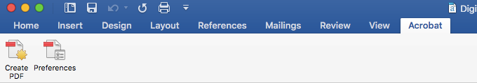
More Digital Rules of Thumb
Use Arial (just kidding…but sans serif is best)
Remember: PDF and .HTM files are easier for your students to open online
Notes:
When creating your document, consider using a sans serif font like Arial. Sans serif fonts are easier for dyslexic students and students with certain other learning disabilities to read. When you are finished with your document, consider saving a copy as .HTM or PDF if you are putting it online. If you have Adobe Acrobat on your computer, you may have an “Acrobat” tab. If you do, choose “create PDF” rather than using the “export format” in the “file, save” area of Word.

Slide 10
Even More Digital Rules of Thumb
Avoid unnecessary bells and whistles (and color)
Avoid unnecessary tables
Avoid unnecessary visual and organizational complexity
Remember: a picture really is worth “1,000 words”
Name your hyperlinks
Caption video, or find video that is captioned
Notes:
Whether you are creating a digital document, a website, or an online class, it’s important to remember that visual complexity makes your content less accessible. By avoiding bells and whistles and unnecessary color, you are reducing your user’s cognitive load and helping them focus on the content of your presentation. Color is a particular problem when it “carries information,” and should never be the only way certain information is communicated. For example, avoid such things as listing class dates and then saying that all the dates in red are test days. Make sure that important information is communicated in at least one additional way.
Avoiding tables will also help you avoid technical headaches. Screen readers read documents through “document tags,” and tables must be hand-tagged by you when you create them. Hand tagging tables can be difficult and time consuming, so it’s labor saving to avoid them unless they are necessary.
Any non-decorative pictures, images, graphs, etc. that you create will need a written explanation of the content. This is called an “alt tag” and the alt-tag is attached to the image when you create the document. If you do not have alt tags, your accessibility checker will ask you to add them when you run the check. To add them, most applications have an alt tag editing feature if you right-click the image.

Slide 11
Textbook & Publisher Content Rules of Thumb
Ask “what is not accessible?”
Avoid Flash-based content
Check for captions
Remember: not all “digital” content is accessible content
Remember: “equally effective” is a high standard
Remember: high cost is low access
Remember: publishers aren’t liable, we are
Remember: you are not alone. Get help
Notes:
Publisher content is a serious area for accessibility problems. For years, publishers developed digital content, investing billions of dollars in the digital world. Unfortunately, much of that content was built to be visually rich and interactive with no real concern for accessibility because colleges and universities were not demanding it. Now, with the increased federal oversight of higher ed accessibility, the pressure on publishers is increasing. But publishers are not liable for accessibility problems in their content, the colleges and universities are. That means it’s important to ask specifically “what is not accessible” in the content you are considering adopting. Avoid Flash-based content entirely and make sure to check for captions. Remember that just because something is “digital” doesn’t mean it’s necessarily accessible and if you or the publisher relies on “equally effective” content for certain groups of students, the legal standard for equally effective content is very high. There are other access issues associated with this content as well, the biggest of which is cost. Most digital content is not available used, so all students pay full price for it. If you need help figuring out if content you want to adopt is accessible, get help from
[WSU: Instructional Design and Technology, the library, or someone in your department]
[non-WSU: from the relevant office on your campus]

Slide 12
Face-to-Face Instruction
Our standards may change over time
Recommendations and expectations
  Lectures
  Discussions
  Media
  Assessments and Exams
  Communication with students
  Guest speakers
Notes:
The challenge of f-2-f instruction is that while digital accessibility has clear guidelines that flow from federal law and industry standards, face-to-face accessibility standards are still very much in development. Wichita State’s face-to-face standards have been extrapolated from the standards for digital classrooms and from ADA regulations and have emerged in part from cooperation with other universities and colleges.
[WSU Audiences: These standards are still somewhat in flux and could change in response to a WSU faculty survey needs assessment and as new federal guidelines emerge and as the standard of the industry in higher ed become codified. ]
These standards cover all aspects of face-to-face instruction. Please consult the handout or view them online from any wichita.edu page by scrolling to the bottom of the page and clicking the “accessibility” link.

Slide 13
Questions?

