Slide 1
Notes:
Many people think innovation comes from having plenty of time and resources to come up with great ideas; however, for us, the opposite is becoming true. In our case, limited resources are causing us to come up with new and creative solutions leading to a variety of initiatives.
We also recognize that development begins with awareness. We typically don't fix things if we think they don't need fixing and we don't use tools we don't know we have. Awareness, both personal and organizational, is critical to our students’ and our college’s success. One of the things we are trying to do is be much more aware of and responsive to the feedback we receive from constituents and to employ resources we may have overlooked previously or at the very least look at our resources differently.
The feedback we receive from our constituents is the best vehicle we have to develop awareness of emerging fields and potential growth areas.

Slide 2
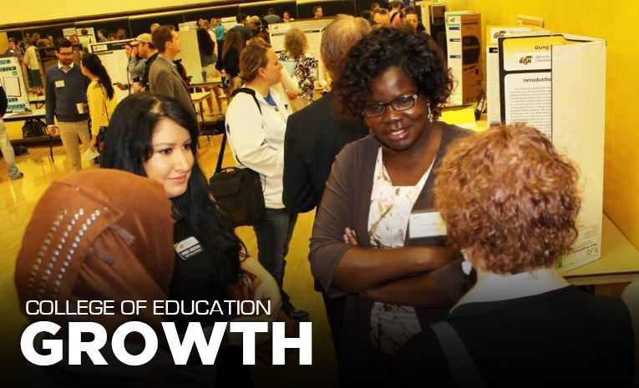
Alignment: WSU Goals 3, 5
Notes:
Enrollment Growth and Reaching new markets
For example, feedback solicited by the Kansas State Department of Education through their Kansas Can initiative pointed out School Counseling and mental health programs are in big demand throughout the state. We also know psychology majors are looking for career opportunities. Therefore, we have developed new Ed Psych and School Psych pathways in their programs that will pave the way for students to matriculate from bachelors in Psychology to a M.Ed in School Psych then directly into Ed.S in Ed. Psych.
Our new AT to PT program has resulted in triple enrollment in AT in the first year. Realize not all of these students will be able to enter the PT program, so program faculty are identifying additional pathways for students who are not accepted. Also exploring how to increase capacity of the AT program. AT students must demonstrate competence in numerous skills. Very time consuming for faculty to do the assessments. Hiring graduate students to assist with completing some of the program assessments will help alleviate that problem.
Also taking a long term look at recruitment by offering programs for elementary through high school students such as after school programs and GAP year program.
We also know teachers are looking for support as they implement new curriculum standards and learn how to meet a wide variety of student needs. To respond, we are now offering Market Based Tuition courses in a range of topics including STEM, SEL and Trauma informed instruction.
Similarly, Districts are responding to new legislation to support beginning teachers. Our Kansas Mentor and Induction center is working with districts to provide this support. Currently serving districts all over the state including Wichita, Winfield, Goddard, Mulvane, Holcomb, Newton and Lawrence.

Slide 3
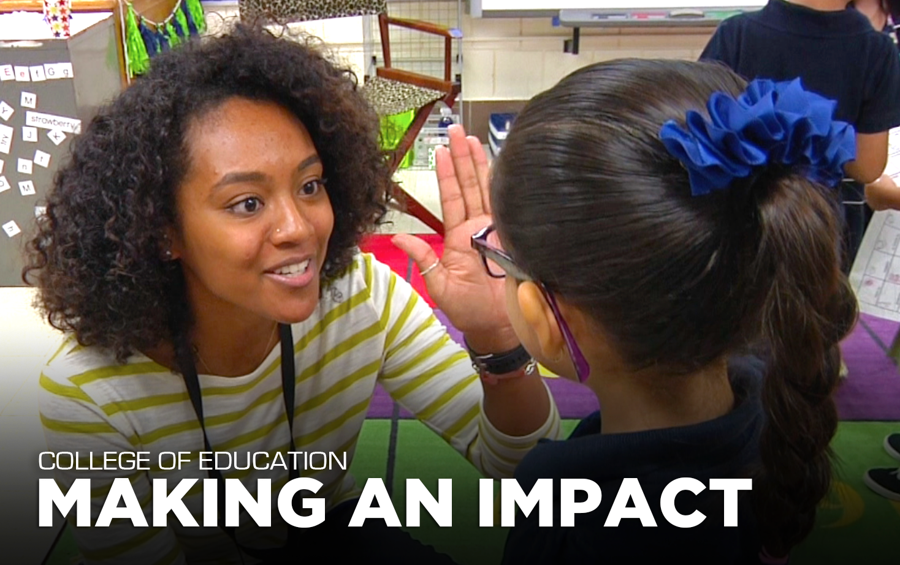
Alignment: WSU Goals 1, 3, 5, 6
Notes:
Blue Ribbon panel conducted by Kansas State Dept. of Education revealed big vacancies in Western Kansas and a ”greening” of the profession. Fewer teachers entering profession and growing numbers are leaving after 5-10 years. Districts are forced to higher under qualified persons (substitute teachers) to fill vacancies, increasing class sizes etc. We are working with districts in Western Kansas to develop a new teacher preparation program targeting Para Educators and transitioning them to be licensed classroom teachers. Tell story about Para Educators working for average of 9 years at minimum wage. TAP program not only provides new opportunities for Paras and their families but also for kids they will teach. Very positive response from the districts with over 40 in attendance at our first info meeting last week.

Slide 4
Alignment: WSU Goals 2, 3
Notes:
Growing need for STEM careers. Coming Jobs War. Three pronged approach. P-12, In-service and Pre Service. Youth camps such as Girls Rock Science where we had over 100 kids participating in our first experience. Plan is to enlarge next summer with broader range of camps. Programs for In-service teachers include program for STEM Coaches and impact on P-12 classrooms. Students are more engaged and involved. Tell story about little boy and not wanting to miss STEM time.

Slide 5
Alignment: WSU Goals 2, 3, 4, 5
Notes:
Our Human Performance Lab is known for it’s success in launching small businesses. Students from all over campus engage in collaborative, interdisciplinary teams to develop products and services that eventually turn into successful businesses. Teams are always well represented in the top performers of the New Ventures competition each spring. Also having success in creating partnerships with businesses where students in the HPL benefits from entrepreneurs’ expertise and access to new products. HPL has launched new website that is attracting more partners and request for services such as performance assessments and product evaluations.
Newest collaborative work is being done in the area of wearable technology such as the sensors being developed for the next spacesuit. New faculty in HPS is an engineer from NASA. He is already collaborating with faculty across campus to further develop this area.

Slide 6
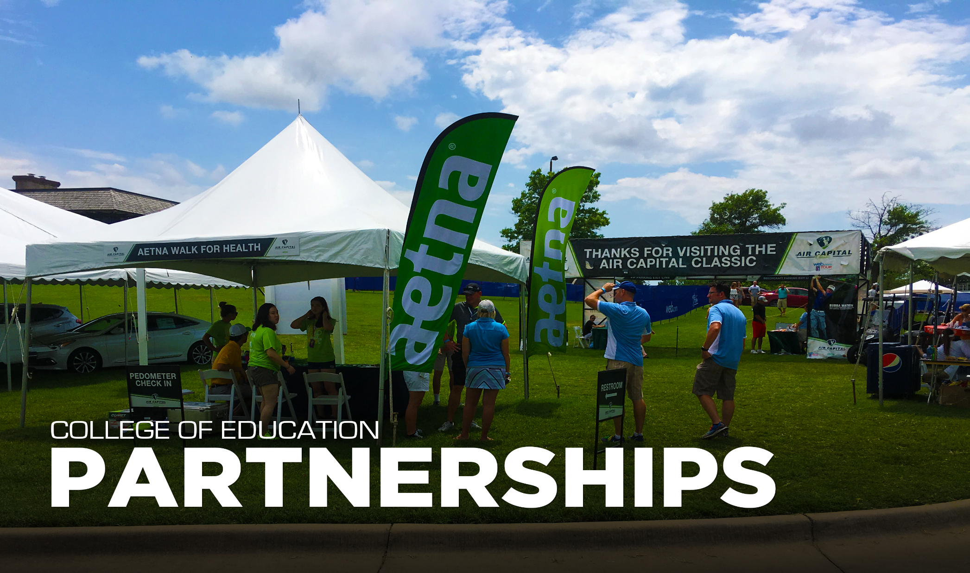
Alignment: WSU Goals 1-5
Notes:
As you can see in this photo, our SM dept. providing valuable experiences for our students working with industry on market analyses and marketing campaigns.
We have partnered with the Air Capital Classic for past several years to assist with collecting data for businesses like AETNA who are using data and information gathered by our interns to guide decisions for new growth areas and strategies for their target demographic audiences.
Continuing to develop these partnerships as organizations such as Sporting KC, OKC Thunder, Derby Rec Center and others recognize our interns are valuable resources. Participation in these events is great exposure for our programs

Slide 7
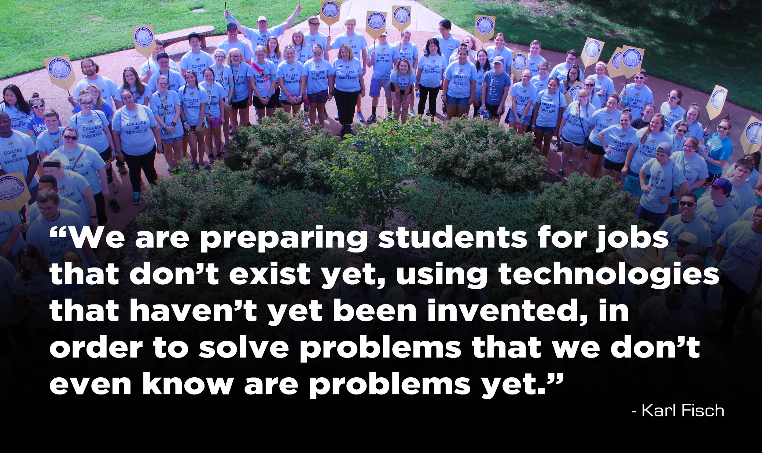
Notes:
As we move forward it is becoming increasingly clear we need to move forward with flexibility. We want to capitalize on trends and opportunities. The market is evolving quickly and we need to be adept at changing to meet the needs. Our Infrastructure and processes need to be able to respond as well, need to be nimble and able to adapt. ( –Registration issues and Having to submit CCFs, etc before implementing programs detracts from the speed at which we can adapt.) Resources - time, energy, finances, etc. - are all finite. We can only spend them once so we must make sure to spend them on what’s most important
We need to become more comfortable with the ambiguity these changes and this flexibility creates and recognize that Leadership is the single most significant input to success in changing our society. We can positively impact society if our students have the ability to make quality leadership decisions and choices.
We are striving to help our students to understand we are not simply consumers of our community, we must be contributors.

