Slide 1
Honors: Who We Are and Where We’re Going
Kimberly Engber
Dean, Dorothy and Bill Cohen Honors College
Strategic Planning Annual Review
September 7, 2016

Slide 2
Dorothy and Bill Cohen Honors College Strategic Planning Annual Review
Highlights
Diversity: Student Research and/as Recruitment
Empowerment: Cohen Scholarships and Fellowships
Multidisciplinary collaboration
Honors Curriculum and Teaching
Challenges
Retention: Qualitative Growth and Post Graduate Pathways
Next steps
Faculty Engagement and Student Development

Slide 3
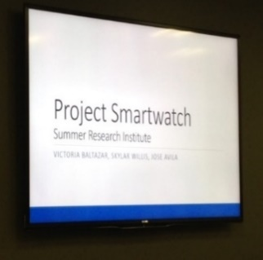
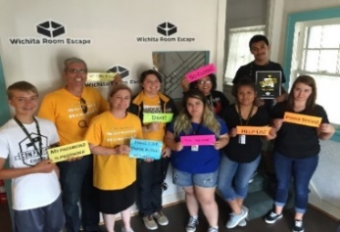
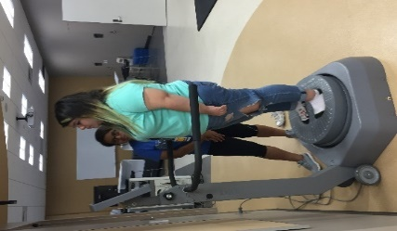
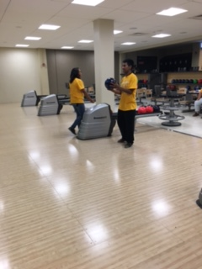
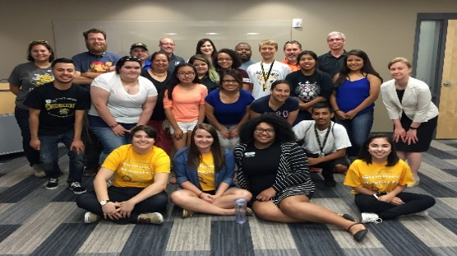
Diversity:
Student Research and/as Recruitment
Summer Research Institute 2016
Residential summer research experience designed for high school students who are underrepresented minorities or will be first-generation college
Facilitated by faculty and college student mentors
In collaboration with the WSU Regional Institute on Aging, Department of Psychology, Human Performance Lab, Fairmount College Advisory Council, Office of Admissions, and Office of Financial Aid
Goal: Increase student participants and campus partners

Slide 4
Empowerment: Cohen Scholars-in-Service
Awarded $19,000 in Cohen Enhancement Scholarships to support continuing students:
service-learning seminar and travel Hunger and Homelessness in NYC, created by Student Involvement
student research presentations at Great Plains Honors Council Conference, Siloam Springs, Arkansas
unpaid summer internship with Y International, Chicago
intensive summer linguistics institute
summer research in Alzheimer’s at KU
development of Honors peer mentorship program
service as college mentors for Summer Research Institute for high school students who will be first generation college students
unpaid White House internship with First Lady’s policy team

Slide 5
Multidisciplinary Collaboration and Post-graduate Pathways
Honors Law and Public Policy Interdisciplinary Track
Students who are considering careers in law or public policy have the opportunity to put together a course of study to explore both theory and application in legal and policy studies. Students who complete the requirements for the law and public policy track earn a notation on the transcript.
Faculty are encouraged to submit courses to Neal Allen, coordinator, to be considered by the Honors Faculty Council for inclusion in the track.

Slide 6
Honors by the Numbers
125 Approximate number of incoming Honors students each year
3.85 Average unweighted high school GPA of incoming fall 2016 Honors class
28 Average composite ACT score of incoming fall 2016 Honors class
8:1 Average student to teacher ratio in Honors courses
89 Majors across seven colleges have at least one Honors College student in them
2,086 Hours of Community Service and Engagement given by Honors students in spring 2016
33 Honors students and faculty earned Community Service and Engagement awards in spring 2016
4000 Dollar scholarships available through the Cohen Enhancement Scholarships program to support any Honors student in good standing to study abroad, take unpaid internships in the public sector, engage in research or creative activity, and travel for national conferences or service learning

Slide 7
Honors College Membership by College

Slide 8
Honors College Membership by Class

Slide 9
Cohen Faculty Fellows
Roles and responsibilities developed
Recruitment plan in process
The Honors College believes it is crucial to devote resources to faculty members who are excited about engaging with highly motivated students and want to explore with them new avenues of interdisciplinary learning and creative problem-solving. Put simply, faculty will be pivotal to the success of the Honors College. Their investment in students will manifest itself in many ways: mentoring, helping to apply for highly competitive national scholarships, overseeing research, leading reading and discussion groups, and helping to ensure that academically gifted students are receiving the attention and direction they need.

