Slide 1
University Libraries
Strategic Plan Progress Report
2015-2016

Slide 2


Highlights
2

Slide 3
Library Without Walls
Increased Online Access
3

Slide 4





More Support for Online Classes
Streaming Media
E-Books (DDA)

Slide 5
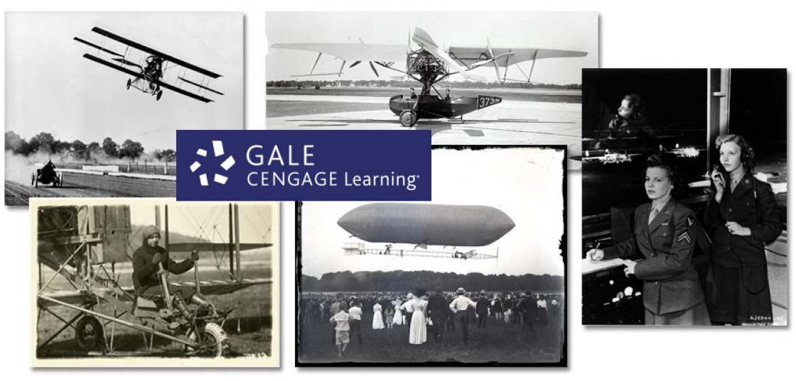

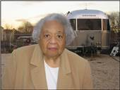

Increased Online Research Collections
Primary Research Materials
Journal Archives

Slide 6
Current Access to Online Resources
87,442 Unique e-journal titles
438,137 Unique e-book titles
23,293 Unique media titles
Students and Faculty conducted 5,524,621 online searches (Approximately 360 per student or faculty)

Slide 7

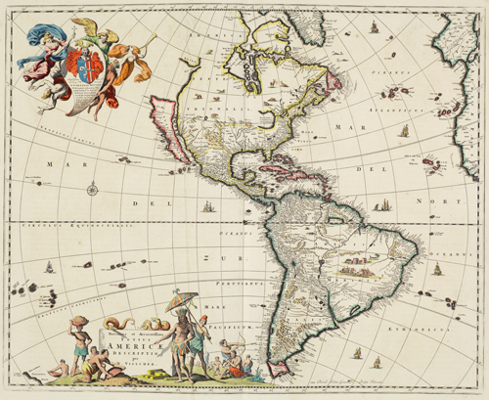
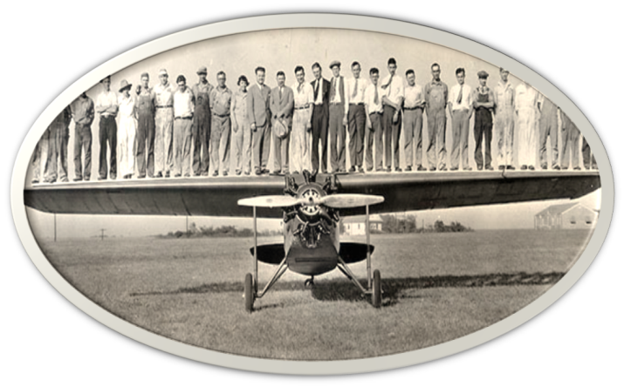
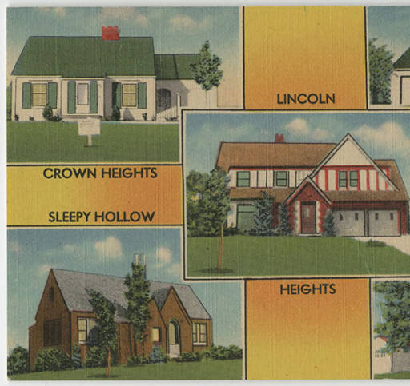
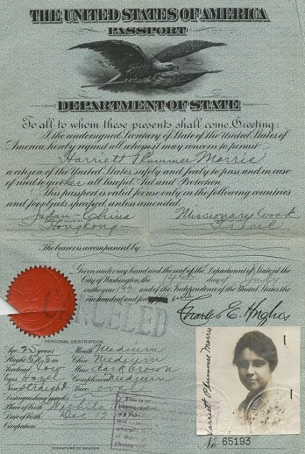

Digitized Unique Local Collections
Local Business Archives
Rare Maps
Historic Papers
Rare Books

Slide 8



Digitized Unique Local Collections
The Advanced Generalist:
Social Work Research Journal
Fairmount Folio:
Journal of History
Shocker Open Access Repository:
WSU Theses, Dissertations, Articles, Reports, Catalogs, GRASP

Slide 9
Digital Collection Growth
FY15-FY16
Over 42,000 items scanned and added to CONTENTdm complete with locally developed metadata
Over 1,500 titles added to SOAR. Currently 3,070 titles are authored by WSU students

Slide 10
Enhanced Support for
Student Success
10

Slide 11
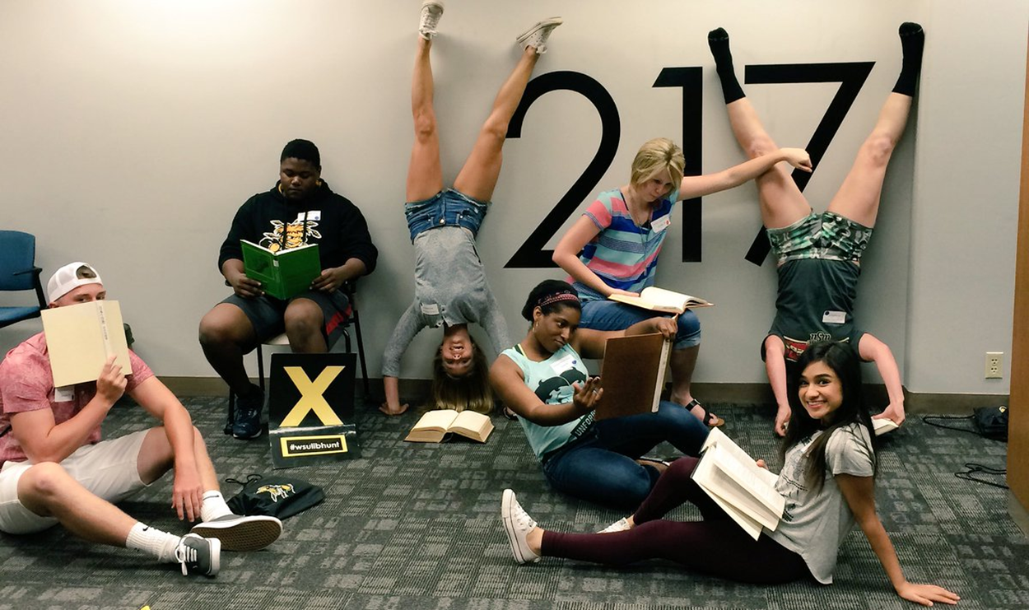
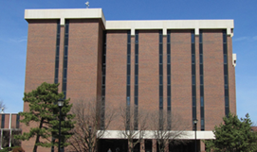
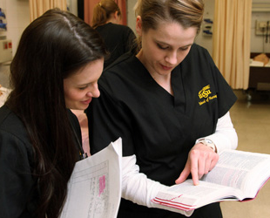

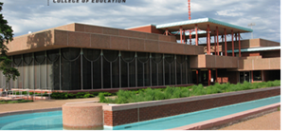
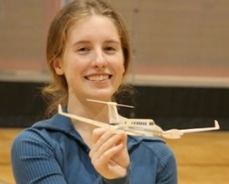
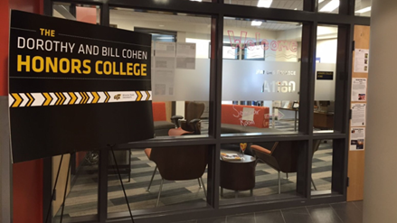
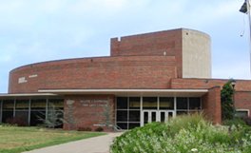
Information Literacy through Collaboration
Student Orientation
First-Year Seminars
WSU Reads
Academic Departments

Slide 12
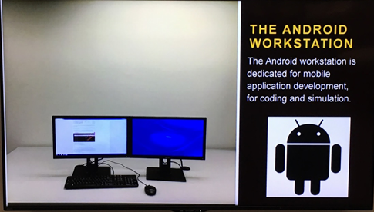


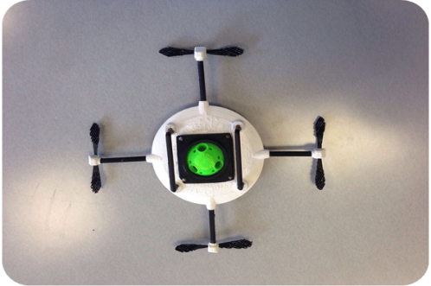

Through Enhanced Services and Facilities
C-Space
Enhanced Interlibrary Loan
LibGuides/LibCal
Embedded Librarians
3-D Printing

Slide 13
Interdisciplinary Collaboration
13

Slide 14
Economic Development Agency
REPICS Grant
The University Libraries is home to the only Patent and Trademark Resource Center (PTRC) in Kansas
Funding for fulltime staffing to the center was removed from UL budget during budget cutbacks in 2009
The grant provides a 50% staffing match

Slide 15
Grant Responsibilities
Part of larger grant
The UL’s role was to:
  Develop and implement a patent research instructional program for Dr. Jim Wolff’s team of entrepreneurship graduate students involved in vetting the IP of items submitted to WSU Ventures
  Provide technology transfer support including patent and trademark resources, instruction, and services
  Inform clients using PTRC resources about WSU Ventures

Slide 16

Grant Outcome Highlights So Far
18 training sessions and 236 one-on-one consultations
Networking with entrepreneurship community including MakeICT, DevICT, 1 Million cups, & Get Started Wichita
Enhanced research guides and developed new Entrepreneurship Research Series
New this fall: 1-hour patent search training to multiple sessions ENGR101

Slide 17
Challenges
17

Slide 18
Outside of the University
18

Slide 19
Average Price for Journals Based on ISI Indexes 2012-2016

Slide 20
% Change of Serial Prices and University Libraries GU-OOE FY12-FY16

Slide 21
Inside the University
21

Slide 22



Prioritizing to Meet Evolving University Goals
Established Services
and Collections
Staffing
Opportunities
Innovation Campus
Badges Market-based
Institute for Multidisciplinary Creativity
IDEAS Lab SEM

Slide 23
Next Steps
23

Slide 24

Resource Development
Seek additional sources of funding
Reduce current commitments

Slide 25

Assess Established Services & Prioritize New Opportunities

