Slide 1
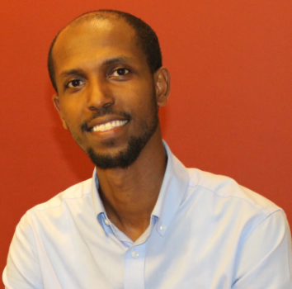
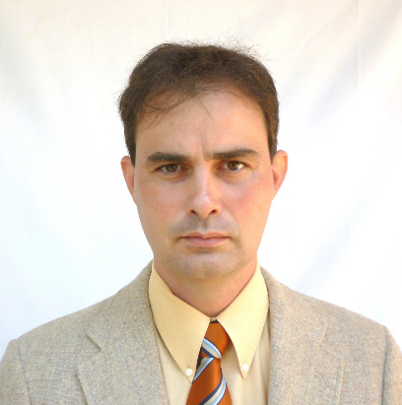
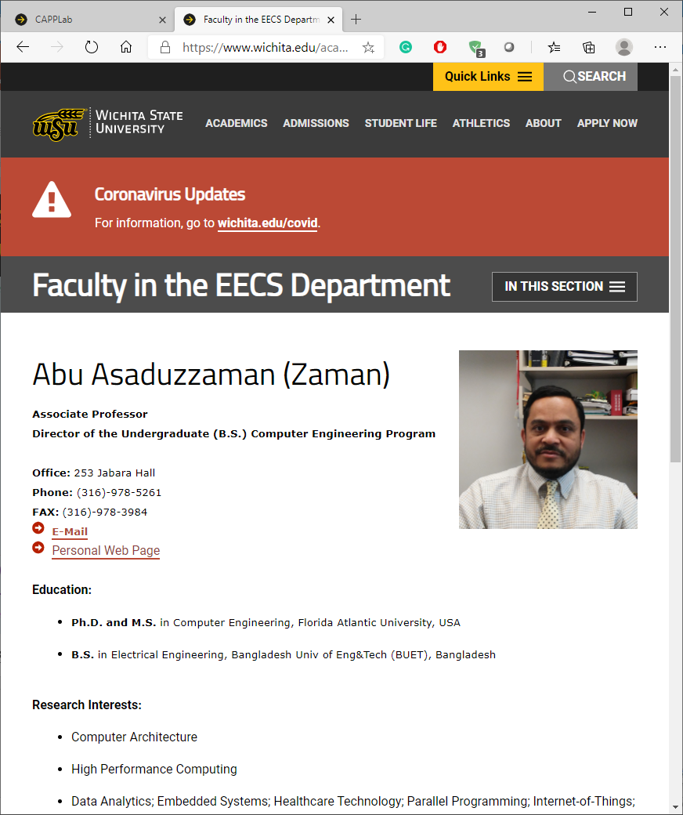

EECS Graduate Student Orientation ~ Fall 2018
“SMT-Capable CPU-GPU Systems”
Three P’s, three Z’s?
DRZ
Dr. Tewodros Aklilu Zewde
Dr. Gergely V. Zaruba
Dr. Zewde
Dr. Zaruba
Less than five minutes, a lot to say/prove…
I’ll start with explaining my title…
“SMT-Capable CPU-GPU Systems”
Next presenter, please come start when it is your time…
Dr. Zaman; WSU-5261

Slide 2

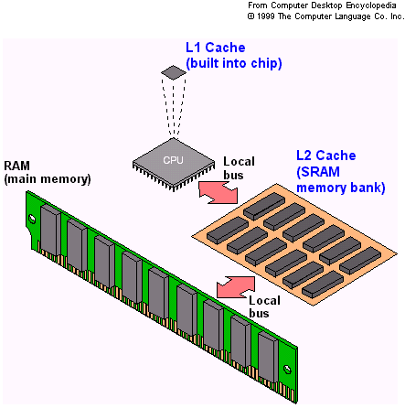
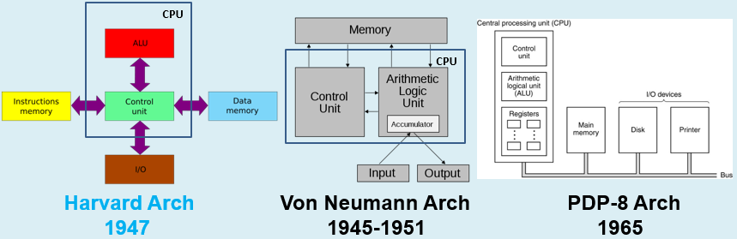
EECS Graduate Student Orientation
“SMT-Capable CPU-GPU Systems”
CS 394
SMT – Simultaneous Multi-Threading
CPU – Central Processing Unit
GPU – Graphics Processing Unit
A Computer System
Name of the Game: performance, power, price, …

Slide 3
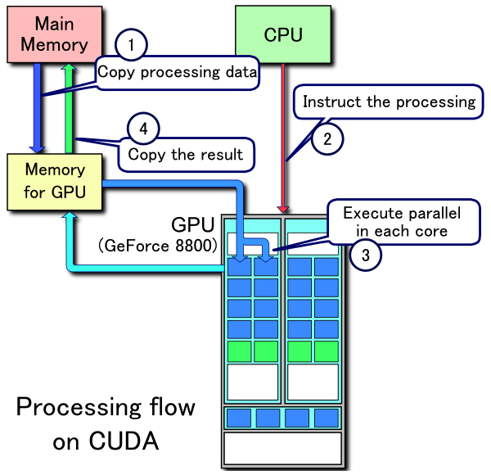
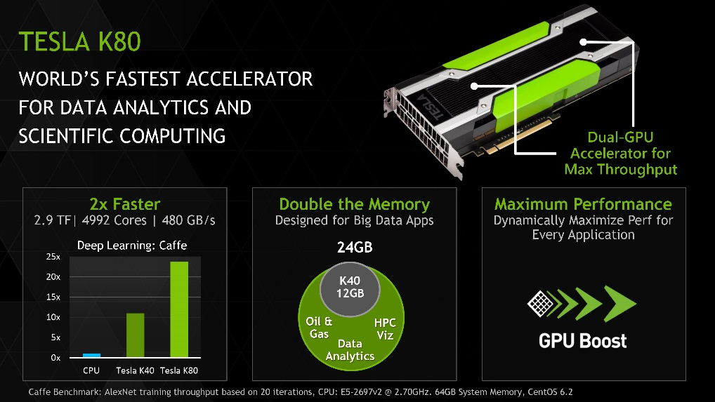
EECS Graduate Student Orientation
“SMT-Capable CPU-GPU Systems”
CS 694
SMT – Simultaneous Multi-Threading
CPU – Central Processing Unit
GPU – Graphics Processing Unit
Compute Unified Device Architecture
(CUDA) – a parallel computing platform
and application programming
interface (API) model created by Nvidia
CPU-GPU System

Slide 4
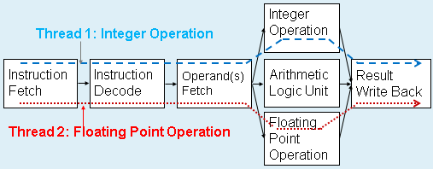
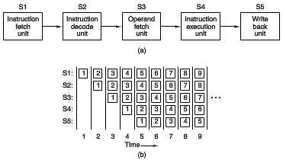
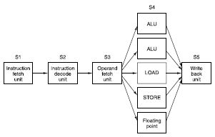
EECS Graduate Student Orientation
“SMT-Capable CPU-GPU Systems”
SMT – Simultaneous Multi-Threading
CPU – Central Processing Unit
GPU – Graphics Processing Unit
SMT-Capable CPU-GPU System
Many-Core GPU Card
A process is a running program. A process can
generate many processes (called threads). …
Instruction Execution
SMT-Multicore CPU
Pipelining → Instruction-Level Parallelisms (ILP)
→ Thread-Level Parallelisms (TLP)
Superscalar → SMT
Notes:
Intel Xeon Phi has up to 72 cores [http://www.intel.com/content/www/us/en/products/processors/xeon-phi/xeon-phi-processors.html]
Nvidia Tesla K80 has up to 4992 cores [http://www.nvidia.com/object/tesla-k80.html]

Slide 5
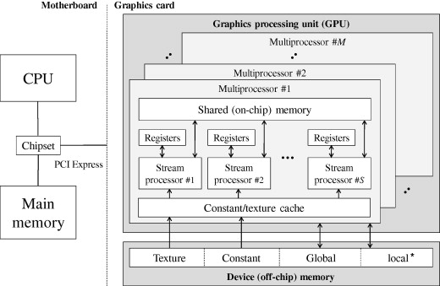
EECS Graduate Student Orientation
“SMT-Capable CPU-GPU Systems”
SMT – Simultaneous Multi-Threading
CPU – Central Processing Unit
GPU – Graphics Processing Unit
SMT-Capable CPU-GPU Systems →
High-Performance Computer (HPC) Systems
CL1 – Level-1 Cache
CL2 – Level-2 Cache
Cache and memory are very
power-hungry. More energy
consumption, more heat dissipation!
HPC: CPU i7-980X 130W,
GPU Tesla K80 300W [1, 2]
Tianhe-1A consumes 4.04 MW;
for 4 MW at $0.10/kWh
is $400 an hour or
about $3.5 million per year. [3]
CL1
CL2
Name of the Game: performance, power, price, …
Notes:
[1] https://ark.intel.com/products/series/79666/Legacy-Intel-Core-Processors
[2] https://images.nvidia.com/content/pdf/kepler/Tesla-K80-BoardSpec-07317-001-v05.pdf
[3] https://en.wikipedia.org/wiki/Supercomputer

Slide 6
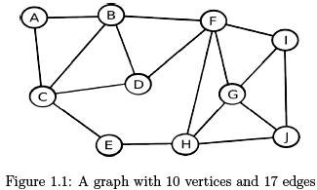
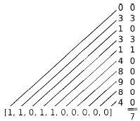
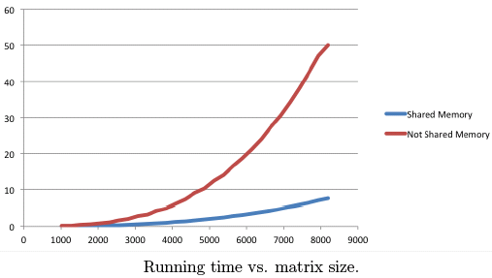
EECS Graduate Student Orientation
“SMT-Capable CPU-GPU Systems”
CS 794
MM w/ CUDA for Graphs [1]
Number of paths of length 4 between C and J? 7
Row (# of paths of length 1)
x Column (# of paths of length 3)
➔ Column (# of paths of length 4)
CUDA (parallel programming) improves performance.
Length 3 →
Length 4 →
Length 1 →
Notes:
[1] Robert Hochberg, "Matrix Multiplication with CUDA — A basic introduction to the CUDA programming model," August 11, 2012

Slide 7
EECS Graduate Student Orientation
“SMT-Capable CPU-GPU Systems”
CS 894
SMT – Simultaneous Multi-Threading
CPU – Central Processing Unit
GPU – Graphics Processing Unit
HPC Systems
  If SMT-capable 16-core CPU and 5000-core GPU card are used to build a HPC system, it offers about 9 Tera (10^12) FLOPS and costs about $5K. [1]
  HPC: CPU i7-980X 130W, GPU Tesla K80 300W
Supercomputers
  A supercomputer may have more or less 300,000 processing cores and operate at Peta (10^15) FLOPS; however, it costs tens of millions of dollars. [2, 3]
  Tianhe-1A: 4.04 MW (about $3.5 million per year)
Name of the Game: performance, power, price, …
Notes:
[1] https://insidehpc.com/hpc-basic-training/what-is-hpc/
[2] https://en.wikipedia.org/wiki/Supercomputer
[3] https://www.anandtech.com/show/8729/nvidia-launches-tesla-k80-gk210-gpu

Slide 8
EECS Graduate Student Orientation
Other Research/Teaching Activities
Microprocessor-Based System Design
The objective of this course is to teach the basic microprocessor organization (hardware) and how to program it (software). Particular attention will be given to the following areas: handling interrupts and interfacing analog/digital input/output devices. Laboratory work should give students hands-on experience.
CS 594
Computer-Based Security Engineering
This course is intended for seniors and graduate students who want to study and explore the role of hardware in improving computer security. Topics in this course can be divided into three major groups: Elements of Computer Security (such as cryptography and password/key generation), Qualities of Workable Security Solutions (such as secure coprocessors, secure memory management, and hardware-based authentication), and Security Engineering (such as managing the secure systems and system evaluation).
CS 697AN
Collaborations
Henry J. Neeman; Assistant Vice President IT, Director of OSCER; University of Oklahoma
Ramazan Asmatulu; Professor of Mechanical Engineering; Wichita State University
M. Emre Celebi; Professor and Chair of Computer Science; University of Central Arkansas
…

Slide 9
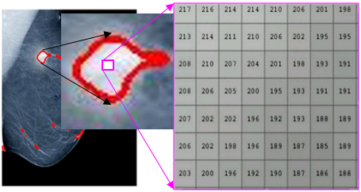
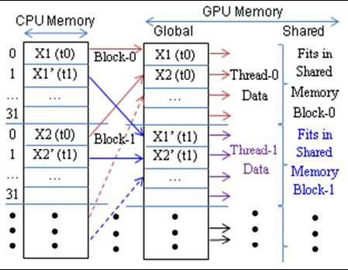
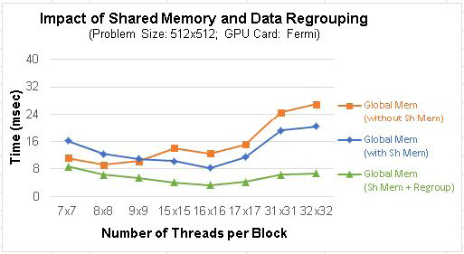
EECS Graduate Student Orientation
CAPPLab Research Activities
Research supported by Kansas NSF EPSCoR, Nvidia, CybertronPC, …
Asaduzzaman, A., Chidella, K.K., Mitra, P., Cluff, K., Saeed, K.A., Islam, M.F., and Islam, A., “A Computerized Imaging Technique to Analyze Mammogram Images with Poor Contrast for Breast Cancer Diagnosis,” under review, Elsevier Journal of Computerized Medical Imaging and Graphics (CMIG), 2018.
Chidella, K.K. and Asaduzzaman, A., “A Novel Wireless Network-on-Chip Architecture with Distributed Directory for Faster Execution and Minimal Energy,” accepted, Elsevier Journal of Computers and Electrical Engineering, 2017.
Asaduzzaman, A., Chidella, K.K., and Vardha, D., “An Energy-Efficient Directory Based Multicore Architecture with Wireless Routers to Minimize the Communication Latency,” in IEEE Transactions on Parallel and Distributed Systems (TPDS), Vol. 28, No. 2, pp. 374-385, May 2016.
CAPPLab earned top research designation (GPU Research Center) by Nvidia in 2015.
Asaduzzaman, A., Gummadi, D., and Yip, C.M., “A Talented CPU-to-GPU Memory Mapping Technique,” in IEEE SoutheastCon 2014, Lexington, KY, March 13-16, 2014.

Slide 10
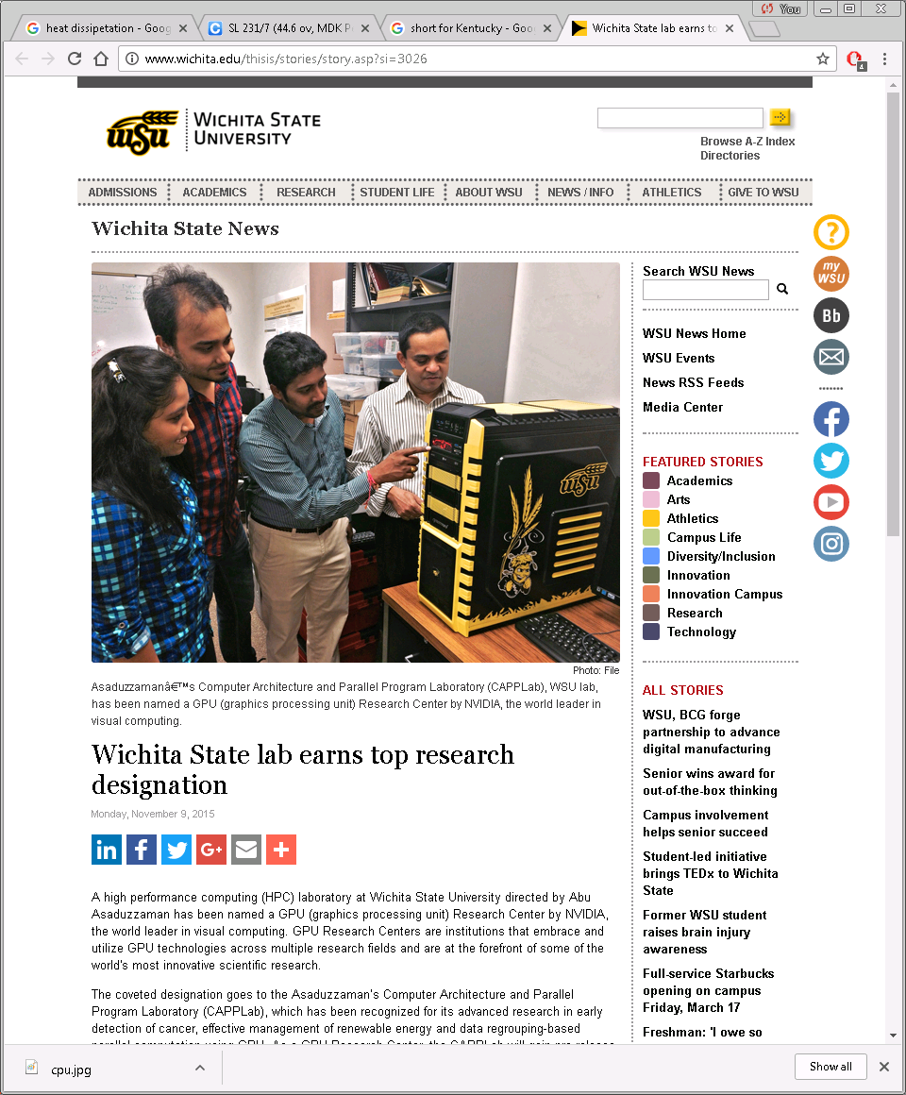

Dr. Zaman; WSU-5261

