Slide 1


MS Thesis Defense,
CUDA ACCELERATED LARGE SCALE VEHICULAR AREA NETWORK SIMULATOR
Presenter:
Chok Meng Yip
Presentation Location: Jabara Hall, ROOM: 260
Presentation Date: 07/17/2014

Slide 2
About Me
I am Chok Meng Yip, majoring in Computer Networking with thesis under Dr. Abu Asaduzzaman
Lab Assistant at CAPPLab
Embedded Systems
Parallel Programming
Co-author of publications:
“An effective CUDA based simulation for lightning strike protection on nanocomposite materials” in Southeastcon 2013
“Fast Effective Deterministic Primality Test Using CUDA/GPGPU”, in International Journal of Computers & Technology (IJCT), Vol. 12, No. 3, pp. 3738-3746, Jan. 2014.
“CUDA/C Based ‘Green’ Technology for Very Fast Analysis of Nanocomposite Properties,” in SAMPE Tech 2013 Conference, Wichita, Kansas, Oct. 21-24, 2013.
“Fast, Effective, and Adaptable Computer Modeling and Simulation of Lightning Strike Protection on Composite Materials,” in IEEE SoutheastCon Conference 2013, Jacksonville, Florida, April 4-7, 2013.
“A Promising CUDA-Accelerated Vehicular Area Network Simulator Using NS-3,” under review, in 33rd IEEE International Performance Computing and Communications Conference (IPCCC), Austin, TX, Dec. 5-7, 2014.

Slide 3
Improved VANET Simulator
Outline ►
Introduction
Motivation
Proposal
Evaluation
Results
Conclusions
Q U E S T I O N S ?
Any time, please.

Slide 4
Introduction
Vehicular Area Networking (VANET)
Wireless Networking Technologies
Physical Layer
Medium Access Control
802.11p
Mobility Modelling
Vehicular Area Networks Types
Driving Behavior
Applications
Accident prevention

Slide 5
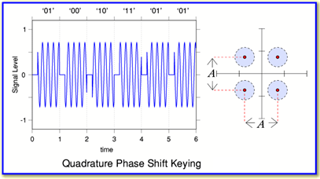
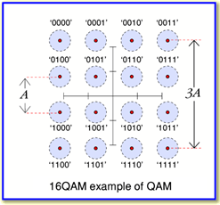
Wireless Networking
Physical Layer
Modulation
Encode
Demodulation
Decode
Digital <-> Analog
Signal Modulation[1]

Slide 6
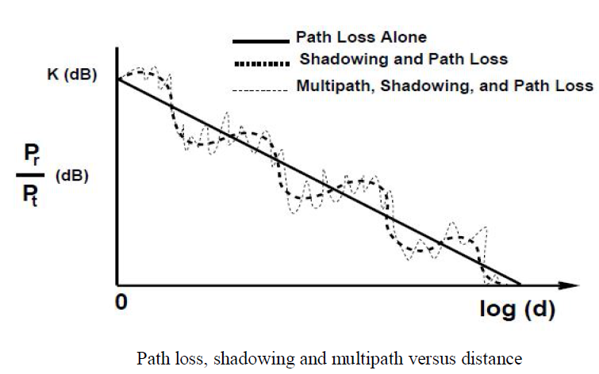

Wireless Networking (+)
Physical Layer (+)
Signal-Noise Ratio
SNR <-> Bit Rate
Distance
Fixed Frequency
Signal Modulation[1]

Slide 7
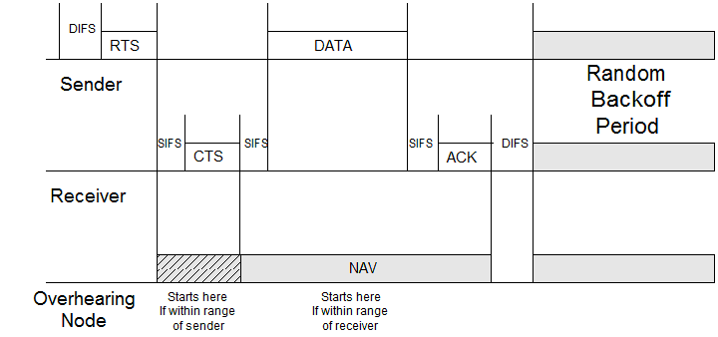
Wireless Networking (+)
Medium Access Control
Coordinates nodes
Medium Sharing
High usage
Distributed Coordinated Function[2]

Slide 8
Wireless Networking (+)
IEEE 802.11p
Intelligent Transportation System
802.11p
5.8Ghz Allocated 75Mhz
Service Channels
Control Channels
Frequency (Ghz) | 5.850 | 5.860 | 5.870 | 5.880 | 5.890 | 5.900 | 5.910 | 5.920
Channel Number |  | 172 | 174 | 176 | 178 | 180 | 182 | 184
Usage | Spacing | Critical Safety | Service Channels |  | Control Channel | Service Channels |  | Public Safety

Slide 9

Introduction
Mobility Modelling
Driving Behavior
Acceleration
Lane Change
Merits
Politeness
Treiber Intelligent Driving Model
V current velocity
V₀ intended velocity

Slide 10
Introduction
Applications
Influence Driving Behavior
Beyond visible range
Line of sight
Communication Types
V2V
V2I
V2x

Slide 11
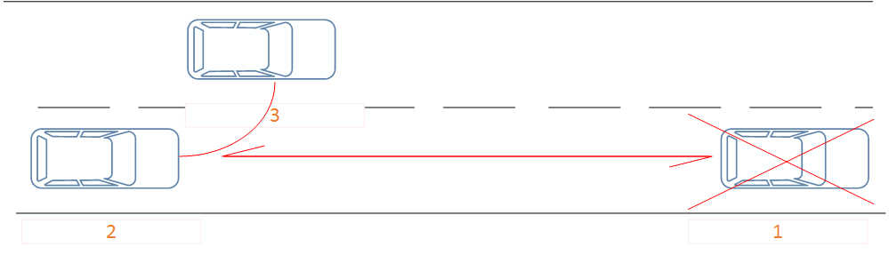
Wireless Networking
Applications-An Example
Vehicle Breakdown
Driver Alerted
Driver Informs to Change Lane

Slide 12
CUDA ACCELERATED LARGE SCALE VEHICULAR AREA NETWORK SIMULATOR
Outline ►
Introduction
Motivation
Proposal
Evaluation
Experimental Results
Conclusion
Q U E S T I O N S ?
Any time, please.

Slide 13
Motivation
Optimize Network Performance
Simulation
MAC
Signal Strength
Placement of Nodes
Data dissemination

Slide 14
Problem Statement
Simulators
Current Available Technology
MoVes
Distributed Systems
Many Computers
Expensive
Moritz
Mathematical Optimization
15% Less accurate
Traditional Simulator
Slow

Slide 15
Problem Statement
NS-3 Simulator
Open Source
Accurate Models
Weingartner et.al [3] -Fastest Simulator
 | OMNet++ | NCTuns | NS-3
Implementation | GUI | GUI + Backend | Backend Only
Simulation Speed [3] | Baseline | Fast | Fastest
Source Model | Open | Closed | Closed

Slide 16
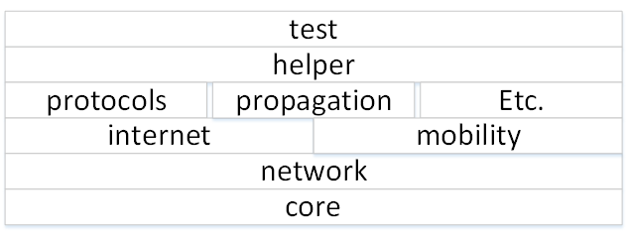
Problem Statement
NS-3 VANET Simulator
Event based simulator
Hadi Arbabi & Michelle Wiegle
Models
Treiber IDM
NS-3 Wireless Stack
NS-3 Modules

Slide 17
CUDA ACCELERATED LARGE SCALE VEHICULAR AREA NETWORK SIMULATOR
Outline ►
Introduction
Motivation
Proposal
Evaluation
Experimental Results
Conclusion
Q U E S T I O N S ?
Any time, please.

Slide 18
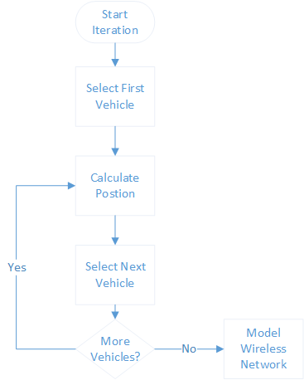
Traditional Simulator
Vehicular Modelling
Stores data in Linked List
No easy parallelization method
Computationally Expensive

Slide 19
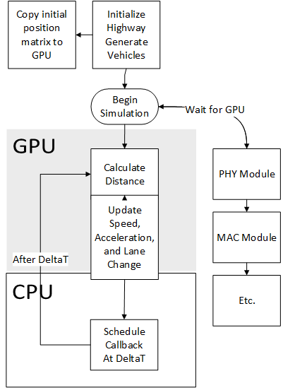
Proposed Simulator
Proposed NS-3 Simulator
Initialization
Position Matrix
Velocity Matrix
Iteration
Acceleration
Apply Matrix
Copy Distance

Slide 20
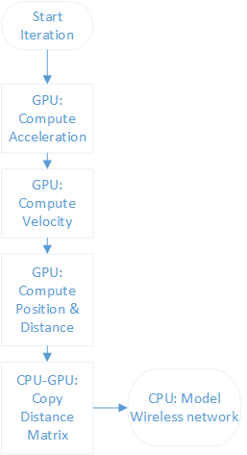
Proposed Simulator (+)
CUDA NS-3 VANET Simulator
Change Data structure to Matrix
Collect all data before computing
GPU to speed up
Many Cores
Same Equation

Slide 21
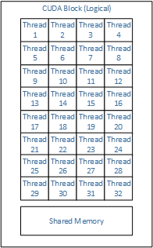
CUDA
CUDA GPGPU
Compute Unified Device Architecture
SIMD
Device memory
Divide Data into
Grid
Block
Threads
Shared Memory for each block
Programmers (Logical) perspective

Slide 22
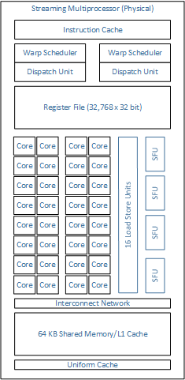
CUDA(+)
CUDA GPGPU
GPU Core
Many Cores
Hardware (Physical) perspective

Slide 23

Proposed Simulator (+)
Position Matrix
Easy to Compute for GPU
Easy to retrieve from CPU
Pt[0] – Position of node 0

Slide 24
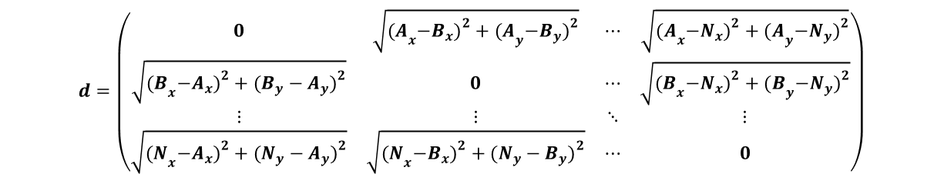
Proposed Simulator (+)
Distance Matrix
Computes distance between all nodes
Performed in GPU
__global__ void computeDistanceMatrix(Vector3D *a, Vector3D *b, double *c, int numberOfNodes){ .. if ( (i<numberOfNodes) && (j < numberOfNodes)){ c[i*numberOfNodes + j] = sqrt(dx*dx + dy*dy + dz*dz); } }

Slide 25
Proposed Simulator (+)
Proposed NS-3 Simulator
Uses same input
Generates same output
Wireless: Only need Distance between nodes

Slide 26
CUDA ACCELERATED LARGE SCALE VEHICULAR AREA NETWORK SIMULATOR
Outline ►
Introduction
Motivation
Proposal
Evaluation
Experimental Results
Conclusion
Q U E S T I O N S ?
Any time, please.

Slide 27
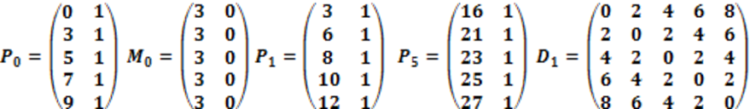
Evaluation
Correctness
P₀ initial position
M₀ initial movement
P₁ after first iteration
D₁ distance after 5 iterations
P₅ after 5 iteration

Slide 28
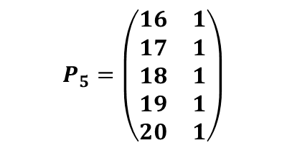
Evaluation
Compare to CPU
Same result as CPU
Node Number | X position |  | Y position
 | Before | After | Before | After
Node 1 | 1 | 16 | 1 | 1
Node 2 | 3 | 21 | 1 | 1
Node 3 | 5 | 23 | 1 | 1
Node4 | 7 | 25 | 1 | 1
Node 5 | 9 | 27 | 1 | 1

Slide 29
CUDA ACCELERATED LARGE SCALE VEHICULAR AREA NETWORK SIMULATOR
Outline ►
Introduction
Motivation
Proposal
Evaluation
Experimental Results
Conclusion
Q U E S T I O N S ?
Any time, please.

Slide 30
Experimental Results
Platforms
 | Supercomputer | Workstation
CPU | AMD Opteron 6134 | Intel Xeon E5506
CPU Cache Size | 512KB | 4096KB
Cores | 32 | 8
Clock Speed | 2.3 Ghz | 2.13 Ghz
RAM Size | 64GB | 12GB
GPU | NVidia Tesla K20m | NVidia Tesla C2075
GPU Architecture | Keper | Fermi
GPU Core Clock | 0.71GHz | 1.15GHz
GPU Memory Size | 5GB | 6144MB
GPU Cores | 2496 | 448

Slide 31
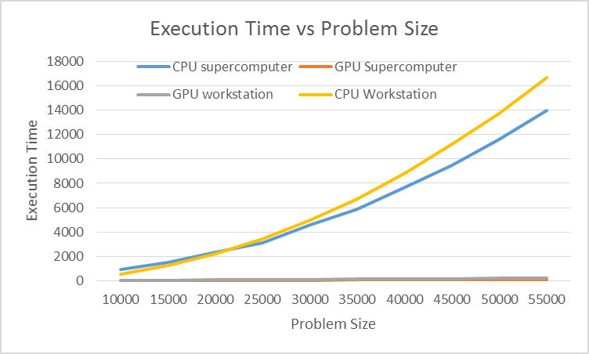
Experimental Results
Isolated Workload

Slide 32
Experimental Results
Isolated Workload
Traditional Simulator
Time increase Exponentially
Proposed Simulator
Minimal Time Increase
75x Speed up

Slide 33
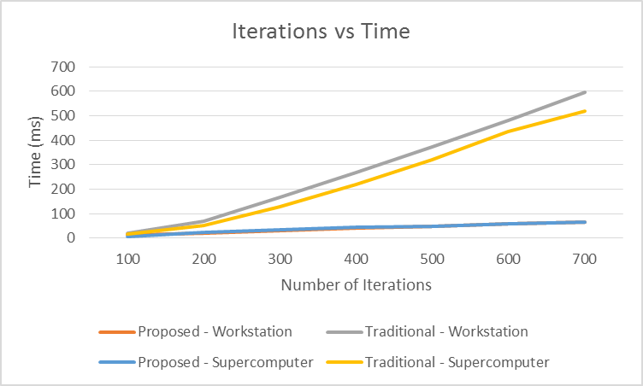
Experimental Results
Isolated Workload

Slide 34
Experimental Results
Isolated Workload
Traditional Simulator
Time increases linearly
Proposed Simulator
Time increases by factor

Slide 35
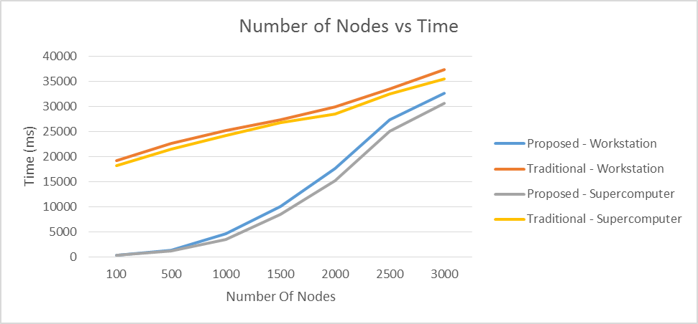
Experimental Results(+)
Full Workload

Slide 36
Experimental Results(+)
Full Workload
Traditional
Time increases linearly
Proposed
Converges to CPU Time

Slide 37
Experimental Results(+)
Energy Consumption- Isolated Workload
Traditional
Exponential increase
Proposed
Small Factor increase

Slide 38
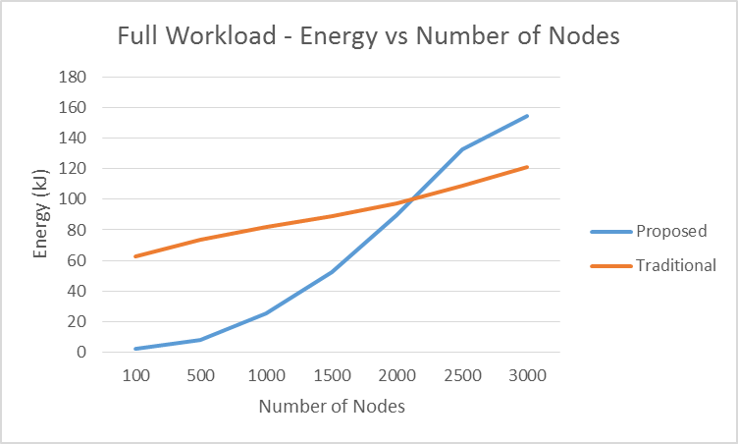
Experimental Results(+)
Energy Consumption- Isolated Workload
Traditional
Linear increase
Proposed
Exponential Increase

Slide 39
CUDA ACCELERATED LARGE SCALE VEHICULAR AREA NETWORK SIMULATOR
Outline ►
Introduction
Motivation
Proposal
Evaluation
Experimental Results
Conclusion
Q U E S T I O N S ?
Any time, please.

Slide 40
Conclusion
VANET is a complex system
Simulation assists network designers to design VANET network
VANET is computationally expensive due to complexity

Slide 41
Conclusion (+)
By modifying the NS-3 data-structure, we can parallelize the process
Using NVIDIA CUDA, we achieve up 75x speed up
Data-Dependency on CPU
Enhance more modules to reduce dependence on CPU

Slide 42
Future Extensions
Enhance NS-3 Modules:
Further improve VANET simulator throughput by using CUDA in more modules
Self Optimizing Simulator:
Simulator optimize input parameters by using output as feedback.
Data Regrouping:
Improve CUDA effectiveness by using data regrouping based on locality principle.

Slide 43
Questions?

Slide 44
CUDA ACCELERATED LARGE SCALE VEHICULAR AREA NETWORK SIMULATOR
Thank you.
Chok Meng Yip
cxyip1@wichita.edu

Slide 45
References
Gronemeyer, Steven A., and Alan L. McBride. "MSK and offset QPSK modulation." Communications, IEEE Transactions on 24, no. 8 (1976): 809-820.
Bianchi, Giuseppe. "Performance analysis of the IEEE 802.11 distributed coordination function." Selected Areas in Communications, IEEE Journal on 18, no. 3 (2000): 535-547.

