Slide 1
Dissertation Defense
“DIRECTORY-BASED WIRED-WIRELESS NETWORK-ON-CHIP ARCHITECTURES TO IMPROVE PERFORMANCE”
Doctoral Candidate:
  Kishore Konda Chidella
  EECS Department
  11/19/2018
PhD Committee:
  Chair: Dr. A. Asaduzzaman
  Member: Dr. R. Asmatulu (ME)
  Member: Dr. H. He
  Member: Dr. W. Jewell
  Member: Dr. E. Sawan

Slide 2
About Me
Kishore Konda Chidella, pursuing Ph.D. degree in Electrical Engineering and Computer Science.
Assistant Professor in the Department of Electronics and Communication at JNTU, INDIA from 2008 to 2013.
Five selected publications (out of a total of 14):
Kishore K. Chidella, Abu Asaduzzaman, and Abdulrahman Almohaimeed, “Impact of Non-Uniform Subnets on the Performance of Wireless Network-on-Chip Architectures,” (under review), IEEE CCWC, 2019.
Kishore K. Chidella and Abu Asaduzzaman, “A Novel Wireless Network-on-Chip Architecture with Distributed Directories for Faster Execution and Minimal Energy,” ELSEVIER Journal on Computers & Electrical Engineering, No. 65, pp. 18-31, 2018.
Abu Asaduzzaman, Kishore K. Chidella, and Divya Vardha, “An Energy-Efficient Directory Based Multicore Architecture with Wireless Routers to Minimize the Communication Latency,” IEEE Transactions on Parallel and Distributed Systems, Vol. 28, No. 2, pp. 374-385, 2017.
Kishore K. Chidella and Abu Asaduzzaman, “Prior Detection of Explosives to Defeat Tragic Attacks using Knowledge Based Sensor Networks,” IEEE Green Technologies Conference (GreenTech), Denver, Colorado, Mar. 29-31, 2017.
Abu Asaduzzaman and Kishore K. Chidella, “A Novel Directory Based Hybrid Cache Coherence Protocol for Shared-Memory Multiprocessors,” IEEE Symposium on Phased Array Systems and Technology (PAST), Boston, Massachusetts, Oct. 18-21, 2016.

Slide 3
DIRECTORY-BASED WIRED-WIRELESS NETWORK-ON-CHIP ARCHITECTURES TO IMPROVE PERFORMANCE
Outline ►
  Introduction
  Literature Survey
  Proposed Directory-Based
  Wireless Network-on-Chip Architectures
  Experimental Details
  Results and Discussion
  Conclusions and Future Extensions
Q U E S T I O N S ?
Any time, please.

Slide 4
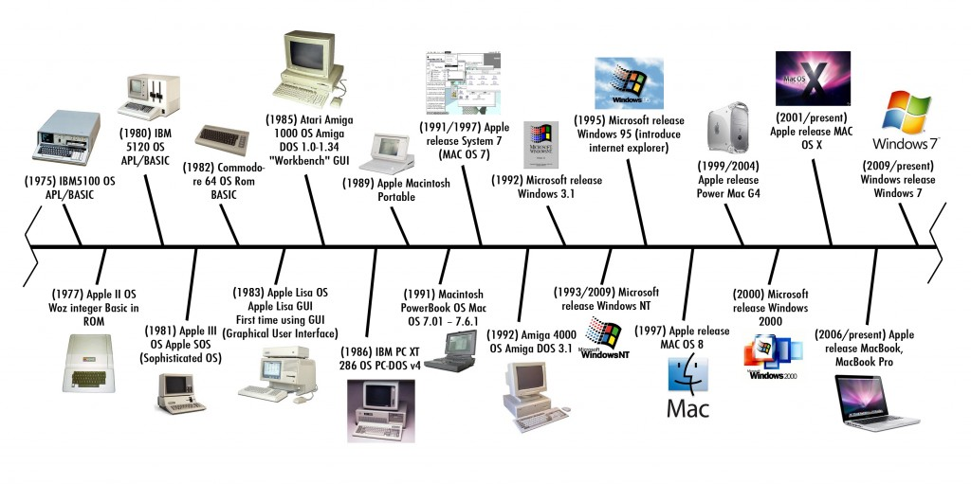

DIRECTORY-BASED WIRED-WIRELESS NETWORK-ON-CHIP ARCHITECTURES TO IMPROVE PERFORMANCE
Introduction
Computer Systems
Single-core
Dual-core, Multicore started after 2004
(2005/present) AMD released dual-core
“Evolution of computers,” https://prezi.com/d_-cpssu6zyx/inventionevolution-of-the-relay-computer/
Notes:
Brief history of computer systems
Performance (less execution time is better)
Power (less consumption is better)
Communication (less time is better)
Cost (less is better)

Slide 5

DIRECTORY-BASED WIRED-WIRELESS NETWORK-ON-CHIP ARCHITECTURES TO IMPROVE PERFORMANCE
Introduction (+)
Intel Processors
“Evolution of computers,” https://collaborativebriefresearch.wordpress.com/2011/01/31/evolution-of-products/
Notes:
Brief history of Intel processors
Moore’s law (more number of transistors in a chip)
Single-core to multicore architectures
Network topology

Slide 6
DIRECTORY-BASED WIRED-WIRELESS NETWORK-ON-CHIP ARCHITECTURES TO IMPROVE PERFORMANCE
Introduction (+)
Computing is a critical task of modern technology, where it uses computers to manage and process the information.
According to Moore’s law the number of transistors on the chip doubles about every two years. However, with the physical limitation of transistor size, Moore's law does not valid for long time [1].
Considering the future challenges with respect to the physical size of transistor, computer scientists started looking for alternatives to improve performance.
Initially, performance improvement of single-core processors is by increasing clock frequency, but brings other challenges such as switching frequency, heat dissipation etc. [2].
With the limitations of single-core processor in terms of processing speed and adoptable features, the designs shifted to multicore architectures.
[1] Oates, and Anthony S, "Will reliability limit Moore's law?." In Electron Devices Meeting (IEDM), 2014 IEEE International, pp. 20-7, IEEE, 2014.
[2] Bambagini, Mario, Marko Bertogna, and Giorgio Buttazzo, “On the effectiveness of energy-aware real-time scheduling algorithms on single-core platforms,” In Emerging Technology and Factory Automation (ETFA), 2014 IEEE, pp. 1-8. IEEE, 2014.

Slide 7
DIRECTORY-BASED WIRED-WIRELESS NETWORK-ON-CHIP ARCHITECTURES TO IMPROVE PERFORMANCE
Introduction (+)
Cache coherence, memory architecture, and interconnection between cores, are some of the considered factors for improving performance in multicore architectures.
Multicore architectures suffer from cache coherence due to incoherent cached data, and with the increase of wired links, interconnection issues raise [1].
To facilitate the communication between cores and enhance performance in multicore architectures, Network-on-Chip (NoC) architectures are introduced.
However, NoC has limitations like latency, limited to smaller networks, and connection node issues.
High latency and power consumption will be introduced due to the multi-hop in the communication path between two nodes.
Wireless Network-on-Chip (WNoC) architecture is proposed that is by adding wireless links to reduce the number of hops in the path [2].
[1] Jadon, Shruti, and Rama Shankar Yadav, “Multicore processor: Internal structure, architecture, issues, challenges, scheduling strategies and performance,” In Industrial and Information Systems (ICIIS), 2016 11th International Conference on, pp. 381-386. IEEE, 2016
[2] C. Wang, W. H. Hu, and N. Bagherzadeh, “A wireless network-on-chip design for multicore platforms,” in 19th Euromicro International Conference on Parallel, Distributed and Network-Based Processing (PDP), pp. 409-416, 2011

Slide 8
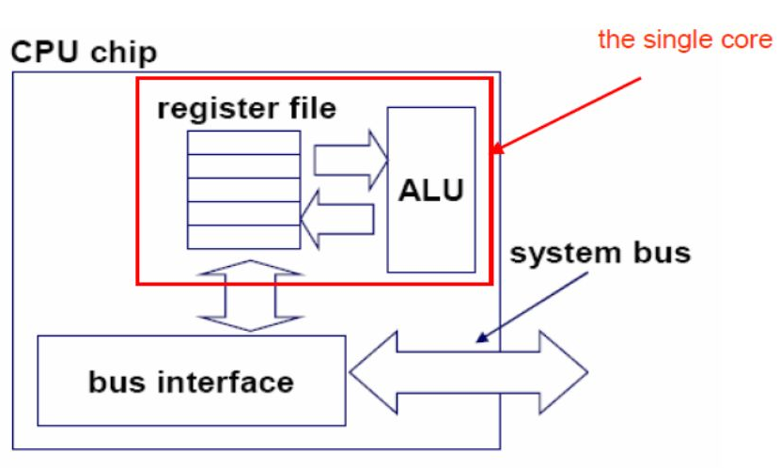
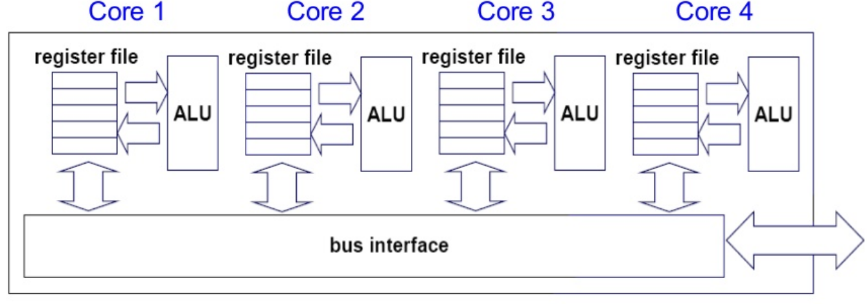
DIRECTORY-BASED WIRED-WIRELESS NETWORK-ON-CHIP ARCHITECTURES TO IMPROVE PERFORMANCE
Introduction (+): Computer Architectures [1] [2]
Single-core
Multicore
Drawbacks | Drawbacks
Clock speed Thermal or heat dissipation Multitasking not supported | Cache coherence Network topology Latency and scalability
[1] Pase, Douglas M., and Matthew A. Eckl, “A comparison of single-core and dual-core Opteron processor performance for HPC,” IBM xSeries Performance Development and Analysis, p. 3039, 2005
[2] H. V. Caprita, and M. Popa, “Design methods of multithreaded architectures for multicore microcontrollers,” in IEEE International Symposium on Applied Computational Intelligence and Informatics (SACI), pp. 427-432, 2011

Slide 9
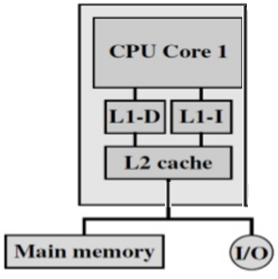
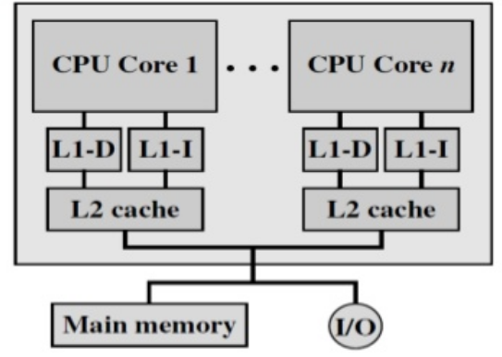
DIRECTORY-BASED WIRED-WIRELESS NETWORK-ON-CHIP ARCHITECTURES TO IMPROVE PERFORMANCE
Introduction (+): Cache Organization in Computer Architectures
Single-core- Intel Pentium [1]
Multicore-AMD Opteron [2]
Drawbacks | Drawbacks
Clock speed Thermal or heat dissipation Multitasking not supported | Cache coherence Network topology Latency and scalability
[1] http://www.edwardbosworth.com/CPSC2105/MyTextbook2105_HTM/MyText2105_Ch07B_V06.htm
[2] William Stallings, “Computer Organization and Architecture Designing for Performance,” 8th edition, Prentice Hall, Pearson Publisher, 2010

Slide 10
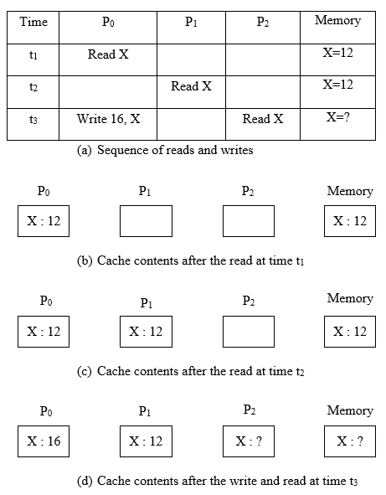
DIRECTORY-BASED WIRED-WIRELESS NETWORK-ON-CHIP ARCHITECTURES TO IMPROVE PERFORMANCE
Introduction (+): Cache Coherence Example [1]
To address Cache Coherence:
Snoopy protocols- Good for small networks < 32-cores
Limitations in bandwidth, Scalability
Directory protocols- Address the issues of snoopy protocols
MESI protocols- Modified (M), Exclusive (E), Shared (S), and Invalid (I)
Uses write-back policy and avoids bus invalidation
Limitations for continuous read and write which will cause main memory to flush every time
[1] Lilja, David J, “Cache coherence in large-scale shared-memory multiprocessors: issues and comparisons,” ACM Computing Surveys (CSUR), Vol. 25, No. 3, pp. 303-338, 1993

Slide 11
DIRECTORY-BASED WIRED-WIRELESS NETWORK-ON-CHIP ARCHITECTURES TO IMPROVE PERFORMANCE
Introduction (+): Performance Issues of Network Topologies
Multiple nodes or cores are connected to communicate with each other, which is referred to as network topology.
The performance of any network topology depends upon all the components used in that network [1].
Some topologies with greater trade-off abilities are bus, ring, crossbar, and mesh topologies and all of these are wired interconnects.
Wired interconnects can cause delay, power loss, and scalability issues.
On-chip interconnects with wireless techniques are introduced to address the issues of wired interconnects [2].
[1] Gilabert, F., Daniele Ludovici, Simone Medardoni, Davide Bertozzi, Luca Benini, and Georgi Nedeltchev Gaydadjiev, “Designing regular network-on-chip topologies under technology, architecture and software constraints,” In International Conference on Complex, Intelligent and Software Intensive Systems, pp. 681-687, IEEE, 2009
[2] Wang, Chifeng, Wen-Hsiang Hu, and Nader Bagherzadeh, “A wireless network-on-chip design for multicore platforms,” In Parallel, Distributed and Network-Based Processing (PDP), 2011 19th Euromicro International Conference on, pp. 409-416. IEEE, 2011

Slide 12
DIRECTORY-BASED WIRED-WIRELESS NETWORK-ON-CHIP ARCHITECTURES TO IMPROVE PERFORMANCE
Introduction (+): Problem Description
In traditional mesh architecture, communication latency, hop count, and power consumption are high due to its architecture design and routing protocol.
Mesh architecture is completely wired interconnects and thus having scaling issues.
As the number of cores increase, the complexity of controlling the architecture in terms of latency, wired/wireless links are always challenging.
Cache coherence due to incoherent cached data.
By using the entire architecture for a single task, leads to poor utilization of cores and boosts power consumption for nothing.
Uniform partition leads to underutilization of cores and more power consumption for smaller applications.

Slide 13
DIRECTORY-BASED WIRED-WIRELESS NETWORK-ON-CHIP ARCHITECTURES TO IMPROVE PERFORMANCE
Introduction (+): Contributions
In this work, we propose a novel architecture with uniform and non-uniform partition of subnets that enhances performance with minimal energy using wireless routers and directories.
Centralized directory to reduce cache coherence, data synchronization, communication latency and in addition, the system consequentially reduces power consumption.
Distributed directories to overcome centralized directory issues such as network size, traffic, and bandwidth. The performance is improved compared to traditional mesh, traditional WNoC, and WNoC architecture with centralized directory.
Partition of subnets in a uniform or non-uniform passion to improve balanced workloads. Non-uniform subnets are better for large core architectures and to assign different size of jobs/applications to a specific subnet.

Slide 14
DIRECTORY-BASED WIRED-WIRELESS NETWORK-ON-CHIP ARCHITECTURES TO IMPROVE PERFORMANCE
Outline ►
  Introduction
  Literature Survey
  Proposed Directory-Based
  Wireless Network-on-Chip Architectures
  Experimental Details
  Results and Discussion
  Conclusions and Future Extensions
Q U E S T I O N S ?
Any time, please.

Slide 15
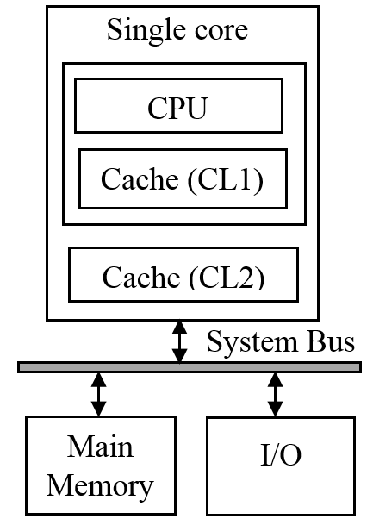
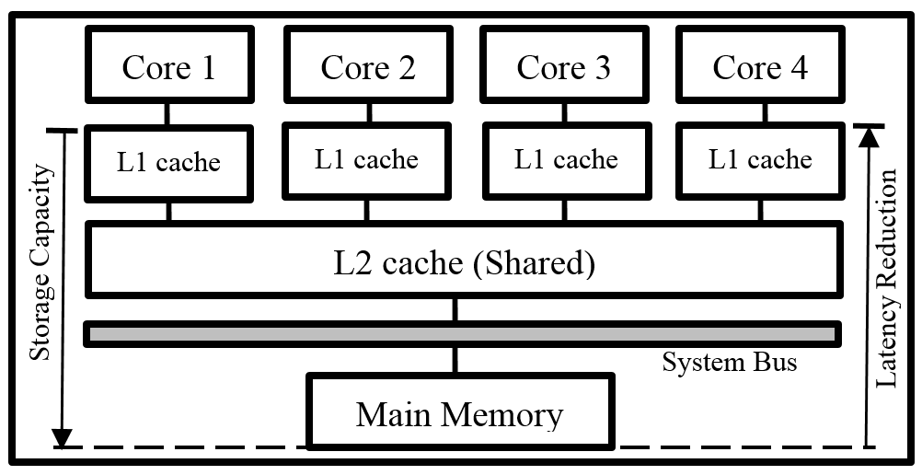
DIRECTORY-BASED WIRED-WIRELESS NETWORK-ON-CHIP ARCHITECTURES TO IMPROVE PERFORMANCE
Literature Survey: Cache Memory Hierarchy
Single-core Celeron processor [1]
Intel-like quad-core architecture [2]
Drawbacks | Drawbacks
Latency Only sequential tasks Power consumption | Cache coherence Latency Power consumption with cache miss
[1] Scott Mueller, and Mark Edward Soper, “ Microprocessor Types and Specifications,” 2001, http://www.informit.com/articles/article.aspx?p=130978&seqNum=4.
[2] Asaduzzaman, Abu, Mark P. Allen, and Tania Jareen, “An effective locking-free caching technique for power-aware multicore computing systems,”
In Informatics, Electronics & Vision (ICIEV), 2014 International Conference on, pp. 1-6, IEEE, 2014

Slide 16
DIRECTORY-BASED WIRED-WIRELESS NETWORK-ON-CHIP ARCHITECTURES TO IMPROVE PERFORMANCE
Literature Survey (+): Directory-based DASH Architecture
Directory Architecture for SHared Memory (DASH) Multiprocessor [1]
[1] D. Lenoski, J. Laudon, K. Gharachorloo, W. D. Weber, et al., “The Stanford dash multiprocessor,” in J. of Computer, Vol. 25, No. 3, pp. 63-79, 1992

Slide 17
DIRECTORY-BASED WIRED-WIRELESS NETWORK-ON-CHIP ARCHITECTURES TO IMPROVE PERFORMANCE
Literature Survey (+): Directory-based DASH Architecture (+)
Stanford DASH architecture is considered in this work because of its directory-based cache coherence protocol and high scalability [1].
Directory Architecture for SHared Memory (DASH) protocol does not rely on broadcast messages and instead uses point-to-point messages sent between processors and memories to keep caches consistent.
The physical memory or the main memory is distributed among all the clusters in such a manner that the memory is accessible from each and every core.
In DASH architecture, shared memory provides a major reduction in the communication latency.
[1] Chen, Xian, Wenzhi Chen, Shuiqiao Yang, Zhongyong Lu, and Zonghui Wang, "DASH: A duplication-aware flash cache architecture in virtualization environment," In 2014 20th IEEE International Conference on Parallel and Distributed Systems (ICPADS), pp. 842-847. IEEE, 2014

Slide 18

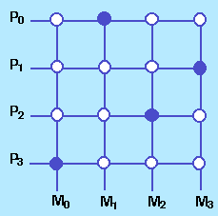
DIRECTORY-BASED WIRED-WIRELESS NETWORK-ON-CHIP ARCHITECTURES TO IMPROVE PERFORMANCE
Literature Survey (+): Interconnection Network Topologies [1], [2]
(a) Bus
(b) Crossbar
(c) 2D-Mesh
Bus | Crossbar | Mesh
Good for small networks | Good throughput network with low latency | Easy, low router complexity, feasibility
Limitations- Traffic, scalability | Limitations- Expensive, scalability, more switches required | Limitations- Network congestion, scalability, latency
[1] Dally, William James, and Brian Patrick Towles, “Principles and practices of interconnection networks,” Elsevier, 2004.
[2] L. Cheng, N. Muralimanohar, K. Ramani, R. Balasubramonian, et al., “Interconnect-aware coherence protocols for chip multi-processors,” in ACM SIGARCH Computer Architecture News, Vol. 34, No. 2, pp. 339-351, 2006

Slide 19
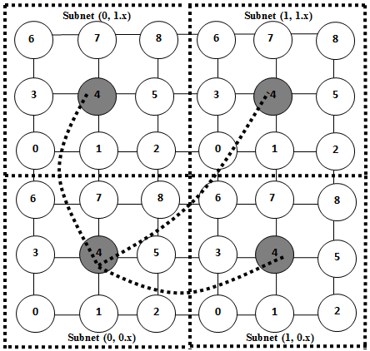
DIRECTORY-BASED WIRED-WIRELESS NETWORK-ON-CHIP ARCHITECTURES TO IMPROVE PERFORMANCE
Literature Survey (+): Wired-Wireless Network-on-Chip Topology [1]
WNoC Topology
Uniform partition of subnets Center wired routers are replaced with wireless router XY routing algorithm [2]
Limitations- Broadcasting, bandwidth, latency
(d) Wireless Network-on-Chip (WNoC) Topology
[1] DiTomaso, Dominic, Avinash Kodi, David Matolak, Savas Kaya, Soumyasanta Laha, and William Rayess, “A-WiNoC: Adaptive wireless network-on-chip architecture for chip multiprocessors,” IEEE Transactions on Parallel and Distributed Systems 26, No. 12, pp. 3289-3302, 2015
[2] Zhang, Wang, Ligang Hou, Jinhui Wang, Shuqin Geng, and Wuchen Wu, “Comparison research between xy and odd-even routing algorithm of a 2-dimension 3x3 mesh topology network-on-chip,” In Intelligent Systems, 2009. GCIS'09. WRI Global Congress on, Vol. 3, pp. 329-333, IEEE, 2009

Slide 20
DIRECTORY-BASED WIRED-WIRELESS NETWORK-ON-CHIP ARCHITECTURES TO IMPROVE PERFORMANCE
Literature Survey (+): Wired-Wireless Network-on-Chip Topology
WNoC Topology
The basic component in a WNoC architecture is a network based processor array (NePA) [1].
Each and every processing element (PE) consists of a processor core, network interface (NI), and a router.
Each of these routers has two bidirectional 64-bit links that forms an East and a West subnet.
Whenever a packet is to be transmitted, it is injected into the router via internal port (Int) and directs to destination by following through East subnet or West subnet.
A 4x4 2D NePA Architecture
NePA Router Port Description
[1] Wang, Chifeng, Wen-Hsiang Hu, and Nader Bagherzadeh, “A wireless network-on-chip design for multicore platforms,” In Parallel, Distributed and Network-Based Processing (PDP), 2011 19th Euromicro International Conference on, pp. 409-416, IEEE, 2011

Slide 21
DIRECTORY-BASED WIRED-WIRELESS NETWORK-ON-CHIP ARCHITECTURES TO IMPROVE PERFORMANCE
Literature Survey (+): Uniform and Non-Uniform Partition of Subnets
Uniform Partition
Subnet mechanism plays a vital role in routing [1].
Good for smaller core architectures.
Limitations: Useful for only fixed size applications, cores underutilization for smaller applications.
Non-uniform Partition
Pre-defined irregular topologies can improve performance compared to regular topologies [2].
Useful for even size and odd size number of cores.
Good for distinct size of applications as well as fixed size of applications.
Limitations: Complexities in design for dynamic non-uniform subnet partition.
[1] Han, Xing, Yuzhuo Fu, Jiang Jiang, and Chang Wang, “A Subnetting Mechanism with Low Cost Deadlock-Free Design for Irregular Topologies in NoC-based Manycore Processors,” In Information Science and Control Engineering (ICISCE), 2016 3rd International Conference on, pp. 110-114. IEEE, 2016
[2] Romanov, A. Yu, and I. I. Romanova, “Use of irregular topologies for the synthesis of networks-on-chip,” In Electronics and Nanotechnology (ELNANO), 2015 IEEE 35th International Conference on, pp. 445-449. IEEE, 2015

Slide 22
DIRECTORY-BASED WIRED-WIRELESS NETWORK-ON-CHIP ARCHITECTURES TO IMPROVE PERFORMANCE
Outline ►
  Introduction
  Literature Survey
  Proposed Directory-Based
  Wireless Network-on-Chip Architectures
  Experimental Details
  Results and Discussion
  Conclusions and Future Extensions
Q U E S T I O N S ?
Any time, please.

Slide 23
DIRECTORY-BASED WIRED-WIRELESS NETWORK-ON-CHIP ARCHITECTURES TO IMPROVE PERFORMANCE
Outline ►
  Proposed Architectures:
    Proposed Architecture 1: Uniform Partition of Subnets in WNoC Architecture with Centralized Directory (WNoC-CD)
    Proposed Architecture 2: Uniform Partition of Subnets in WNoC Architecture with Distributed Directories (WNoC-DDs)
    Proposed Architecture 3: Non-Uniform Partition of Subnets in WNoC Architecture with Distributed Directories

Slide 24
DIRECTORY-BASED WIRED-WIRELESS NETWORK-ON-CHIP ARCHITECTURES TO IMPROVE PERFORMANCE
Proposed Architecture 1: WNoC-CD
The proposed architecture is a hybrid combination of the WNoC architecture and the DASH architecture.
The major goal of the proposed multicore architecture is to reduce the communication latency among the cores by decreasing the number of hops.
The key design considerations include:
    Grouping cores
    Designing directory
    Directory mechanism

Slide 25
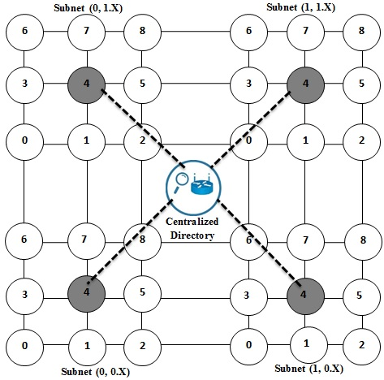
DIRECTORY-BASED WIRED-WIRELESS NETWORK-ON-CHIP ARCHITECTURES TO IMPROVE PERFORMANCE
Proposed Architecture 1: WNoC-CD (+)
    Grouping cores
Considering a 6x6 mesh topology, the cores are grouped into 3x3-core subnets, forming four quadrants.
All the cores inside a subnet are local to the subnet and the cores outside of a subnet are remote cores for that subnet.
A centralized directory with wireless router is proposed and is equally available to all other subnets [1].
Subnet sends a request to the centralized directory through its center-core wireless router for the requested block of data, if it is not in local subnet.
[1] Asaduzzaman, Abu, Kishore K. Chidella, and Divya Vardha, “An energy-efficient directory based multicore architecture with wireless routers to minimize the communication latency,” IEEE Transactions on Parallel and Distributed Systems, Vol. 28, No. 2, pp. 374-385, 2017

Slide 26
DIRECTORY-BASED WIRED-WIRELESS NETWORK-ON-CHIP ARCHITECTURES TO IMPROVE PERFORMANCE
Proposed Architecture 1: WNoC-CD (+)
Designing Directory
Size of the memory in each cache = 1 KB (1024 Bytes)
Each cache line = 128 Bytes
Number of blocks in each core = 1024 / 128 = 8
So, each core consists of 8 blocks each of which is 128 bytes

Slide 27
DIRECTORY-BASED WIRED-WIRELESS NETWORK-ON-CHIP ARCHITECTURES TO IMPROVE PERFORMANCE
Proposed Architecture 1: WNoC-CD (+)
Directory Mechanism: Status Update using Customized MESI Protocol
Read or Write in Block 4
TABLE I
A row in directory that shows initial stage of core-1
TABLE II
A row in directory showing changes after reading a block by core-1
TABLE III
A row in directory showing changes for write in a block of core-1
Core # | Block 0 | Block 1 | Block 2 | Block 3 | Block 4 | Block 5 | Block 6 | Block 7
Core1 (0,0.0) | 0 Addr Empty | 0 Addr Empty | 0 Addr Empty | 0 Addr Empty | 0 Addr Empty | 0 Addr Empty | 0 Addr Empty | 0 Addr Empty
Core # | Block 0 | Block 1 | Block 2 | Block 3 | Block 4 | Block 5 | Block 6 | Block 7
Core1 (0,0.0) | 0 Addr Empty | 0 Addr Empty | 0 Addr Empty | 0 Addr Empty | E 100th Blk | 0 Addr Empty | 0 Addr Empty | 0 Addr Empty
Core # | Block 0 | Block 1 | Block 2 | Block 3 | Block 4 | Block 5 | Block 6 | Block 7
Core1 (0,0.0) | 0 Addr Empty | 0 Addr Empty | 0 Addr Empty | 0 Addr Empty | M100th Blk | 0 Addr Empty | 0 Addr Empty | 0 Addr Empty

Slide 28
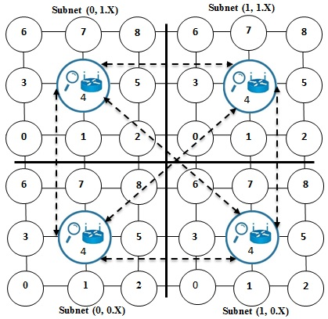
DIRECTORY-BASED WIRED-WIRELESS NETWORK-ON-CHIP ARCHITECTURES TO IMPROVE PERFORMANCE
Proposed Architecture 2: WNoC-DDs
The directory contains the information of all other subnets that includes data sync, minimal routing path, and it is integrated with wireless router in the central core (Core-4) of each subnet.
The proposed system is based on distributed directories and the architecture design of each directory is identical with equal priority [1].
The directory contains cores’ subnet addresses, status of each cached block, and addresses of the blocks that have been cached.
The directory is dynamic.
[1] Chidella, Kishore K., and Abu Asaduzzaman, “A novel Wireless Network-on-Chip architecture with distributed directories for faster execution and minimal energy,” Computers & Electrical Engineering, Vol. 65, pp. 18-31, 2018

Slide 29
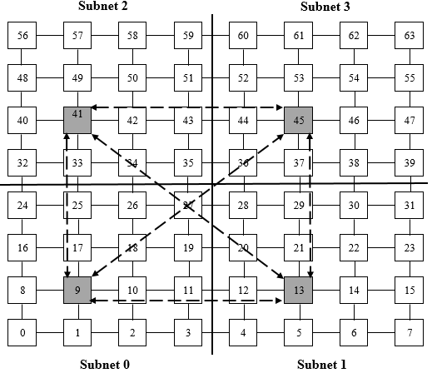
DIRECTORY-BASED WIRED-WIRELESS NETWORK-ON-CHIP ARCHITECTURES TO IMPROVE PERFORMANCE
Proposed Architecture 3: Uniform and Non-Uniform Partition of Subnets in WNoC-DDs
Uniform Partition of Subnets [1]
Finding a center for even subnet size is always challenging.
The opportunity for being center-core is of equal priority to the cores 9, 10, 17, and 18.
Uniform partition leads to underutilization of cores and more power consumption for smaller applications.
Random size of applications are not well entertained.
[1] Kishore K. Chidella, Abu Asaduzzaman, and Abdulrahman Almohaimeed, “Impact of Non-Uniform Subnets on the Performance of Wireless Network-on-Chip Architectures,” (under review), IEEE CCWC, 2019

Slide 30
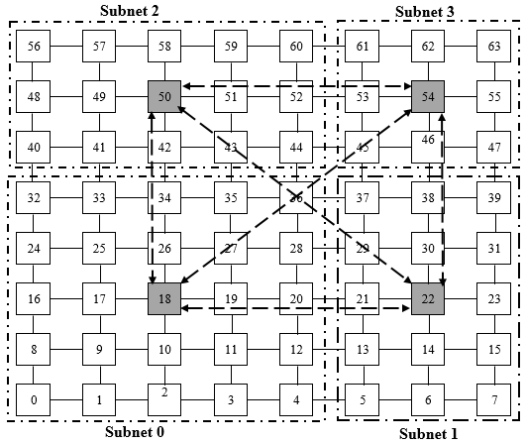
DIRECTORY-BASED WIRED-WIRELESS NETWORK-ON-CHIP ARCHITECTURES TO IMPROVE PERFORMANCE
Proposed Architecture 3: Uniform and Non-Uniform Partition of Subnets in WNoC-DDs
Non-Uniform Partition of Subnets
Distinct size of partitions improve performance.
Selection of closer center core is possible.
Applications with different sizes can be easily accommodated.
Core utilization is satisfactory.
Center core selection in each subnet improves the routing path strategy and thus reduces latency and power consumption.
[1] Kishore K. Chidella, Abu Asaduzzaman, and Abdulrahman Almohaimeed, “Impact of Non-Uniform Subnets on the Performance of Wireless Network-on-Chip Architectures,” (under review), IEEE CCWC, 2019

Slide 31
DIRECTORY-BASED WIRED-WIRELESS NETWORK-ON-CHIP ARCHITECTURES TO IMPROVE PERFORMANCE
Outline ►
  Introduction
  Literature Survey
  Proposed Directory-Based
  Wireless Network-on-Chip Architectures
  Experimental Details
  Results and Discussion
  Conclusions and Future Extensions
Q U E S T I O N S ?
Any time, please.

Slide 32
DIRECTORY-BASED WIRED-WIRELESS NETWORK-ON-CHIP ARCHITECTURES TO IMPROVE PERFORMANCE
Experimental Details
Assumptions for Calculating Communication Latency and Hop Count
Delay caused due to the intermediate cores = 4 units
Delay caused due to the destination core = 40 units
Delay between directly connected cores = 1 unit
Delay between wireless router cores = 1 unit

Slide 33
DIRECTORY-BASED WIRED-WIRELESS NETWORK-ON-CHIP ARCHITECTURES TO IMPROVE PERFORMANCE
Considerations and Assumptions for Power Calculations (WNoC-CD)
No. | Consideration | Notation | Power (Unit)
1 | Power consumed by a wired link | P_{wr} | 1.0
2 | Power consumed by a wireless link | P_{wl} | 1.1
3 | Power consumed by a core with wired router | P_{cwr} | 3.0
4 | Core average of network- Mesh | P_{canw} | 19.5
5 | Average links of wired network-Mesh | P_{alwr} | 5.5
6 | Number of wired links | N_{wr} | (vary)
7 | Number of cores wired | N_{cwr} | (vary)
8 | Number of wireless links | N_{wl} | (vary)
9 | Power consumed by a core with a wireless router | P_{cwl} | 3.3
10 | Power consumed by the wired links in a subnet on an average | P_{awrsn} | 2.5
11 | Power consumed between source and directory-WNoC-CD | P_{sdr} | (vary)
12 | Power consumed by the directory- WNoC-CD | P_{dr} | 6.0
13 | Power consumed by the directory core in WNoC-CD | P_{cdr} | 9.3
14 | Power consumed between destination to source in WNoC-CD | P_{ds} | (vary)

Slide 34
DIRECTORY-BASED WIRED-WIRELESS NETWORK-ON-CHIP ARCHITECTURES TO IMPROVE PERFORMANCE
Considerations and Assumptions for Power Calculations (WNoC-DDs)
The considerations and assumptions are similar to WNoC-CD.
However, there are some additional assumptions due to introduction of distributed directories.
No. | Consideration | Notation | Power (mW)
1 | Power consumed between source and distributed directories | P_{sdd} | (vary)
2 | Power consumed by each of the distributed directories with wireless router | P_{ddr} | 6
3 | Power consumed between destination to source distributed directories | P_{dsddr} | (vary)

Slide 35
DIRECTORY-BASED WIRED-WIRELESS NETWORK-ON-CHIP ARCHITECTURES TO IMPROVE PERFORMANCE
Experimental Details:
Simulation Tool : VisualSim Architect 15
We use VisualSim Architect [1] (a world-class modeling and simulation platform suitable for computing systems), tool to model and simulate the systems.
The sequence of tasks is generated using VisualSim Architect 15 tool to calculate communication delay, hop count, and power consumption in all the three architectures.
VisualSim Architect allows us to calculate and analyze performance trade-offs using bandwidth utilization, communication response time/delay, routing metrics and power consumption.
[1] VisualSim Architect. Mirabilis Design. http://mirabilisdesign.com/new/visualsim/; 2016

Slide 36
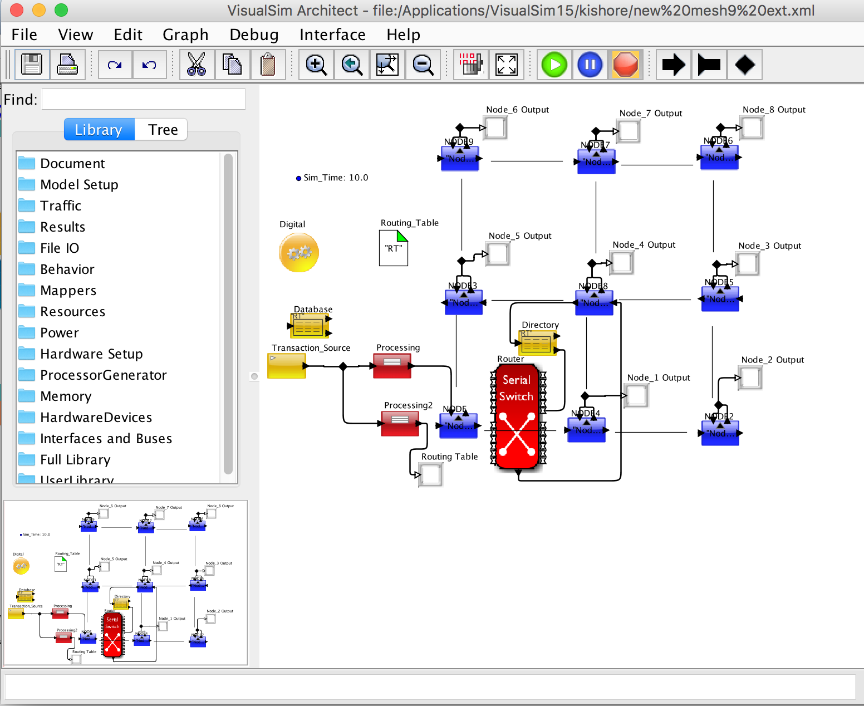
DIRECTORY-BASED WIRED-WIRELESS NETWORK-ON-CHIP ARCHITECTURES TO IMPROVE PERFORMANCE
Experimental Details: Tool Used (+)
VisualSim Model: Subnet with Directory and Wireless Router

Slide 37
DIRECTORY-BASED WIRED-WIRELESS NETWORK-ON-CHIP ARCHITECTURES TO IMPROVE PERFORMANCE
Experimental Details (+) : Proposed 1 and 2
Different Scenarios of Work Load for WNoC-CD and WNoC-DDs
Case Number | Source Node | Destination Node | Subnet Details
Case 1 | Core (0, 0.0) | Core (1, 1.8) | Out-Subnet
Case 2 | Core (0, 0.4) | Core (1, 1.4) | Out-Subnet
Case 3 | Core (0, 0.7) | Core (1, 0.1) | Out-Subnet
Case 4 | Core (0, 0.3) | Core (0, 1.5) | Out-Subnet
--- | --- | --- | ---
--- | --- | --- | ---
Case 24 | Core (1, 1.6) | Core (1, 1.2) | In-Subnet
Case 25 | Core (0, 1.7) | Core (0, 1.1) | In-Subnet

Slide 38
DIRECTORY-BASED WIRED-WIRELESS NETWORK-ON-CHIP ARCHITECTURES TO IMPROVE PERFORMANCE
Experimental Details (+) : Proposed 3
Different Scenarios of Work Load: Non-Uniform partition in WNoC-DDs
Job Number | Subtasks | Uniform Subnet Location | Non-Uniform Subnet Location
Job 1 | 5 | Out | Out
Job 2 | 4 | Out | In
Job 3 | 4 | In | Out
Job 4 | 7 | Out/In | In/Out
Job 5 | 7 | In | In
Job 6 | 4 | Directory/Out | Out/Directory

Slide 39
DIRECTORY-BASED WIRED-WIRELESS NETWORK-ON-CHIP ARCHITECTURES TO IMPROVE PERFORMANCE
Outline ►
  Introduction
  Literature Survey
  Proposed Directory-Based
  Wireless Network-on-Chip Architectures
  Experimental Details
  Results and Discussion
  Conclusions and Future Extensions
Q U E S T I O N S ?
Any time, please.

Slide 40
DIRECTORY-BASED WIRED-WIRELESS NETWORK-ON-CHIP ARCHITECTURES TO IMPROVE PERFORMANCE
Results: WNoC-CD [1]
Calculate:
  Communication Latency
  Hop Count
  Power Consumption
Ex: Task 1: (0, 0.0) (1, 1.8)
[1] Asaduzzaman, Abu, Kishore K. Chidella, and Divya Vardha, “An energy-efficient directory based multicore architecture with wireless routers to minimize the communication latency,” IEEE Transactions on Parallel and Distributed Systems, Vol. 28, No. 2, pp. 374-385, 2017

Slide 41
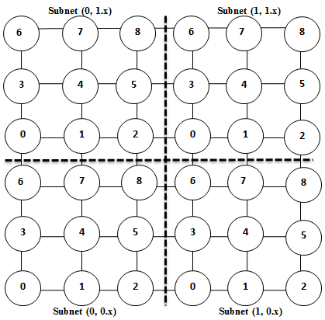
DIRECTORY-BASED WIRED-WIRELESS NETWORK-ON-CHIP ARCHITECTURES TO IMPROVE PERFORMANCE
Results (+)
Analysis for Hop Count: (+)
Architecture | Communication Setup |  | Data Fetch |  | Total Hops
 | S to D | ACK | D to S | ACK
Mesh | 10 | 10 | 10 | 10 | 40
Traditional WNoC | 5 | 5 | 5 | 5 | 20
WNoC-CD | 3 | - | 6 | - | 9
S: Source |  | D: Destination |  | ACK: Acknowledge

Slide 42
DIRECTORY-BASED WIRED-WIRELESS NETWORK-ON-CHIP ARCHITECTURES TO IMPROVE PERFORMANCE
Results (+)
Analysis for Hop Count: (+)
In mesh architecture, to communicate between source and destination core it has 10 intermediate hops and it needs an acknowledgement, so communication setup takes 20 hops.
For data receive and acknowledgement it takes 20 hops, and in total it takes 40 hops.
In traditional WNoC, to fetch data is 10 hops and return path is 10 hops, and in total it takes 20 hops.
In proposed WNoC-CD, the request to fetch data is up to centralized directory which takes 3 hops, the return path is 6 hops, and in total it takes 9 hops.

Slide 43
DIRECTORY-BASED WIRED-WIRELESS NETWORK-ON-CHIP ARCHITECTURES TO IMPROVE PERFORMANCE
Results (+)
Analysis for Hop Count: (+)
In mesh architecture, to communicate between source and destination core it has 10 intermediate hops and it needs an acknowledgement, so communication setup takes 20 hops.
For data receive and acknowledgement it takes 20 hops, and in total it takes 40 hops.
In traditional WNoC, to fetch data is 10 hops and return path is 10 hops, and in total it takes 20 hops.
In proposed WNoC-CD, the request to fetch data is up to centralized directory which takes 3 hops, the return path is 6 hops, and in total it takes 9 hops.

Slide 44
DIRECTORY-BASED WIRED-WIRELESS NETWORK-ON-CHIP ARCHITECTURES TO IMPROVE PERFORMANCE
Results (+)
Analysis for Hop Count: (+)
In mesh architecture, to communicate between source and destination core it has 10 intermediate hops and it needs an acknowledgement, so communication setup takes 20 hops.
For data receive and acknowledgement it takes 20 hops, and in total it takes 40 hops.
In traditional WNoC, to fetch data is 10 hops and return path is 10 hops, and in total it takes 20 hops.
In proposed WNoC-CD, the request to fetch data is up to centralized directory which takes 3 hops, the return path is 6 hops, and in total it takes 9 hops.

Slide 45
DIRECTORY-BASED WIRED-WIRELESS NETWORK-ON-CHIP ARCHITECTURES TO IMPROVE PERFORMANCE
Results (+): Analysis for Communication Latency (Proposed_1)
WNoC-CD architecture helps in reducing the communication latency up to 16.01%, and 10.32%, compared to mesh and traditional WNoC architectures respectively.

Slide 46
DIRECTORY-BASED WIRED-WIRELESS NETWORK-ON-CHIP ARCHITECTURES TO IMPROVE PERFORMANCE
Results (+): Analysis for Hop Count (Proposed_1)
WNoC-CD architecture helps in reducing the hop count up to 62.03%, and 52.65%, compared to mesh and traditional WNoC architectures respectively.

Slide 47
DIRECTORY-BASED WIRED-WIRELESS NETWORK-ON-CHIP ARCHITECTURES TO IMPROVE PERFORMANCE
Results (+): Analysis for Power Consumption (Proposed_1)
WNoC-CD architecture helps in reducing the power consumption up to 66.96%, and 57.30%, compared to mesh and traditional WNoC architectures respectively.

Slide 48
DIRECTORY-BASED WIRED-WIRELESS NETWORK-ON-CHIP ARCHITECTURES TO IMPROVE PERFORMANCE
Results (+): Analysis for Communication Latency (Proposed_2)
WNoC-DDs architecture helps in reducing the communication latency up to 20.54%, and 5.40%, compared to mesh and WNoC-CD architectures respectively.

Slide 49
DIRECTORY-BASED WIRED-WIRELESS NETWORK-ON-CHIP ARCHITECTURES TO IMPROVE PERFORMANCE
Results (+): Analysis for Hop Count (Proposed_2)
WNoC-DDs architecture helps in reducing the hop count up to 73.11%, and 29.19%, compared to mesh and WNoC-CD architectures respectively.

Slide 50
DIRECTORY-BASED WIRED-WIRELESS NETWORK-ON-CHIP ARCHITECTURES TO IMPROVE PERFORMANCE
Results (+): Analysis for Power Consumption (Proposed_2)
WNoC-DDs architecture helps in reducing the power consumption up to 73.56%, and 19.97%, compared to mesh and WNoC-CD architectures respectively.

Slide 51
DIRECTORY-BASED WIRED-WIRELESS NETWORK-ON-CHIP ARCHITECTURES TO IMPROVE PERFORMANCE
Results (+): Analysis for Communication Latency (Proposed_3)
Non-Uniform subnets partition in WNoC-DDs architecture helps in reducing the communication latency up to 11.11% compared to uniform subnet partition.

Slide 52
DIRECTORY-BASED WIRED-WIRELESS NETWORK-ON-CHIP ARCHITECTURES TO IMPROVE PERFORMANCE
Results (+): Analysis for Hop Count (Proposed_3)
Non-Uniform subnets partition in WNoC-DDs architecture helps in reducing the hop count up to 26.26%, compared to uniform subnet partition.

Slide 53
DIRECTORY-BASED WIRED-WIRELESS NETWORK-ON-CHIP ARCHITECTURES TO IMPROVE PERFORMANCE
Results (+): Analysis for Power Consumption (Proposed_3)
Non-Uniform subnets partition in WNoC-DDs architecture helps in reducing the power consumption up to 14.76%, compared to uniform subnet partition.

Slide 54
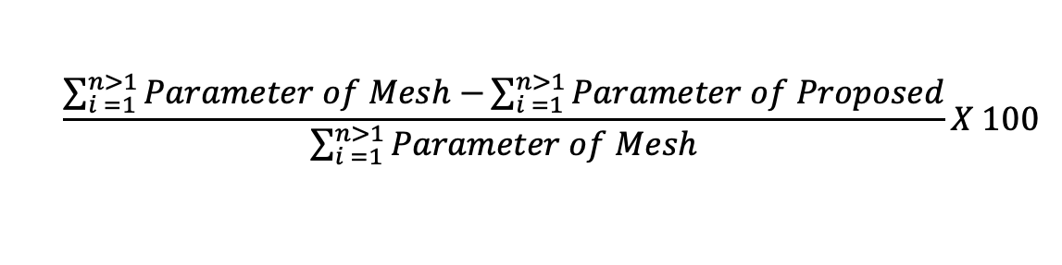
DIRECTORY-BASED WIRED-WIRELESS NETWORK-ON-CHIP ARCHITECTURES TO IMPROVE PERFORMANCE
Results (+): Average of Parameters
The overall performance such as average calculation of each parameter gives precise statistics, whether to consider the new proposed architecture is beneficial compared to the other architectures.
To calculate average of parameters for n (n>1) number of tasks, when compared to mesh in %=
$$\frac{\sum_{i =1}^{n>1}{Parameter of Mesh−}\sum_{i =1}^{n>1}{Parameter of Proposed}}{\sum_{i =1}^{n>1}{Parameter of Mesh}}X 100$$

Slide 55
DIRECTORY-BASED WIRED-WIRELESS NETWORK-ON-CHIP ARCHITECTURES TO IMPROVE PERFORMANCE
Results: Average Communication Latency Compared to WNoC-DDs
WNoC-DDs architecture helps in reducing the communication latency up to 20.54%, 15.16%, and 5.40%, compared to mesh, traditional WNoC, and WNoC-CD architectures respectively.

Slide 56
DIRECTORY-BASED WIRED-WIRELESS NETWORK-ON-CHIP ARCHITECTURES TO IMPROVE PERFORMANCE
Results: Average Hop Count Compared to WNoC-DDs
WNoC-DDs architecture helps in reducing the hop count up to 73.11%, 66.47%, and 29.19%, compared to mesh, traditional WNoC, and WNoC-CD architectures respectively.

Slide 57
DIRECTORY-BASED WIRED-WIRELESS NETWORK-ON-CHIP ARCHITECTURES TO IMPROVE PERFORMANCE
Results: Average Power Consumption Compared to WNoC-DDs
WNoC-DDs architecture helps in reducing the power consumption up to 73.56%, 65.83%, and 19.97%, compared to mesh, traditional WNoC, and WNoC-CD architectures respectively.

Slide 58
DIRECTORY-BASED WIRED-WIRELESS NETWORK-ON-CHIP ARCHITECTURES TO IMPROVE PERFORMANCE
Results: Analysis for Communication Latency (Proposed_3)
WNoC-DDs architecture helps in reducing the communication latency up to 20.54%, and 5.40%, compared to mesh and WNoC-CD architectures respectively.

Slide 59
DIRECTORY-BASED WIRED-WIRELESS NETWORK-ON-CHIP ARCHITECTURES TO IMPROVE PERFORMANCE
Results: Analysis for Hop Count (Proposed_3)
WNoC-DDs architecture helps in reducing the hop count up to 73.11%, and 29.19%, compared to mesh and WNoC-CD architectures respectively.

Slide 60
DIRECTORY-BASED WIRED-WIRELESS NETWORK-ON-CHIP ARCHITECTURES TO IMPROVE PERFORMANCE
Results: Analysis for Power Consumption (Proposed_3)
WNoC-DDs architecture helps in reducing the power consumption up to 73.56%, and 19.97%, compared to mesh and WNoC-CD architectures respectively.

Slide 61
DIRECTORY-BASED WIRED-WIRELESS NETWORK-ON-CHIP ARCHITECTURES TO IMPROVE PERFORMANCE
Outline ►
  Introduction
  Literature Survey
  Proposed Directory-Based
  Wireless Network-on-Chip Architectures
  Experimental Details
  Results and Discussion
  Conclusions and Future Extensions
Q U E S T I O N S ?
Any time, please.

Slide 62
DIRECTORY-BASED WIRED-WIRELESS NETWORK-ON-CHIP ARCHITECTURES TO IMPROVE PERFORMANCE
Conclusions
In this research, we analyze different architectures such as mesh, traditional WNoC, WNoC-CD, and WNoC-DDs.
Cache in multicore architectures suffer from high core-to-core communication latency and power consumption.
To address the cache coherence, latency and power consumption, we present a novel directory-based mechanism in WNoC architectures as WNoC-CD, and WNoC-DDs.
However, they are several challenges with WNoC-CD architecture such as latency due to waiting time of tasks and for every out-subnet task the subnet must request the centralized directory. WNoC-CD architectures are not suitable for larger number of cores.
WNoC-DDs perform better when compared to other architectures.
Non-Uniform subnets partition addresses the issues on uniform subnets such as cores underutilization, subnets allocation according to size of workload.

Slide 63
DIRECTORY-BASED WIRED-WIRELESS NETWORK-ON-CHIP ARCHITECTURES TO IMPROVE PERFORMANCE
Conclusions (+)
WNoC-CD architecture helps decrease the communication latency by up to 15.71%, 10.01%, compared to mesh and traditional WNoC respectively.
Similarly power consumption is reduced by up to 67.58%, 58.10%, compared to mesh and traditional WNoC respectively.
WNoC-DDs architecture helps decrease the communication latency by up to 20.54%, 5.40%, compared to mesh and WNoC-CD respectively.
Similarly power consumption is reduced by up to 73.56%, 19.97%, compared to mesh and WNoC-CD respectively.
Non-Uniform subnets partition helps decrease the communication latency by up to 11.11%, compared to uniform partition in WNoC-DDs architecture.
Similarly power consumption is reduced by up to 14.76%, compared to uniform partition in WNoC-DDs architecture.

Slide 64
DIRECTORY-BASED WIRED-WIRELESS NETWORK-ON-CHIP ARCHITECTURES TO IMPROVE PERFORMANCE
Future Extensions
This work can be extended for future multicore/many-core system analysis. Some possible extensions are listed below:
Designing, modeling, and simulating CPU-GPU architectures for big data analytics.
Adding traffic parameters to the simulation of proposed architectures to check the range of workload that is enforced on a single hop and calculate bandwidth utilization and the range for each workload.
Simulating multicore/many-core architectures to allow non-uniform subnets with dynamic working strategy to study performance.
Study on 3D NoC architectures and investigate the impact of combining 3D routers with 3D processor architectures.

Slide 65
DIRECTORY-BASED WIRED-WIRELESS NETWORK-ON-CHIP ARCHITECTURES TO IMPROVE PERFORMANCE
Thank You!
Queries/Suggestions:
E-mail: kkchidella@shockers.wichita.edu
Phone: +1-940-231-4245

