Slide 1

A Fast Flexible Simulation Platform for Multi-Core Systems
Committee Members:
Dr. Abu Asaduzzaman
Dr. Ravi Pendse
Dr. Mehmet Bayram Yildirim - Phanendra S. N. Gavara

Slide 2
Outline
Problem description
Thesis contributions
Why simulation technique?
Brief introduction to multicore processors
Proposed simulation tool
Evaluation
Conclusions
Future work

Slide 3
Problem Description
Multicore systems are now a days mainly method against the power consumption and high-performance
Design and research on such physical systems are confined to research industries:
Intel Polaris- 80 Core Terascale Chip, 80 cores[1]
IBM BladeCenter System-QS22/LS21 has 122,400 cores[2]
There is no suitable software/firmware that meets our research needs in multicore systems
[1] http://software.intel.com/en-us/articles/developing-for-terascale-on-a-chip-first-article-in-the-series/?wapkw=Teraflop%20Research%20Chip
[2] http://www-05.ibm.com/fr/events/campus_paris/Francois_Thomas.pdf

Slide 4
Problem Description Cont…
Any few traces found are specific to their own design and imposes copy right issues
Hence there is a need for flexible simulation platform which is:
Suitable to model any multicore system
Flexible to perform the top level pre-design analysis
Can be used for the future complex architectures

Slide 5
Thesis Contributions
Develop a fast flexible simulation platform for multicore systems
Using the platform, implement a serial/parallel processing system for the top level analysis of performance and power
Analyze the sequential and parallel executions of the target workloads

Slide 6
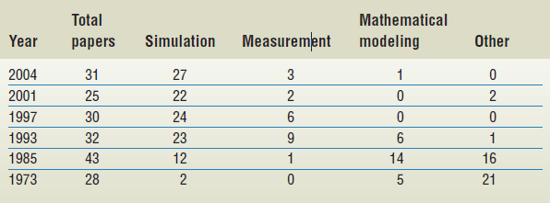
Evaluation Techniques
Performance evaluation methodologies in proceedings of the international symposium on computer architecture
J.J. Yi, L. Eeckhout, D.J. Lilja, B. Calder, L.K. John, and J.E. Smith. The Future of Simulation: A Field of Dreams? The IEEE Computer Society, pages 22-29,2006.

Slide 7
Why Simulation Technique?
Measurement | Analytical | Simulation
Physical system Cost involved Not Flexible Not Scalable | Not required Less cost Not Flexible Scalable | Not required Less cost Flexible Scalable
Direct measurement is a post-design step and not useful for systems under design.
Analytical method is good for preliminary design but not suitable for assessing detailed design trade-offs and complex systems.

Slide 8
Current Research & Tools
MIT Hornet - Targeted for cycle accurate simulation for up to 1000 Cores
Graphite Multicore Simulator - Deep level analysis
FastMP - Aimed at speeding up multi-core simulation runtimes
VirtualSim
SimuLink
MicroSaint etc.

Slide 9
MULTI-CORE ARCHITECTURE

Slide 10
A Multicore Processor
In which, cores are integrated onto a single circuit known as a Chip Multicore processor.
Composed of two or more independent cores (or CPUs) typically up to 32 [1].
A Manycore Processor
Cores are large in number, likely requires a Network-on-Chip architecture.
Threshold is up to hundreds and several thousands of cores
[1] Many-core processor, 2008. http://software.intel.com/en-us/articles/many-core-processor/

Slide 11
Current & Future Market
Current publicly available multicore processors have 2 to 4 cores [i.e. Amd x2 and x4 series, Intel i7 (8 threads)]
Future we will see up to hundreds and several thousands of cores for the commercial purpose like Could Services , Heavy Virtualization, Super Computers etc.
http://ark.intel.com/products/63698/Intel-Core-i7-3820-Processor-%2810M-Cache-3_60-GHz%29

Slide 12
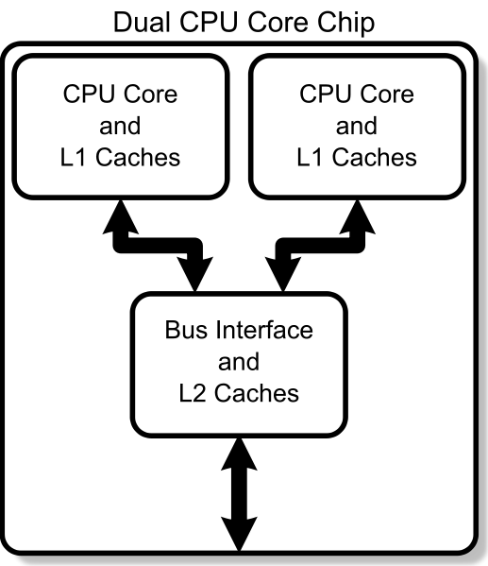
Dual Core Chip
The two cores are two separate processors plugged into the same socket
Theoretically twice as powerful as a single core processor.
Performance gains are said to be about fifty percent: Therefore one-and-a-half times as powerful as a single core processor.
http://www.xda-developers.com/android/first-htc-sensation-rom-with-enabled-full-dual-core-support/

Slide 13
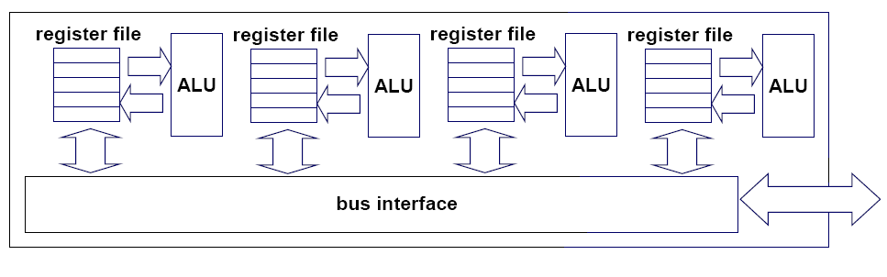
Multicore Chip
Core 1
Core 2
Core 3
Core 4
http://www.teknocrat.com/core-vs-cpu-socket-chip-processor-difference-comparison.html

Slide 14
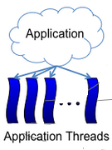
Threads Running Concurrently (in Parallel)
[1]
Threads
Threads
Threads
Core 1
Core 2
Core 3
[1] http://groups.csail.mit.edu/carbon/?page_id=111

Slide 15
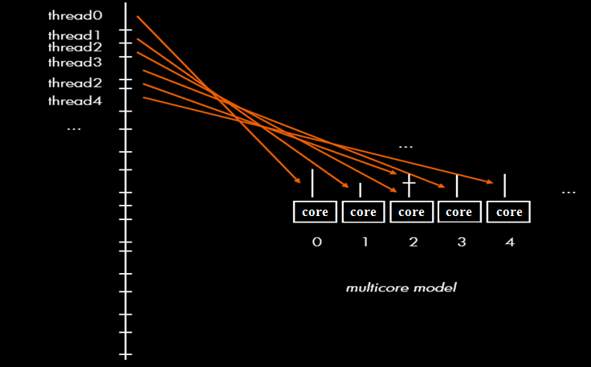
Threads Assignment
http://home.dei.polimi.it/gpalermo/doc/PIN.pdf

Slide 16
PROPOSED SIMULATION TOOL

Slide 17
Design Goals
Preprocessing Tools
Multi-Core Simulation Platform
Synthetic Workloads
Results/
Analysis
Add additional Functionality (Optional)
Applications

Slide 18
Serial/Parallel Processing
N Cores
I1, D1 Cache
L2 Cache
Interval
Input
Independent/Parallel workloads
Dependent/Serial workloads
Output
Total Processing Time
Total Power
FCFS (First Come, First Serve) System
Provision for Arrival time and Priority

Slide 19
Workloads
In computer industry, a workload is the real task done by the CPU
Synthetic workloads are the abstraction of real workload
In multicore, workloads are characterized into:
Serial/Dependent
Parallel/Independent

Slide 20
Serial Workload
Job_Num | Num_of_Threads | Thread_Duration (Units) | Arrival_Time (Units) | Priority
0001 | 002 | 003 | 0.00 | 1
0001 | 003 | 004 | 0.00 | 1
Same job could have different thread types
Each job could be real-time application
Each applications is divided into multiple threads

Slide 21
Parallel Workload
Job_Num | Num_of_Threads | Thread_Duration (Units) | Arrival_Time (Units) | Priority
0001 | 002 | 002 | 0.00 | 1
0002 | 008 | 001 | 0.00 | 1
0003 | 002 | 002 | 0.00 | 1
0004 | 004 | 001 | 0.00 | 1
0005 | 001 | 007 | 0.00 | 1
Each job could be real-time application
Each applications is divided into multiple threads

Slide 22
Raw Workload
Job_Num | Num_of_Threads | Thread_Duration (Units) | Arrival_Time (Units) | Priority
0001 | 002 | 002 | 0.00 | 1
0002 | 008 | 001 | 0.00 | 1
0003 | 003 | 003 | 0.00 | 1
0003 | 004 | 001 | 0.00 | 1
0004 | 009 | 001 | 0.00 | 1
0005 | 006 | 003 | 0.00 | 1
0006 | 002 | 003 | 0.00 | 1
0006 | 004 | 006 | 0.00 | 1
Each job could be real-time application
Duplicate jobs are interdependent

Slide 23
Flowchart of Executions
Start
User Inputs: Number of Cores, Interval, Mode, Input and Output File Name
Initialization: Processor, Cores & other Parameters like Job, Queue etc.
CP-1
Process the Input file into Sequential & Parallel workload files
Parallel
Mode P/S?
Serial
B
A

Slide 24
Serial Execution
A
CP-2
Compute the total number of threads and delays associated with each job and write the new jobs to a Serial_to_Prallel workload file.
Append the jobs of Serial_to_Prallel file to the Parallel _Input file for the analysis of total processing time and power in a multi-core environment.
C

Slide 25
P
A
R
A
L
L
E
L
E
X
E
C
U
T
I
O
N
B
CP-3
C
Based on the Multicore System, jobs are loaded from the Parallel _Input file to the Input_Queue
Threads are distributed among the available free cores, Interval timer is set and the Avl_Free_Cores are updated
Allocate/Busy
Allocate/Busy
Allocate/Busy
Allocate/Busy
Core 1
Core 2
Core N-1
Core N
Thread_Durations are updated with the Interval duration and Cores are set free accordingly
Core 1
Core 2
Core N-1
Core N
De-allocate/Free
De-allocate/Free
De-allocate/Free
De-allocate/Free
Parameters like Upd_Free_Cores, Processing_Time, Power_Cnsmptn are updated and logged to a file called Results
Yes
Load Jobs?
B
CP-4
No
Total Processing_Time & Power_Cnsmptn are computed and written to an output file
Stop

Slide 26
Code
Struct processor{
unsigned int num_of_cores;
typeCore processor_core[];
unsigned int cl2_size;
};
typedef struct processor typeProcessor;
Struct Core{
unsigned int i1_size;
unsigned int d1_size;
unsigned int flag;//0 for free, 1 for empty
};
typedef struct Core typeCore;

Slide 27
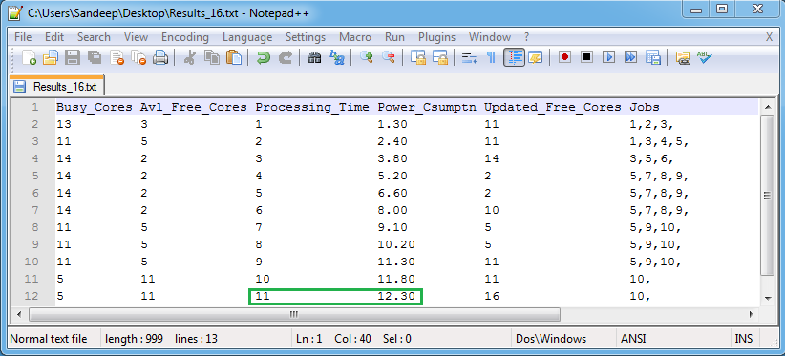
Parallel workload on a 16 Core System
Job_Num | Num_of_Threads | Thread_Duration (Units) | Arrival_Time (Units) | Priority
0001 | 002 | 002 | 0.00 | 1
0002 | 008 | 001 | 0.00 | 1
0003 | 003 | 003 | 0.00 | 1
0004 | 004 | 001 | 0.00 | 1
0005 | 002 | 008 | 0.00 | 1
0006 | 009 | 001 | 0.00 | 1
0007 | 006 | 003 | 0.00 | 1
0008 | 002 | 003 | 0.00 | 1
0009 | 004 | 006 | 0.00 | 1
0010 | 005 | 005 | 0.00 | 1

Slide 28
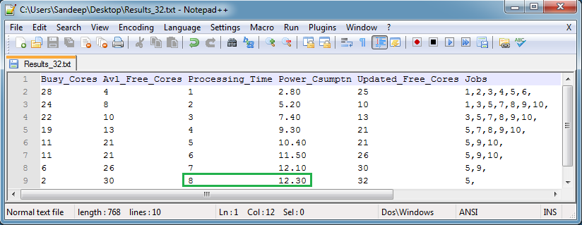
Parallel workload on a 32 Core System
Job_Num | Num_of_Threads | Thread_Duration (Units) | Arrival_Time (Units) | Priority
0001 | 002 | 002 | 0.00 | 1
0002 | 008 | 001 | 0.00 | 1
0003 | 003 | 003 | 0.00 | 1
0004 | 004 | 001 | 0.00 | 1
0005 | 002 | 008 | 0.00 | 1
0006 | 009 | 001 | 0.00 | 1
0007 | 006 | 003 | 0.00 | 1
0008 | 002 | 003 | 0.00 | 1
0009 | 004 | 006 | 0.00 | 1
0010 | 005 | 005 | 0.00 | 1

Slide 29
EVALUATION

Slide 30
Checkpoint Evaluation
 | Raw Input | Serial Workload | Parallel Workload | Total Processing Time | Total Power
Checkpoint-1 | I | O1 | O2 | - | -
Check Point-2 | - | I | O3 | - | -
Check Point-3 | - | - | O3+O2 | - | -
Check Point-4 | - | - | I | ✓ | ✓

Slide 31
Checkpoint-1:
Raw workloads → Serial/Dependent (O1) & Parallel/Independent (O2) workload files
Checkpoint-2:
Output of Checkpoint-1 (O1)→ Parallel/Independent (O3)
Checkpoint-3:
Output of checkpoint-2 (O3) → Parallel/Independent (O2+O3)
Checkpoint-4:
Output of checkpoint-3 (O2+O3) → Evaluate total processing time and power

Slide 32
Sequential Workload Analysis

Slide 33
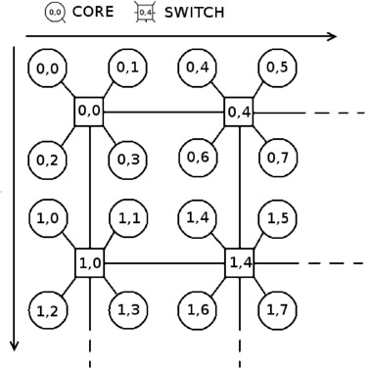
Logic Based Distributed Routing Architecture
Core 1(0,0) wants to communicate with Core 15(1,6)
Path taken: (0,0), (0,0). (1,0). (1,4), (1,6)
Abstraction of actual work to Synthetic Workload
Job_Num | Num_of_Threads | Thread_Duration
0001 | 002 | 002
0001 | 003 | 001
Rodrigo, S.; Medardoni, S.; Flich, J.; Bertozzi, D.; Duato, J.; “Efficient implementation of distributed routing algorithms for NoCs Computers & Digital Techniques, IET Volume: 3, Issue: 5, DOI: 10.1049/iet-cdt.2008.0092, page(s): 460-475.2009.

Slide 34
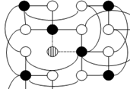
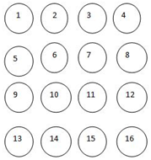
[Chaturvedula, 2011] Proposed Architecture
Solid nodes Switching Nodes
Empty nodes Computing Nodes
Striped node Switching & Computing Node
Chaturvedula, R.;” Designing Multi-Core Architecture Using Folded Torus Concept to Minimize the Number of Switches”, Thesis in Masters of Science, Florida Atlantic Wichita State University, Dec, 2011.

Slide 35
Communication paths for LBDR and [Chaturvedula, 2011] Proposed Architectures in the case of 16 Core
 | Source-Destination | LBDR | [Chaturvedula,2011] Model
Case 1 | Node 2 – Node 15 | 2, 1(Sw), 6(Sw), 11(Sw), 15 | 2, 1(Sw), 13(Sw) , 15
Case 2 | Node 3- Node 14 | 3, 1(Sw), 6(Sw), 11(Sw), 14 | 3, 1(Sw), 13(Sw), 14
Case 3 | Node 7 – Node 15 | 7, 6(Sw), 11(Sw), 15 | 7, 11(Sw), 15
Case 4 | Node 2 – Node 10 | 2, 1(Sw), 6(Sw), 10(Sw) | 2, 6(Sw), 10
Chaturvedula, R.;” Designing Multi-Core Architecture Using Folded Torus Concept to Minimize the Number of Switches”, Thesis in Masters of Science, Florida Atlantic Wichita State University, Dec, 2011.

Slide 36
Derived workloads for LBDR Model
Job_Num | Num_of_Threads | Thread_Duration (Sec) | Arrival_Time | Priority
0001 | 002 | 002 | 0.00 | 1
0001 | 003 | 001 | 0.00 | 1
0002 | 002 | 002 | 0.00 | 1
0002 | 003 | 001 | 0.00 | 1
0003 | 002 | 002 | 0.00 | 1
0003 | 002 | 001 | 0.00 | 1
0004 | 002 | 002 | 0.00 | 1
0004 | 002 | 001 | 0.00 | 1
Derived workloads for [Chaturvedula, 2011] Model
Job_Num | Num_of_Threads | Thread_Duration (Sec) | Arrival_Time | Priority
0001 | 002 | 002 | 0.00 | 1
0001 | 002 | 001 | 0.00 | 1
0002 | 002 | 002 | 0.00 | 1
0002 | 002 | 001 | 0.00 | 1
0003 | 002 | 002 | 0.00 | 1
0003 | 001 | 001 | 0.00 | 1
0004 | 002 | 002 | 0.00 | 1
0004 | 002 | 001 | 0.00 | 1

Slide 37
LBDR and Simulation results are very similar

Slide 38
[Chaturvedula, 2011] and Simulation results are very similar

Slide 39
Parallel Workload Analysis

Slide 40
Parallel Workload
Job_Num | Num_of_Threads | Thread_Duration | Arrival_Time | Priority
0001 | 002 | 020 | 0.00 | 1
0002 | 008 | 006 | 0.00 | 1
0003 | 007 | 018 | 0.00 | 1
0004 | 004 | 010 | 0.00 | 1
0005 | 004 | 028 | 0.00 | 1
0006 | 007 | 009 | 0.00 | 1
0007 | 003 | 001 | 0.00 | 1
0008 | 015 | 025 | 0.00 | 1
0009 | 004 | 005 | 0.00 | 1
0010 | 005 | 005 | 0.00 | 1
0011 | 010 | 007 | 0.00 | 1
0012 | 001 | 060 | 0.00 | 1
0013 | 007 | 028 | 0.00 | 1
0014 | 002 | 041 | 0.00 | 1
0015 | 015 | 001 | 0.00 | 1

Slide 41
Total Processing Time Analysis
Load Interval = 1 Unit
High performance results in128 core system

Slide 42
Total Power Analysis
ASSUMPTIONS:
Core Busy = 0.1 Unit
Core Idle = 0.05 Unit
Core Off = 0 Unit
On/Off condition results in constant power utilization
On/Idle/Off condition results in increased power utilization with the increase in number of cores

Slide 43
Overall Observations
128 core system results in high performance, but with high power utilization
64 core system provides an equivalent performance and with less power utilization
For the target workloads, any system greater than 128 is considered to have high availability and poor power utilization

Slide 44
Conclusions
A fast flexible Multi-Core Simulation Platform has been introduced
Using the platform, implemented a Serial/Parallel processing system
Analyzed the sequential and parallel executions of the target workloads

Slide 45
Future work
Efficient algorithms can be developed for the cache analysis purpose
Efficient algorithms can be developed for various core allocation strategies
Efficient multi-core route algorithms can be developed
Web interface and cloud services can be provided for the future researchers

Slide 46
Thank you
Phanendra Sandeep Naidu Gavara
myWSU ID: J667T676
Phone: (316) 841 3767

