Slide 1


MS Project Defense
“A Semantic Knowledge Engine Using Automated Knowledge Extraction from World Wide Web”
Venkatesh Mabbu
EECS Department, College of Engineering
November 20, 2015

Slide 2
A Semantic Knowledge Engine Using Automated Knowledge Extraction from World Wide Web
Project Committee:
Dr. Abu Asaduzzaman, EECS, Committee Chair
Dr. Kaushik Sinha, EECS, Committee Member
Dr. Ramazan Asmatulu, ME, Committee Member

Slide 3
About me
Venkatesh Mabbu
MS in Computer Science with Project
Hadoop Developer at Ennovar (WSU)
Publications
“Advanced Desktop Search” at “International Conference on Engineering, Technology and Management (ICETM-2012).

Slide 4
A Semantic Knowledge Engine Using Automated Knowledge Extraction from World Wide Web
Outline ►
Introduction & Basic Definitions
Background & Motivation
Current Technologies
Problem Description
Proposed Solution
Experiment
Results
Conclusion & Future work
Q U E S T I O N S ?
Any time, please.

Slide 5
Introduction
What is a search engine?
Search engines are programs that search documents for specified keywords and returns a list of the documents where the keywords were found. A search engine is really a general class of programs, however, the term is often used to specifically describe systems like Google, Bing and Yahoo! Search that enable users to search for documents on the World Wide Web.
Basic Definitions:
Web Spider/Robot: A Web crawler is an Internet bot which systematically browses the World Wide Web, typically for the purpose of Web indexing.
Crawling: Web Crawling is the process of search engines combing through web pages in order to properly index them.

Slide 6
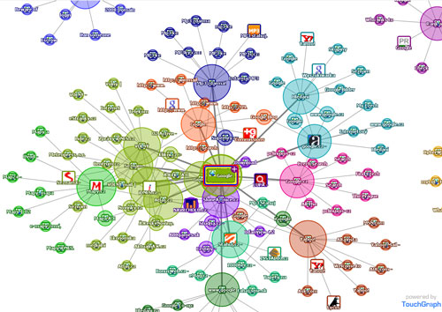
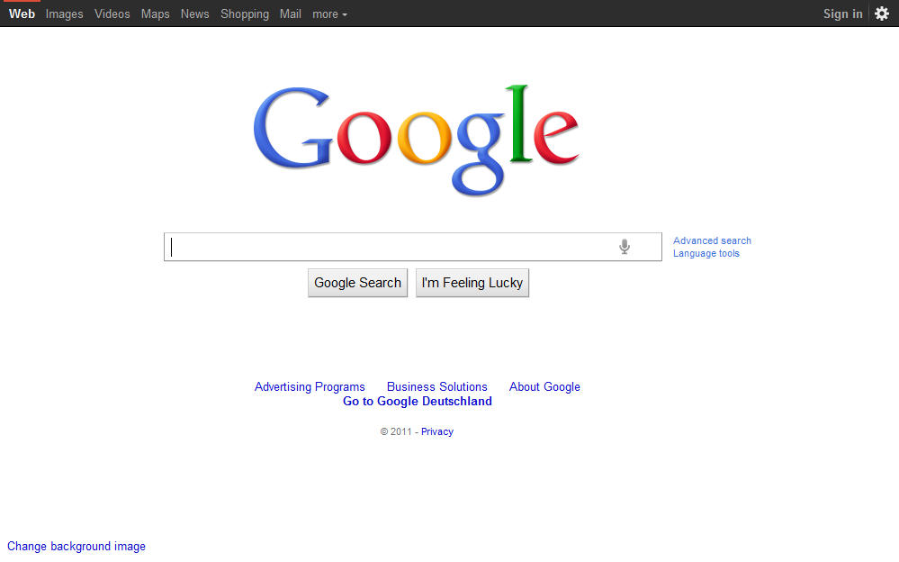
Introduction
Search Engine

Slide 7
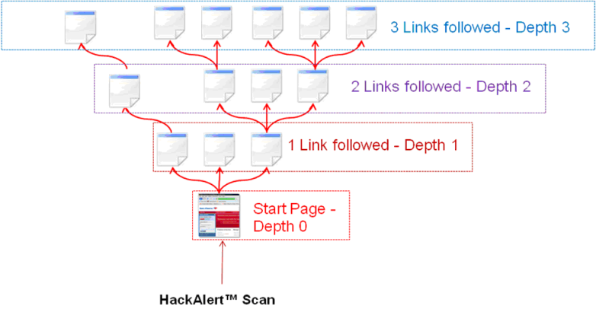
Introduction
How Search Engine Works?
Crawling:
Crawling mechanism

Slide 8
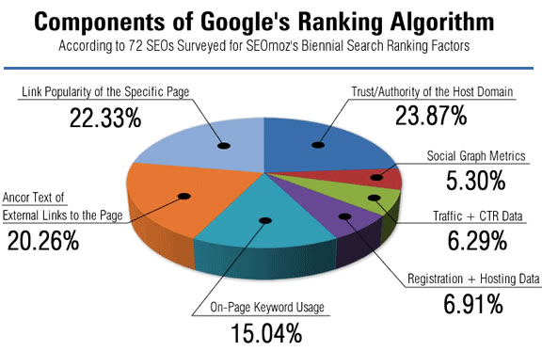
Introduction
How Google ranking works?
Components of Google Ranking algorithm

Slide 9
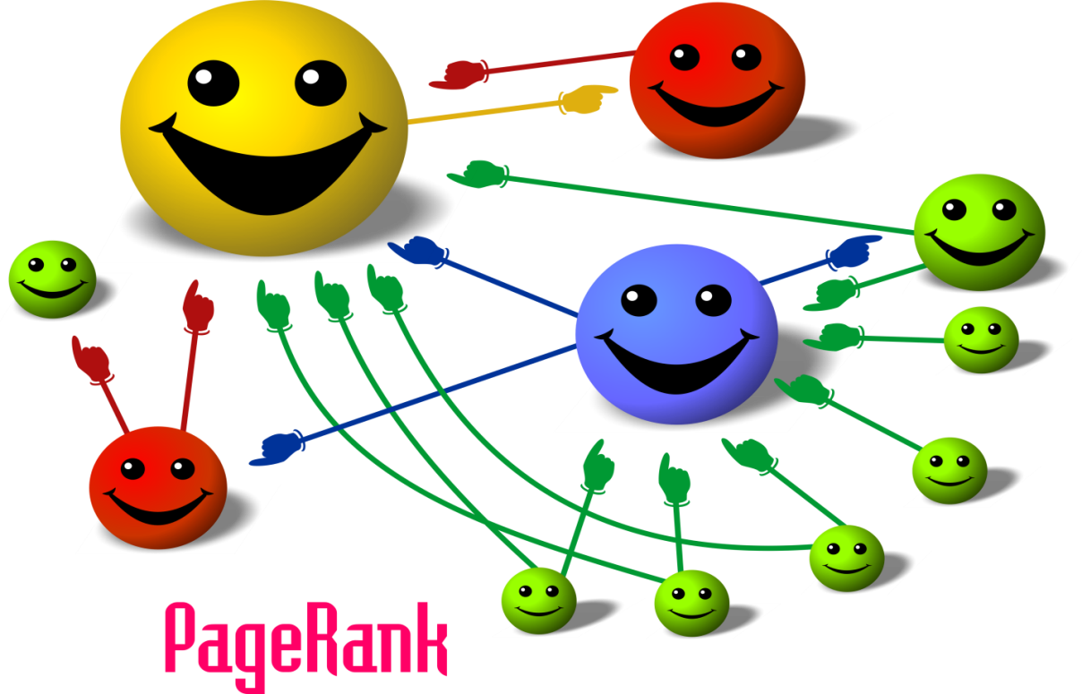
Introduction
How PageRank Works?
Google PageRank

Slide 10
Problem Description
It becomes extremely difficult for the existing search engines (such as Google) to crawl, index, rank, and manage huge amount of data and locate information while answering questions. Semantic web technology (such as Google Knowledge Graph) is emerging into the answer engine market in order to transform the unstructured data into more structured useful information. However, the existing engines suffer due to the fact that curators and volunteers feed these systems manually.

Slide 11
Problem Description
Problems:
It is a known fact that the internet is so big (50 billion pages) to crawl, index, summarize and monitor.
The web is highly unstructured.
Difficult to handle spam
High redundant data
Ranking pages
Privacy issues
Copyright issues.
The query words as "keywords”, Search engine works as a word matching program !!
Google’s many data centers around the world burn through 260 million watts—one quarter of the output of a nuclear power plant—the New York Times reports.
Data centers in general are responsible for 0.13 percent of the world’s electricity consumption, One Google search is equal to turning on a 60W light bulb for 17 seconds

Slide 12
Project Contributions
This proposed system focused on all the pre-discussed issues and we provided the best solution in overcoming these problems.
The following are the main contribution of this project:
Reduces the size of index
Reduces index time and complexity
Reduces the redundant data
Enhances Privacy Features
Copyright Issues
Protection from spamming websites
Excellent user experience

Slide 13
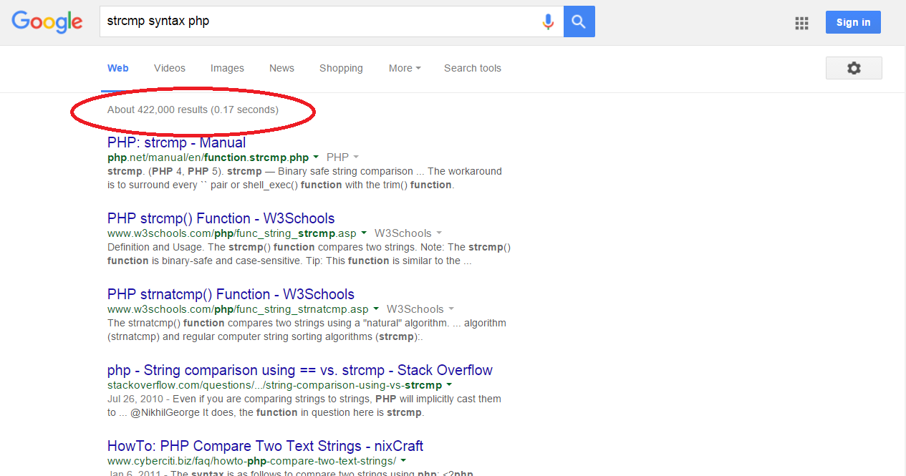
Redundancy
Google SERP for the search “strcmp syntax in php”

Slide 14
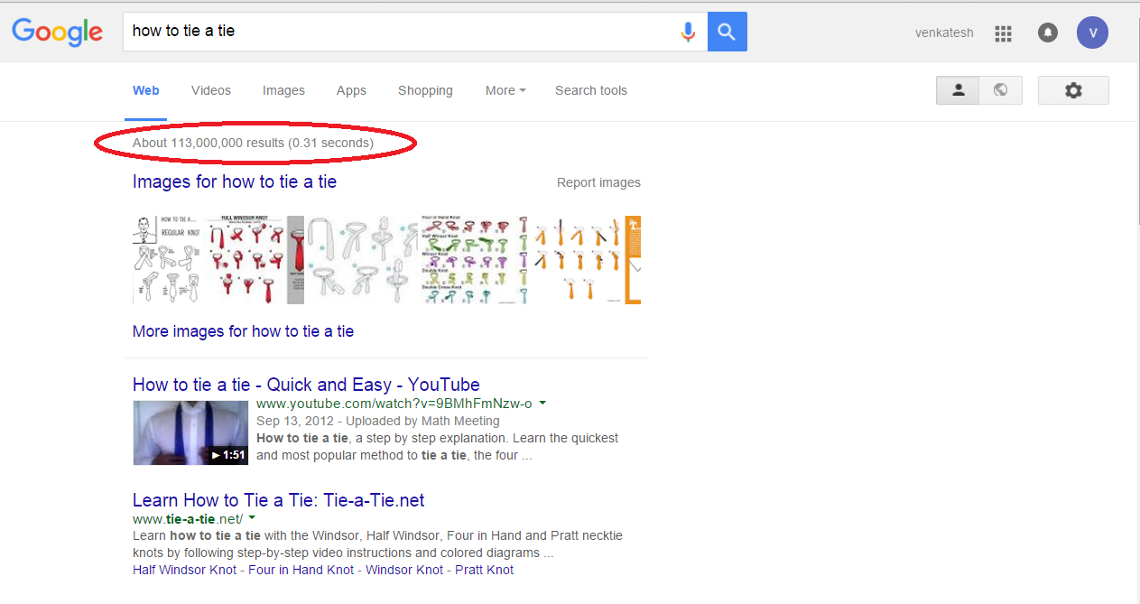
Redundancy
Google SERP for the search “how to tie a tie”

Slide 15
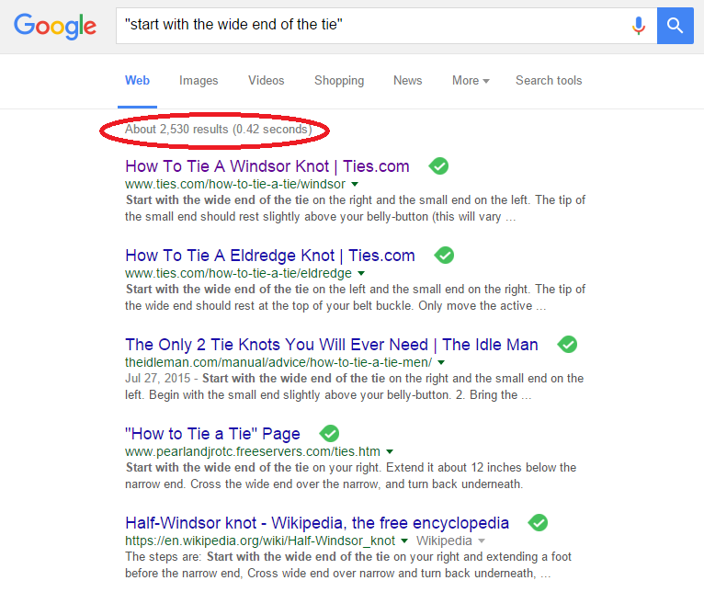
Redundancy
Google SERP for the search “start with wide end of the tie”

Slide 16
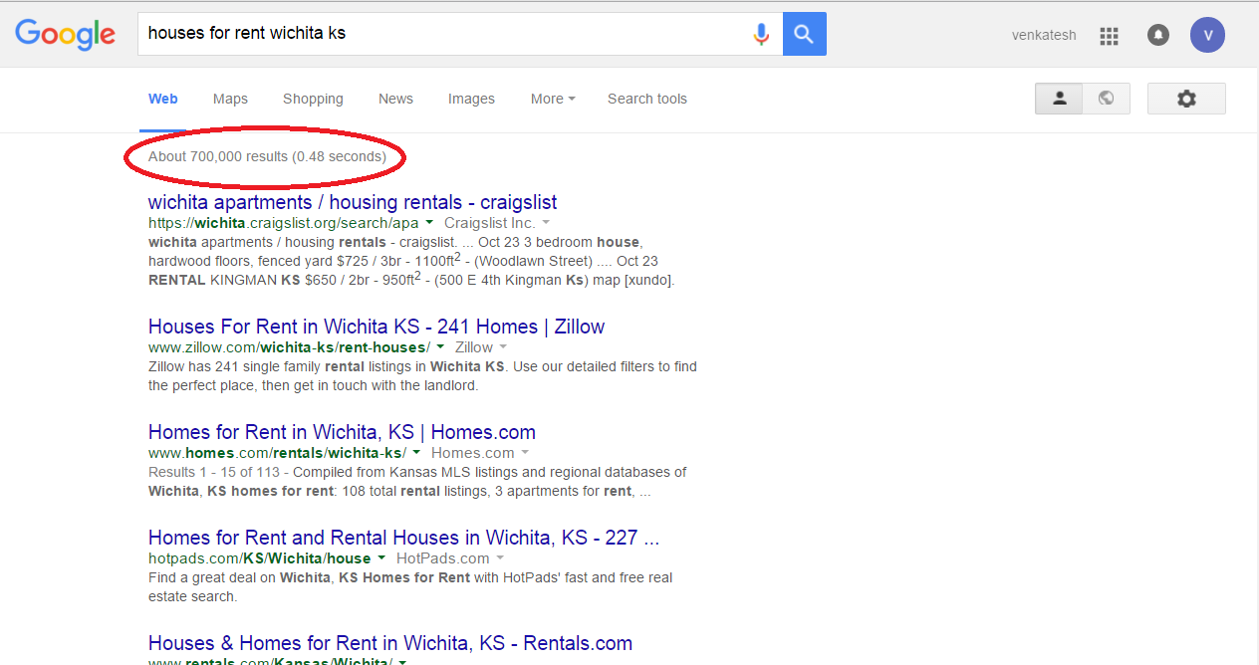
Redundancy
Google SERP for the search “houses for rent Wichita KS”

Slide 17
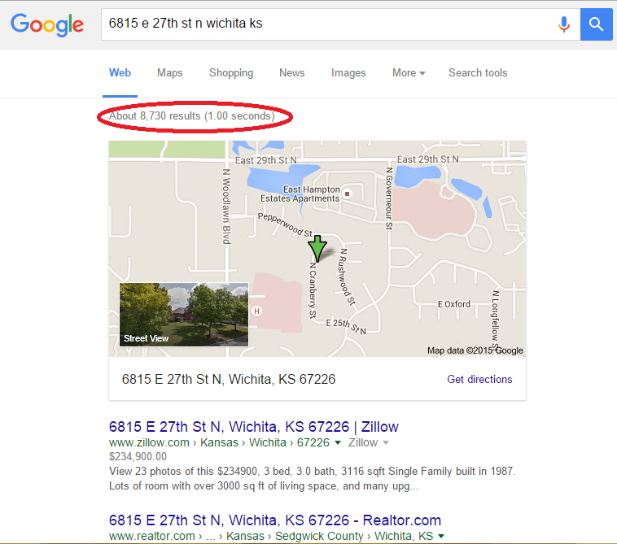
Redundancy
Google SERP for the search “6815 e 27t st Wichita KS”

Slide 18
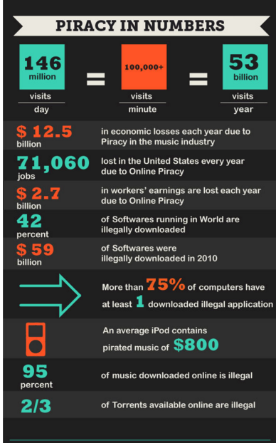
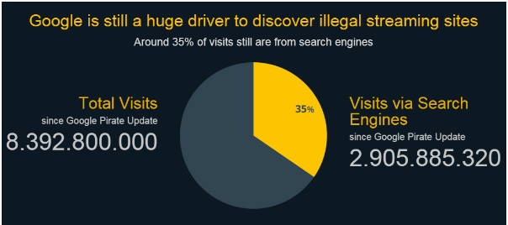
Copyright infringement
Google receives thousands of complaints every year under US Digital Millennium Copyright Act for providing access to the websites which infringes copyrights.
Piracy stats
Visits via Search Engine

Slide 19
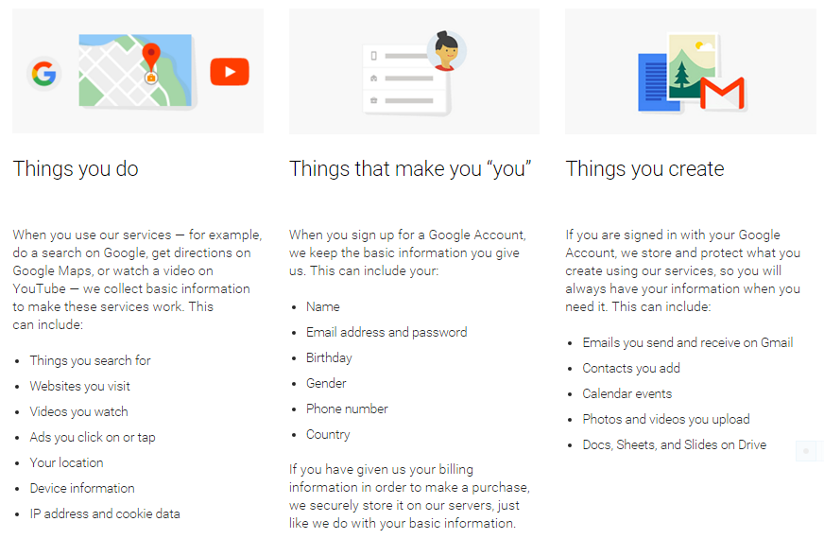
Privacy Concerns
Google collects lot of private information from the user. The following is the screenshot from the Google website about the information it collects from the user. “DuckDuckGo” is a search engine solely launched with a feature “it won’t track user information”
What Google collects from the users

Slide 20
Existing Solutions
Structured Web:
Data that resides in a fixed field within a record or file is called structured data. This includes data contained in relational databases and spreadsheets.
Current Research:
Wikidata: Wikidata is a free linked database that can be read and edited by both humans and machines. Wikidata acts as central storage for the structured data of its Wikimedia sister projects including Wikipedia, Wikivoyage, Wikisource, and others.
Freebase: Freebase was a large collaborative knowledge base consisting of data composed mainly by its community members. It was an online collection of structured data harvested from many sources, including individual, user-submitted wiki contributions. Freebase aimed to create a global resource that allowed people (and machines) to access common information more effectively.

Slide 21
Existing Solutions
3. Wolfram Alpha: Wolfram Alpha is a computational knowledge engine or answer engine developed by Wolfram Research. It is an online service that answers factual queries directly by computing the answer from externally sourced "curated data", rather than providing a list of documents or web pages that might contain the answer as a search engine might.
4. Google Knowledge Graph: The Knowledge Graph is a knowledge base used by Google to enhance its search engine's search results with semantic-search information gathered from a wide variety of sources. According to Google, the information in the Knowledge Graph is derived from many sources, including the CIA World Factbook, Freebase (being replaced by Wikidata), and Wikipedia. The feature is similar in intent to answer engines such as Wolfram Alpha and efforts such as Linked Data and DBpedia.
Challenges:
Missing values.
Completely rely on human curators/volunteers.

Slide 22
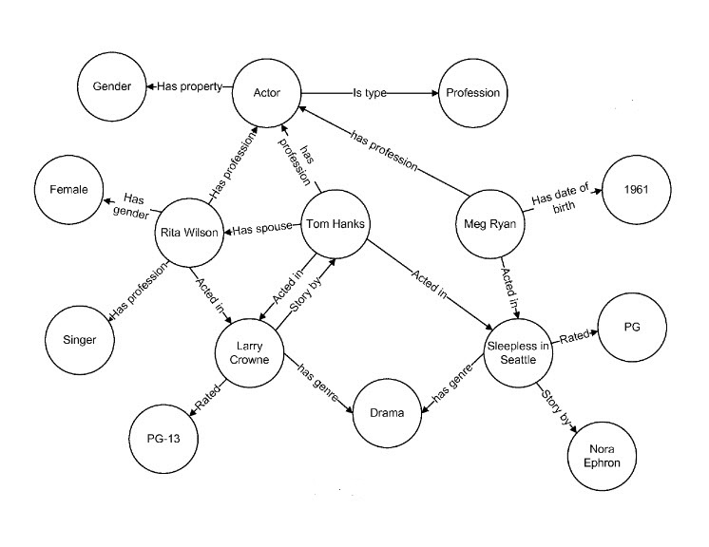
Semantic Web Example
In Semantic Web, every real world object is treated as an entity and every entity do have some finite set of attributes and these attributes, entities connected together in a semantic representation. The following figure describes how entities and attributes are interconnected in a semantic way.
Semantic web representation

Slide 23
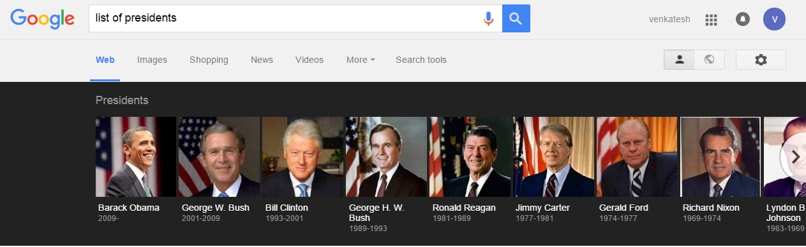
Google Knowledge Graph
Example:
Google Knowledge Graph result for the query “List of presidents”

Slide 24
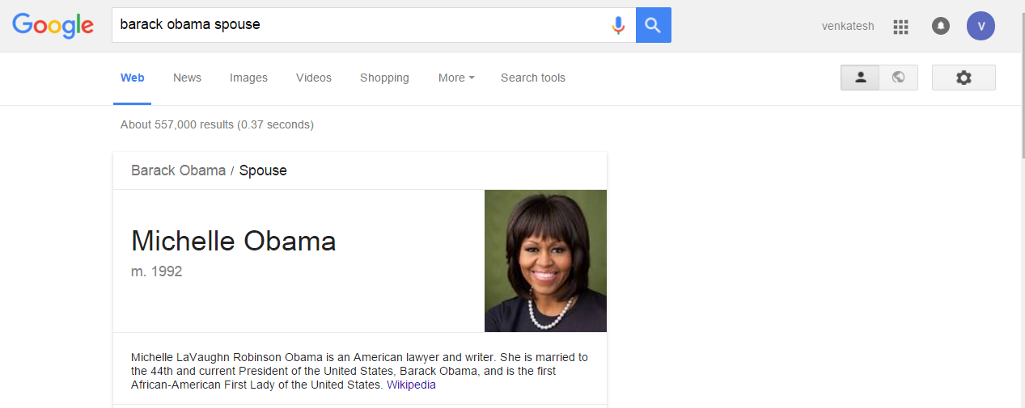
Google Knowledge Graph
Example:
Google answer for the query “barack obama spouse”

Slide 25
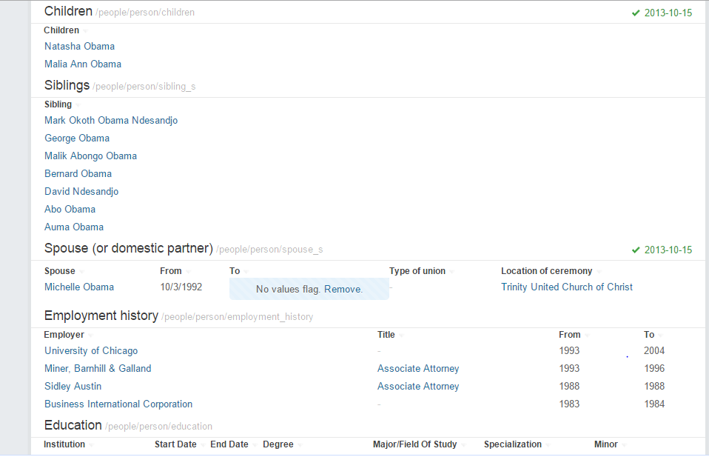
How Google Knowledge Graph Works
According to Google, the information in the Knowledge Graph is derived from many sources, including the CIA World Factbook, Freebase (being replaced by Wikidata), and Wikipedia.
Obama Freebase page

Slide 26
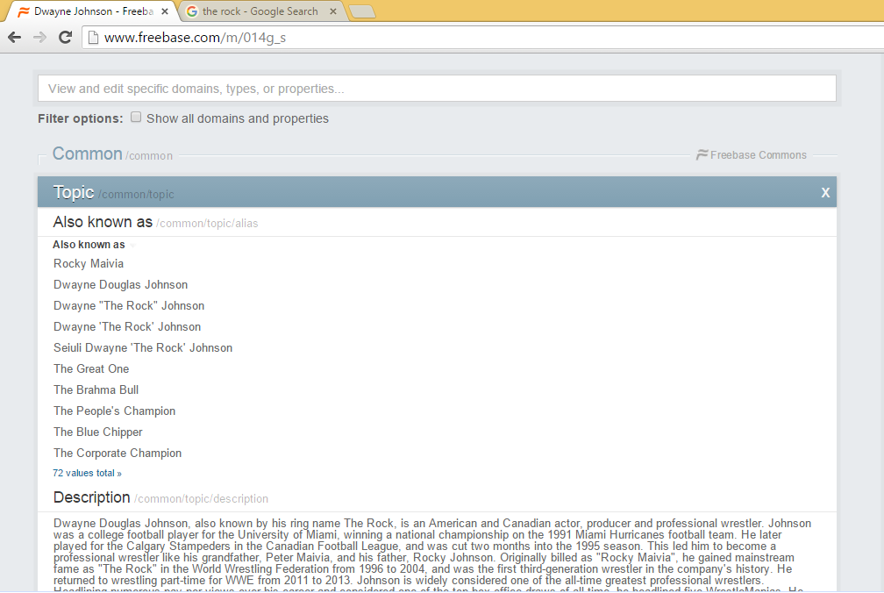
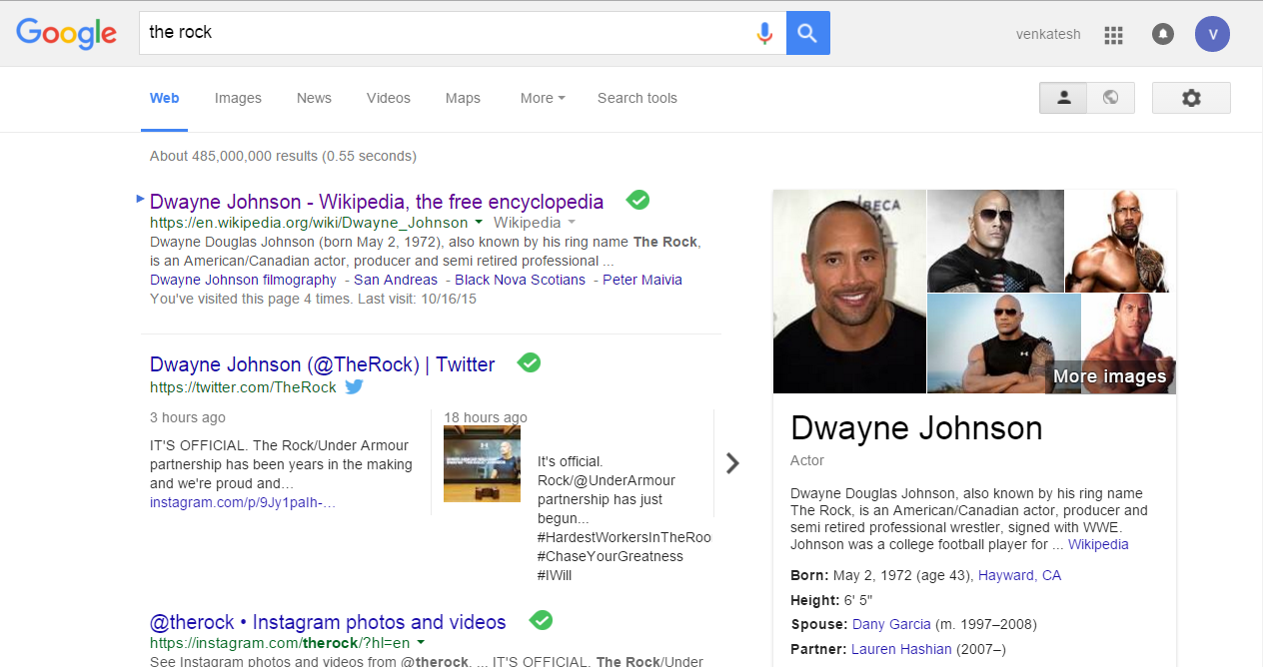
How Google Knowledge Graph Works

Slide 27
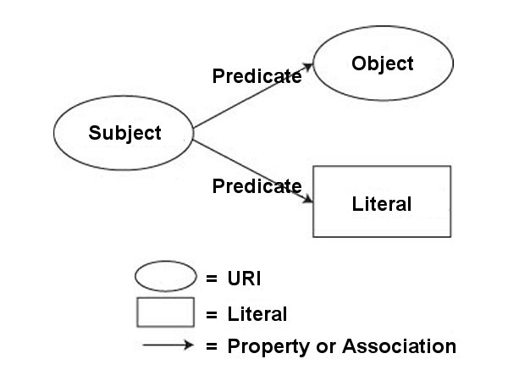
RDF Triple
The Resource Description Framework (RDF) is a family of World Wide Web Consortium (W3C) specifications originally designed as a metadata data model. It has come to be used as a general method for conceptual description or modeling of information that is implemented in web resources
RDF Triple Overview

Slide 28
RDF Example
Subject | Predicate | Object
http://bioimages.vanderbilt.edu/kirchoff/ac1490 | http://www.w3.org/1999/02/22-rdf-syntax-ns#type | http://purl.org/dc/dcmitype/StillImage
http://bioimages.vanderbilt.edu/kirchoff/ac1490 | http://xmlns.com/foaf/0.1/maker | http://bioimages.vanderbilt.edu/contact/kirchoff#coblea
http://bioimages.vanderbilt.edu/kirchoff/ac1490 | http://purl.org/dc/terms/created | "2010-09-01T03:41:31"
http://bioimages.vanderbilt.edu/kirchoff/ac1490 | http://purl.org/dc/elements/1.1/rights | "(c) 2011 Bruce K. Kirchoff"
http://bioimages.vanderbilt.edu/contact/kirchoff#coblea | http://www.w3.org/1999/02/22-rdf-syntax-ns#type | http://xmlns.com/foaf/0.1/Person
http://bioimages.vanderbilt.edu/contact/kirchoff#coblea | http://xmlns.com/foaf/0.1/name | "Ashley Coble"
Raw RDF Triples

Slide 29
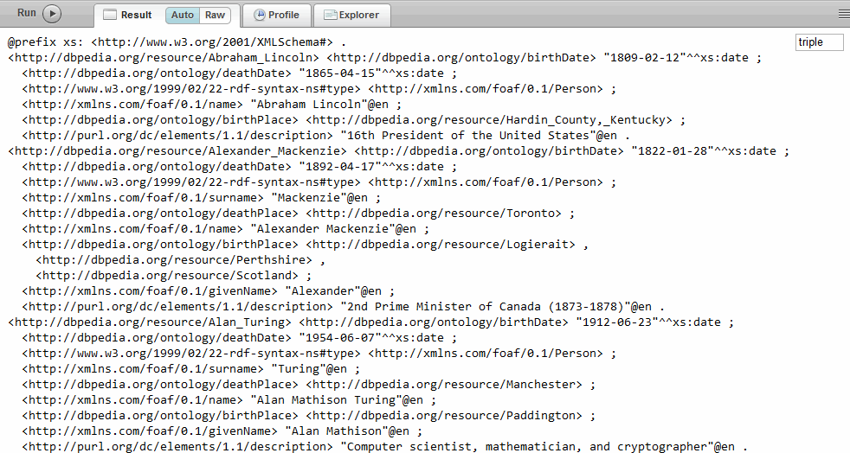
RDF Example
Raw RDF Triples

Slide 30
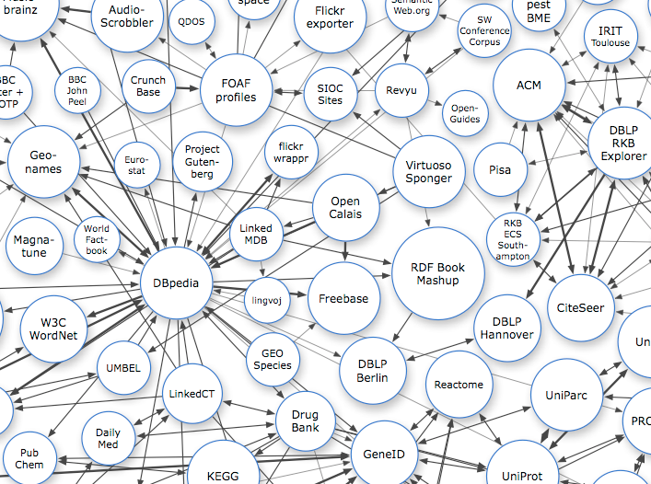
Linked Data
Linked Data describes a method of publishing structured data so that it can be interlinked and become more useful through semantic queries.
Interlinked Structured data over web

Slide 31
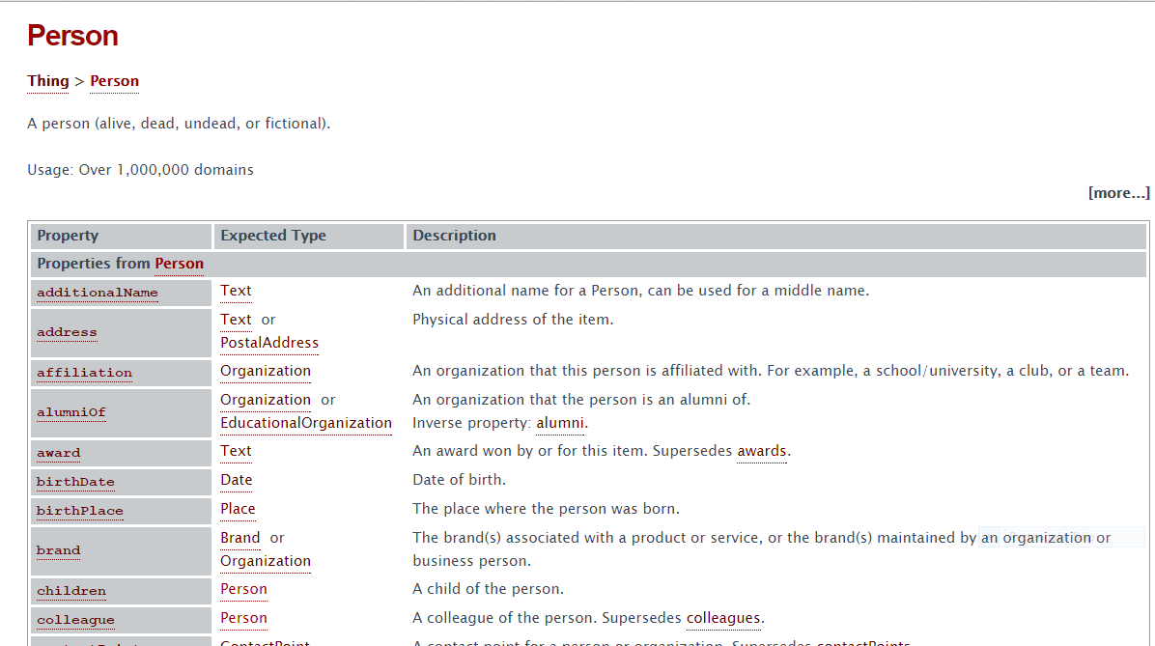
Schemas (schema.org)
Schema.org is an initiative launched on 2 June 2011 by Bing, Google and Yahoo (the operators of the then world's largest search engines) to “create and support a common set of schemas for structured data markup on web pages.”
Schema for type “person”

Slide 32
Schema Example
<div itemscope itemtype="http://schema.org/Movie">
<h1 itemprop="name">Avatar</h1>
<div itemprop="director" itemscope itemtype="http://schema.org/Person"> Director:
<span itemprop="name">James Cameron</span> (born <time itemprop="birthDate" datetime="1954-08-16">August 16, 1954</time>)
</div> <span itemprop="genre">Science fiction</span> <a href="../movies/avatar-theatrical-trailer.html" itemprop="trailer">Trailer</a>
</div>
<div >
<h1>Avatar</h1>
<div> Director:
<span>James Cameron</span> (born <time>August 16, 1954</time>)
</div> <span>Science fiction</span>
<a href="../movies/avatar-theatrical-trailer.html">Trailer</a>
</div>
HTML code
Microdata schema representation

Slide 33
Limitations of Schemas
Schema types are limited:. Structured data is great for people, products, places, and events, but these cover only a fraction of the entire content of the web.
Markup is difficult: Realistically, in a world where it's sometimes difficult to get authors to write a title tag implementing proper structured data to source HTML can be a daunting task.
Adoption is low: A study last year of 2.4 billion web pages showed less than 25% contained structured data markup.

Slide 34
Proposed Solution
We are proposing a solution to transform this unstructured data into most useful and easily accessible knowledge using smart automated bot. The proposed system is world’s first of it’s kind in transforming unstructured data into structured web with zero human intervention. The system is trained with highly structured millions of entities and attributes in order to produce a series of facts and those facts will help in solving user posed questions.
proposed solution is a blend of regular search and semantic search
Identify Entities
Identify Scope
Identify relevant attributes
Crawl what you need instead of what you get

Slide 35
Experiment
We identified the following three popular categories of search that users perform everyday.
Instant/Real-Time Data: The queries which come under this category are definitions, weather, Stock market data, different conversions (currency, area, volume, temperature, etc.), basic calculations (like mathematical expression solver)
Factual Data: This project is highly focusing on this section as it requires intelligent and smart computations in order to answer the user query. For this we indexed early one million facts in eleven different categories from the most reliable sources on internet like Wikipedia, CIA world Factbook, us news, US Department of Agriculture and more popular websites.
Web Results: This section of queries needs to be answered with hyperlinks instead of answers like Cheap flights, amazon, manage Bank of America account, etc.

Slide 36
Experiment
Prototype:
The goal of this project is to index one million facts of different categories and test the system using different Natural Language queries.
1. Universities Data (1700 USA universities with statistics and reviews)
2. Countries (180 countries basic data)
3. Nutrition data (8560 food items)
4. Animals facts (800 different animals and species)
5. Movies (3500 English movies from the year 2000 - 2015)
6. Film personalities (13200 profiles)
7. Programming languages (PHP) (4000 different syntax and examples)
8. Gadgets (laptops/ mobiles and tablets) (1000 models)
9. Automobile (400 Cars with full specifications)
10. Famous people (4500 profiles)

Slide 37
Experiment
Prototype:
11. Local restaurants (500 restaurants in Wichita with menu)
12. Companies (2000 USA companies basic information)
13. Websites (Alexa top 1 lakh domains data)
14. Basic Expression solver (supports 11 different operations)
15. Meaning, Synonyms and Antonyms for WordNet (117000 words)
16. AccuWeather Data (51318 locations in USA)
17. Mathematical conversions (400 conversions of size, area and volume)
18. Currency Exchange prices
19. Stock data (to be indexed)
20. Basic General Knowledge (to be indexed)
1 million facts

Slide 38
Experiment
Software Used:
PHP (for crawling the web)
Java (for indexing and image creation)
MySQL (Backend/Database)
HTML & JavaScript (Frontend/User Interface)
Hardware Used:
Lenovo Y40 laptop (2.6 GHZ Processor, 8 GB RAM)
Source Code:
PHP (58 files, 26000 lines of code)
Java (8 files, 3200 lines of code)
MySQL (20 Databases, 46 tables)
HTML & JavaScript (2 files, 500 lines of code)
The size of the index for 1 million facts is just “12.8MB” (compressed)
For 100 billion facts the approximate size of index = 1 TB

Slide 39
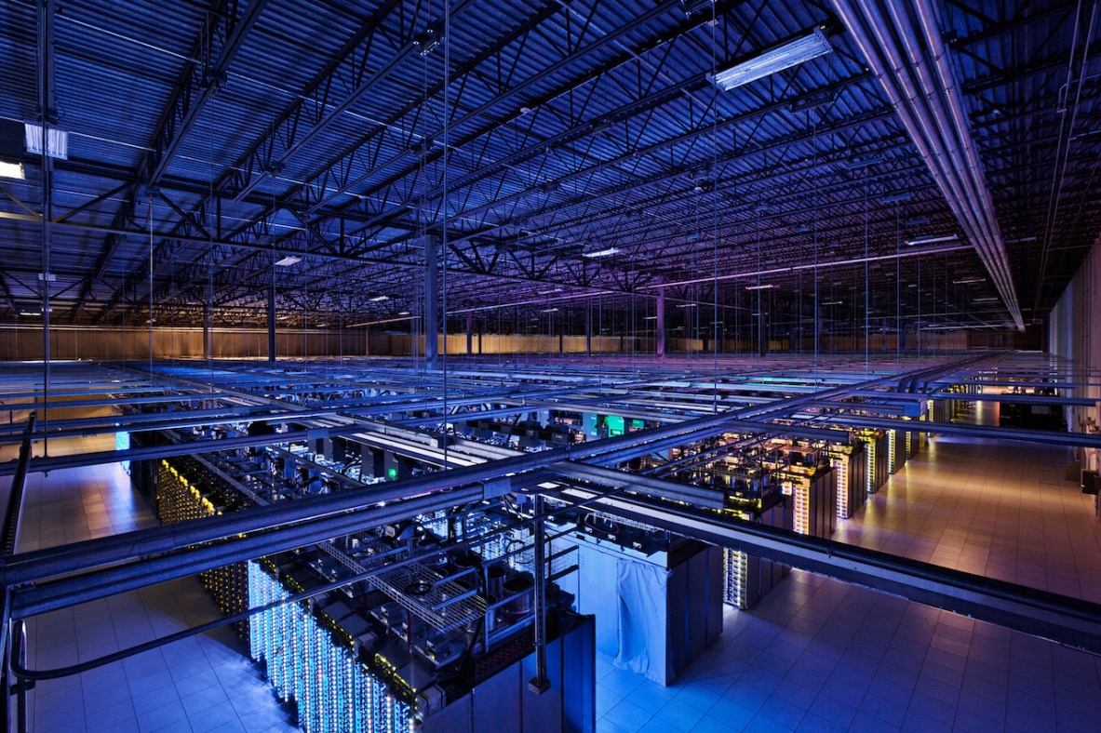
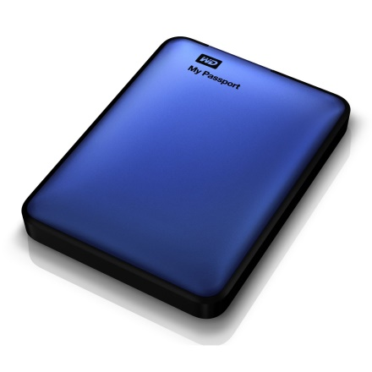
Experiment
The final goal of this project is to bring the power of millions of servers to just one normal
server and to run the answer engine with a storage of less than 1 Terabyte

Slide 40
Query Processing
(Search Engine vs. Semantic Engine)

Slide 41
Query Processing
(Search Engines)
Example: “cars with highest trunk volume”
Search engines intersects the webpages which contains these keyword(s), order these Webpages by rank and present these results to the user. The following table shows the list of keywords and their corresponding documents.
keywords | documents
Cars | a.com, b.com, c.com,….
… | …
Highest | c.com, m.com, a.com,…
… | …
Trunk | a.com, g.com, c.com,…
… | …
volume | x.com, a.com, c.com,…
Sample index table

Slide 42
Query Processing
(Semantic Engines)
Example: “cars with highest trunk volume”
Entities | attributes
Person | Name, age, profession, …
… | …
Cars | Make, model, price,…
… | …
University | Name, address, type,..
… | …
Restaurant | Name, address, menu,..
Sample index table

Slide 43
Query Processing
(Semantic Engines)
Step 1: Given input query is tokenized and tries to find the entity token.
Token matched entity found
Cars
With
Highest
Trunk
Volume
Entities
Person
…
Cars
…
University
…
Restaurant
Table of Entities

Slide 44
Query Working Mechanism
(Semantic Engines)
Step 2: Identify attributes in the rest of the tokens
attributes
Model
…
Mileage
…
Horsepower
…
Trunk volume
Cars
With
Highest
Trunk
Volume
Token(s) matched attribute found
List of attributes for “car”

Slide 45
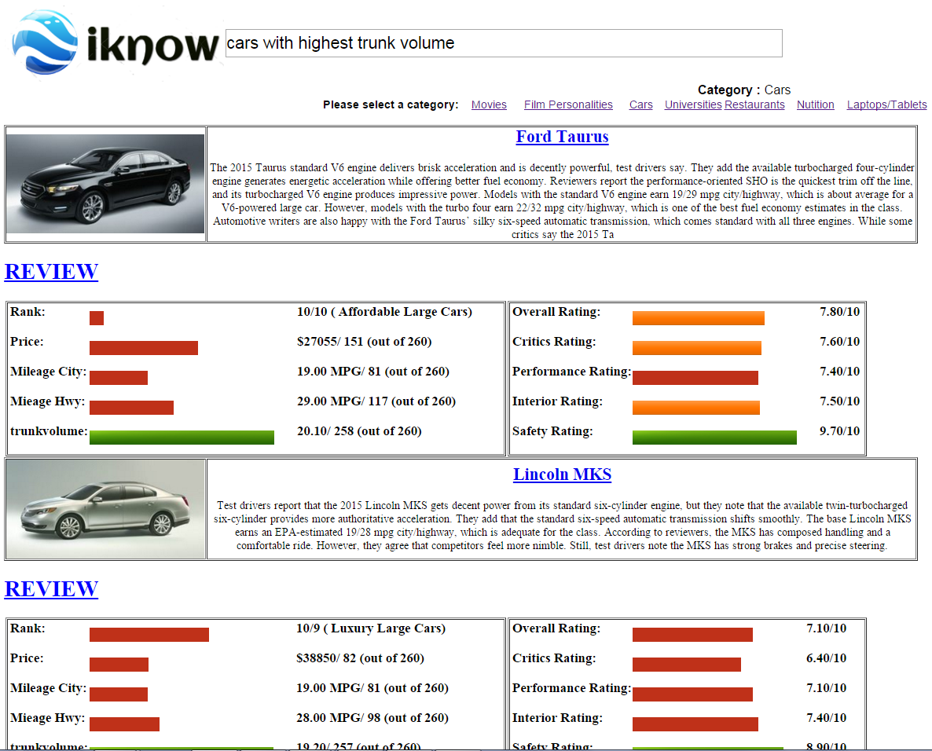
Query Processing
(Semantic Engines)
Step 3: “highest/lowest” specifies the order of result high to low and low to high respectively
Step 4: Returns the list of cars with highest trunk volume
Screenshot of the results page

Slide 46
Feedback from Students
This project is presented to 40 student(s) and feedback is taken from them about how
Proposed system controls redundancy, spam, usefulness, time efficiency and overall
performance on a scale of 1-10 (1 means strongly disagree and 10 means strongly agree).
Survey results

Slide 47
Evaluation
 | Universities | Nutrition | Cars | Movies | Film Personalities | Restaurants
Google | 55% | 65% | 30% | 55% | 55% | 85%
Bing | 35% | 50% | 15% | 50% | 50% | 85%
Wolfram Alpha | 20% | 70% | 15% | 20% | 35% | 0
Proposed System | 80% | 95% | 70% | 75% | 90% | 100%
Comparison of accuracy in different search/answer engines

Slide 48
Evaluation
 | Mobiles | Laptops | Animals | Countries | Instant answers | Web search
Google | 20% | 15% | 70% | 50% | 100% | 100%
Bing | 15% | 5% | 55% | 35% | 100% | 100%
Wolfram Alpha | 10% | 10% | 10% | 50% | 95% | 0
Proposed System | 95% | 80% | 85% | 95% | 60% | 30%
Comparison of accuracy in different search/answer engines

Slide 49
The Big Picture
Canadian actress whose father is an ex-wrestler.
I'm allergic to lattice suggest me some good restaurants nearby with food and price list
Score of Sachin Tendulkar in world cup 2011
I'm diabetic, can I eat banana?
My GRE and IELTS scores are 308 and 7.0, suggest some good universities in Wichita with highest international student population
I am experiencing severe headaches at night time, weight and hair loss. What might be the problem?
Suggest me some good drugs for fever and cold

Slide 50
Live Demo

Slide 51
Conclusion and Future work
The proposed system completely automates the process of transforming the unstructured web to more structured useful knowledge and help in replacing human curators without compromising accuracy. It has an excellent understanding and capability in providing answers to the users questions when compared with any other search engine/answer engines. The future scope of this project is to index even more number of categories and launch it is a commercial website.

Slide 52

Questions ?

Slide 53
A Semantic Knowledge Engine Using Automated Knowledge Extraction from World Wide Web
Thank you
Contact:
Venkatesh Mabbu
E-mail: vxmabbu@wichita.edu

