Slide 1
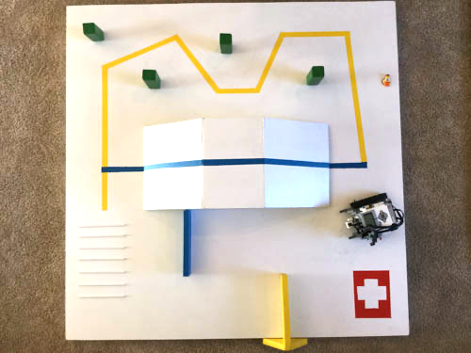
Checkpoint A
Checkpoint C
Slalom Pole
Checkpoint B
Ski Slope
Ski Slope
Ski Slope
Snow Fences
Start & End
Red Cross Area
Mogul Strips
Snow Fences

