Slide 1
Parts List
(1) 4’ x 8’ 5mm Utility Panel (plywood) $26.68
(2) 1” x 8” x 8’ Whitewood Board 21.98
This wall height is only to keep balls on the course and to support the
hoops. The walls may be shorter if you choose.
(1) 1” x 6” x 6’ Whitewood Board 8.47
(3) 1” x 2” x 8’ Whitewood Board 8.22
(1) 2” x 2” x 8’ Whitewood Board 6.96
(8) ¼” x 2.5” Bolts 2.16
(8) Wing Nuts for ¼” Bolts 5.52
$999.999
Plus
(4) oversized golf tees – see example on next page
(4) 5.5cm diameter plastic balls – see example on next page
Plus miscellaneous
Paint (color scheme has no bearing on this course, paint it how you want)
Glue
Nails (if required)

Slide 2
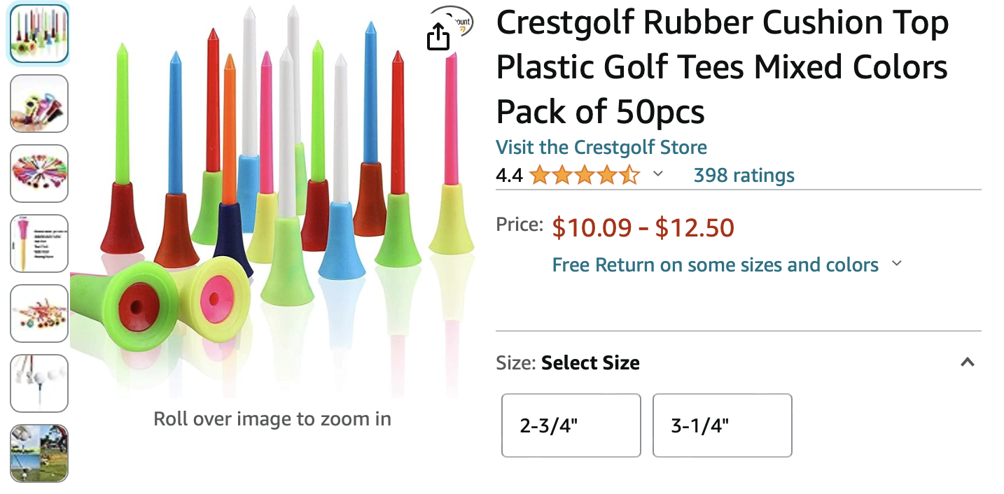
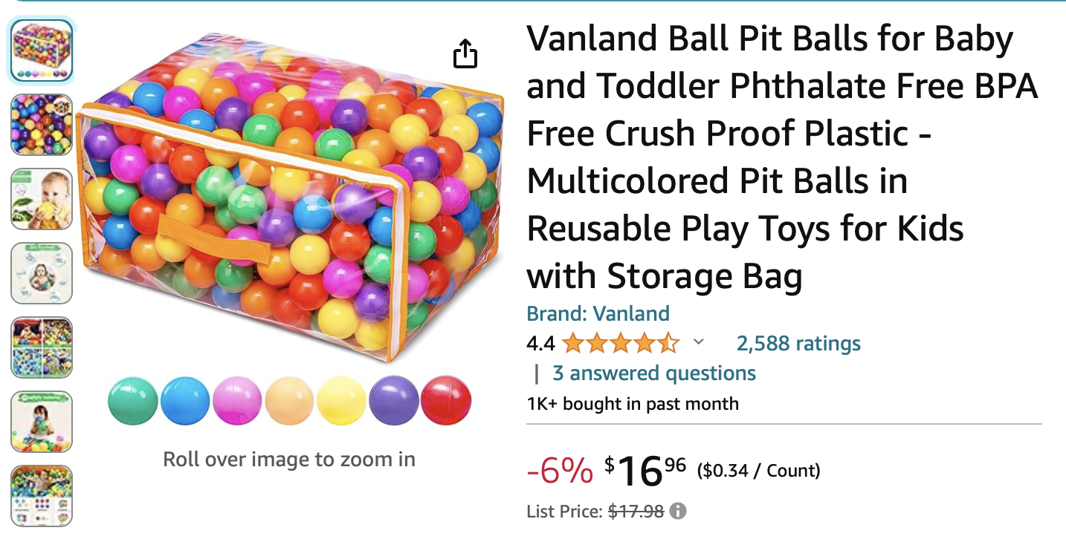

Slide 3

Note:
add a 1” x 2” x 2” block in each corner to support the golf tees
(1) 4’ x 4’ 5mm thick plywood sheet
(2) 1”x2”x48”
(4) 1”x2”x45”
Course frame assembled with glue and nails
Grid is 3” x 3”

Slide 4
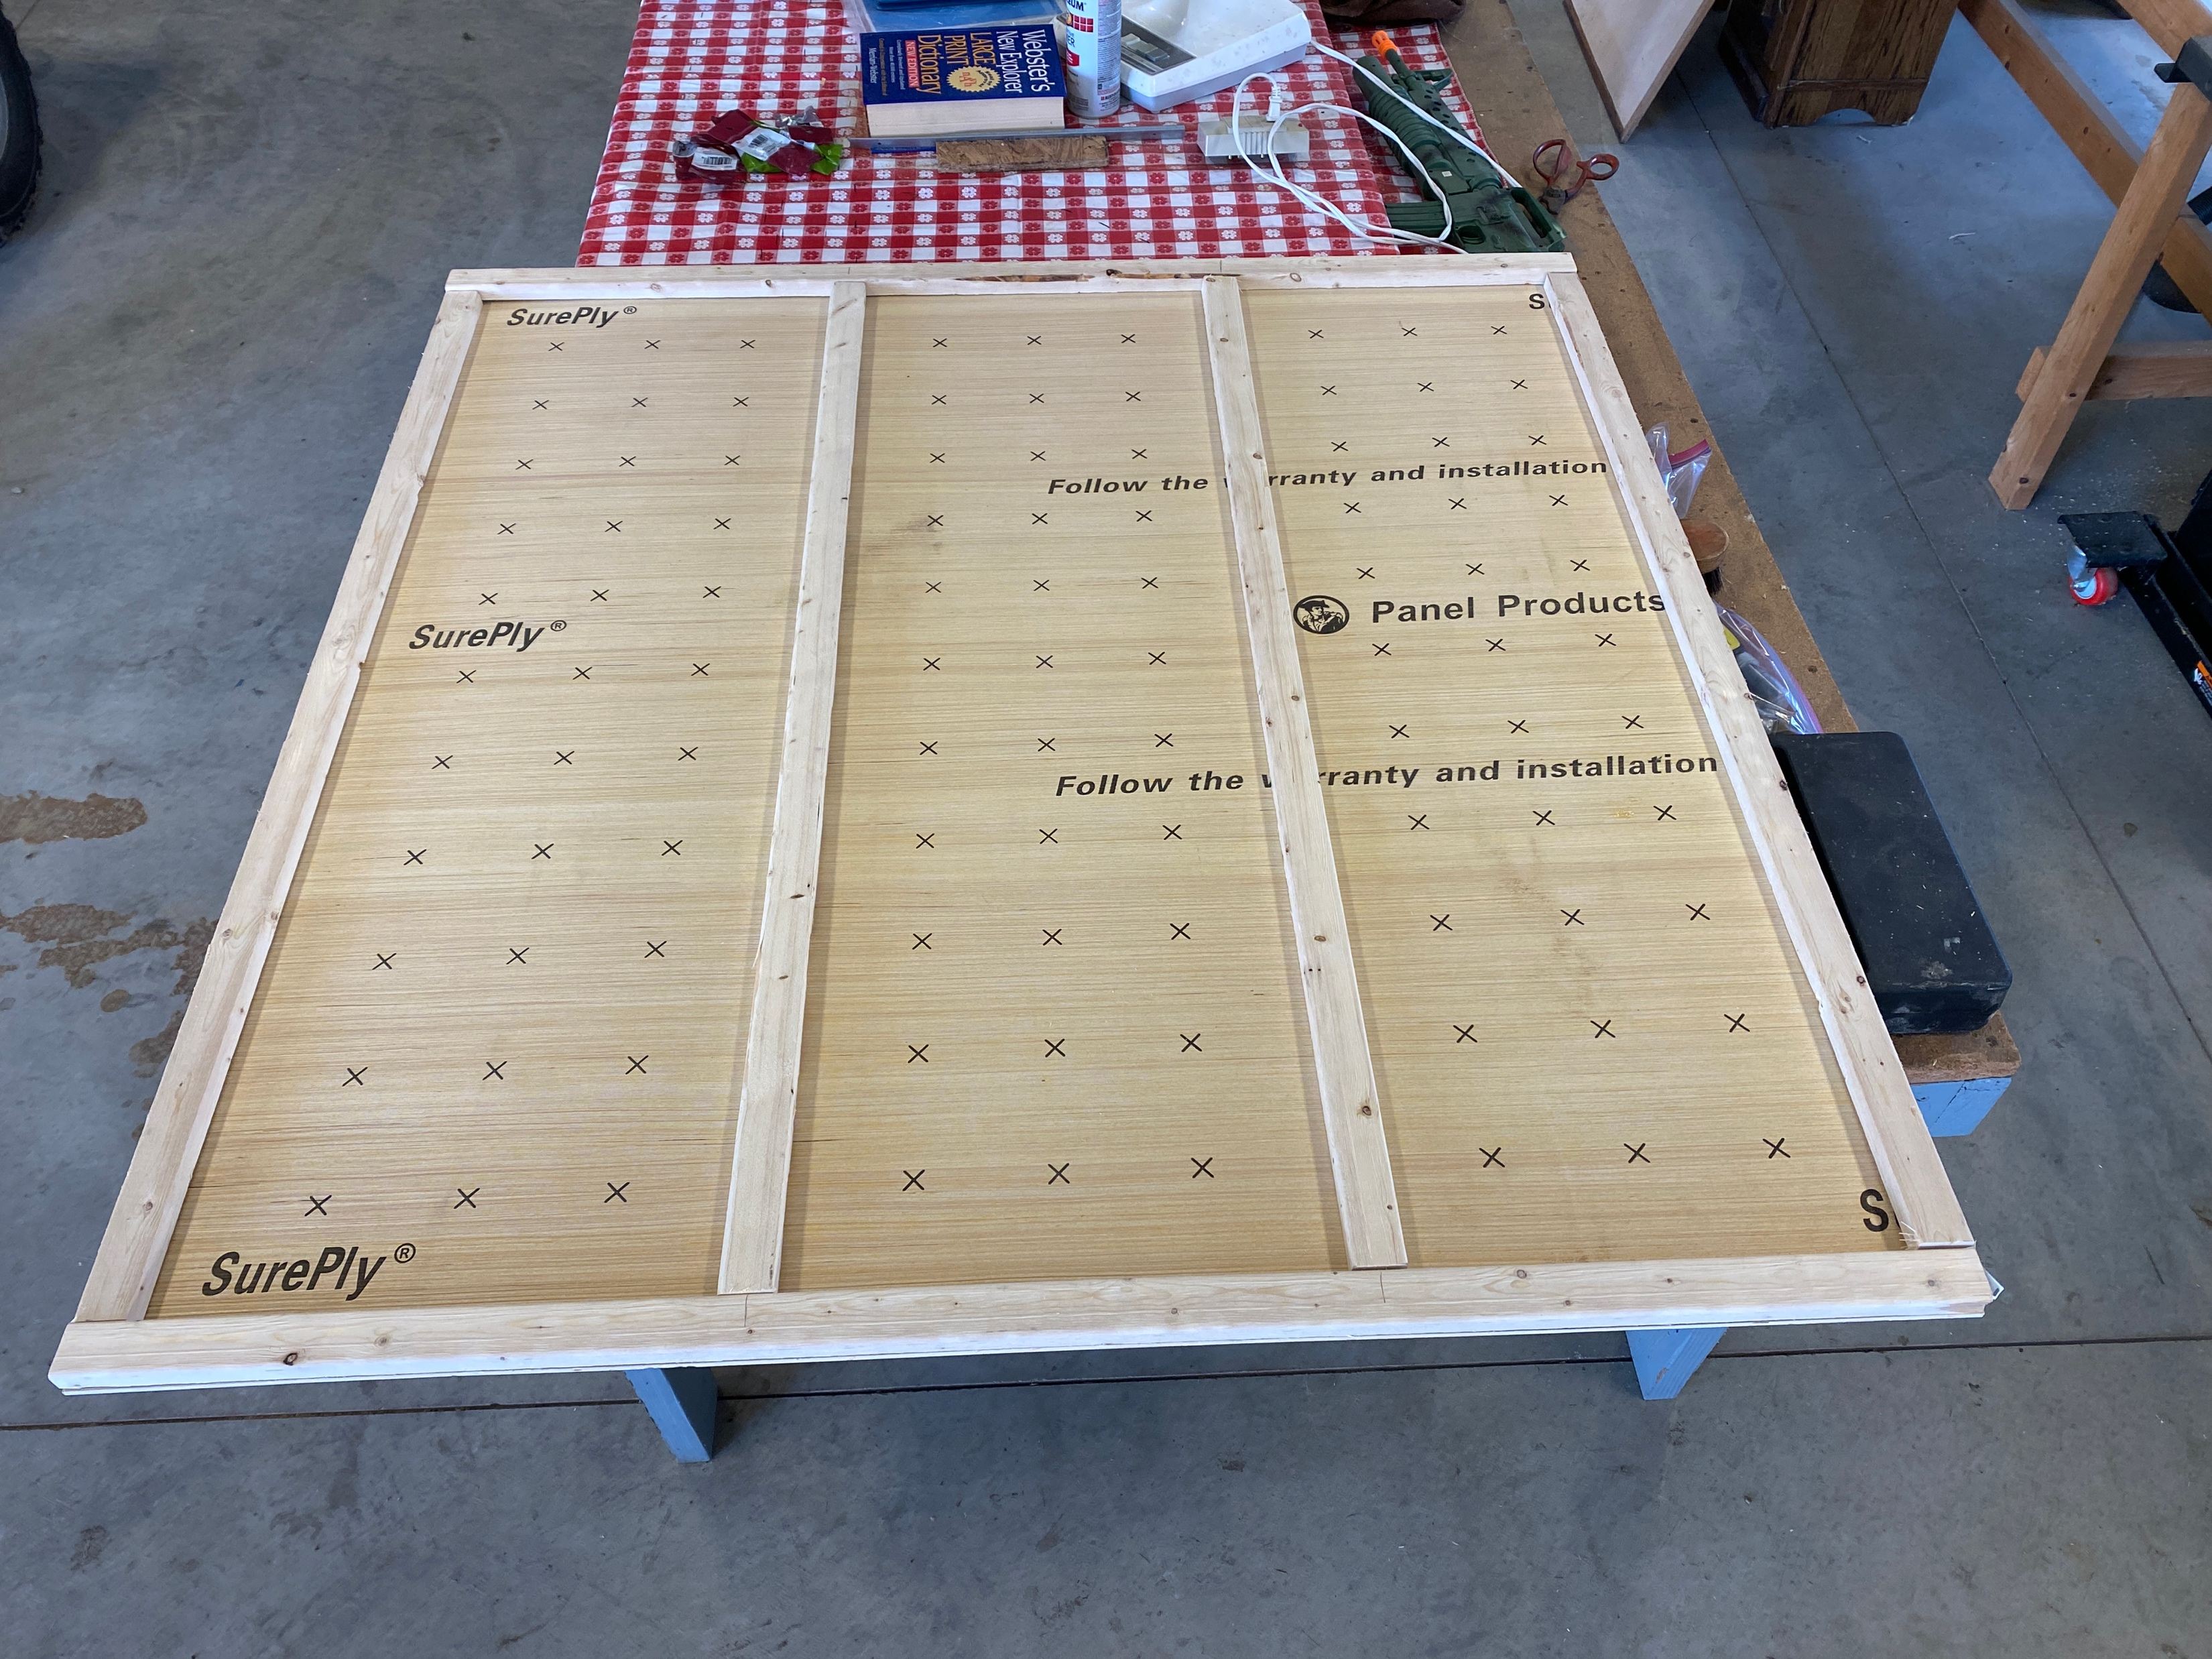

Slide 5
Attach walls around base. (2) walls 48” long and (2) walls 19.5” long. All wall are 8” tall.
Drill holes in corners 3” from each wall. Drill holes to fit golf tees.
Grid is 3” x 3”

Slide 6
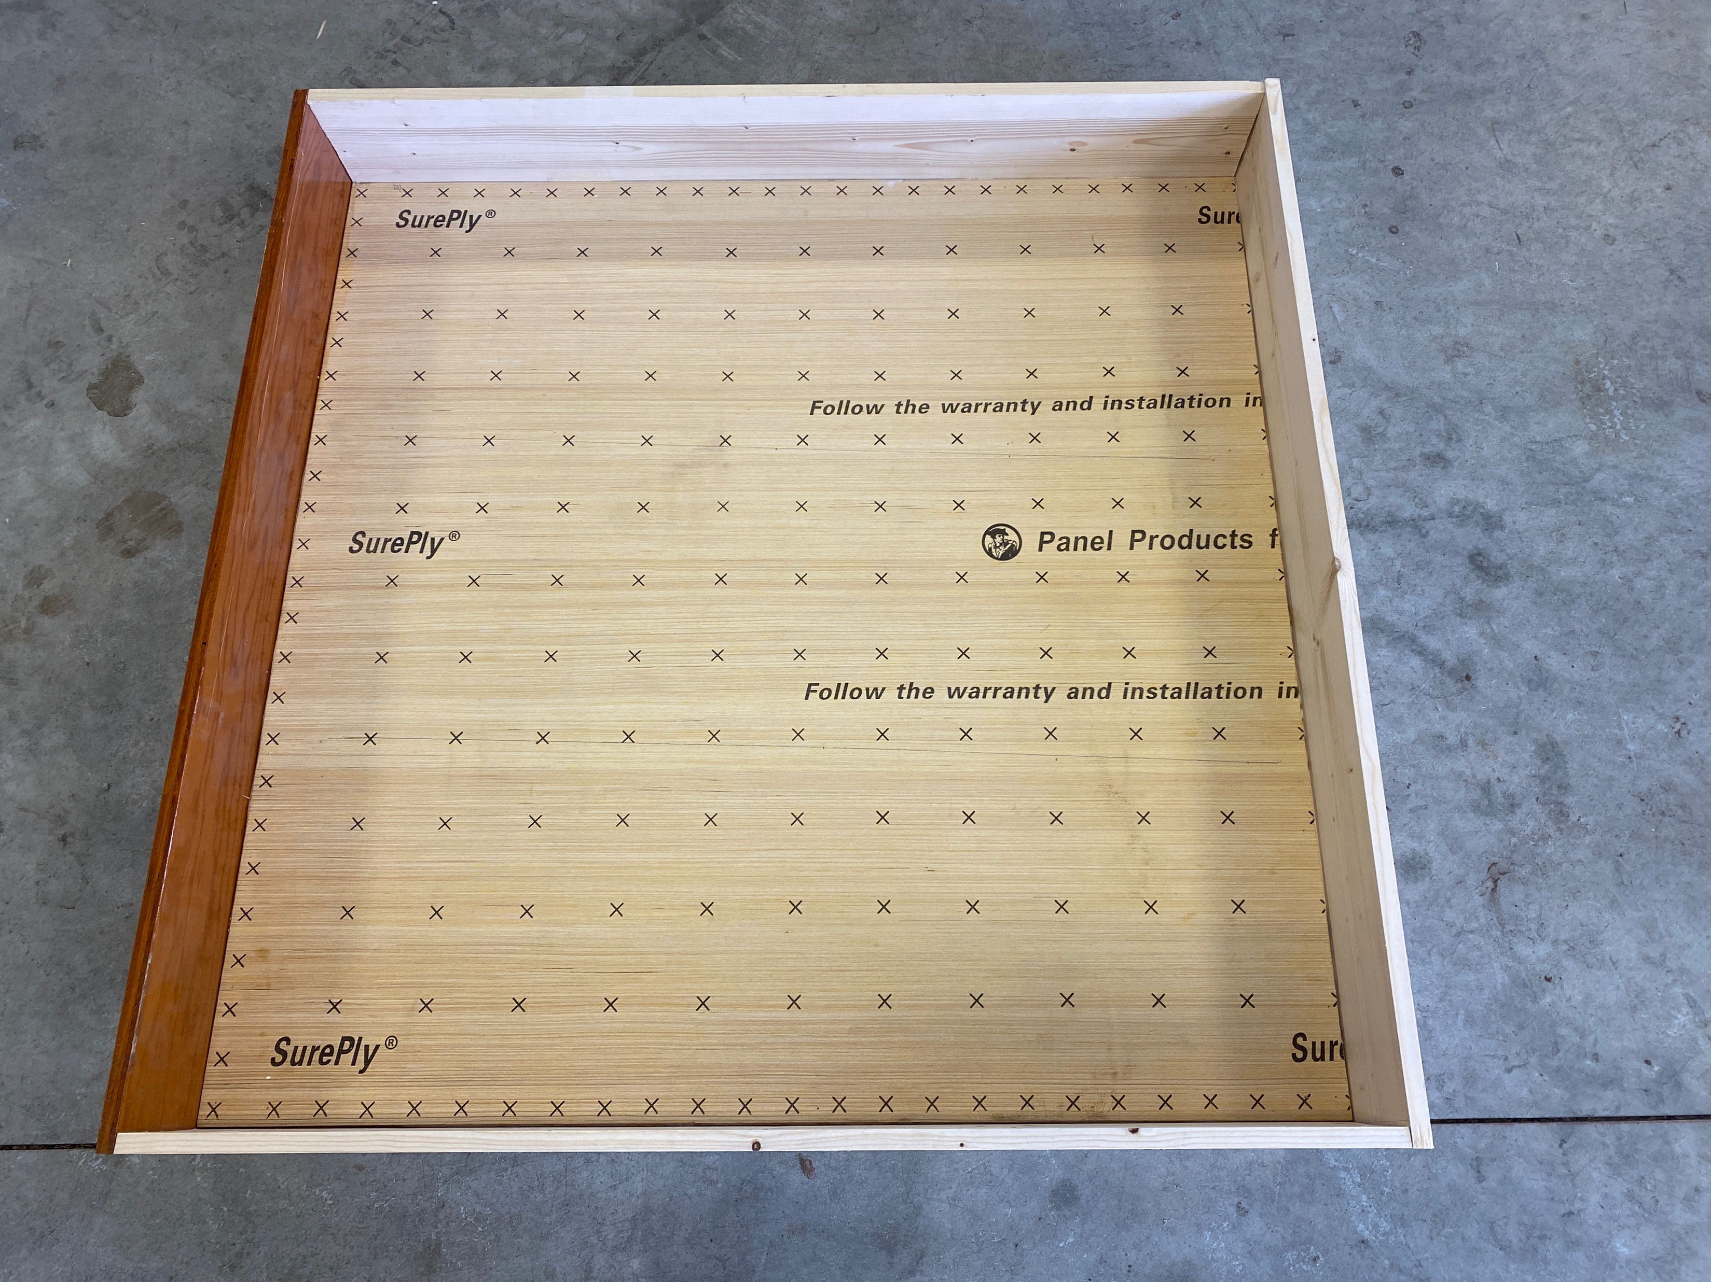

Slide 7
There are four baskets. Dimensions of those baskets are in the table below.
No. of baskets | Color | Height | Hoop diameter | Arm Length
Basket 1 | Red | 6 1/8 in | 3.5 in | 5.25 in
Basket 2 | Blue | 10 1/8 in | 4 in | 5 in
Basket 3 | Yellow | 6 1/8 in | 4 in | 5 in
Basket 4 | Green | 10 1/8 in | 3.5 in | 5.25 in
Adjust 2” x 2” basket stands as required to match total height requirements in the table.
Cut hoops from 1” x 6” material
Attach hoops to basket stands with glue and nails/screws.
Attach basket assemblies to walls with (2) bolts and wing nuts
Make line between baskets with a ¾” black line of tape or paint
hoop inside diameter
per table
Height per table
hoop arm
length per table

Slide 8
