Slide 1
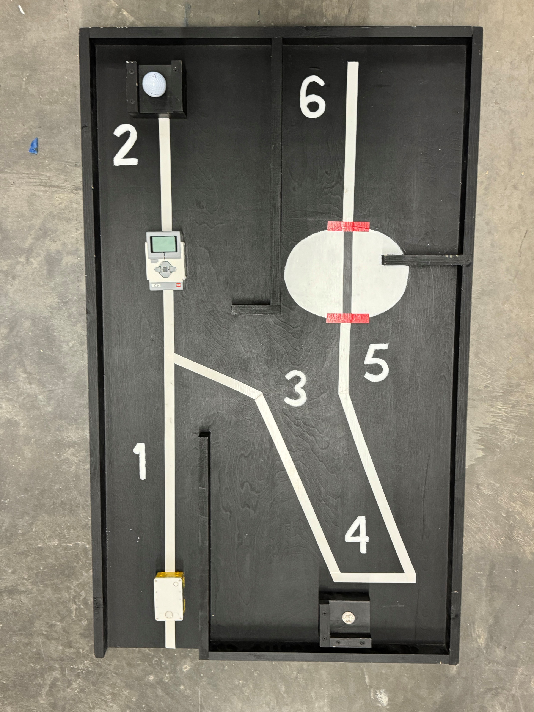
Mining Madness
Story:
Steve has had a tough time in the mines lately. On his last expedition, he lost his lucky helmet deep underground! Now, he’s counting on you to design and build a robot that can retrieve it—so he doesn’t have to face the dangerous creepers lurking in the dark.
Steve’s helmet (a golf ball) is stuck at the end of the first tunnel. Your robot will need to recover it for him. But that’s not all! Next, your robot must squeeze through a narrow gap to get a stash of iron down from a hard-to-reach place so Steve can retrieve it later!
The mission ends with one last challenge—navigating your robot through the cave’s winding, treacherous exit and into the bright sunlight. There, Steve will be waiting, eager to get his gear back!
Play the Mission Impossible theme song to celebrate the completion of this treacherous mission.

Slide 2
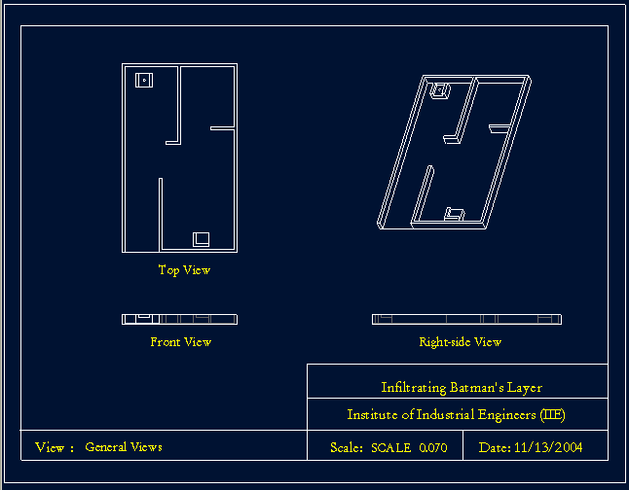

Slide 3
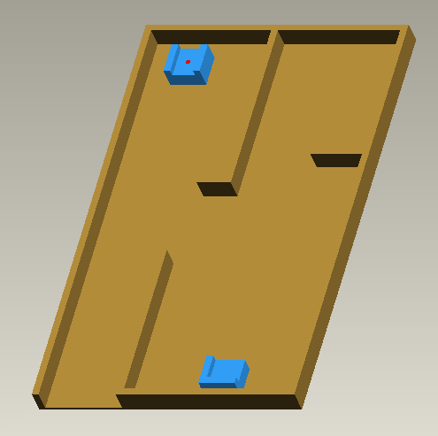
Bill of Materials:
Material | Quantity
¼”x 4’x4’ Floor Underlayment | 1
1”x2”x8’ Pine Board | 3
Black Paint # 1372400010346 | 1
White Paint # 1372400010312 | 1
Multi-Color Electric Tape | 1

Slide 4
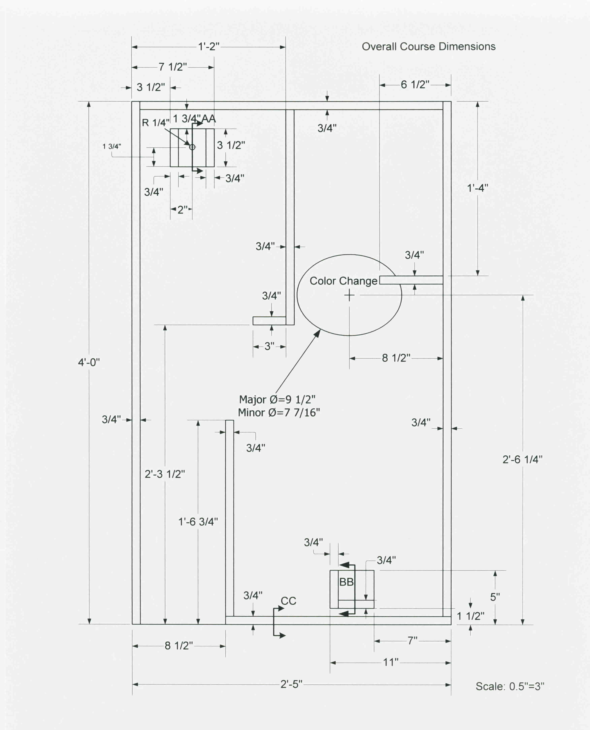
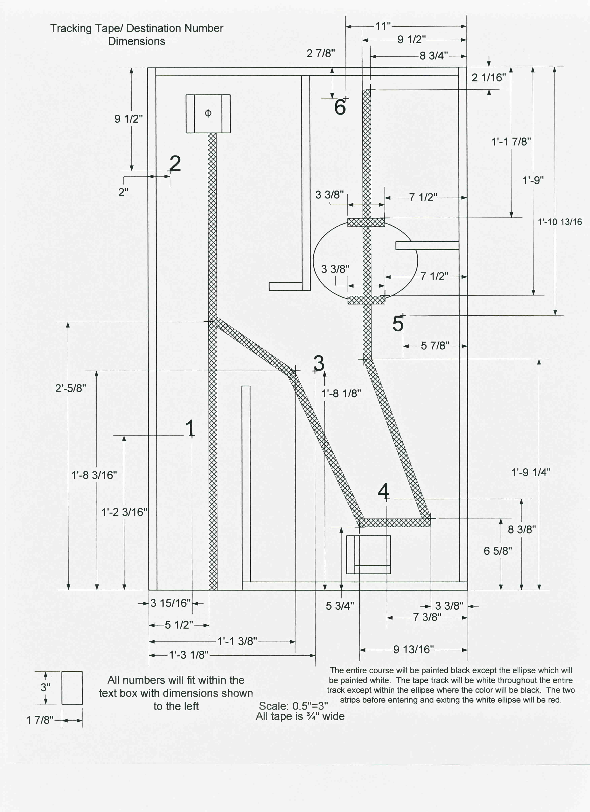

Slide 5
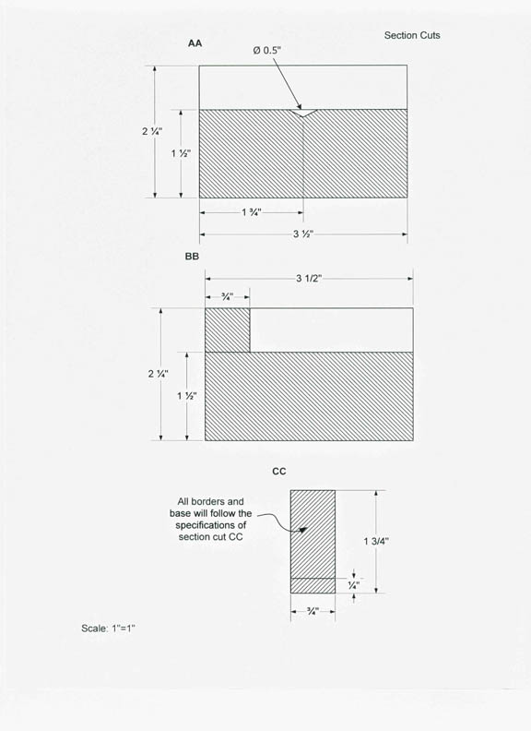
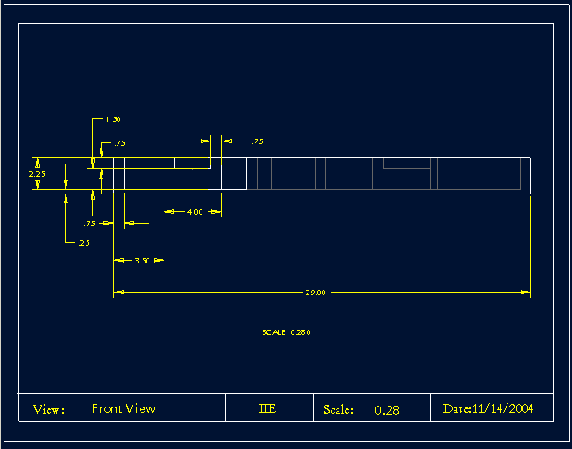

Slide 6
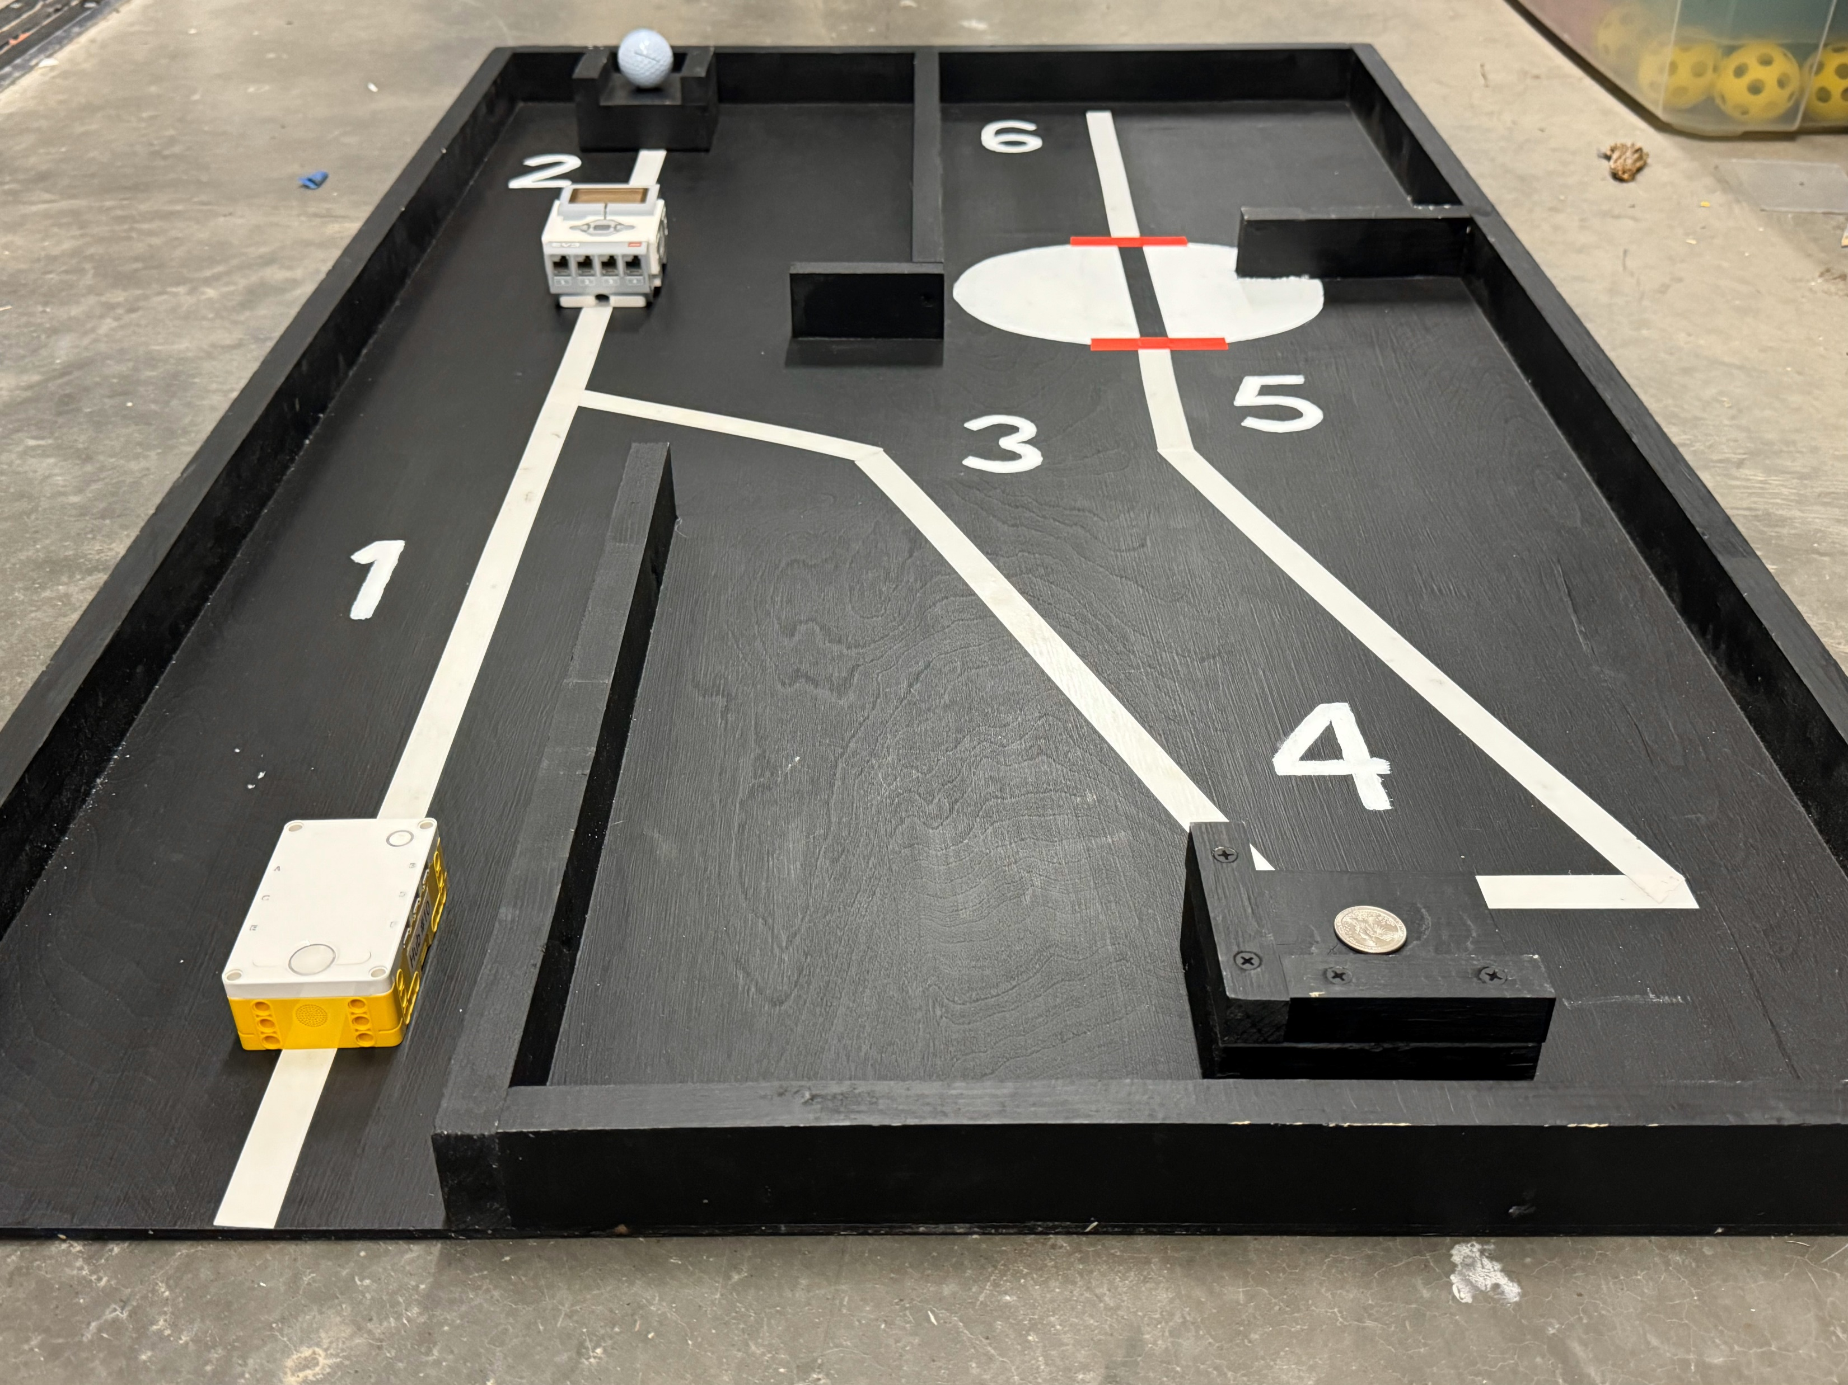

Slide 7
ACTION | POINTS
Robot must start with all touchpoints on the gym floor, completely outside of the course, facing the number “1”. | 0
Robot reaches destination “1” (touch or travel over the number) | 50
Robot reaches destination “2” (touch or travel over the number) | 50
Remove Steve’s helmet (golf ball) off first pedestal (knock table tennis ball completely off platform) | 200
Enter through the tight gap in the mines to destination “3” (touch or travel over the number) | 50
Robot reaches destination “4” (touch or travel over the number) | 50
Dislodge the stash of iron from the second pedestal (knock quarter completely off platform) | 300
Robot reaches destination “5” (touch or travel over the number) | 50
Robot enters the bright cave entrance room (all touchpoints have moved past the first red line) | 50
Robot does a spin to look for Steve (rotates 360 degrees) | 50
Robot reaches destination “6” (touch or travel over the number) | 50
Robot stops and plays the opening bars of the “Mission Impossible Theme” (D D F G D D C C#) | 100
Scoring Matrix:

Slide 8
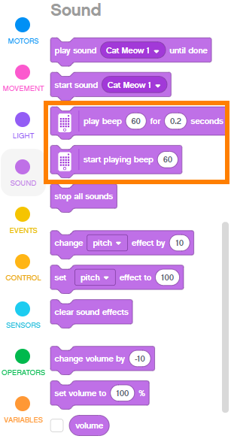
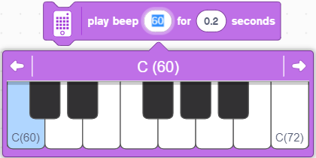
Once a beep command is in the program, you can change the tone of the beep by clicking on the tone number. This will bring up a keyboard where you select a different tone.
The “Mission Impossible Theme” can be played with the notes: D D F G D D C C#
The course must be run in order. There are two platforms which are 1 ½ inches tall. You must knock the table tennis ball off of the first platform to turn off the force field before approaching number “3”. You must knock the quarter off of the second platform before approaching number “5”.
The beep commands can be found in the Sound Category. The commands that play sounds on the Hub have the Hub Icon on the block.

