Slide 1
Can Carnage – Apprentice course 2026
Reach for the gold and knock the cans off every tower! This new for 2026 apprentice course will test your skill navigating and avoiding obstacles while also presenting a height intensive building challenge. Can you conquer the towers and make it out unscathed? We shall see!
Q&A:
Can the robot drive over the starting square without ending the run? | Yes, once the starting box has been vacated you may drive across it at any time. Final robot position at the end of the run will determine points from robot being on the starting square.
Can the robot get points for returning to the starting box without ever leaving it? | No, the robot must completely leave to get points for returning
If a can is knocked off a pillar and touches an obstacle can, does that count as obstacle being touched? | No. Cans touched by falling cans do not count for a penalty. Only physical contact between robot an obstacle can causes penalty.
Can the ending box be returned to if no cans were knocked off? | Yes
Will this course come back in future years? | That’s the plan! The intent is to change some small things each year: starting position changing, and/or new obstacle locations!
Objective | Score
Robot starts entirely within the starting box (all parts of robot within vertical plane of box)
No cans can be knocked off pillars until the robot entirely leaves the start box (any touched prior are void).
Robot knocks can off pillar #1 (8” shortest pillar) | 150
Robot knocks can off pillar #2 (10” pillar) | 250
Robot knocks can off pillar #3 (12” pillar) | 250
Robot knocks can off pillar #4 (14” tallest pillar) | 350
Robot ends run with at least one touch point in starting box (wheel or otherwise, must have left before this) | 200
Obstacle bumped (black can touched) #1 | -75
Obstacle bumped (black can touched) #2 | -75
Obstacle bumped (black can touched) #3 | -75
Obstacle bumped (black can touched) #4 | -75
Max score | 1200

Slide 2
Parts List
(1) 4’ x 8’ 5mm Utility Panel (plywood) $26.68
(1) 1” x 8” x 8’ Whitewood Board 10.29 (walls of field)
(2) 1” x 8” x 6’ Whitewood Board 16.47 (walls of field)
(3) 1” x 2” x 8’ Whitewood Board 3.84 (base support)
(3) 1” x 4” x 8’ Whitewood Board 6.24 (towers)
$63.52
Plus miscellaneous
9 soda cans with 4 cans having 3x pennies inside (for pillars) with top taped.
0x pennies in obstacle cans
Paint (color scheme has no bearing on this course, paint it how you want)
Glue/Nails/screws (as required)

Slide 3

(1) 4’ x 4’ 5mm thick plywood sheet
(2) 1”x2”x48”
(4) 1”x2”x45”
Course frame assembled with glue and nails
Underside of course view
Grid is 3” x 3”

Slide 4
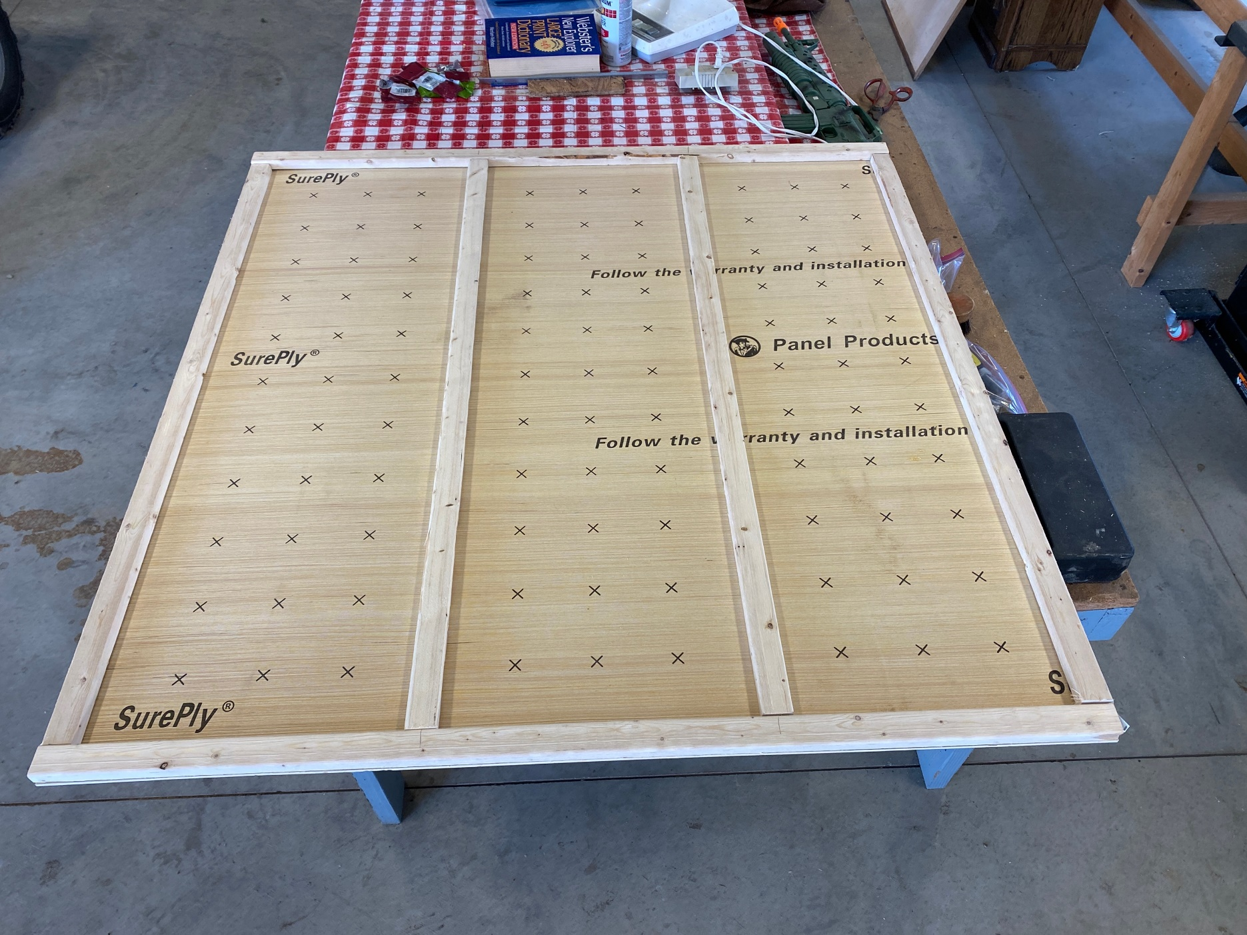
Underside of course view

Slide 5
Attach walls around base. (2) walls 48” long and (2) walls 49.5” long. All walls are 8” tall.
Recommended to pre-drill to prevent wood splitting
Grid is 3” x 3”

Slide 6
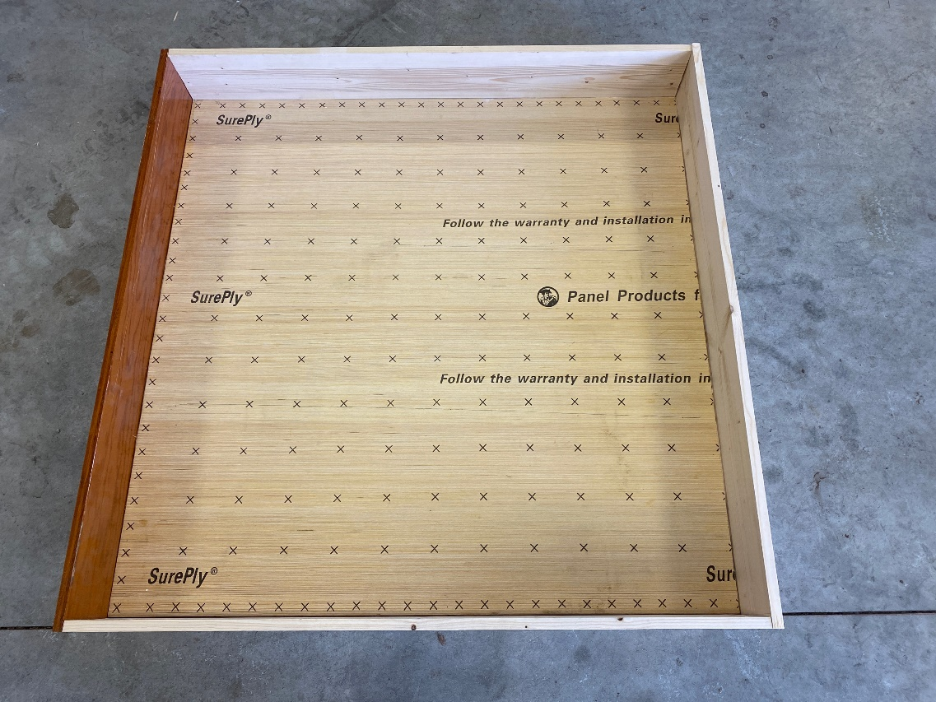
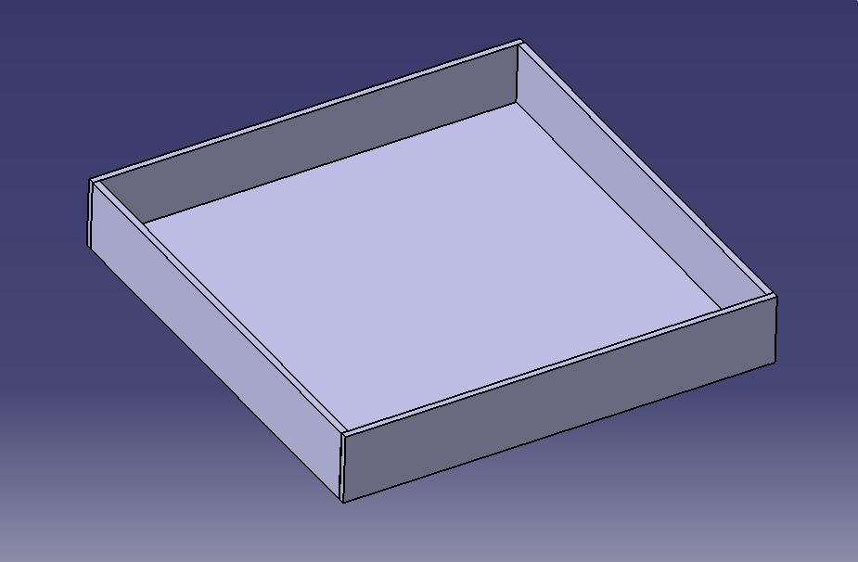

Slide 7
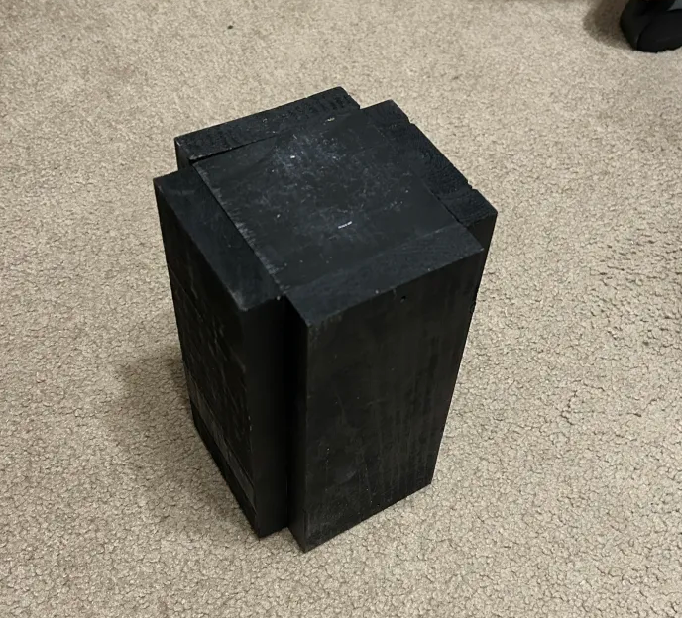
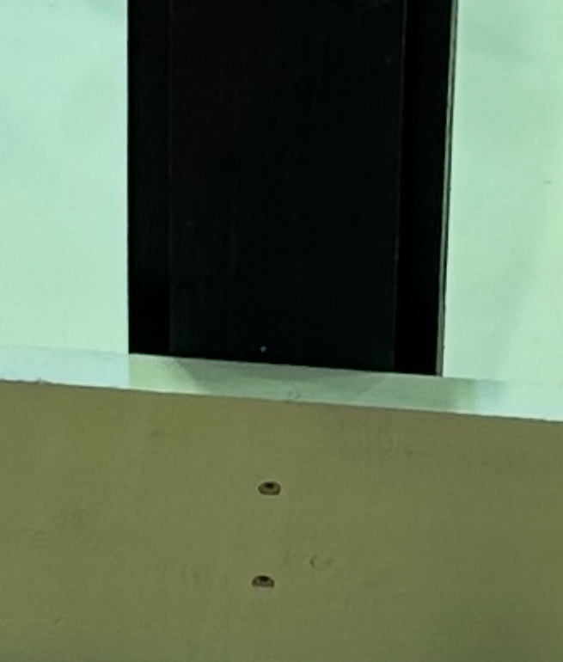
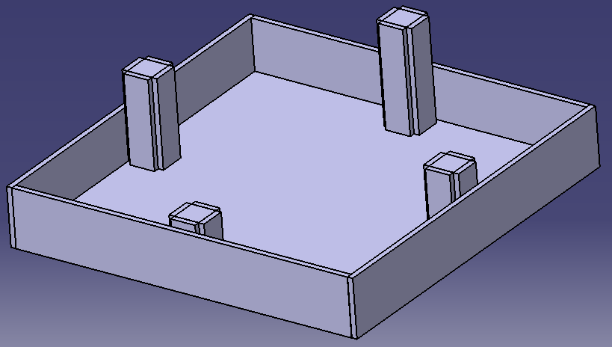
There are four towers of heights: 8”, 10”, 12”, and 14” (±1/8”)
Wood piece | QTY | Description
3.5"x3.5" | 8 | These are attached at top and bottom of each tower
3.5"x8" | 4 | Tower #1 outside structure
3.5"x10" | 4 | Tower #2 outside structure
3.5"x12" | 4 | Tower #3 outside structure
3.5"x14" | 4 | Tower #4 outside structure
All pillars made of 1”x4”x8’ pine,
Actual size: 0.75”x3.5”x8’
Towers assembled with finish nails. 1 nail on top and bottom of each longer board into the associated middle board.
Glue and/or screws should be a simple alternative to this approach if no nail gun available.
Towers are attached to middle of the walls using 2x screws

Slide 8
14”
Objective | Score
Robot starts entirely within the starting box (all parts of robot within vertical plane of box)
No cans can be knocked off pillars until the robot entirely leaves the start box (any touched prior are void).
Robot knocks can off pillar #1 (8” shortest pillar) | 150
Robot knocks can off pillar #2 (10” pillar) | 250
Robot knocks can off pillar #3 (12” pillar) | 250
Robot knocks can off pillar #4 (14” tallest pillar) | 350
Robot ends run with at least one touch point in starting box (wheel or otherwise, must have left before this) | 200
Obstacle bumped (black can touched) #1 | -75
Obstacle bumped (black can touched) #2 | -75
Obstacle bumped (black can touched) #3 | -75
Obstacle bumped (black can touched) #4 | -75
Max score | 1200
12”
10”
Starting box 12”x12”
8”
Obstacle locations
(may change each year)
Grid is 3” x 3”

Slide 9
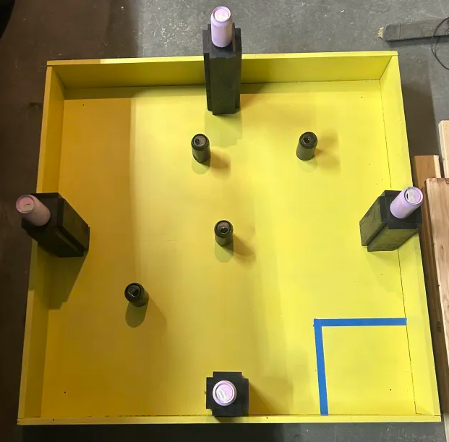
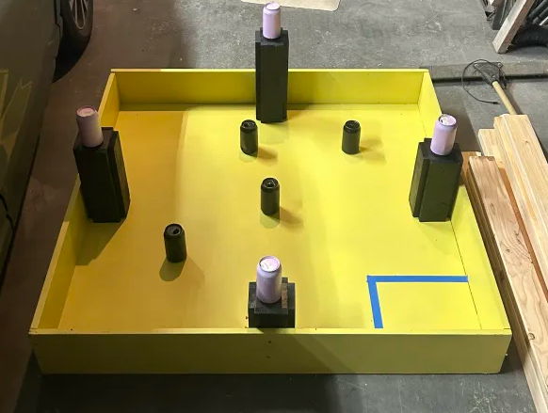
2026 Layout (reference only, slide 8 is the controlling diagram)

