Slide 1
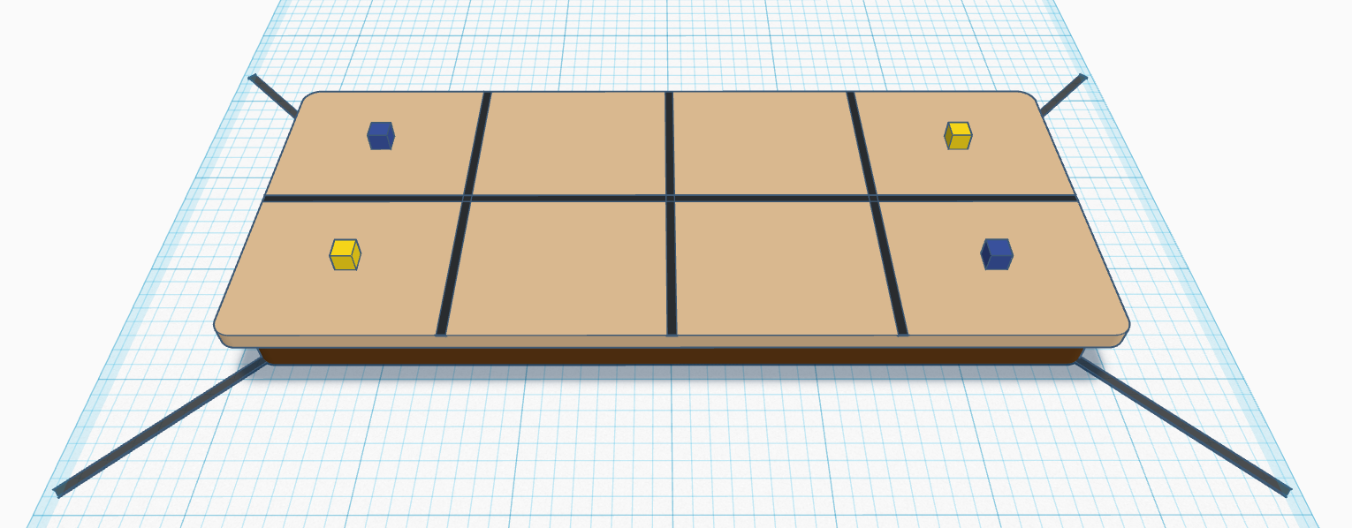
Over the Edge
Bill of Materials:
6’ x 2.5’ folding table (or similar size)
¾” Black electrical tape
1.75” wooden cubes (x4)
(Tip: Put the table on the floor without unfolding the table legs. Your robot will still have an edge to feel, but if it falls off the edge, it will be a much shorter distance to the ground.

Slide 2
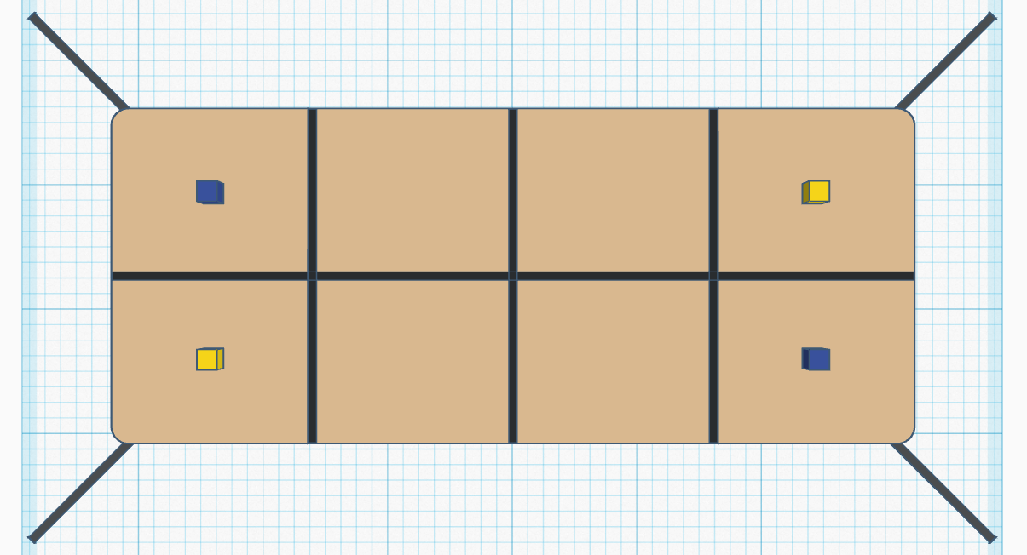
30 in
15 in
18 in
36 in
54 in
72 in

Slide 3
9 in
7.5 in
Center the cubes in each of the four outer sections.

Slide 4
Scoring Zones
Zone 1
Zone 4
Zone 2
Zone 3

