Slide 1
University Finance Faculty Senate
February 2026

Slide 2
Common Questions on University Finances

Slide 3
HOW IS CAMPUS GUIDANCE ON THE BUDGET ACHIEVED?
Budget Advisory Committee
Meets at least monthly from December to May/June
A lot of effort to facilitate transparency on campus regarding the financial framework
Includes a representative from each college, including 3 Deans
Not a silo…committee representatives are charged with sharing what they hear with the area of the university they represent, and sharing what they hear back to the committee

Slide 4
WHO MAKES UNIVERSITY FINANCIAL DECISIONS?
SGF General Operating & Tuition – 20% of Total FY 2026 Budget
Budget Office establishes the budget development framework through divisional targets after considering:
Enrollment expectations as provided by the Tuition Estimating Team
State funding implications
Tuition rate expectations
Mandatory inflationary impacts
Priority funding needs
Each division then has the authority to decide how best to meet their assigned target with the VP coordinating with their direct reports
Shared with Budget Advisory Committee and Published in the Annual Operating Budget

Slide 5
WHO MAKES UNIVERSITY FINANCIAL DECISIONS?
The Rest of the Budget – 80% Includes College Course Fees, SGA Student Fees, Foundation Funds, Auxiliaries (Housing & Parking), Research Revenue, Research Indirects, and EBF
Controlled, managed, and appropriated by the receiving Division/College/Department
Overall Budgetary and Financial Decisions are Made by 651 Budget Officers and 68 Review Officers
Budget Office normally has one week from receipt of budget submissions to finalize the budget and load in banner for the next fiscal years payroll

Slide 6
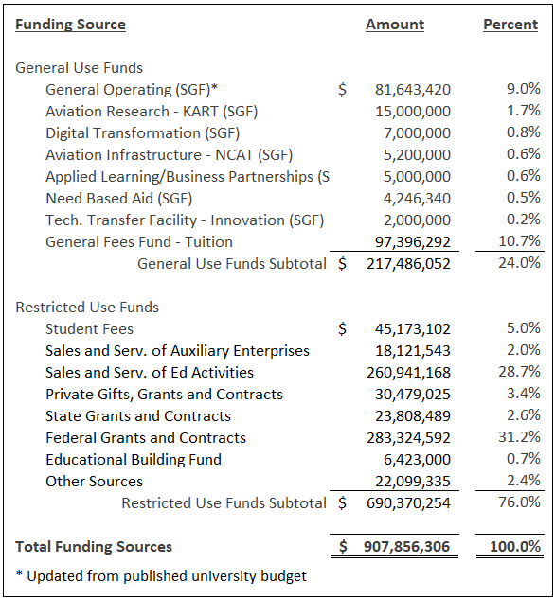
HOW IS THE BUDGET STRUCTURED?
TOTAL GENERAL USE OPERATING and TUITION RESOURCES: $177.4M
SGF General Operating Grant: $81.6M
Tuition: $97.4M
ALL OTHER RESOURCES: $728.7M
Student Fees - $45M
SGA Student Fees - $10.1M
Health & Wellness / Athletics - $7.5M
Other Student Fees - $27.5M
Industrial Research

Slide 7
WHAT BUILDINGS HAVE BEEN FUNDED WITH SGF & TUITION REVENUE?
The only recent capital campus construction using GU support (Tuition or SGF) include:
Woolsey Hall
Shocker Success Center (partially funded with student fees)
Hub for Advanced Manufacturing and Research (HAMR) – Federal Grant and Research Funds
BioMed Center – Federal and State Grants, Donations
Digital Research and Transformation Hub (DIRTH) – Board of Trustees
University Stadium – Board of Trustees, Local Partnerships, Donations
Softball Indoor Practice Facility – Board of Trustees, Donations

Slide 8
HOW IS THE BOARD OF TRUSTEES STRUCTURED?
Board of Trustees is established through state statute, with the 9 Member Board Appointed by the Governor
The university does not have the ability to direct or control the decisions made by the Board.
1.5 Mill Local Property Tax Levy
$11.5M Budget
$5.5M Student & Workforce Development Support (Scholarships & PPMC GRAs)
$4.3M Debt Service
$526K Economic & Community Development (City/County Services & Interns)
$1.0M General Board Initiatives (Dental School Study)

Slide 9
What Are the University’s Fundamental Revenue Issues

Slide 10
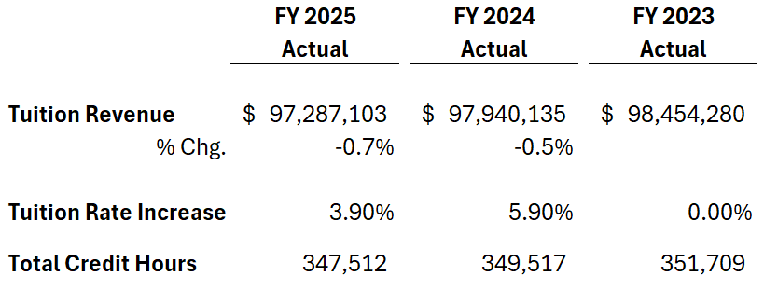
STAGNANT TUITION REVENUE
Even with tuition rate increases, tuition revenue declines
Driven by significant declines in international students

Slide 11
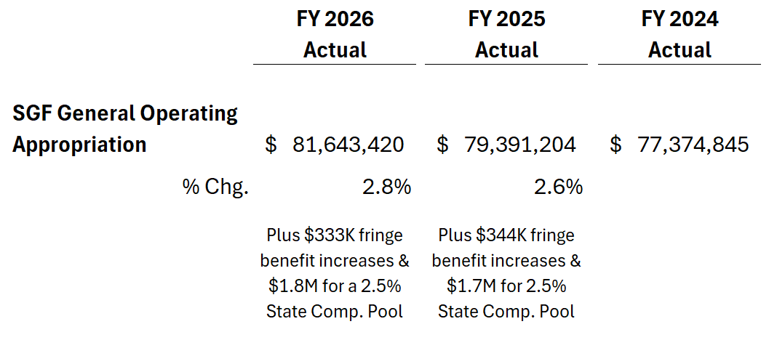
STAGNANT SGF GENERAL OPERATING SUPPORT
SGF General Operating Support is also Stagnant
Recent funding increases dedicated to offsetting fringe benefit increases & compensation increases only…no additional funding for inflationary impacts

Slide 12
What is the University’s Tuition & SGF General Operating Expenditure History

Slide 13
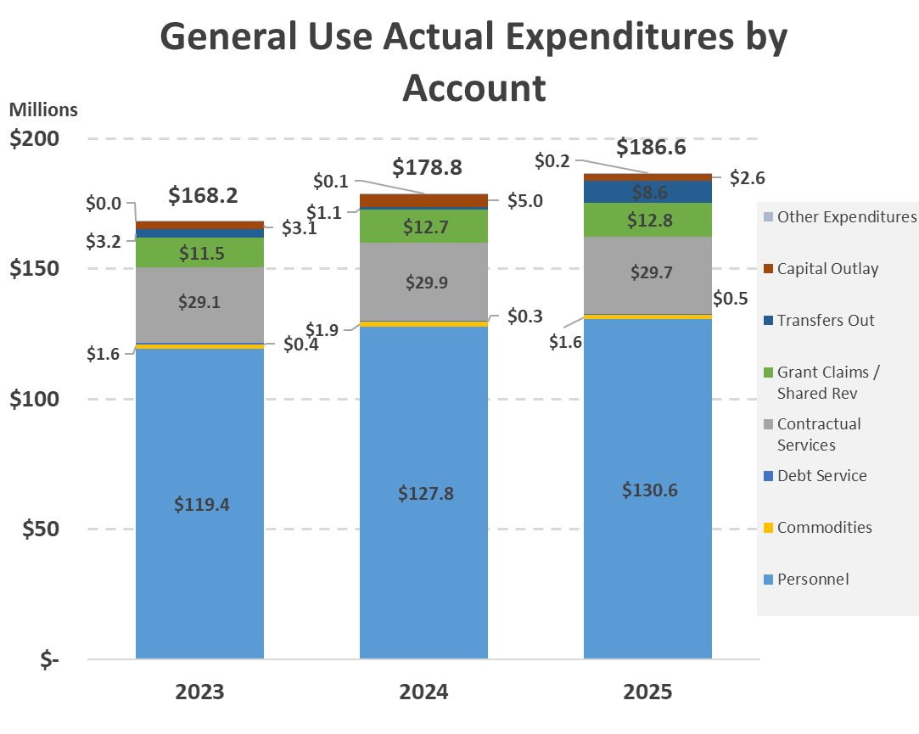
TUITION & SGF GENERAL OPERATING EXPENDITURES
Growth in personnel costs in 2024 w/ 2.5% across-the-board & market-based comp. adjustments & 11 FTE increase in Academic Affairs (NISS)
FY 2025 contribution to Athletics

Slide 14
TUITION & SGF GENERAL OPERATING EXPENDITURES
FY 2024 growth in Academic Affairs
FY 2025 contribution to Athletics thru Admin., Finance & Operations

Slide 15
TUITION & SGF GENERAL OPERATING EXPENDITURES
Consistent growth across all program areas

Slide 16
What are the Key Driver’s of the FY 2027 Budget Reduction

Slide 17
WHAT ARE THE KEY DRIVER’S OF THE FY 2027 GU BUDGET REDUCTION?
Stagnant Revenue:
Student mix from projected declines in international students (UG – 10%/GR – 35%) - $2,606,407
SGF General Operating Support reduction of 3% - $2,449,303 (House proposing 2.5% currently)
Tuition increase of 4% Modeled - $3,781,413 (House proposing no increases)
Fringe Benefit increase - $591,522
Net Difference of $(682,775)

Slide 18
WHAT ARE THE KEY DRIVER’S OF THE FY 2027 GU BUDGET REDUCTION?
Impact of Inflation, Maintenance Needs, & Strategic Investments
Inflationary increases (ex: fringe benefit costs, insurance, software, leases) - $2,359,859
Promotions in Academic Rank & Tenure - $300,000
Internal Auditor - $104,000
Institutional Scholarships - $200,000
NIHSI Executive Director - $300,000
WBC Operating Expenses - $1,250,000
Athletics Operating Support - $1,000,000
Athletics Capital Needs (Koch arena roof & HVAC expansion tank, Eck elevators) - $1,623,434
Total of $7,137,293

Slide 19
WHAT ARE THE KEY DRIVER’S OF THE FY 2027 GU BUDGET REDUCTION?
Minimum 3% Reduction Early December included:
Inflationary Increases
Promotions in Academic Rank & Tenure
Internal Auditor
Institutional Scholarships
NIHSI Executive Director
WBC Operating Expenses
Athletics Capital Needs
Fringe Benefit Increases
3% Tuition Increase Modeled
7% Reduction in January
Impact of International Student Enrollment
State Reduction – 3%
Athletics Operating Support
4% Tuition Increase Modeled

