Slide 1

February 9, 2026
Budget
Monica Lounsbery, Senior Executive Vice President and Provost

Slide 2
GENERAL OPERATIONS BUDGET
Encompasses primarily the teaching, research, and service enterprises and the support systems that enable these things including physical plant, security, business and admin structure, student support services, marketing, IT, and operating
Funding sources SGF operating grant, tuition, and fees
Research is significantly funded by general operations but is supplemented by grants, contracts, and foundation funds
Foundation funds can, but do not always, supplement general operation costs; specified by the donor agreement
Student services budget can be and is supplemented by specific state funding (e.g., NISS, paid applied learning funding, etc.)
When there is budget deficit in general operations, it means our expenditures in operations have exceeded our budget.
The unknown revenue that informs our budget is related to student enrollment.
headcount enrollment
volume of student credit hours
tuition rate students pay

Slide 3
UNIVERSITY GENERAL OPERATIONS BUDGET
SGF Operating Grant is the funding WSU receives from the state for general operating.
It has remained unchanged with the exception of cost-of-living increases (e.g., 2.5% increase for FY26)
FY26 SGF operating budget: $80M
Tuition is revenue from enrolled students and is paid by credit hour.
Revenue is a function of how many student credit hour units students enroll in and the tuition rate
WSU has many tuition rates for specialized programs, in-state, out-of-state, and international students.
FY26 budget from tuition revenue: $97.4M
Colleges, programs, and courses charge enrolled student fees.
FY26 budget from fees: $19.8M
SGF + tuition + fees = TOTAL general operating funding – FY26 $197.2M
Key challenges
General operating personnel expenses are $130.6M — exceeding SGF funding by more than $50M.
WSU must rely on tuition and fees to make up the gap
3
Notes:
Startup packages. 3 covered by central at $695K over 3 years and 5 covered by Engineering or $$3.5M.

Slide 4
KEY AA BUDGET INSIGHTS
Ability to charge students fees created flexibility in RU funds for colleges and departments, but it also resulted in higher and sometimes hidden student costs.
In some colleges, budgets expenditure plans are based on 100% of projected tuition and fee revenue.
In at least one case, budget expenditure plans were not corrected once actuals were known to be less than the projected budget
Years of previous budget cuts were addressed by moving expenditures to RU fee budgets. RU fee budgets are now oversubscribed
Expenditures have risen due to rising inflationary costs; and in some instances, there has been growth in new expenditures
Notes:
X

Slide 5
MOVING FORWARD
Moved to a centralized academic affairs-wide budgeted plan for hiring faculty
Dissolution of college and program fees and development of strategic university-wide streams of revenue – growth in high enrollment demand programs, summer term, short-term career path programs, tech transfer and commercialization (NIHSI)
Movement to a formula-driven budget comprised of base-budget and an incentive-budget components
Optimal deployment of personnel with possible implementation of differentiated staffing and shared services models
Standardized budgeting program with training and monthly meetings with college finance leaders
Quarterly touch-base meetings with all college leadership teams and budget office
Academic college fundraising targets and specific targets for endowed faculty positions and GAs

Slide 6
Enrollment Management – A Key to Greater Budget Opitimization

Slide 7
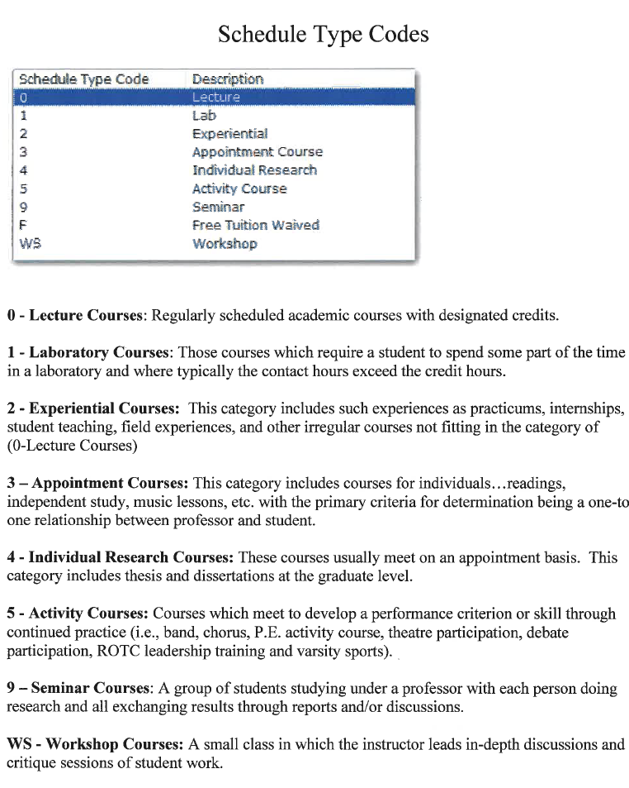
KBOR Defined CRN Types

Slide 8
WSU MINIMUM COURSES CAPS
 | Dean Recommendation | Minimum Standard Course CAP, 100-699 level courses | Minimum Standard Course CAP, 700-999 level courses
Lecture | 25-30 | 30 | 25
Lab | 30 | 22* | 12*
Experiential | 10-15 | 10 | 10
Appointment | Related to workload | 5 | 5
Individual Research | Related to workload | 5 | 5
Activity Course | -- | 10 | 10
Seminar (graduate level only) | 10 | -- (graduate level only) | 10 (graduate level only)
Workshop | -- | 5 | 5
* Caps in labs constrained by equipment, room occupancy, & safe operation requirements should be noted in CLSS.

Slide 9
Push for Growth in Student Enrollment
Additive model
Growth in new courses
Growth in programs
Do we have more program and course options than we have students?

Slide 10
Growing Course Sections
When there is growth in course sections, it grows workload and it grows cost.
Growth in course sections, have collective financial impact university-wide.
If we want to realize financial stability, we need to get a handle on the volume of course sections that we are offering.
It’s the single largest thing we can do to cut costs.

Slide 11
Course Offerings and Student Enrollment
Spring 2025
3,262 CRNs of which 60.8% were below 80% fill rate.
1,760 lecture CRNs of which 53.2% were below 80% fill rate.
Fall 2025
3,346 CRNs of which 50.9% were below 80% fill rate.
1,900 lecture CRNs of which 41.6% were below 80% fill rate.

Slide 12
Part-Time Lecturer Salary Expenditures = $3,632,762
Additional Compensation
= $3,431,650
Total: $7,064,412
Additional Instructional Workforce Costs in FY 25

Slide 13
AA BUDGET CUT PLAN
AA requires a $5.4 M cut.
We will take a strategic approach to meeting this cut rather than an across the board 7% cut.
$600K in vacated staff positions will not be replaced.
All units have presented specific plans and some of those ideas will be implemented including moving GU fund expenditures to RU.
All units in AA have been charged with examining structural optimizations and efficiencies to identify administrative, operating, staffing, and operating cost savings. Plans are due to the provost office on March 1.
Most cuts will come from a concerted effort to reduce the volume of CRNs that do not meet an 80% fill rate.
Reduction in instructional additional compensation and lecturer hiring pool

Slide 14
Questions?

