Slide 1
Notes on AI and our LMS
John Jones - Ex. Dir. Media Resources Center

Slide 2
High-Level Notes
Blackboard is safe, including the new AI tools
We are in Blackboard for a variety of reasons; when appropriate we will conduct an LMS review
A network of professionals protects the university, our students and our data from potential threats

Slide 3
Data Management Committee

Slide 4
Members of the DMC
C-Suite Compliance Officers
Chief Data Officer (Moderator) - David Wright
Chief Information Officer – Ken Harmon
Chief Information Security Office – Mark Rodee
Chief Privacy Officer – Gina Riggs
Coordinating Development And Advisory Bodies
Academic Affairs – Ashlie Jack
Registrar – Gina Crabtree
Financial Aid – Sheelu Surender
Admissions – Bobby Gandu
International Education – Vince Altum
General Counsel – Misha Jacob-Warren
Financial Operations – Troy Bruun
Industry and Defense Programs - Karen Davis
Human Resources – Karen Davis
Media Resources Center – John Jones

Slide 5
DMC Workflow
Notes:
The DMC meets twice a month most months, and for the past several years has reviewed a wide variety of tools and software for campus use. It’s important to know that last fall the OIR team brought the new AI tools in Blackboard for review, and the tools were approved for use.
We will be even taking existing tools that we have existing relationships with to the DMC when they are renewed so that the DMC has a chance to review and understand all of these relationships over time.

Slide 6
AI Tools in Blackboard

Slide 7
Generative AI Tools in Blackboard
Name | Function | Input | Who uses | Where is data transmitted
Generate Learning Modules | Provide a structure for a class | Name of the course. Any description added in the tool by the professor | Professor | Microsoft servers (held no longer than 30 days. No data is used to train, retrain, or improve Microsoft's generative AI models.
Generate Learning Module Images | Easy, customized images for learning modules | Name of module. Any description added in the tool by professor. | Professor | Microsoft servers (held no longer than 30 days. No data is used to train, retrain, or improve Microsoft's generative AI models.
Generate Content Editor Images | Provide images to illustrate instructor-provided documents | Instructor provided document | Professor | Microsoft servers (held no longer than 30 days. No data is used to train, retrain, or improve Microsoft's generative AI models.
Generate Test questions and Question Banks | Provide editable questions covering instructor-provided content | Instructor provided document | Professor | Microsoft servers (held no longer than 30 days. No data is used to train, retrain, or improve Microsoft's generative AI models.
Generate Keywords for Unsplash | Supports finding appropriate images from the Unsplash (real image) index | Module name | Professor | Microsoft servers (held no longer than 30 days. No data is used to train, retrain, or improve Microsoft's generative AI models.
Generate Rubrics | Provide and editable, customizable rubrics for assignments/assessments | Name of the assignment | Professor | Microsoft servers (held no longer than 30 days. No data is used to train, retrain, or improve Microsoft's generative AI models.
Generate Jounal, Discussion, Assignment prompts | Provide editable prompts for assignments. Prompts based on Bloom's Taxonomy. | Name of assignment. Instructor provided description. | Professor | Microsoft servers (held no longer than 30 days. No data is used to train, retrain, or improve Microsoft's generative AI models.

Slide 8
Terms & Conditions
Notes:
Often the Terms and conditions that a company has for the free, public use of a product is very different from what we have with them when we are paying for a service, and that is especially true in the case of Copilot.
I want to show you an example that we happened to have at hand.

Slide 9
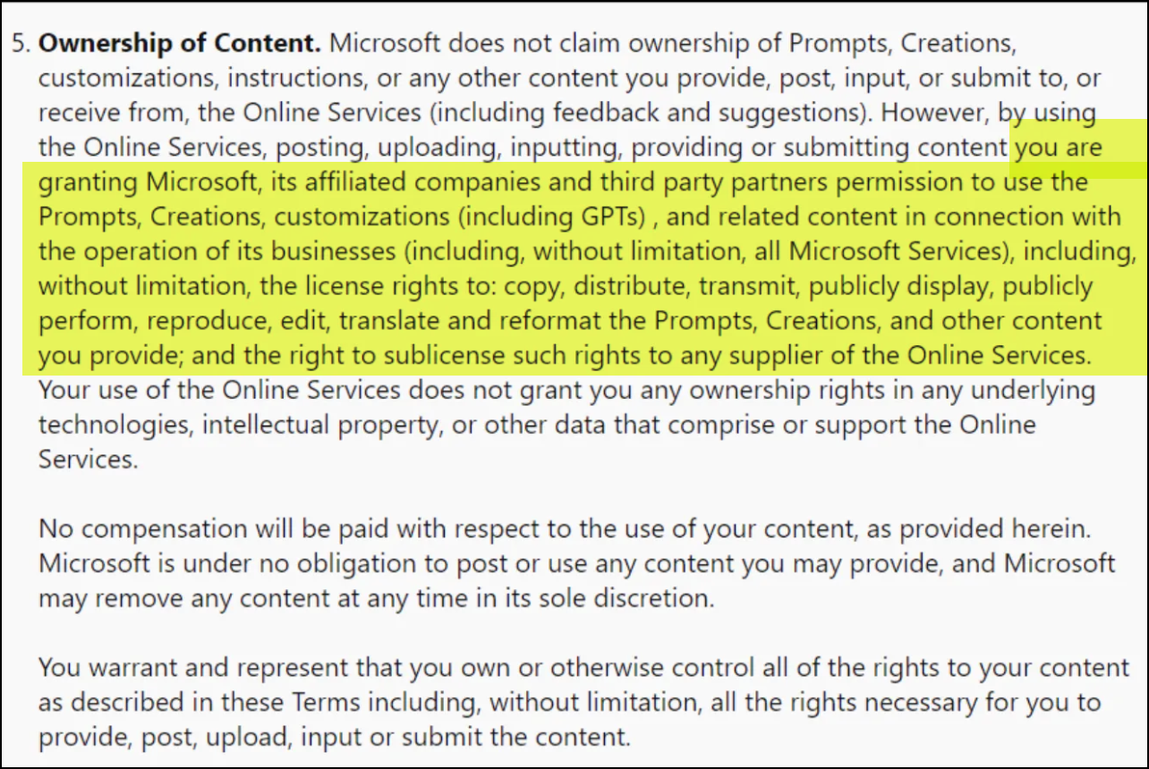
Copilot Public T&C
Notes:
Here’s an excerpt from the terms and conditions for Copilot for public use – these are the terms that users agree to when they use the free versions of copilot or bing. I want to especially focus on the highlighted passage – look at what you are giving away. You are granting Microsoft, it’s affiliated companies and third party partners permission to use the Prompts, Creations, customizations (including GPTs), and related content in connection with the operation of its business (including, without limitation, all Microsoft Services), including, without limitation, the license rights to copy, distribute, transmit, publicly display, publicly perform, reproduce, edit, translate, and reformat Prompts, Creations, and other content you provide; and the right to sublicense such rights to any supplier of the Online Services.” This is pretty broad – anything we put into Copilot or that is a product of our interaction with MS is theirs.

Slide 10
MS Copilot T&C for our Protected use:

Slide 11
Questions?
John Jones | john.jones@wichita.edu | 316-978-7751

