Slide 1
Faculty Senate 2023 Office of Civil Rights, Title IX & ADA Compliance (CTAC)

Slide 2
Dr. Courtney McHenry
Associate Vice President
&
University Title IX Coordinator
Higher Ed:
West Virginia University (WVU)
Florida State University (FSU)
FL International University (FIU)
Florida A&M University (FAMU)
Non-Higher Ed:
City of Columbus, OH
USIS/OPM
Pasco County Sheriff’s Office
Orange County Department of Corrections

Slide 3
WARNING

Slide 4
What We Do
CTAC reviews and responds to allegations of violation of university policies relating to Equal Opportunity law, Title IX regulations, and ensures compliance with ADA accessibility guidelines.

Slide 5
Title VII of the
Civil Rights Act of 1964

Slide 6
Conduct Addressed
Discrimination
Harassment
Retaliation

Slide 7
Protected Classes - Title VI & Title VII
Age
Ancestry
Color
Disability
Gender
Gender Expression
Gender Identity
Genetic information
Marital Status
National Origin
Political Affiliation
Pregnancy
Race
Religion
Sex
Sexual Orientation
Veteran Status
Retaliation

Slide 8
Title IX of the Education Amendments of 1972

Slide 9
Conduct Addressed – Title IX
Sexual Harassment
Sexual Misconduct
Sexual Assault, Fondling
Sexual Exploitation
Dating/Domestic Violence
Stalking

Slide 10
Jurisdiction Under Title IX
What is your understanding of CTAC’s jurisdiction under Title IX?

Slide 11
Jurisdiction Under Title IX Cont’d
Dear Colleague Letter – In the U.S.
Final Rule – On Campus
2023 Proposed Changes – In the U.S.

Slide 12
Confidential Resources
WSU has several confidential resources when it comes to reporting Title IX matters. Which of these are confidential resources? Select all that may apply.
Counseling and Prevention Services (CAPS)
Student Health Center
Athletic Trainers
Ordained Clergy acting in their Pastoral role
University Ombudsperson
Answer: All of the Above

Slide 13
Initial Report to CTAC
wichita.edu/ctac

Slide 14
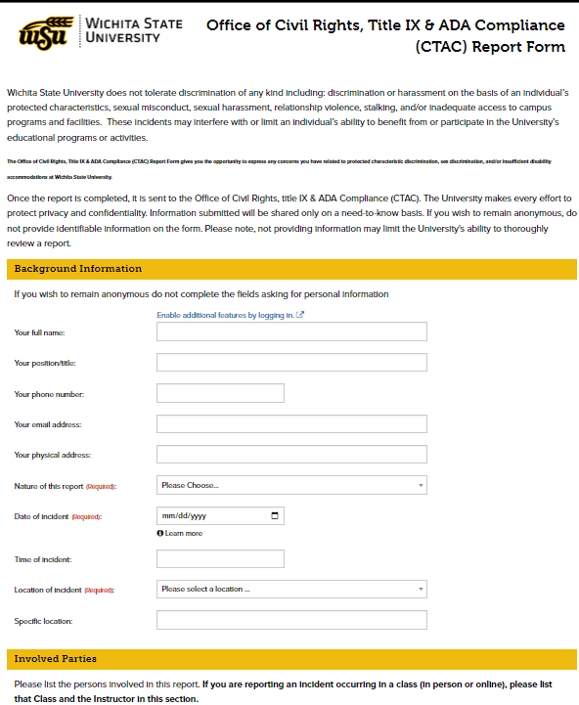
Report to CTAC
Complaints may be filed electronically, in person, or over the phone.
Online report form:
wichita.edu/ctac

Slide 15
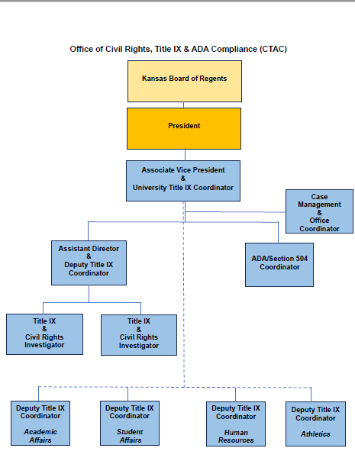
CTAC Organizational Chart

Slide 16
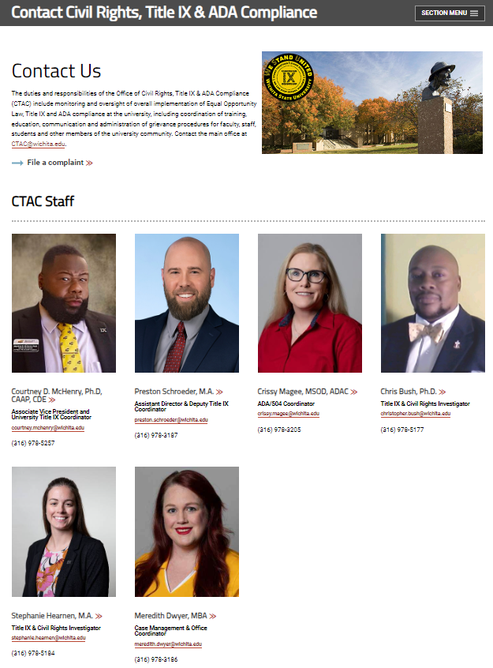
CTAC Staff

Slide 17
New Annual Training…

Slide 18
Catharsis
Students
U Got This! – Undergrads, three modules (each module is about 15-20 minutes) – about 45-60 minutes in total length
U Got This 2! – for grad students, one module about 35-40 minutes in length *This course has been approved for our athletes as well.
Employees
Report = Support – A Title IX program for employees – about 40 minutes in length
Refresher
Students and Employees about 25-30 minutes in length
Informal Resolution
Culture Matters – a workplace harassment program for employees – about 60 minutes in length

Slide 19
“What else is new?”
Collaborative Training
DEI and CTAC
ADA and ODS

Slide 20
CTAC Contacts
Courtney D. McHenry, Ph.D., CAAP, CDE
Associate Vice President
University Title IX Coordinator
courtney.mchenry@wichita.edu
(316) 978-5257
LINDQUIST HALL
SUITE 208
Preston Schroeder, MA
Assistant Director
Deputy Title IX Coordinator
preston.schroeder@wichita.edu
(316) 978-3187
Crissy Magee, MSOD, ADAC
ADA/504 Coordinator
crissy.magee@wichita.edu
(316) 978-3205

Slide 21
CTAC Contacts
Stephanie Hearnen, M.A.
Title IX & Civil Rights Investigator
stephanie.hearnen@wichita.edu
(316) 978-5184
LINDQUIST HALL
SUITE 208
Chris Bush, Ph.D.
Title IX & Civil Rights Investigator
christopher.bush@wichita.edu
(316) 978-5177
Meredith Dwyer, MBA
Case Management & Office Coordinator
meredith.dwyer@wichita.edu
(316) 978-3186

Slide 22
Questions?

