Slide 1
Student Early Alert System (SEAS) Report to Faculty Senate 4.28.25

Slide 2
SEAS
As a reminder:
SEAS is the electronic tool for instructors to give timely feedback to students who may be in danger of failing a class.
System is open for instructors to use for all students (including graduate students) for the entire semester.
Best practice is to flag students during the first half of the semester, so they have time to modify their behavior if needed.
Feedback can be given on attendance, participation, assignments, and quizzes/exams to students in each of their current classes.
Instructors are nudged through e-mail during weeks 1, 3, 5, 8, 11, and 14 to place, adjust, and/or remove flags.

Slide 3
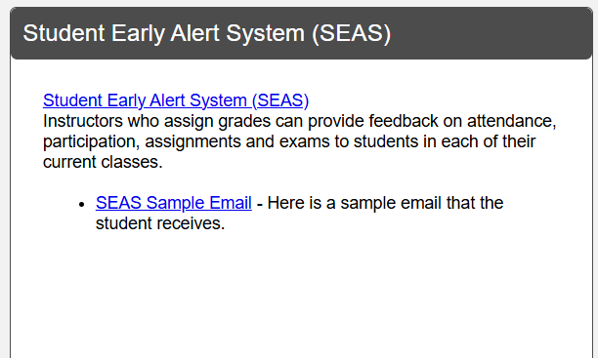
Accessing SEAS
On myWSU

Slide 4
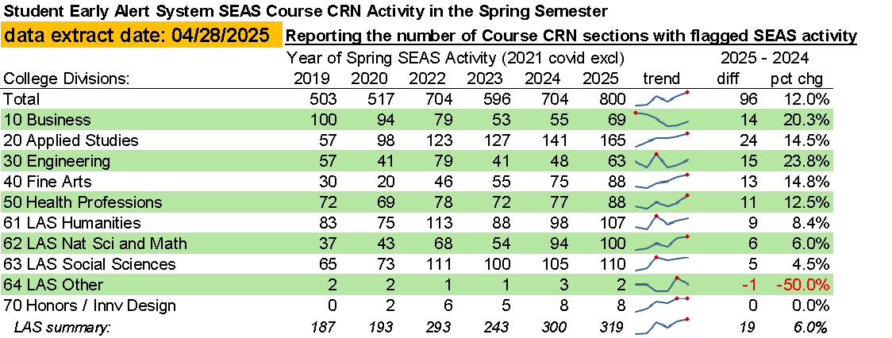
SEAS Activity
Notes:
In comparing today's report with the 03/11/2025 report, went from 37 more CRNs for a 6.3% gain from last year to this year, to 76 additional CRNs for a 10.7% gain from last year at this time.

Slide 5
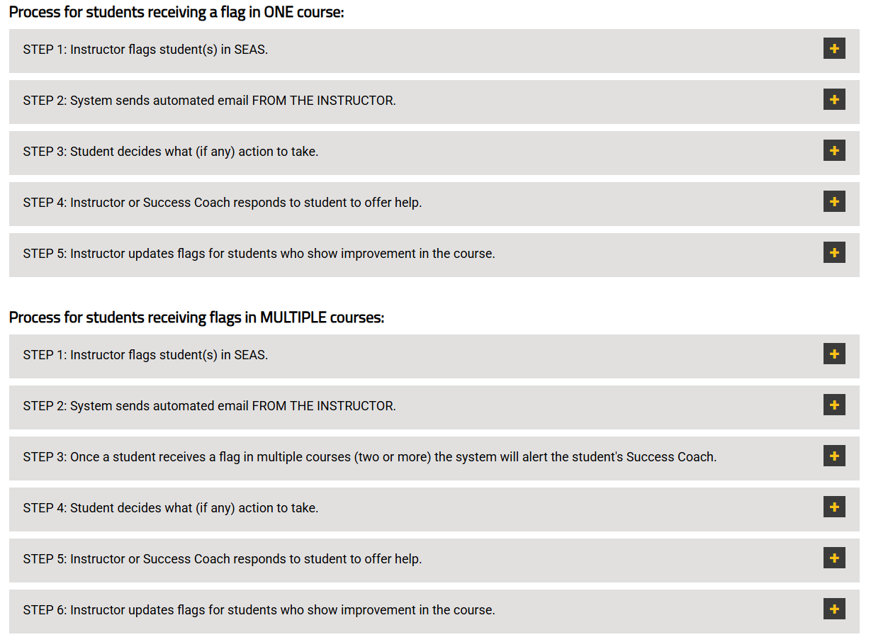
SEAS Processes

Slide 6
SEAS Review Committee
Created during the Spring 2023 semester.
Meets quarterly (January, April, July, and October) to review processes, messages, and strategies for SEAS usage.
Membership:
Co-Chairs: Brett Bruner (Assistant Vice President for Student Success & Persistence) & Kim Sandlin (Director of Student Success)
David Wright (Chief Data Officer)
Kevin Crabtree (SEAS Administrator, ITS)
Gina Crabtree (Registrar & Director of Enrollment Services)
Sarah Taylor (Faculty, College of Health Professions)
John Hammond (Faculty, Fairmount College of Liberal Arts & Sciences)
Jeff Pulaski (Faculty, College of Fine Arts)
Emily Stevens (Director of Academic Advising, College of Applied Studies)
If you have a SEAS suggestion to be considered by the SEAS Review Committee, e-mail Brett at brett.bruner@wichita.edu.

Slide 7
SEAS Resources
www.wichita.edu/seas
Videos
FAQs
Sample message to explain SEAS to students

Slide 8
For questions or more information:
Ashlie R. Jack, Ph.D. – Senior Associate Vice President, Institutional Effectiveness & Strategic Enrollment Management ashlie.jack@wichita.edu
Brett L. Bruner, Ed.D. – Assistant Vice President, Student Success & Persistence brett.bruner@wichita.edu

