Slide 1
Copy and Paste the Next Slide between Slides 18 and 19 in your Work in Water Classroom Power Point Presentation

Slide 2
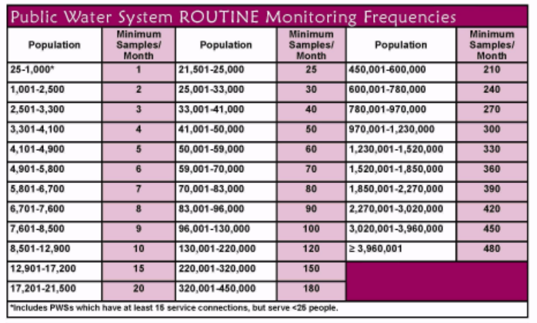
Water Testing Example
Purpose | Improve public health protection by reducing fecal pathogens to minimal levels through control of total coliform bacteria, including fecal coliforms and Escherichia coli (E. coli).
Notes:
Here is just one of the 95 contaminants that your water utility tests for. How many samples each month does your system take for total coliform?

