Slide 1
WATER
It’s more complicated than you think.

Slide 2

Hi, I’m Amanda
Senior
WSU – EPA’s Environmental Education Grant
  Work in Water
  Seminar – April
  Internship - June
Water, Waste Water, and Service & Finance

Slide 3
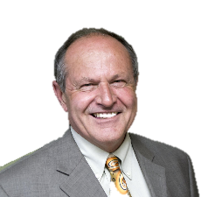
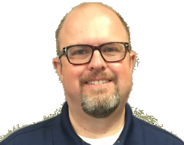
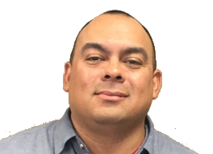
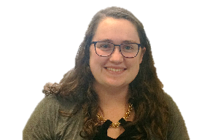
Water Dept.
Public Utilities Director - Mike Muirhead
Water Resource Manager – Fred Jones
Superintendent – Tony Hurtado
GIS Specialist - Mackenzie Thibault
Notes:
Mike is the head of the department, the representation and the face, he guides the dept and keeps the goals consistent and compatible.
Fred is the water resource manager – he represents the city on various fronts – he is on the ground water management district #3 board and attends several conferences about conservation
Tony manages the water utilities workers, - makes sure everything that needs to be fixed is fixed and is running smoothly
The city uses gis – geographic information system to map parcels, and flood zones, and in this case utility lines. Mackenzie is the specialist specifically for the public utilities dept – the city does have a gis dept but they are busy 24/7

Slide 4
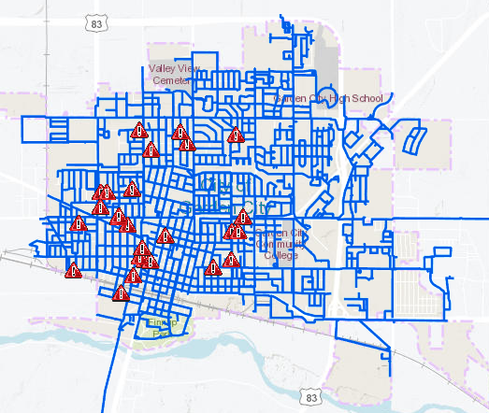
GIS
Water Model
Notes:
Water lines and past main breaks

Slide 5
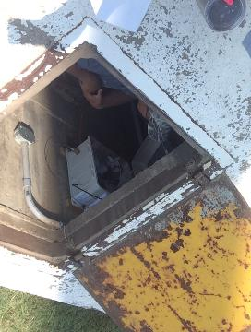
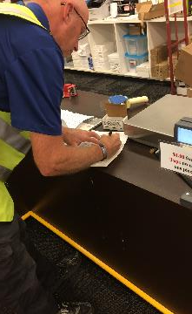
Water Operators - Production
Collect samples
Oversee SCADA
Maintain wells, water towers, and big pool
Water Operators must:
  Work for a water supply
  Graduate HS or get a GED
Notes:
Water quality specialist – scott – does free chlorine tests and collect samples for all sorts of things
Supervisory control and data acquisition (SCADA)
Greg working on the chlorinator at the 3rd and mary tower
All have some level of water operator certification – employed by a water supply and degree and the following

Slide 6
Points and Experience Required
Class | Points | Years of Experience
Small System | 12.5 | 6 months
Class I | 13.0 | 1 year
Class II | 14.0 | 1 year
Class III | 16.0 | 2 years
Class IV | 18.0 | 2 years
http://www.kdheks.gov/water/download/FAQs_General_Session_2012.pdf
Notes:
Garden city is a class 4 because we chlorinate our groundwater and serve more than 20k people

Slide 7
Training/Education Experience | Points Earned
1-day training | 0.0
2-day training | .25
KDHE Annual School -3-day | .50
High School Diploma/GED | 12
College – each full year 30 credit hours | 1.00
Operating experience – each full year – 40 hours a week | 1.00
Approved semester-long courses | 1.50
Approved 2-year environmental technology degree | 6.00
http://www.kdheks.gov/water/download/FAQs_General_Session_2012.pdf

Slide 8
Hardness in the water is caused by?
Calcium & Magnesium
Alum
What is the correct formula for determining watts?
Watts = volts/amps
Watts = (amps)(volts)
Sodium & Potassium
Watts = resistance/volts
What is pH a measure of?
Conductivity
Hydrogen ion concentration
Dissolved solids

Slide 9



Water Math
Conversion between Fahrenheit and Celsius
Calculate surface area
Calculate velocity
Calculate flow
Basic chemistry
Notes:
Basic chem = pH, temp effects on treatment, indicators of specific gases or reactions

Slide 10
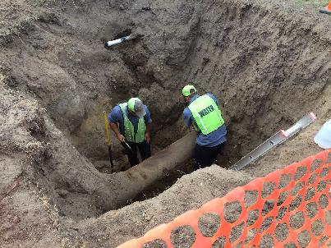
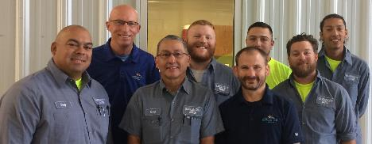
Utility Workers
Distribution
Maintain lines
Fix main breaks
Some experience needed
Notes:
From left to right: Tony, Scott, Greg, Ean, John, Freddy, Patriot, Jonathan

Slide 11
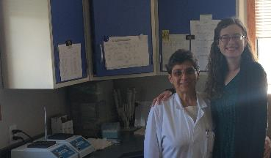
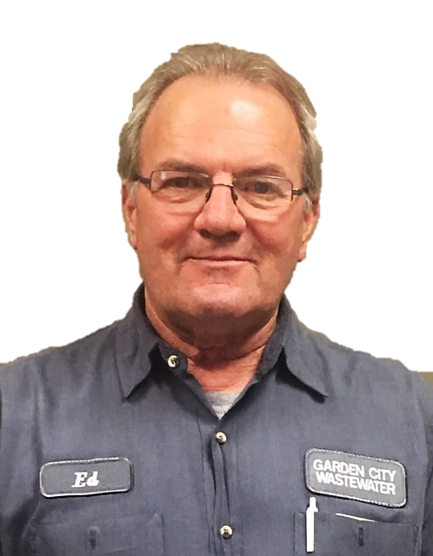
Waste Water
Superintendent – Ed Borgman - balances the books, coordinates with other depts., represents the dept.
Foreman – Brandon Crawford - runs the plant, helps w/ trouble calls, manages and coordinates his utility workers
Chemist – Anca Jucan – ensures KDHE compliance for WWTP, tests water from wells (for the City and commercially)
Notes:
Ed and Brandon both started as utility workers and just outlasted everyone else, waste water has it’s own waste water operator system just like water does, both like to be in the field even though it’s not strictly necessary
Anca tests the treatment process and helps the plant workers run the plant in compliance with KDHE regulations, she runs the tests on the city water samples that the water operators collect, people can also bring in samples from their wells for her to test and the city will charge them

Slide 12
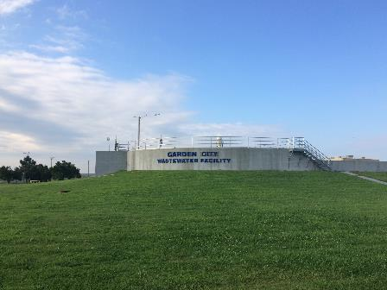
Waste Water – Plant & Collections
Plant workers - run the plant, keep it clean, maintain the machinery, keep the WWTP looking nice
Collections workers – maintain the sewer lines (cleaning dead ends, camera-ing lines, etc.), maintain lift stations, locates
No experience needed
Notes:
Plant workers really are plant workers - When it’s slow they landscape! They have the prettiest lilies!
Neither are as dirty as you would think and they hire people on with no experience and train them

Slide 13
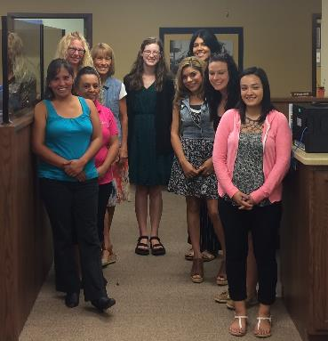
Service & Finance
Finance director – Melinda Hitz - head of the dept., coordinates with other depts., manages employees
Collections clerk/supervisor – Rosario Ibarra - figures out who hasn’t paid (tells Brett to cut them off), manages clerks
Clerks – take payments, explain services, help customers find right person for their problem

Slide 14
Service & Finance
Utilities & systems manager – Amy Perkins - accounting, manages employees, does pay orders
Utilities & systems assistant – Jellisa Patterson – manages tax exemptions, automatic billing,
Utility billing clerk – Lucy Mena – reviews billing statements, reviews account details to fix any mess-ups
Notes:
Jellisa is the person to call when you have troubles,
Lucy checks every bill that comes out of the city - yes everyone

Slide 15
Any questions?

