Slide 1
Introduction to Nutrient Optimization
Nicholas Willis
Environmental Finance Center at Wichita State
Grant Weaver, Grant Tech Solutions
Tom Stiles, KDHE W

Slide 2
Nutrient Optimization Webinar Series
Series of Five Webinars
November 8, 2023 Introduction to Optimizing Wastewater Treatment Plant Performance
November 15, 2023 Kansas Nutrient Optimization Case Studies
November 29, 2023 Nitrogen Removal Concepts
December 6, 2023 Phosphorus Removal Concepts
December 13, 2023 Review of Nutrient Optimization Concepts
1.5 CEUs per session wastewater operator credit

Slide 3
Who’s this guy?
Environmental Finance Center at Wichita State University
Nutrient optimization and jar testing – over 90 plants
Asset management, rates and finance training and technical assistance
Assistant Utility Director – Hays, KS
Four budgets, two plants, levee, limited water, bad drought, conservation
NPDES Permit Writer, State of Arkansas
Biosystems Engineering – University of Neb-Lincoln. Registered P.E. - Kansas

Slide 4
Who’s the other guy?
Grant Tech, Inc.
In-plant support for optimizing nutrient removal in 175+ municipal wastewater treatment plants including 73 in Kansas
Wastewater Operator
Connecticut
Massachusetts
New Hampshire
Rhode Island
Professional Engineer
Connecticut
MIT: Post-Grad Studies in Environmental Toxicology
Oklahoma State: MS Bio-Environmental Engineering
Kansas State: BS Biology

Slide 5
KDHE Perspective

Slide 6
KDHE Perspective on Optimization for Nutrients

Slide 7
What’s the issue with nutrients?

Slide 8
Ecosystem Productivity
All ecosystems having limiting factors to their productivity:
Deserts – water
Corn fields – typically nitrogen, phosphorus or water
Soybean fields – typically pH, phosphorus or water
Tundra – sunlight, temperature
Freshwater – typically phosphorus
Salt water – typically nitrogen
Activated sludge treatment – dissolved oxygen, pH, time

Slide 9
Total Nitrogen
If ammonia is removed – converted to nitrates
Ammonia removal preserves nearby aquatic life
Nitrates are problematic:
Maximum Contaminant Level under Safe Drinking Water Act
Brackish and salt-water eutrophication
Gulf of Mexico Dead Zone

Slide 10
From the National Oceanic and Atmospheric Administration

Slide 11
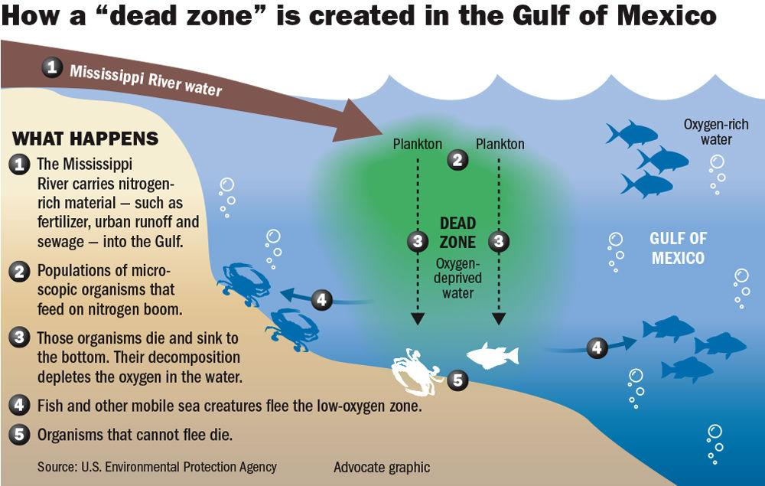
From: The Advocate (Louisiana Newspaper). 'Large to very large' Gulf of Mexico dead zone expected this year; Here's what caused it May 16, 2019

Slide 12
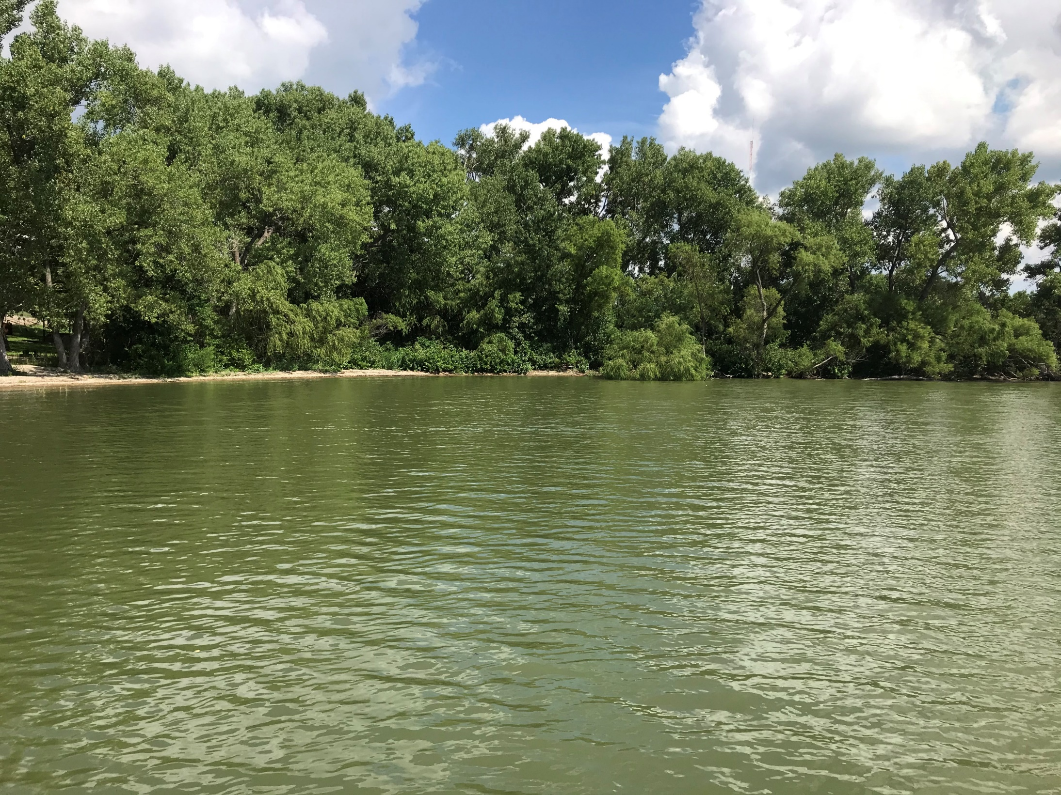
Total Phosphorus
Excess phosphorus increases freshwater biomass production
Similar to dead zone in Gulf of Mexico – increases algae production
Excessive algae a problem:
Can be toxic – Harmful Algal Blooms
Shades lower parts of lake
Taste & Odor Issues
May close recreation
May impact drinking water treatment
Fish kills may occur

Slide 13
Where is phosphorous coming from?
People
Dominates WWTP
Anyone with a bottle of soda?
Read the ingredient list
Common food preservative
Detergents
Minor contributor at this point
Fertilizers
Animal wastes
Added to hog & dairy feed
Notes:
Humans excrete about 3.3 million tons of phosphorous annually
A UK study showed that about 70% of phosphorous in wastewater was from feces and urine

Slide 14
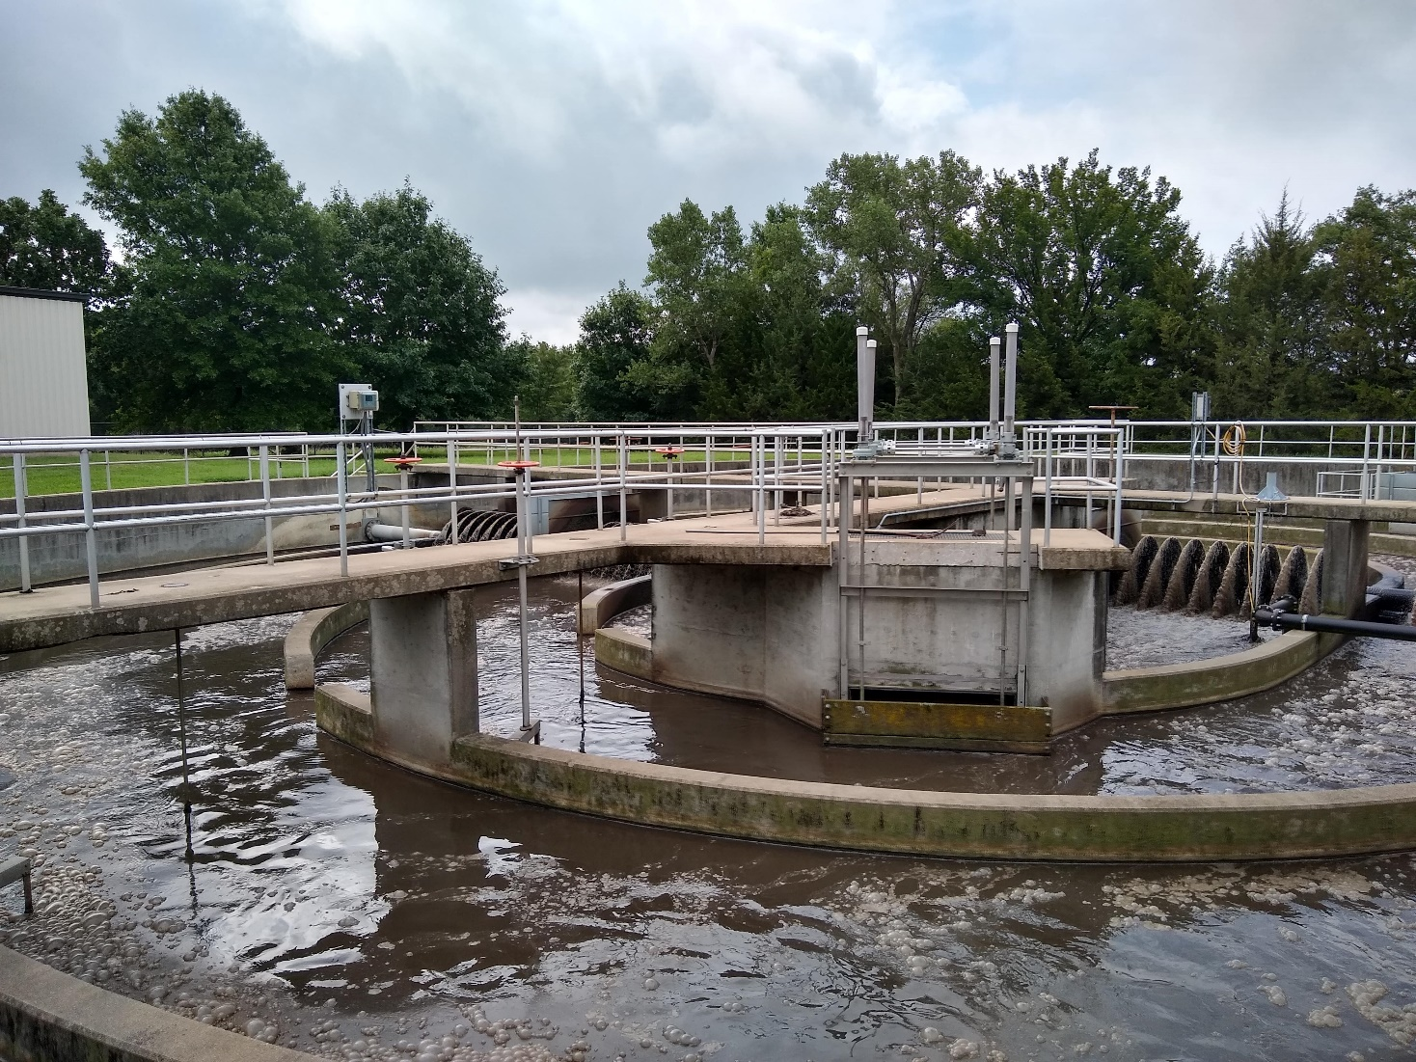
Industrial sources
Food & beverage processing
Waste products
Cleaning products
Preservatives
Fertilizer Production
Metal finishing
Cleaning
Hesston, KS

Slide 15
Nutrient Regulation in Kansas

Slide 16
Kansas Nutrient Regulations
Most facilities can expect:
Mass-based limits calculated off plant design-flows at:
10.0 mg/l Total Nitrogen
1.0 mg/l Total Phosphorus
Typically Rolling Annual Averages
Some facilities will get:
Hard limits for total nitrogen or nitrates (drinking water MCL)
More stringent phosphorus limits (TMDL driven)

Slide 17
What does this mean?
Mass-based limits
Can discharge higher than concentration based limit
i.e. if plant design is 1.0 MGD and you average 0.5 MGD, concentration can effectively double and be in mass-based compliance
Rolling Annual Average
Allowed to exceed limits if offset by performance better than limits in other months
One bad month can cause months of non-compliance
Sample early – repeat if high to reduce monthly average
i.e. if TP comes back at 5.2 mg/l, sample again to reduce monthly average

Slide 18
Nutrient Optimization

Slide 19
Utility Sustainability
Wastewater systems face numerous pressures:
Collection System Investment Needs
Aging Infrastructure
Equipment Supply Chain
Emerging contaminants – i.e. PFAS/PFOS
Stagnant/declining populations
ALL pressure utility finances

Slide 20
Nutrient Optimization Benefits Utility Finances
Reduce energy usage
Reduce chemical usage
Alum/ferric for phosphorus
Alkalinity addition for denitrification (rare in KS)
Eliminate or Delay Need for Capital Investment
Resource availability for collection systems

Slide 21
Theory of Nutrient Optimization
Operators can operate differently than plant design
Nutrient removal is all about:
Having the right environments
In the right places
At the right times
Biological Nutrient Removal Plants do this by design
Other plants do it with creativity and operator skill

Slide 22
Environments for Nitrogen Removal
Two-steps (in most plants)
Aerobic – convert ammonia to nitrates
~6 hours for conversion
Anoxic – convert nitrate to nitrogen gas
~1-2 hours for conversion
Need BOD or added carbon

Slide 23
Environments for Phosphorus Removal
Volatile Fatty Acid Production
Anaerobic with carbon
Typically influent + Return Activated Sludge
Bio-P consume VFA
Anaerobic with carbon (typically same tank as fermentation)
Phosphorus Release occurs
Phosphorus Uptake
Aerobic environment

Slide 24
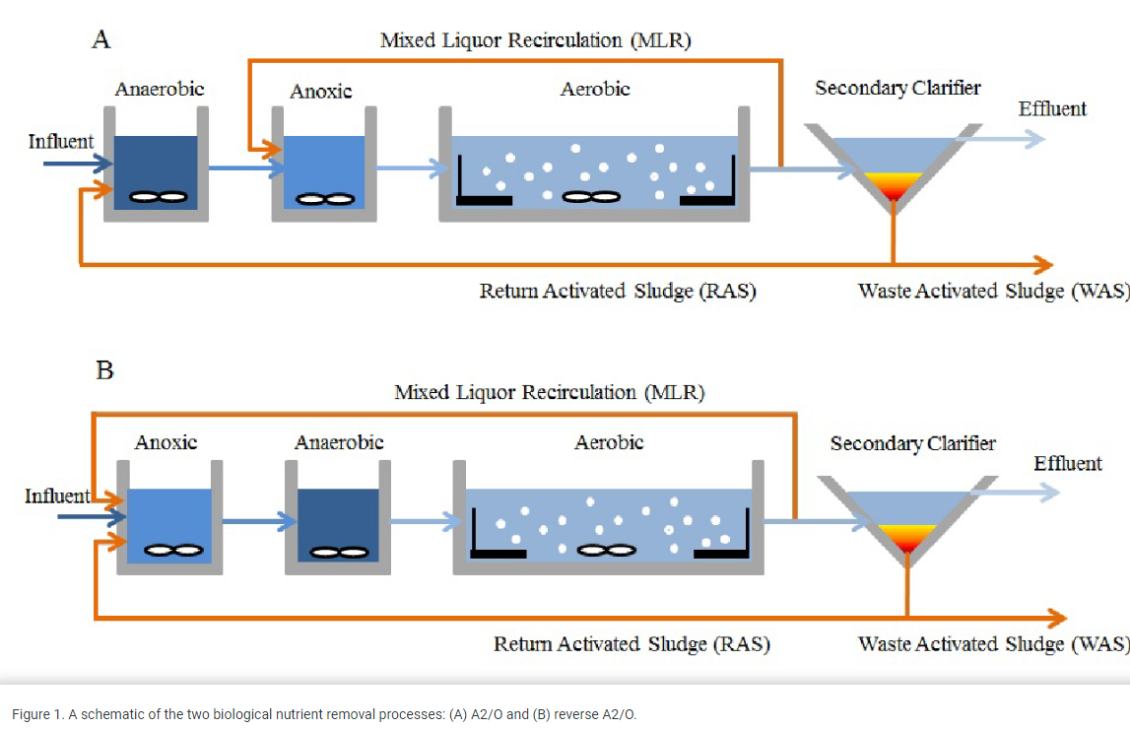
What does this look like?
Image from Shengan Xu, 2014

Slide 25
Optimization Versus Design
Your plant optimized for nutrient removal will not look like the plant on the right.
That’s OK
You need the environments – not the tanks

Slide 26
Total Nitrogen Removal
Two Step Process
Step 1: Convert Ammonia to Nitrates
Step 2: Convert Nitrates to Nitrogen gas

Slide 27
Conversion of Ammonia (NH₄)
Nearly all nitrogen entering municipal plants is in ammonia form
Toxic to aquatic life
Needs removed
NO₃ is product – stays in water
Drinking water professionals – this can be a problem – MCL of 10.0 mg/l
“Nitrifiers” are responsible for conversion of ammonia to nitrates
Energy derived from oxidizing inorganic nitrogen compounds (ammonia)
Aerobic environment – Oxygen Rich
pH and temperature sensitive bacteria
Functionally, most NE plants will struggle with temperature, pH should be fine with most hard waters
Two-step process
Ammonia oxidized to nitrite (NO₂) then nitrite oxidized to nitrate (NO₃)
Very little nitrite is seen in wastewater discharges

Slide 28
Ammonia Removal
Ammonia (NH₄) is converted to Nitrate (NO₃)
Ammonia (NH₄)
Animation from Grant Weaver

Slide 29
Ammonia Removal
Oxygen (O₂)
Ammonia (NH₄)
Animation from Grant Weaver

Slide 30
Ammonia Removal
Oxygen (O₂)
Ammonia (NH₄)
Alkalinity
H⁺
Animation from Grant Weaver

Slide 31
Ammonia Removal
Oxygen (O₂)
Ammonia (NH₄)
Nitrite (NO₂)
Alkalinity
H⁺
Animation from Grant Weaver

Slide 32
Ammonia Removal
Oxygen (O₂)
Oxygen (O₂)
Ammonia (NH₄)
Nitrite (NO₂)
Alkalinity
H⁺
Animation from Grant Weaver

Slide 33
Ammonia Removal
Oxygen (O₂)
Oxygen (O₂)
Ammonia (NH₄)
Nitrite (NO₂)
Nitrate (NO₃)
Alkalinity
H⁺
Animation from Grant Weaver

Slide 34
Nitrate conversion to nitrogen gas
For conversion, the following is needed:
Low/no dissolved oxygen
Carbon source
Typically influent BOD, some plants add
Regain half of lost alkalinity

Slide 36
Benefits of Nitrate Removal
Improved water quality
Gulf of Mexico & Drinking Water Quality
Energy savings
Cycle aeration or turn off part of aeration
Control D.O. with D.O. feedback

Slide 37
Total Phosphorus
3 Steps

Slide 38
Step 1: Produce Volatile Fatty Acids
Ingredients:
Mixed liquor solids, low in nitrates
Influent rich in carbon
Time: 1 to 2ish hours
Directions – allow to ferment
Minimal mixing, no/minimal air introduction
Oxidation Reduction Potential = -100 to -250 mV

Slide 39
Step 2: Bio-P uptake VFA
Directions:
This occurs, typically in same basin as VFA production
Prevent nitrates, as denitrifying bacteria consume VFA
Check your work:
Phosphate levels should be 3x influent leaving basin as influent
Oxidation Reduction Potential = -100 to -250 mV

Slide 40
Step 3:
Direct fluid rich in Bio-P bugs, fat with VFA, into aerobic basin
“Luxury” phosphorus uptake occurs
Remove in solids
Operate clarifier and biosolids to minimize phosphorus release

Slide 42
Phosphorus – Common Failure Points
Nitrates entering “Anaerobic Zone”
Return Activated Sludge
High Dissolved Oxygen in “Anaerobic Zone”
Return Activated Sludge
Backflows
Overmixing
Release from sludge
Deep clarifier blankets
Sludge processing

Slide 43
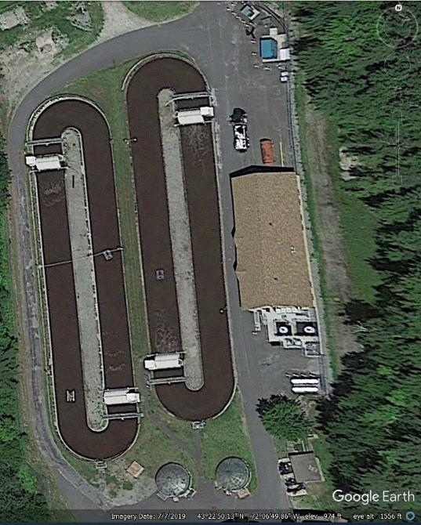
Sunapee, NH
Total Nitrogen
Ditches operate in parallel
TN Removed in ditches – rotors cycle on/off
Aerobic to Anoxic
Dissolved Oxygen setpoints for rotors
Total Phosphorus
Two parallel anaerobic basins
Overmixed – reduce mixing time
Protect from washout?
All aerials in presentation from Google Earth unless otherwise specified.

Slide 44
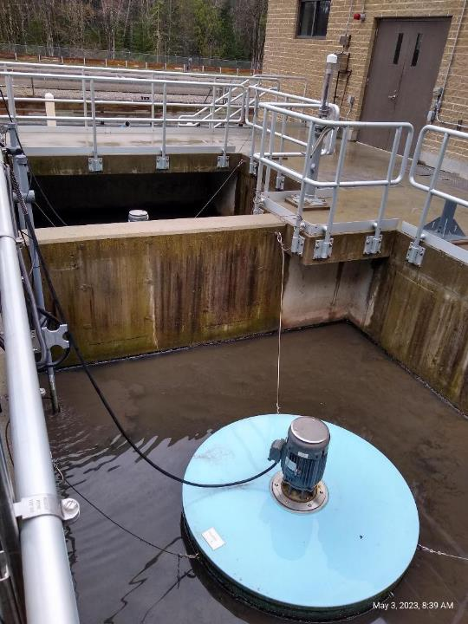
Sunapee, NH
Solids handling
Dose Polyaluminum Chloride (PAC) with polymer before belt press
Binds phosphorus released during solids storage – remain in solids
Adaptive Operations
Test phosphate leaving ditches. Monitor Anaerobic Basin Oxidation Reduction Potential values
Plan A: Anaerobic zones
Plan A.1: PAC during solids processing
Plan B: Chemical before clarifiers
Plan B.1: PAC during solids processing

Slide 45
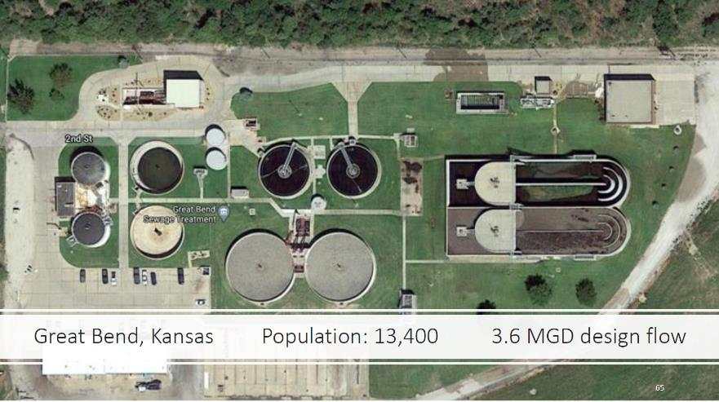

Slide 51
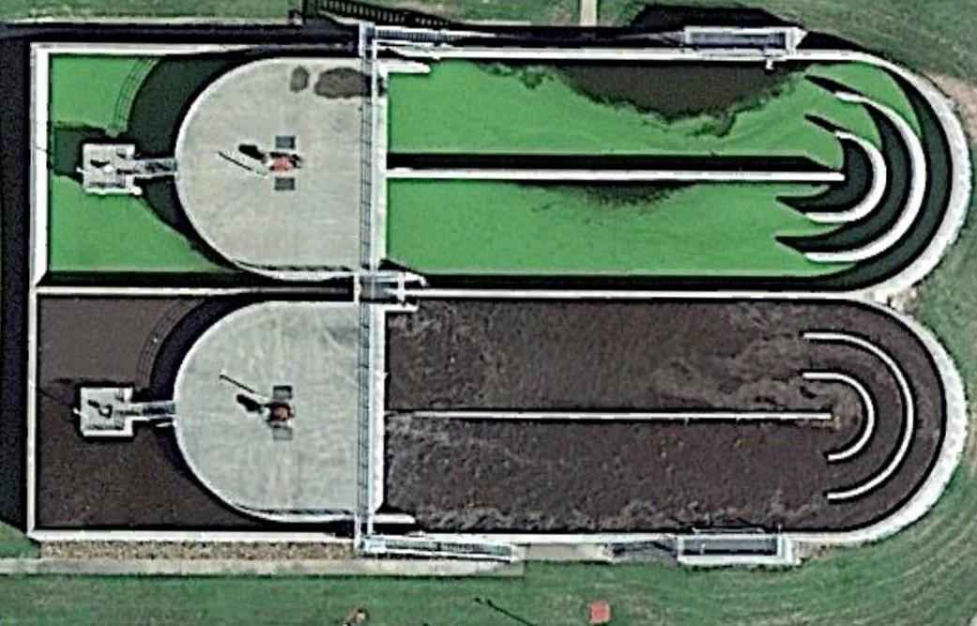
Before
Anoxic
Oxic – Remove Ammonia
Influent/RAS
Open Recycle Gate – Return Nitrates to Anoxic Zone

Slide 52
After
Reduce Mixing
Anaerobic
Control D.O., Cycle
Oxic - Anoxic
Influent/RAS
Close Recycle Gate

Slide 53
After
PO4 Release
PAO Growth
Ammonia Conversion to Nitrates + Denitrification.
Luxury Phosphorus Uptake
VFA Production

Slide 54
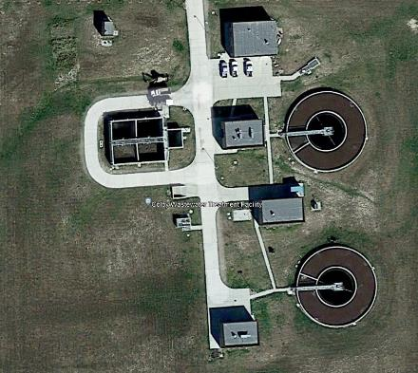
Colby, KS
Traditional newer activated sludge plant
Facing permit limits soon
Modified air levels and timing

Slide 55
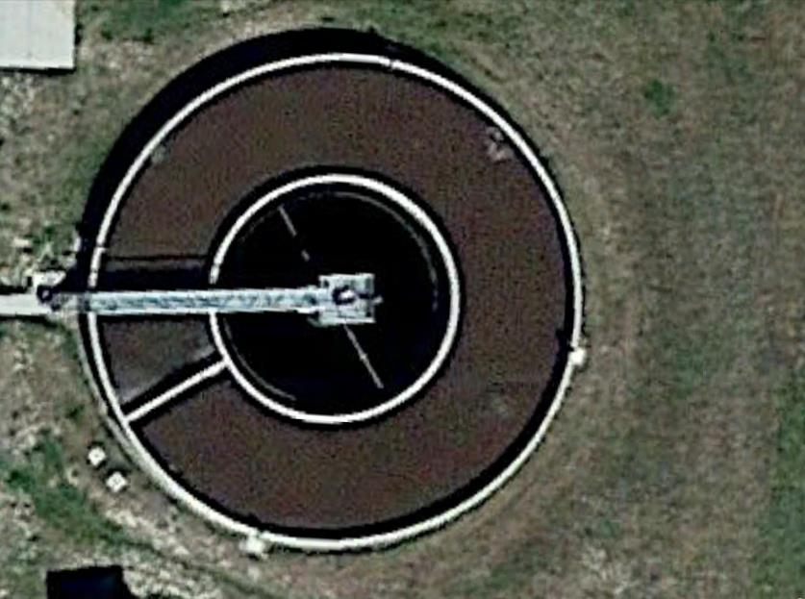
Before
Basic Activated Sludge
Some air control to denitrify & save energy
Ammonia to Nitrates
Influent/RAS

Slide 56
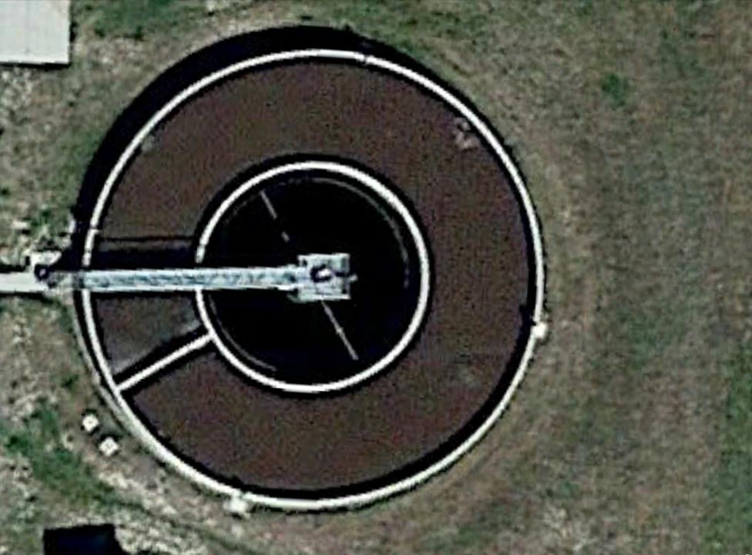
Aerobic
Cycled Anoxic
After
Control air at influent
Cycle Air in Basin
Anaerobic
Influent/RAS
Aerobic
Cycled Anoxic

Slide 57
Ammonia to Nitrates
PO4 Release
PAO Growth
After
Control air at influent
Cycle Air in Basin
VFA Production
Denitrification
Influent/RAS
Luxury Phosphorus Uptake

Slide 60
Fine-Tuning a BNR Plant
Horton, KS Case Study

Slide 61
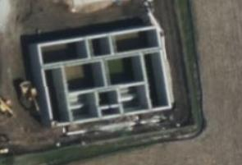
Improve Biological Phosphorus Removal
New AeroMod plant -2023
Bio-P basin – bottom center
Mediocre phosphorus removal
Monitored ORP
Reduced mixing from 24/7 to 1 hour on, one hour off
Photo from Microsoft Maps.

Slide 62
Results
Source: EPA ECHO Database

Slide 63
Takeaways
Develop and execute total nitrogen strategy first
Once RAS is low in nitrates, can execute total phosphorus
Develop reasonable monitoring plan for nutrients and compliance

Slide 64
Small Group Development
We are considering regular small-group meetings
Groups would be by plant type
i.e. SBR, oxidation ditch, Aeromod, etc.
Believe better sharing can help with nutrient removal efforts & plant management
i.e., contacts to help diagnose issues, share vendor information, etc.
We’ll ask for more input next week.

Slide 65
KDHE Sponsored Technical Assistance
Available to all municipal plants in Kansas
Onsite – Willis
Remote – Weaver
No cost
Loaner equipment

Slide 66
Contact Information & Technical Assistance
Free technical assistance on Nutrient Optimization in Kansas
Nicholas Willis
Environmental Finance Center at Wichita State University
nicholas.willis@wichita.edu
316-978-6538

