Slide 1
Nick Willis
Environmental Finance Center at Wichita State University
Nutrient optimization and jar testing – over 90 plants
Asset management, rates and finance training and technical assistance
Assistant Utility Director – Hays, KS
Four budgets, two plants, levee, limited water, bad drought, conservation
NPDES Permit Writer, State of Arkansas
Biosystems Engineering – University of Neb-Lincoln. Registered P.E. - Kansas

Slide 2
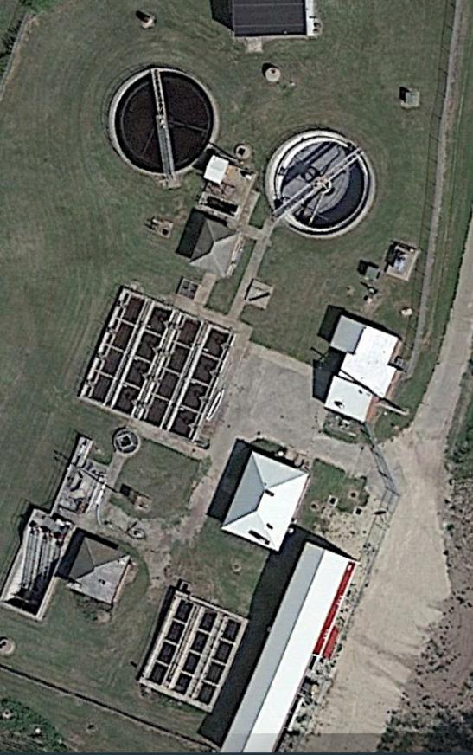
Herington – Testing Before Upgrades
Old Activated Sludge
Will be replacing:
Blowers
Aerators
Headworks
Four Parallel Basins

Slide 3
Limited Trials in Herington
Can nitrates be lowered?
without recycle to dedicated anoxic zone
without blower cycling
Let’s try!

Slide 4
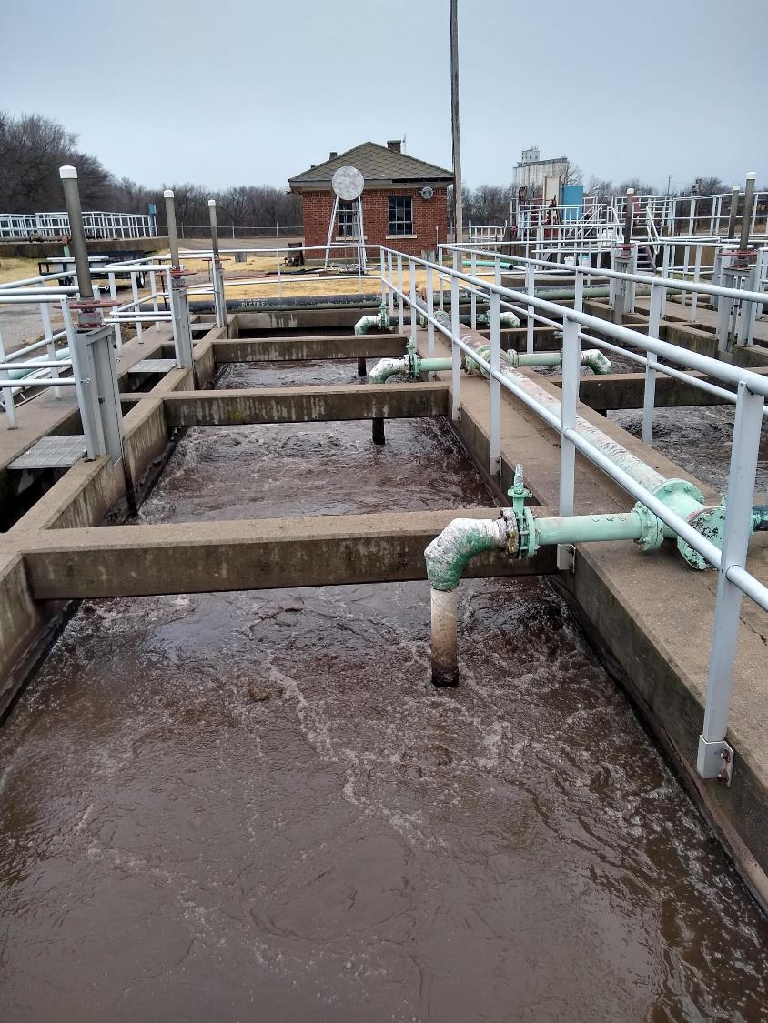
Reduce Nitrates via RAS Recycle
Return Activated Sludge about 40% of plant influent flow
Turn off first aerator in two (of 4) basins
Monitor nitrates in outflow of basins
In-house tests showed 2-3 mg/l decline in nitrates in modified basins
No ammonia increase

Slide 5
Takeaways from Herington
New operator
Gained education and experience
Upgrades should meet 10 mg/l TN
Partial denitrification of RAS can move needle

Slide 6
New Build – Horton
Newly built Biological Nutrient Removal Facility (BNR)
Not achieving good phosphorus removal in first months of operation
Operator training and diagnostics

Slide 7
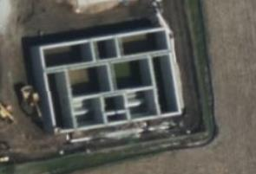
Improve Biological Phosphorus Removal
New AeroMod plant -2023
Bio-P basin – bottom center
Mediocre phosphorus removal
Monitored ORP
Reduced mixing from 24/7 to 1 hour on, one hour off
Photo from Microsoft Maps.

Slide 8
Goals for Horton
Compliance with Total Phosphorus
No chemical addition

Slide 9
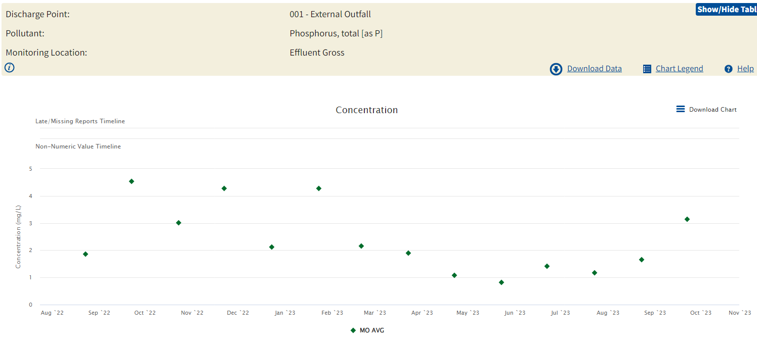
Results
Source: EPA ECHO Database

Slide 10
Horton – TP lbs./day.
Future Limit – 2.07 lbs/day annual rolling average

Slide 11
Horton – Future Operations
Monitor ORP
May need to:
Monitor nitrates into anaerobic zone through RAS
Better control nitrates in cycling of Aeromod basins
Gain understanding of internal phosphorus flows from biosolids processing

Slide 12
Concordia
Right-sizing of basins
Control of air input
Consistent Nitrogen and Phosphorus performance

Slide 13
Right-sizing tankage
Concordia’s population has fallen since plant build
Plant built with growth in mind
Too big – leads to old sludge and related problems

Slide 14
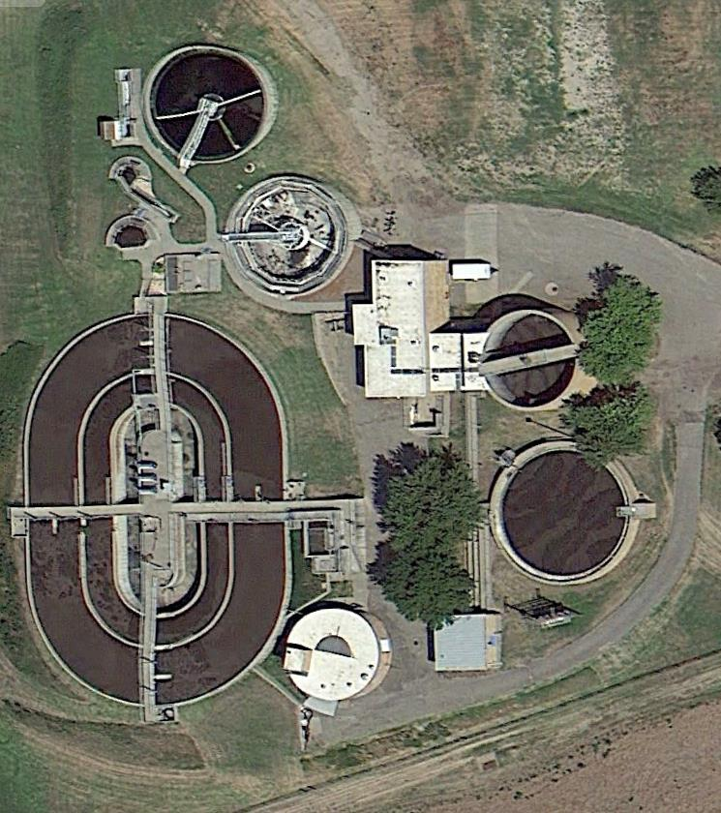
Right-sizing tankage and treatment
Took inside tank offline
Operate on a single clarifier
Operate low MLSS concentrations
Summer ~1500 to 2000 mg/l

Slide 15
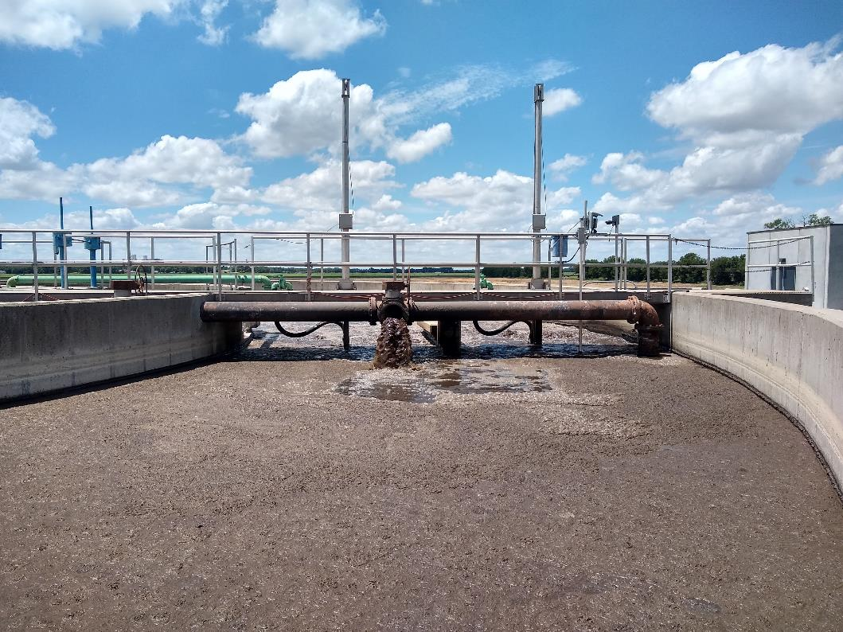
Controls
Control air with Oxidation Reduction Potential
Create zones within plant
Aerobic, anoxic, anaerobic
No baffles/separation of tankage
Meet expected mass-based limits

Slide 16
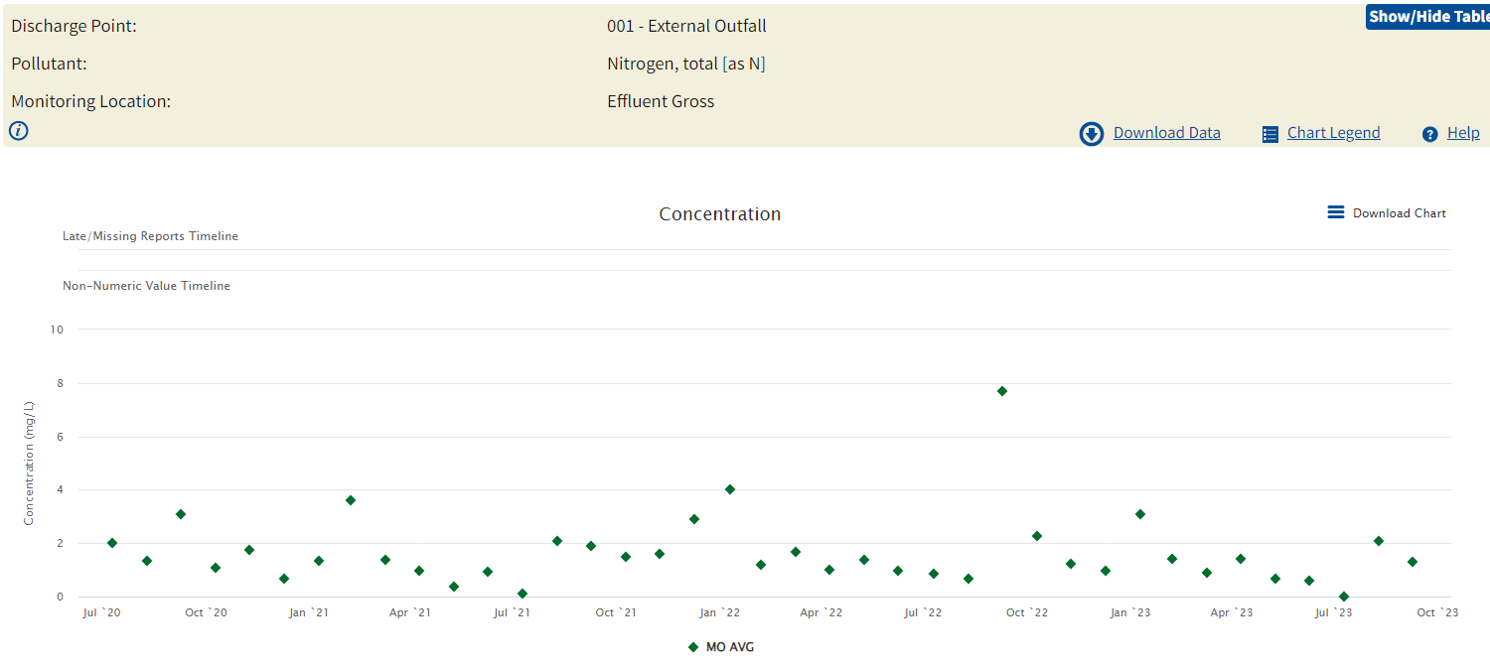

Slide 17
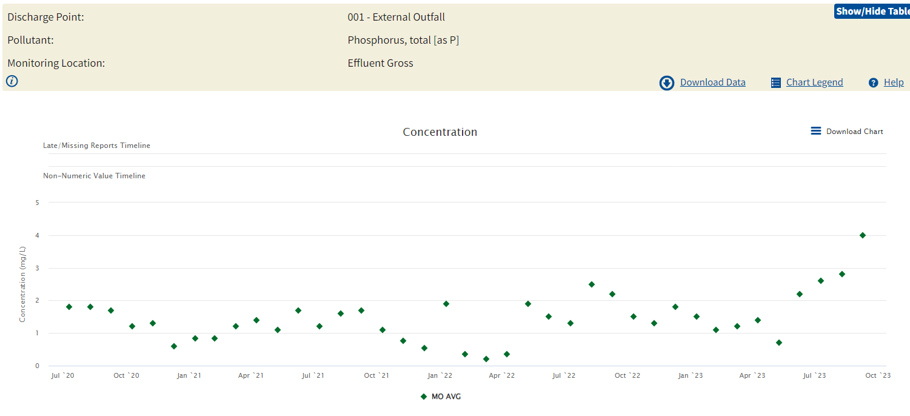

Slide 18
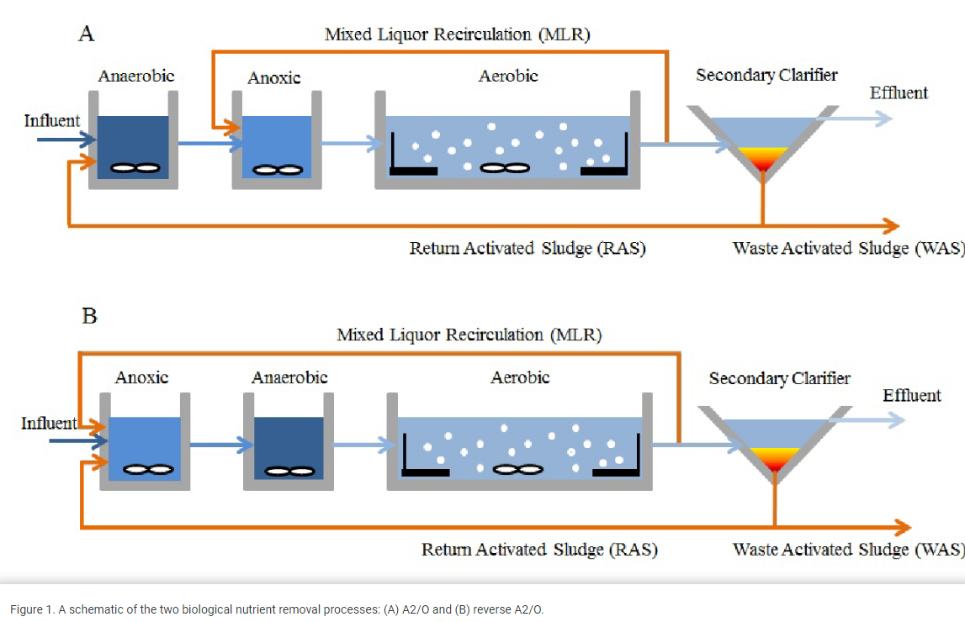
Concordia’s plant creates all of these environments without physical separations
Image from Shengan Xu, 2014

