Slide 1


CITY OF WICHITA WORKING WITH WATER INTERNSHIP PROGRAM
BY : MIGUEL TOVAR

Slide 2
Operations
The operators have a very important job at each Plant.
They follow strict sampling guidelines to ensure that the plant is well within their appropriate limits set by KDHE.
They also monitor the entire plant with a computer software that has set alarms to notify when a basin, sludge pump, and or trickling filter (etc.) is malfunctioning or needing attention.
I witnessed dedication and a sense of pride in what they do for the plant.

Slide 3
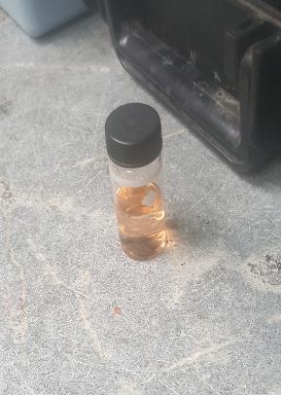
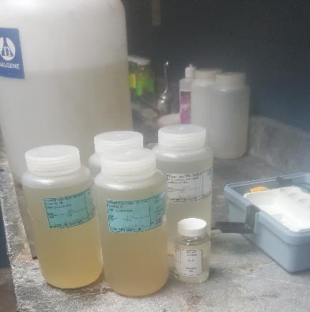

Slide 4

Pre-Treatment
The Pre-Treatment department are like the detectives of the plant.
They investigate when something comes into the plant that has unusual characteristics such as : abnormal pH, unique odor, unusual color, or an uncharacteristic observation by an operator.
They also go out and sample around Wichita, Sampling pH, Water Temp, and grab an E Coli sample for the lab.
They also enforce EPA guidelines and inspect companies to ensure that they are within their permits.

Slide 5
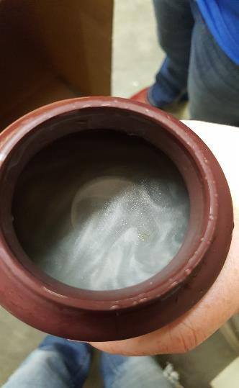
This was the beginning of a huge discovery from sampling which reflected how important it is to routinely sample because you can catch something odd and trace it back to its location.

Slide 6
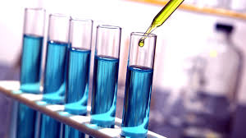
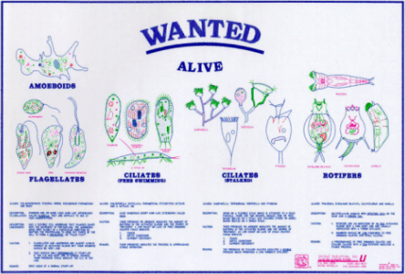
The LAB
The Lab runs a variety of tests.
I was able to run COD tests or chemical oxygen demand tests.
I was also able to see the different types of bugs in the water samples.

Slide 7
Biosolids
In Biosolids they use the nitrogen rich sludge for agricultural purposes to dispose of excess sludge in a beneficial and environmentally friendly way.
I was able to go out and drive a tractor and spread the sludge in the field.
My favorite experience was working in Biosolids because of how i got to go out in the field and drive tractors.
the sludge driers are also important because we can grab samples of the cake from the belts and test the amount of moisture in the sludge.

Slide 8

Maintenance
the Maintenance crew is very important.
i got some hands on experience with replacing valves down in the digesters.
I was also able to see how quickly and effectively the crew is at responding to a situation.

Slide 9
Engineering
The Engineers are really important with designing a lot of the work that goes on with Water rehab projects.
There are some pretty cool tools that they use to scan our sewers with camera’s.
I learned how to locate water meters and how to mark them for repairs.
i got to sit in on some meetings about future projects.
I worked with the guy in charge of rehabbing the pawnee bridge ( It's almost done!!!!!!!!!)

Slide 10

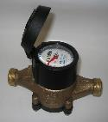
Water distribution
I serviced meters and always got to repaint them with a nice shiny yellow paint.
I learned about the mole holes and how they affect our meter boxes.
I watched a Meter box get dug up and replaced within 15 minutes.
I recalibrated a meter and rewired one.

Slide 11
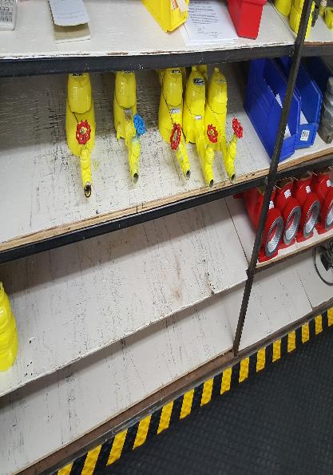
a couple of meters that i serviced

Slide 12
Water plant
The Water plant was very similar to sewage treatment except the water plant is clean water and has a variety of basins and different methods to treat the water.
I learned about the well fields and the equis beds.
i went to a meeting about the equis beds to learn about the steps wichita is taking to make sure we are prepared for future demands and a 1% drought.
operators constantly monitor the water demand which is very important because if the pressure builds too high, pumps and valves can start exploding.

Slide 13
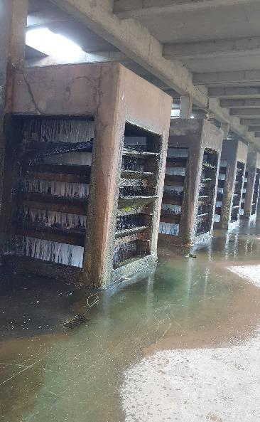
Filter gallery where the water trickles down a bunch of charcoal rocks as part of the treatment process

Slide 14
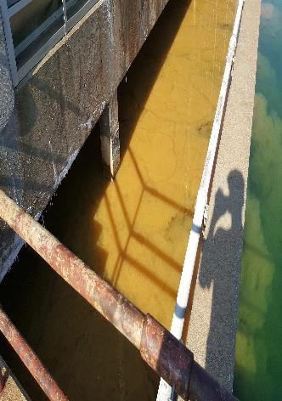
Flocculation basin

