Slide 1
This is not a complete presentation
Before using this presentation, please see the accompanying user guide, script, and related resources.
Some slides will need to be modified or removed to reflect differences in local and/or state requirements and support programs.
Additional content may be added by the user to customize the presentation for local use.
Notes:
Remove this slide before delivering presentation.

Slide 2
Capacity Development & Asset Management
FOUNDATIONS
MANAGEMENT
OPERATION
FINANCE
KanCap | 2015-2016
Notes:
This slide showing as people are entering.

Slide 3
Agenda
Introductions
Overview
Foundations
Management
Technical
Finance
Wrap up
Notes:
Update to reflect changes in order and/or content

Slide 4
Introductions
Use this slide to introduce yourself and your organization
Add your name and organization logo
If you want/have time, have the attendees introduce themselves.
Notes:
Add introductory information to this slide before delivering presentation. Information to add to this slide can include logos and names and titles of presenters.

Slide 5
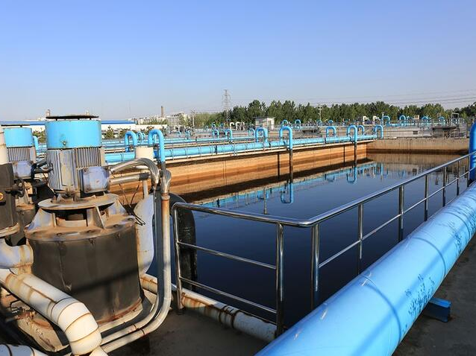
Capacity Development
Water system capacity is the ability of a system to plan for, achieve, and maintain compliance with drinking water standards now and into the future.

Slide 6
Drinking Water Utility Capacity (Outlined in 1996 SDWA Amendments):
Technical
Source Water Adequacy
Infrastructure Adequacy
Technical Knowledge and Implementation
Financial
Revenue Sufficiency
Credit Worthiness
Fiscal Management & Controls
Managerial
Ownership Accountability
Staffing & Organization
Effective External Linkages
Source: Peter Shanaghan. USEPA 2020
Notes:
There are three components of utility capacity: managerial, technical, and financial.
Managerial capacity refers to the utility’s ability to maintain properly certified staff at levels needed to provide efficient and effective service to the community. It also includes external relationships that are necessary, such as contractors, engineers, software companies, etc.
Technical capacity refers to the utility’s ability to provide clean, safe drinking water through adequate source water and proper infrastructure along with the technical knowledge needed to operate, maintain, and upgrade the utility’s facility.
Financial capacity refers to the utility’s ability to sustainably fund the utility’s operational needs as well as the planning for its future needs. Financial capacity includes fiscal management controls to ensure that funding is used in efficient and effective ways.
These components are interrelated, and all rely on the board to make policies and decisions to ensure continuing capacity. This is often referred to by the acronym, TMF (technical, managerial, and financial).

Slide 7
Capacity Development Requirements
Prioritize Public Water Systems in need
State role in complying with regulations
Describe baseline & improvement measurements
Identify Stakeholders
New systems demonstrate TMF capacity
Reduced funding without capacity development strategy
Notes:
Under 1996 Amendments, States are required to:
Outline prioritization of Public Water Systems most in need of improved capacity by describing factors encouraging or impairing capacity development
Describe how they will:
Assist Public Water Systems in complying with primary drinking water regulations
Encourage system partnerships
Assist in training and certifying operators
Describe establishment of their baseline & how improvements will be measured
Identify stakeholders
States must ensure that all new Community and Non-Transient Noncommunity systems demonstrate TMF capacity. This includes ensuring that states have control points to ensure they can prevent a new system from starting if it does not have capacity.
States without developed and implemented Capacity Development Strategy can lose 20% of annual Drinking Water State Revolving Fund allotment and may face a 20% withholding for not implementing new system capacity development program.
Source: Peter Shanaghan. USEPA 2020

Slide 8
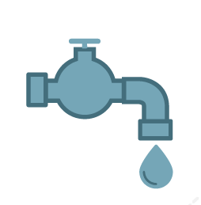
American Water Infrastructure Act of 2018 (AWIA) Asset Management Requirements
Description of Asset Management strategy
Approval and implementation requirements
EPA to review and update
Notes:
In 2018, the American Water Infrastructure Act amended the Safe Drinking Water Act to include asset management planning in their Capacity Development Strategies.
Section 2012 amends SWDA to:
Require state Capacity Development Strategy to include a description of how the state will encourage the development of asset management plans.
States are expected to submit their revised strategies for approval by December 31, 2022.
States must address asset management implementation in triennial Governor’s reports no later than September 30, 2023.
EPA to review and update, if appropriate, asset management documents and trainings every five years.

Slide 9
Asset Management
Maintain a desired level of service at the lowest life cycle cost.
Consider each asset
Rely on:
What you already know
Resources you have available to you
Knowledge of the ENTIRE workforce
Notes:
Asset management is trying to fundamentally change the way the utility views its assets and the management of them. Its purpose is to shift the utility into more community focused thinking. The utility must be aware that the reason they exist is to provide a service to its rate-payers.
Assets need to be viewed as individual assets not as a group of assets. It is important to track and measure performance over time and to make sure that the money spent at the utility is spent in the right places for the right reasons and that the split between O&M and Capital is appropriate.
It is important to realize that asset management is not a “completely new” undertaking. It is based on what the utility already knows, the resources that are available to the utility and the knowledge of the full workforce. It is important for a utility to understand that they do not need to go beyond what they feel comfortable with. They can work within their level of skill and ability.
(emphasize this point) Asset Management should feel like what you should be doing already.

Slide 10
Benefits of Asset Management
Engaged upper management
More planned and less reactionary operation
Sustainable utility
Supportive rate-payers
Sound financial decisions
Cost savings benefits
Confident decision making
Rate sufficiency
Notes:
No matter where your job falls within the utility, whether you are an entry level operator or a board member or a public works director, there is an element of asset management for you.
Upper management who listens to information from the field
More planned and less reactionary operation
Sustainable utility
Supportive rate-payers
Sound financial decisions
Ability to benefit from cost savings over time
Confidence in the decisions that are made
Confidence in the rate that needs to be charged
(emphasize this point) If the utility is sustainable, jobs will be there for the future. There are other reasons for sustainability, but it is important to know that the utility will need workers.

Slide 11
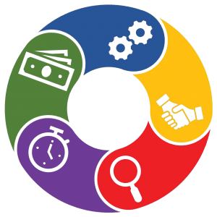
Five Core Components of AM
Current State of the Assets
Level of Service
Long-Term Funding
Criticality
Life Cycle Costing
Notes:
Asset management planning includes 5 core components. These core components are compatible with EPA’s Advanced Asset Management Training and the International Asset Management approaches from Australia and New Zealand. Each of these components will be described as they relate to components of capacity development and your role as a board member.
It is important for you as board members to understand and engage with the process of asset management planning as you are responsible for the operations of your utility; therefore, understanding this process is vital to understanding the needs of your utility.

Slide 12
Foundations
Notes:
Understanding the foundations of being a utility board member is imperative for the efficient management and operation of your community’s utility.

Slide 13
Legal Framework: The Board
Decisions are legally binding
Accountable for the utility
3 fundamental duties
Duty of care
Duty of loyalty
Duty of obedience
Notes:
The utility board is a governing body whose decisions are legally binding and cannot be delegated. As a board, you are accountable for the conduct and performance of the utilities, including providing service at optimal levels and ensuring that your utility is operating within regulations.
Board members have 3 fundamental duties. The duties help you make decisions about operation and management.
Duty of Care – Use the good judgment any reasonable person would in making informed decisions with available info. This not a duty to be perfect, but to be as wise as possible. This does not prevent disagreements, but, points members towards thoughtful consideration of all sides of an issue.
Duty of Loyalty – Always act in the interest of the utility and not in the interest of self or others. The Interest of the utility means ensuring adequate supply of safe drinking water now and into the future.
Duty of Obedience – As a whole and individually adhere to the mission, bylaws and policies of the utility. AND, of the federal and state laws and regulations. The board must act within the bounds of the authority granted to them.

Slide 14
Board Basics
Robert’s Rules of Order
Open Meetings
Open Records
Code of Ethics
Be an Effective Team Member
Notes:
Basic responsibilities of a board include following Robert’s Rules of Order, including running a meeting off an established agenda, and adhering to all open records and open meetings requirements.
The formal code of ethics should reflect the board’s values (such as integrity, transparency, fairness, equality) and should provide board members and employees with guidelines for making ethical choices and ensuring accountability for those choices. The formal code of ethics provides guidelines to prevent unethical behavior, avoids appearance of impropriety, encourages transparency in board decision making, and fosters public trust.
It is important to include conflict of interest in the Code of Ethics.
Would someone on the outside look in on your decision and think that your decision was influenced by your private interest? Board members should disclose any information they think may be a conflict of interest. Discuss potential COI with board attorneys and then the board. It’s time to recuse (abstain) when a board member knows that an action could materially or financially benefit themselves, their spouse, a relative or a private organizational interest. Recusal includes pre-decision communication (including emails), informal or formal discussions and voting. Other topics included in conflict of interest are:
Acceptance of gifts or hospitality
Investments in firms being regulated by your city
Close association with organizations/people seeking benefits
Favoring friends or relatives (nepotism)
Use of government equipment, supplies, employees or time for personal use
Using position to influence for personal gain
Be an effective team member by listening to all voices and ensuring that dialogue is constructive.

Slide 15
Roles and Responsibilities
Board Member
Set policies
Oversee finances
Act transparently
Staff
Implement and enforce policies
Maintain financial records
Provide customer service
Operators
Maintain the system
Comply with regulations
Have proper certification
Rate-Payers
Be wise customers
Understand the utility’s processes
Communicate
Notes:
Board members, utility employees, and community members all contribute to the success of the operation in different ways.
Board Members:
Develop long-term goals that protect health and financial sustainability
Set policies for effective and legal system operation
Set customer service goals
Oversee finances
Act transparently
Communicate to customers
Be a good team member
Staff
Run the system (day-to-day tasks)
Implement & enforce policies
Maintain financial records
Operate, maintain, repair, manage & replace assets
Implement a water loss control program
Practice energy efficiency
Provide customer service
Keep the board informed
Operators:
Valuable members of utility
Maintain system- repairs, maintenance, testing, trouble shooting
Understand the entire treatment process
Understand and comply with regulations
Maintain proper certification
Rate-payers:
Should be wise consumers
Fix leaks, install low-flow toilets, showerheads, washing machines and dishwashers, etc
Know about and support the water utility as an important and vital part of the community (the board and staff must provide learning opportunities to help this happen)
It is important for customers to voice what type of service level they want and indicate that they are willing to pay for the investment. This support in turn allows the board to raise the rates to a sustainable level.

Slide 16
Board & Staff Relationship
Customer Input
Board Decision
Staff Implementation
Staff Feedback to Board
Customers Updated
Notes:
Elected officials focus on what their constituents value and need from the agency; staff has the technical and practical expertise and know what will work and can help inform the decision-making process. BOTH are vital to making decisions in the community’s best interest.
A high-functioning and well-run water utility is the result of
The board making quality decisions about the long-term sustainability of the system
Good working relationships with staff who carry out the board’s decisions
Part of the partnership process, especially between the board and utility staff, is to develop a method of regular communication so the board can remain aware of all the major issues within the utility, ideally before they reach a crisis level.
This does not mean that the board should be made aware of every single issue within the utility; it is not the board’s job to micro-manage the utility staff. The board needs to know:
the overall financial picture (e.g., how well the actual expenditures match budgeted expenditures)
staffing and personnel issues
legal issues
regulatory concerns
needed capital improvements
the need for professional contracts.
Communication may be handled through regular board meetings where key staff attend and make a presentation to the board, or it may be handled through written reports presented to the board on a routine basis.

Slide 17
Team Building Skills Checklist
Participate
On track
Listen
Comfortable disagreement
Use knowledge & skills
ICMA/NLC: Guidebook
Notes:
Some of you may have experienced being on a board with members that control the conversation or do not contribute at all, will not engage in healthy, constructive discussion, or use their knowledge and skills to effectively problem solve. Understand skills for interacting with a team, such as active discussion and listening, productive disagreement, and relevant input.
As a board member, ask yourself these questions?
Did I participate actively in the discussion?
Did I help keep the discussion on track?
Did I listen to others?
Did I feel comfortable disagreeing with others?
Did I feel comfortable when others disagreed with me?
Did I use my knowledge and skills during the session to help the group get its work done?
Did you answer “no” or “maybe” or “I’m not sure” to any of them? If so, evaluate your approach to participating in board meetings and address issues that may be barriers to effective communication and engagement.

Slide 18
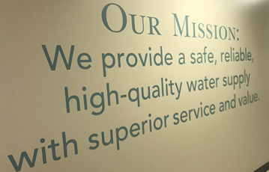
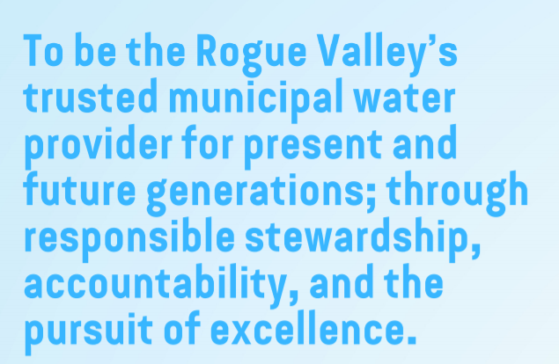
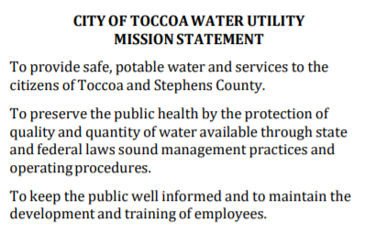
Mission Statements
Sets overall direction of the utility
Clear, concise, and specific
City of Tocca Water Utility| Tocca, GA
WaterOne | Johnson County, KS
Medford Water Commission | Medford, OR
Notes:
A mission statement sets the overall direction for the utility and allows everyone to share the same overall goal.
A well-crafted mission statement is clear, concise, and specific. It is easily remembered and understood by all, including board members, staff, and customers.
It is a good idea for the water utility to develop a mission statement if one does not already exist or to replace an outdated or poorly done mission statement.
There are a variety of tools that can help you learn how to gather a team, go through a brainstorming process, and end up with a mission statement that is unique, supported by all stakeholders, and fits your utility.

Slide 19
Goal Setting
Shape direction for future
Build team commitment
Foundation for accountability & performance
Mobilize people & resources toward the mission
Notes:
Once your mission statement is set, the next step is to determine the small steps that you and the entire utility team can take to meet your mission. Goals can be for one small group in the utility, such as the board, or for the entire utility. For example, the board can set a goal to ensure that everyone has the opportunity to speak on issues by implementing a process of pre-determined speaking times and raising hands to speak.
Another example of a goal could be for the utility billing department to start to include facts about the utility in the mailed bills and/or on the utility’s website and/or social media pages.
The utility’s goals can inform the direction for the future of the utility and build a team atmosphere that is committed to the overall well-being of the utility and its staff. Goals can bring together people and resources that provide additional methods for serving the utility’s mission.
Understand what is reasonable and feasible for your utility and develop the steps and resources needed to meet your goals.

Slide 20
management
Notes:
Managerial capacity is the utility’s institutional and administrative capabilities. Understanding the responsibilities and regulations are a key role of board members to ensure that the utility is meeting its managerial capacity.

Slide 21
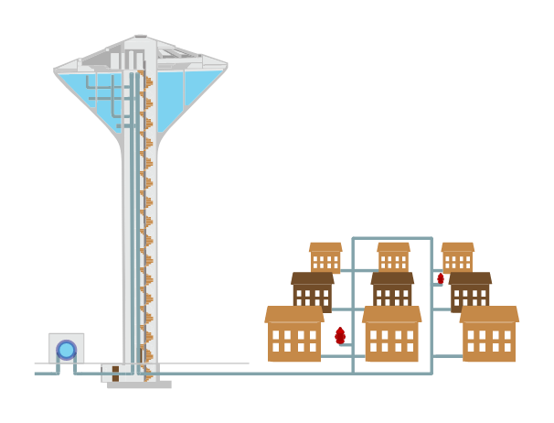
Public Water Systems (PWS)
Provide safe drinking water at the most appropriate cost
Water Quality
Reliability
Affordability
Notes:
The role of a Public Water System is to provide safe drinking water at the most appropriate cost.
This means the PWS is responsible for
water quality
a reliable supply
affordable water
Each of these responsibilities has a litany of regulations, permits, planning processes, policies, customer service needs, etc. Knowing all of it is next to impossible; however, understanding the basic structure of water quality regulations and knowing how to find more information is vital to managing a public water system.

Slide 22
Types of Public Water Systems
Community
Transient Non-Community
Non-Transient Non-Community
Year-round residential customers
Different non-residential customers every day
Same non-residential customers
Notes:
There are three types of public water systems: Community, Transient Non-Community, and Non-Transient Non-Community.
Community: Year-round residential customers
Towns, mobile home parks, rural water districts, subdivisions
Transient Non-Community: Different non-residential customers every day
Motels, parks, airports, campgrounds, truck stops
Non-Transient Non-Community: Same non-residential customers
Schools, daycare facilities, industrial or manufacturing facilities

Slide 23
National Drinking Water Regulations
National Primary Drinking Water Regulations
Maximum Contaminant Level (MCL)
Maximum Contaminant Level Goal (MCLG)
Treatment Technique (TT)
National Secondary Drinking Water Regulations
Cosmetic and aesthetic effects
Can help with level of service goals
Notes:
There are primary and secondary drinking water regulations and numerous amendments to each.
Primary Drinking Water regulations are legally enforceable standards that protect public health by limiting the levels of contaminants in drinking water. Examples of primary regulations are:
Maximum Contaminant Level – MCL: The highest level of a contaminant allowed in water that would still potable
Maximum Contaminant Level Goal – MCLG: Represents the level of a contaminant that would pose no detrimental health effect to humans
Treatment Technique – TT: Regulatory additions and changes necessitate the implementation of new or different treatment techniques for the removal of certain contaminants in drinking water.
Secondary Drinking Water regulations are non-enforceable guidelines regulating contaminants that may cause cosmetic or aesthetic effects, but not pose a public health threat. EPA recommends that secondary standards are met, but does not require compliance. Secondary regulations can help with level of service goals, which we will discuss later.

Slide 24
Effective Managerial Capacity
Organized, well-run & efficient
Accountable & transparent
Responsive to customers
Effective policy makers and implementers
Short- & long-term planners
Notes:
Utilities with effective managerial capacity are:
Organized, well-run & efficient by using tools available for effective communication strategies and engagement.
Accountable & transparent through open records and meetings.
Responsive to customers in a timely manner and are open to listening to praise and concern.
Effective policy makers and implementers by engaging with utility staff and community members to ensure that needs are being met.
Short- & long-term planners. Consider the goals of the utility and how small, quick steps can maintain the utility while progressing toward long-term goals.

Slide 25
Policies & Procedures
Personnel Policies
Purchasing Policies
Contracting Policies
Customer Service Policies
Notes:
Policies & procedures are the “how to” of running your utility
Read through the policies and procedures so that you know your utility inside and out. It helps you to be informed and make wise decisions.
Review them regularly which allows boards to make sure that they are still relevant, appropriate, and being implemented properly.
Change them if needed.
Giving copies of all policies and procedures to staff is important. If staff is asked during a capacity assessment on site if the utility has a written policy, they may answer “no” when there is a policy in place.

Slide 26
Personnel Policies
Set staff expectations
Provide uniform direction for staff and management
Instill confidence, trust and satisfaction
Notes:
Personnel policies are workplace rules and guidelines that set the standard for day-to-day workplace behavior. Personnel policies:
Define what is expected of staff, such as work tasks, dress code, behavior, internet & email, safety, etc.
Outline they can expect from management regarding payroll, benefits, overtime, promotions, etc.
Sets fair and uniform processes for corrective action, decision making, complaints, etc.
Review personnel policies in writing and in person.

Slide 27
Purchasing Policies
Guide for procuring goods & services
1
Optimize price savings
2
Buy quality products
3
Value vendor relationships
4
Comply with state and federal audit standards
5
Notes:
Purchasing policies are guides for procuring goods and services. Setting, reviewing and evaluating the implementation of purchasing policies and procedures is the role of the board; however, it is not the board’s role to weigh-in on every purchase.
Purchasing policies assist with optimizing price savings, ensuring the procurement of quality products, and develop positive vendor relationships for future needs. Purchasing policies can also assist with compliance with state and federal audit standards.
Purchasing policies should include checks and balances to reduce fraud, abuse, improper purchase, accusations, etc.
Write down purchasing policies and distribute to all employees involved in purchasing. Then, TRAIN employees to implement the policy and ensure compliance.

Slide 28
Contracting for Services
Be sure the qualifications fit the job exactly
Check credentials and recommendations
Review the contracting process
Notes:
Whether or not your utility needs to contract for services depends on your staff’s expertise. Communities range from no contractual assistance to strong dependence on contract personnel. Examples of typical contracts include: Attorneys, Engineers, Accountants/Auditors, Financial Advisors, other water utilities
When contracting for services:
Be sure the expert you are hiring has the exact experience for the job you are them hiring for. If it’s electrical work – hire an electrical or systems engineer, not an industrial engineer.
Check credentials and recommendations but take recommendations carefully. A contractor that is the best fit for one utility may not be the best suited for your utility.
Review your contracting processes regularly to ensure that your utility’s needs are current and that you are paying for the right services.

Slide 29
Customer Service Policy
Rates information
Get, quit, or transfer
Pay bills
Nonpayment
Questions
Emergency plans
Notes:
The more a customer understands the less frustrated they will be if something doesn’t go perfectly. Customer service policies are a way for utilities to communicate the goals and mission of the utility with community members. Customer service policies should be easy to read and should include:
Rates information
How to get/quit/transfer service
How to pay a bill
What happens if payments are not made
Where to go with questions
Emergency plans
Be sure that all board members know the customer policies inside and out. They are the ambassadors of the utility and should be able to answer customer questions with confidence.

Slide 30
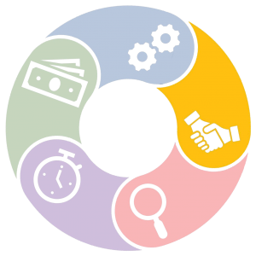
Level of Service
Level of Service is an opportunity to have a
conversation with customers to match their needs & desires with the amount they are willing to pay.
When customers have a say in what they want,
they are more willing to pay for it.
Notes:
All of these policies that we have discussed can help the utility understand their desired level of service.
The Level of Service component of Asset Management is the opportunity to talk with customers about their needs and desires and how that aligns with the needs of the utility. Conversations about what the utility needs to operate and what customers expect from their utility provide an avenue to allow rate-payers to provide input into the process. When they have that opportunity, they may be more willing to pay.

Slide 31
Level of Service Process
Involve Customers
Measurable Goals: Internal and External
Track Progress Towards Meeting Goals
Involve Staff
Notes:
Level of Service defines what you do, how you do it, when you do it, how you spend your money to provide what your customers want. It can be set up in a separate document called “Level of Service Agreement”
In managing the assets, a utility needs to determine what level of service it will provide. The key question for a utility to ask itself is “what do my customers want?” It’s very important to involve customers and staff in the process of establishing the goals or service levels. The goals should be measurable and can be either internal or external. External goals are those that directly impact the customers. Internal goals are those that are related to operations and that would not be easily understood by customers. Progress towards meeting the goals should be tracked and reported to upper management and the public.

Slide 32
Selecting the Goals
Maximum Level = Physical capabilities of the assets
Your Choice
Minimum Level = Must meet all regulatory requirements
Notes:
It is important for a utility to define what they want their assets to do; how they want their assets to perform. There are two boundary conditions. The minimum condition is that the utility must meet all federal, state, and local regulatory requirements. The utility cannot go below this level. The upper boundary condition is the physical capabilities of the assets. For example, if the piping is rated for 100 psi, the utility can not set a level of 120 psi as its level of service goal. Between these boundaries is where a utility can set its level of service goals.

Slide 33
Energy Efficiency and Level of Service
Establish a baseline for current energy usage
Set goals for energy usage
Track energy usage over time to determine if goals were met
May require additional metering or data gathering to better determine the energy usage of individual assets
Notes:
Energy efficiency contributes to Level of Service goals by helping the utility determine potential savings. When funds are freed up in one area, they can be directed to other needs.
To determine the potential for energy savings, it is important to establish a baseline of current energy use. Then goals for energy usage can be established. Energy usage can be tracked over time to determine if goals were met. To determine how well the utility is doing towards meeting the goals, it may be necessary to determine the individual energy usage of assets. This information may require individual metering or checking run times of assets.

Slide 34
External Goals
Fewer than 5 odor complaints per quarter related to WWTP
Minimum water pressure of 50 psi throughout system, 95% of the time
Customer service line available from 8 am – 5 pm, 5 days per week
Customer complaints addressed within 1 business day, 95% of the time
Fewer than 2 sewer backups per month
Notes:
External goals are those that directly impact the customers. These goals are established based on data you may already have regarding customer input or might need to be determined by engaging with the community to determine what the utility’s external goals could be.
Here are a few examples of external goals.
What should be noticed is that the goals are all measurable and each of them could be tracked over time to see if they are being met. Also, in some cases, there are caveats on the goal, like “95%.” It is important to recognize that it is not always possible to meet goals and that in some cases, it’s okay to say that you will meet it 90 or 95% of the time or what may be reasonable and feasible for your utility.
One case where this can not be done is a goal of meeting regulatory requirements. That goal should be met 100% of the time.

Slide 35
Internal Goals
Digitize asset maps
75% planned maintenance, 25% reactive maintenance
Reduce energy consumption by 10% at the wastewater treatment plant
Notes:
Internal goals are those that the are focused on the utility and its operations. These goals might not be easily understood by the public.
Here are some examples of internal goals.
Keep in mind that these goals are also measurable and could be tracked over time. Within each goal, there may be smaller or incremental goals. For example, if your utility seeks to get to 75% planned maintenance and 25% reactive maintenance, you may first have to learn what the utility’s current percentages are.
As another example, reducing energy consumption relies on understanding the amount of energy that the utility consumes. Perhaps another internal goal is to complete an energy audit.

Slide 36
Level of Service Agreement Examples
Level of Service Examples
Level of Service Agreement Example 1: Water System
1. All federal and state water quality regulations will be met | Is it measurable? Yes How often would you measure? Monthly compliance reports
2. Water losses shall be less than 10% | Is it measurable? Yes How often would you measure? Compare master meter readings to billings quarterly
3. The system will maintain a minimum pressure of 40 psi | Is it measurable? Yes How often would you measure? Pressure reading monthly
4. There will be fire flow available for 100% of the customers within the system. | Is it measurable? Yes How often would you measure? Tested quarterly
Notes:
Here are some examples of Level of Service agreement goals for a water system. Establish the goal, then determine if it is measurable, how often to measure, and how to measure.

Slide 37
Level of Service Agreement Examples
Level of Service Examples
LOS Agreement Example 2: Wastewater System
1. System will meet all state and federal regulatory standards | Is it measurable? Yes How often would you measure? Monthly compliance reports
2 Less than 10 odor complaints per year. | Is it measurable? Yes How often would you measure? Review customer complaint logs yearly
3. Less than 4 sewer back-ups per year. | Is it measurable? Yes How often would you measure? Review log of work orders yearly
4. Less than 25% corrective work orders. | Is it measurable? Yes How often would you measure? Review log of work orders quarterly
Notes:
Here are some examples of Level of Service agreement goals for a wastewater system. Establish the goal, then determine if it is measurable, how often to measure, and how to measure.

Slide 38
Level of Service – Gaining Input
How do we know what our customers want?
ASK them!
Methods:
Surveys, focus groups, phone calls, public meetings
News releases, social media
Don’t just listen to the loud voices, listen to all voices
Notes:
Engaging with the community is an essential part of setting goals for your utility. To know what your customer wants, you must ask them. Surveys, focus groups, phone calls, and public meetings are all ways to gather input from the community. Ensure that you are gathering input from everyone in your community. Find ways to reach “hard-to-reach” members and ensure that the variety of demographics in your community is represented.

Slide 39
Communicating with Customers
Bill stuffers
Billboards
Classes
Consumer confidence report
Mailers
Newspapers
Phone calls
Posters
Radio/TV
Social media
Special meetings
Surveys
Notes:
Most of a water utility is buried or hidden from view, and customers only pay attention to it when it doesn’t work. That rarely happens (we hope) but maintaining good communication with customers can help when you do hit a rough patch.
Communicate what you are doing … Tell your story, gain buy-in, build trust by using a variety of tools and methods. Use your website, social media, and text programs to reach tech-savvy individuals. Use bill stuffers or images on the bill’s envelope or newsletters to reach people who prefer that method of communication.
Especially if a rate increase is coming, more communication about the positive things your utilities does, the benefits to the community, and the needs to service folks better will soften the blow of a rate increase.

Slide 40
technical
Notes:
The second component of capacity is technical capacity. Technical capacity provides the utility with the necessary skills and equipment to reliably produce and deliver an adequate supply of water that meets all drinking water standards.

Slide 41
Technical Capacity
Understand:
Regulation
Treatment and Process
Utility Sustainability Programs
Maintain Good Records
Proper Certification and Training
Operate and Maintain Assets
Protect Water Sources
Secure Water Quantity
Infrastructure
Notes:
Technical capacity ensures that staff, operators, and board members understand regulations, the treatment process, and the records and certification required to operate a utility. It also provides the utility with the opportunity to effectively and efficiently operate and maintain the system’s assets, protect source water, ensure adequate water quantity and assess, maintain, and replace infrastructure.

Slide 42
Operations and Maintenance Plans
Level of Service
Current State of the Assets
Criticality
Life Cycle Costing
Long-term Funding
Notes:
Strong Operations and Maintenance (O&M) plans are based on the principals of asset management, including level of service, asset inventory, criticality, life cycle costing, and long-term, sustainable funding.

Slide 43
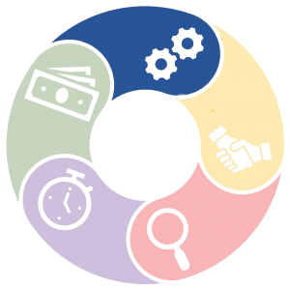
Technical Capacity and Asset Management
What do I own?
Where are the assets?
What is:
their condition?
the life of the assets?
the value of the assets?
the energy use of the assets?
Notes:
To better know the gaps in technical capacity, understand your assets. What does the utility have? Where are the assets? Are there maps of the locations? What is their condition, life, value, and energy use?
Understanding these elements of your utility can inform current and future planning needs for increasing or improving technical capacity.

Slide 44
The Asset Inventory
Shows the current state of the assets
Use inventory that works for your utility
Balance collection of asset data with costs & benefits
Update and maintain the inventory continuously
Notes:
The Asset Inventory shows the Current State of the Assets. This compilation of assets can be kept in any manner that is within the capabilities of the utility. It can be on paper in binders or maintained digitally in a simple spreadsheet or a commercial product. The sophistication level can be increased over time as the system is able to invest in other options.
There is a lot of information that can be collected on assets and put into the inventory. Remember that collecting data takes time and money and that it is important to balance the benefits of having data about the assets with the costs of collecting the data. Data that is beneficial to the utility should be collected. The inventory should be maintained and updated and periodically.

Slide 45
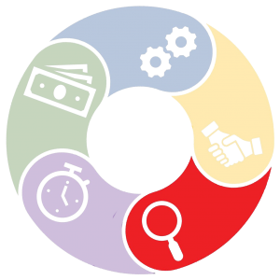
Criticality
Probability
Consequence
Condition
Age
Repair history
Economic impacts
Social impacts
Environmental impacts
Legal costs
Notes:
Not all assets are equal in importance to the utility. Some are essential to operations, and some are not. It is important for each utility to determine what its critical assets are. This process is referred to as Criticality.
As an example, a small water or wastewater pipe that serves a few houses is not as important to a utility as a single pump that supplies the entire water system. If the single pump fails, the whole town is out of water.
Criticality considers the likelihood or probability that an asset will fail, and the consequences if the asset does fail.
Assessing the probability of failure involves understanding:
ways in which an asset fails
the condition of the assets
age of the assets
repair history
historical knowledge, and
operation and maintenance history.
The second component is the consequence of the failure. Thing to consider as the consequences of failure can include:
cost of repair
social impacts
costs associated with the failure
costs related to collateral damage
legal costs
environmental costs
reductions in level of service, and
any other costs or impacts associated with failure.
One way to reduce the consequences is through redundancy. Redundant assets provide a back-up in the event of failure. This can reduce the consequence of failure because the back-up asset is there to continue to provide service. As an example, there are three pumps available and only 2 are needed to meet the demand. If one pump fails, the standby pump will start so the demand will still be met.

Slide 46
Critical Assets – Risk Analysis
Which category of assets require the most attention?
Which category of assets requires the least attention?
Medium Risk
High Risk
Consequence of Failure
Low Risk
Medium Risk
Probability of Failure
Notes:
Each asset can be evaluated in terms of its individual probability of failure and consequence of failure. The assets can then be plotted on a quad chart based on the identified probability and consequence. In this type of chart, the assets with the highest criticality, or risk, appear in the upper right-hand quadrant. The assets in the lower left have lower criticality scores. The other two quadrants represent a medium criticality score.

Slide 47
Criticality & Energy Prioritization
Consequence of Failure &
Feasibility of Addressing Energy Use
Medium Risk
Medium Priority
High Risk
High Priority
Look for overlap in assets.
Are some in the high box for both criticality and energy prioritization?
Low Risk
Low Priority
Medium Risk
Medium Priority
Probability of Failure & Energy Use
Notes:
You can use the same type of chart to prioritize projects that will also result in energy savings. First plot the likelihood that changing an asset or energy source will impact energy use, along with the amount of energy that asset uses. Then, the criticality and energy priority quad charts can be laid on top of each other to see which assets are both high risk and high priority for energy efficiency. If an asset falls in the upper right-hand quadrant for both criticality and energy, that asset would be a top priority for replacement.

Slide 48
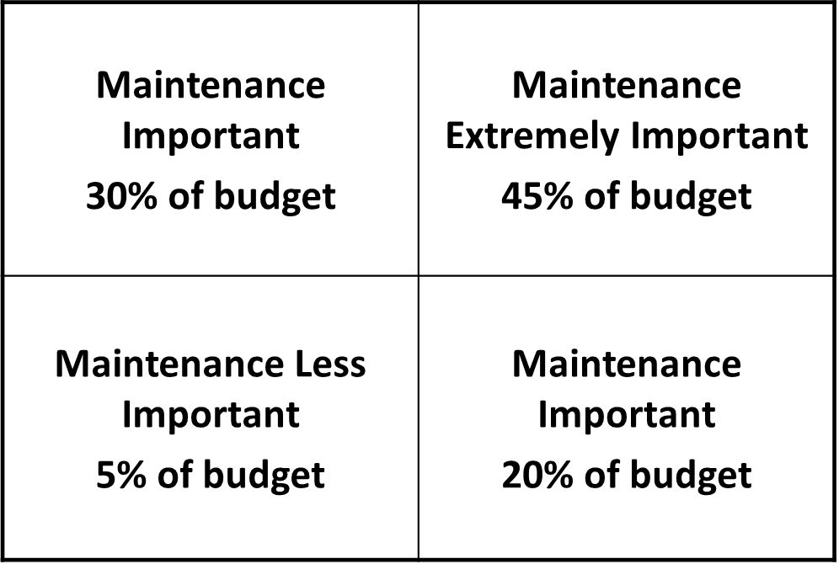
Operation & Maintenance Plans
Maintain Assets
Operations
Activities to keep water flowing
Maintenance
Routine, preventative, predictive
Not emergency
Notes:
The quadrant structure can assist with Operation & Maintenance plans also. By giving each asset a criticality score, your utility can allocate certain amounts of the budget and/or time to the assets with the highest scores. Understanding where your assets are in your O&M plans can help inform how much of your budget should be spent on them, their maintenance, and replacement.

Slide 49
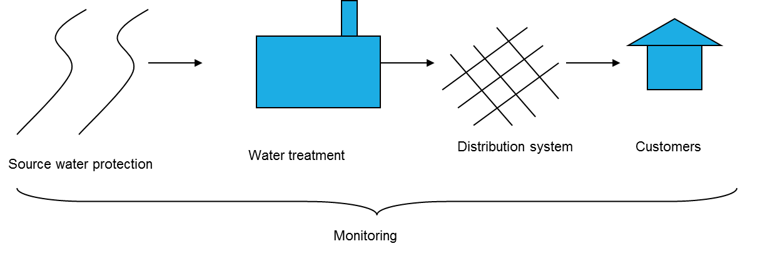
Multiple Barrier Approach
Source Barrier – Keep contamination out
Treatment Barrier – Inactivate or remove it
Distribution Barrier – Prevent it from re-entering
Notes:
Drinking water utilities have a multi-barrier approach to providing clean, safe drinking water: source water protection, water treatment, and the distribution system.
The source protection barrier is meant to keep contamination out of the drinking water source which reduces the amount of treatment needed.
The treatment process is to inactivate or remove contamination from the water to make it drinkable.
The distribution barrier helps prevent contaminants from re-entering the system.

Slide 50
Source Barrier
Elements of a Drinking Water Protection Plan (DWP)
Develop a leadership team
Investigation and assessment
Write the DWP Plan that outlines investigation results, sets goals, objectives and methods to protect or restore water quality
Implement and monitor
This Photo by Unknown Author is licensed under CC BY-NC
Notes:
Protecting drinking water sources usually requires the combined efforts of many partners such as public water systems, communities, resource managers and the public.
The first step is to develop a leadership team. The team should be made up of stakeholders interested in the pursuit of drinking water protection. This group is assembled and led by the public water supply and is made up of local landowners, conservation groups, agency representatives, business, water system operators and other interested parties.
Before a plan is written, information must be gathered. The investigation of the Drinking Water Protection plan will cover historical information from agencies and local community members, and new information is obtained through monitoring, testing and modeling. The original Source Water Assessments will be updated at this time.
After the investigation results have been gathered and evaluated, the DWP plan is written. The plan outlines the investigation results and sets goals, objectives and methods to protect or restore water quality
Implement/Monitor - The true purpose of DWP is the implementation of the DWP plan. The plan identifies resources for the PWS to use to implement the yearly goals. The plan outlines milestones for the purpose of monitoring the plan’s progress.

Slide 51
Treatment Barrier
Disinfection
Chlorine, Chloramines, Chlorine dioxide, Ozone, Ultraviolet
Filtration
Surface and GWUDI required by regulations
Addition Treatment
Corrosion inhibitors
Lead and copper reduction
Notes:
Water treatment processes use a variety of filtration and disinfectants to remove harmful elements from water before it gets to homes and businesses. Chlorine, ozone, and UV disinfection in conjunction with surface filtration and additional treatments ensures that community members are receiving clean and safe water.

Slide 52
Distribution Barrier
Chlorine Residuals
Insert local/state minimum/maximum levels
Minimum Pressure
Insert local/state minimum requirements
Maintain Water Storage
Cross-Connection Control
serious public health hazard
Notes:
Distribution barriers prevent new contaminants from entering the water system by maintaining positive pipeline pressures, regulating cross-connections, and other measures. Additionally, a residual disinfectant, usually chlorine-based, is maintained to attack any surviving or entering pathogens in the water distribution system. Local flushing also is sometimes used to reduce residence times of treated water in parts of the distribution systems.

Slide 53
Additional Barriers
Regulatory Oversight
EPA
State
Security Measures
Bioterrorism Act 2002
Vulnerability, Response Planning
Staff Expertise
Notes:
Additional barriers to contamination are regulatory in nature. Federal and state oversight, security measures such as the Bioterrorism Act of 2002 and response planning, along with staff expertise helps clean source water and protect the clean water in the water distribution system.

Slide 54
Utility Sustainability Programs
Water Loss Control
Protect water resources
Energy Efficiency
Reduced energy cost
Minimize disruptions to customers
Interrelated to water loss
Notes:
Utility sustainability programs are used to control water loss and move to increased energy efficiency in the water treatment plant and processes.
Water loss control includes protecting water resources through effective extraction and water conservation practices and programs. Controlling water loss can also minimize disruptions to customers which can also help to meet level of service goals.
Energy efficiency can be small steps, such as turning off lights that are not needed; to upgrading equipment to more energy efficient devices; to reorganizing operations and maintenance to maximize efficiency. Working toward energy efficiency can lead to reduced energy costs.
Water loss control and energy efficiency are interrelated. Saving water saves energy.

Slide 55
Water Loss Control
Establish Nature of the Problem
1
Set Goals
2
Choose Appropriate Strategies
3
Prioritize Strategies
4
Develop Funding Plan
5
Notes:
To understand why your system is losing water, you must first establish the nature of the problem
Non-Revenue Water
Unaccounted for Water
Unbilled authorized uses
Unauthorized water uses
Data handling errors
Water leaking from the system
real water losses
Then set goals for reducing water loss based on the cause.
Choose appropriate strategies and prioritize them for implementation:
Accurate Meters
Source and service connection
Meter change out program
System cash register
Slow meters – reduced revenue
Encourage conservation
No way we used that much water
Demand and customer data planning
Infrastructure adequate
Finally, develop a funding plan to pay for the identified strategies for reducing water loss.

Slide 56
Energy Efficiency
Establish Nature of the Problem
1
Set Goals
2
Choose Appropriate Strategies
3
Prioritize Strategies
4
Develop Funding Plan
5
Notes:
To determine how your utility can be more energy efficient, the process is similar to water loss control.
First, determine of the problem and/or determine where more energy efficient equipment and processes can be installed and implemented.
Inefficient systems
Excess energy use (e.g., lights always on, old equipment, etc.)
Then set goals for increasing energy efficiency based on the cause or other established goals.
Choose appropriate strategies and prioritize them for implementation:
Accurate Meters
Finally, develop a funding plan to pay for the identified strategies for increasing energy efficiency.

Slide 57
Financial
Notes:
The third component of capacity is Financial Capacity. Adequate financial capacity means that the utility has the financial resources to supply clean, safe, reliable drinking water.

Slide 58
Financial Capacity
Short Term
Long Term
Pay staff
Utilities
Repairs
Leases
Contractors
Debt
Finance replacements
Retain staff
Ensure adequate water supplies
Capital improvements
Notes:
Both short- and long-term financial capacity is important for financial health and sustainability. Short-term capacity provides salaries, repairs, leases, contractors, other utility bills, and other immediate expenses.
Long-term capacity provides replacements, capital improvements, upgrades, and staff retention.

Slide 59
Indicators of Financial Capacity
Financial Resources
Future Expenses
Budgets
Rates & Revenue
Financial Controls
Audits
Credit access
Capital Improvements
Expenditures
Revenue meets expenses
Reserves
Regulatory changes
Notes:
Existing and potential funding are both indicators of financial capacity. Current adequate and protected financial resources, such as rates and budgets, keep the utility operating at the desired level of service.
Future financial planning relies on adequate reserve accounts, balance between revenue and expenses, and planning for capital improvements.

Slide 60
Fiduciary Duty
A system’s financial capacity is critical to the health & well-being of individuals and the community.
Board members are fiduciaries and must always act for the benefit of the public.
Notes:
Stress that board members are ultimately responsible for the financial management of the system.
A utility system must be adequately funded for current operations as well as for future needs. That funding is critical to the environmental, economic, and social health and well-being of the people in your community. As board members, you are fiduciaries that must always act for the benefit of the public.

Slide 61
Budgets and Budgeting
Yearly plans
Future plans
Determine priorities
Board reviews & approves
Notes:
Budgeting is important to maintaining financial capacity and understanding where funding is needed. Yearly plans that cover short-term expenses and future budgets looks at funding long-term projects and goals. Utility and/or city staff does most of the budgeting work; however, since board members review and approve the budget, it is important that you understand the various parts of what goes into the budget.

Slide 62
Budgeting Tips for Water Utilities
Remember
Always
Water use (and revenue) swing from year to year
Suppliers have good knowledge of future costs
Significant users
Reserve funds
Use several past years
Include major changes
Budget based on necessary expenditures
Consider life cycle costing
Factor in criticality of assets
Notes:
Things to remember:
It is important to remember that water use and revenue from use fluctuates from year to year, so consider than when planning for the future.
Often, suppliers have an idea of future costs of equipment and supplies, so getting that information from them could be helpful.
Track events or seasons of large use of significant users. Manufacturers and other commercial customers may have certain times of the month or year when they use more water.
Contribute to your reserve fund!
Always:
Use previous year expenses as a guide for budgeting. Previous years can provide insight into periodic events and can lay groundwork for upcoming major changes.
Include anticipated changes, such as the gain or loss of a significant user, new development, and new equipment
Budget based on necessary expenditures, not projected revenue. You need funding to operate your utility.
Consider life-cycle costing to anticipate expenses over time, such as yearly, every 5 years, every 10 years or whatever timeframe make sense for your utility.
Understanding your assets’ criticality scores can help when budgeting by understanding what will need to be repaired or replaced in the coming year.

Slide 63
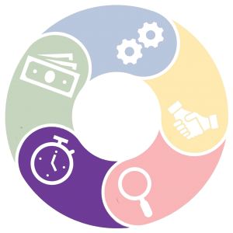
Concept of Life Cycle Costing
Consider all costs of operating and maintaining the assets over the entire life cycle.
Capital Costs
Operations & Maintenance
Repairs
Rehabilitation
Legal
Environmental
Social
Notes:
The concept of life cycle costing is to consider all the costs of operating and maintaining the assets over the entire life cycle. These costs include capital costs, all operation and maintenance costs, all repairs, rehabilitation costs, and any other costs associated with the asset, such as legal, environmental, or social. When all the costs are examined, a utility can determine the optimal time to intervene with maintenance and the appropriate time to replace the assets.

Slide 64
Concept of Life Cycle Costing
Example
Option 1 | Option 2
Do more maintenance and rehab to forestall replacement Initial Cost: $90,000 O&M per year = $2,000 Repair Costs = $30,000 Rehabilitation = $70,000 Life of Asset = 30 years | Do less maintenance and replace more often Initial Cost: $90,000 O&M per year = $500 Repair Costs = $5,000 Rehabilitation = $0 Life of Asset = 10 years
Total Cost Option 1 = $250,000 | Total Cost Option 2 = $300,000
Notes:
Without looking at life cycle costs, it isn’t possible to know which option is the cheapest overall for the operation. In this example, you can visualize how important it is to look at overall costs.
To get the costs, the O&M per year is multiplied by the number of years and added to the other costs. The totals are considering a 30-year life cycle. When life cycle is considered, Option 1 is the most economically efficient.

Slide 65
Life Cycle Costing and O&M
Routine and preventative maintenance can help extend the life of an asset.
Maintenance takes resources – time & supplies
Decide how to allocate maintenance based on risk associated with the asset
Notes:
Routine and preventative maintenance can help extend the life of an asset. Maintenance takes time and resources, so it is important to determine what maintenance should be done on each asset and when it should be done. For high-risk assets, it is very important to do preventative maintenance to reduce failures and extend the life of the asset. On low-risk assets, only routine maintenance and minimal preventative maintenance should be done.
Low-risk assets may be allowed to run to failure. Run to failure is a good management strategy for assets with low consequences of failure.
Using a car as an example, assets that can run to failure are the car radio, horn, electric locks, and automatic door opener. Examples of car assets that would not be allowed to run to failure are brakes, timing belt, and tires.
Consider the assets with a low criticality score and determine if run to failure is an option for those assets.

Slide 66
Maintenance Based on Criticality
High Risk:
Maintenance Extremely Important
45% of Budget
Medium Risk:
Maintenance Important 30% of Budget
Consequence of Failure
Low Risk:
Maintenance Less Important
5% of Budget
Medium Risk:
Maintenance Important
20% of Budget
Probability of Failure
Notes:
This quad chart, similar to the criticality charts, shows a potential budget strategy for maintenance for the four categories of risk. It shows that the majority of the budget should be spent in the high-risk box and the lowest amount of the budget should be spent on the low-risk box. This doesn’t mean that low-risk assets do not require proper funding. This chart is meant to show how to allocate funding to assets based on their risk, or criticality, score.

Slide 67
Replacement of Assets & Risk
High risk assets
Low risk assets
X
X
X
X
Condition
Replacement Point
Condition
Replacement Point
X
X
X
X
X
X
Time
Time
Notes:
For high-risk assets, err on the side of caution and replace the assets before they fail. Then, they can be replaced in a planned manner to minimize the consequences of losing this asset. Low risk assets may be allowed to fail using the run to failure management strategy discussed previously. These assets can be replaced after the failure occurs because the consequences of failure are low.
As seen on these charts, if that asset was high risk, it would be replaced before the optimal point. If it were low risk, it would be replaced after the optimal point. Keep in mind that we don’t know the actual optimal point, so we are erring on the side of caution in the first case and erring on the side of not replacing soon enough in the second case all based on the risk of a failure.

Slide 68
Financial Reserves
Operational
Repair/Replace
Debt Service
Emergency
Notes:
Having financial reserves is important for ensuring that your utility can run efficiently and can be prepared for future needs, including upgrades and replacements.
Operational reserves are for planned expenditures for the upcoming 3-6 months. This reserve provides a smooth cash flow and provides a little security in case of a “rainy day” event. Operational reserves can also absorb costs that are higher than originally intended and can provide continued operations in case of a reduction in revenue. Think of operational reserves as your personal savings account that you use in case you have an unplanned expense or loss of revenue.
Repair/Replace reserves vary year to year depending on maintenance schedules. This reserve can provide cash for items that are too cheap to take on debt for, yet still have a high price tag. Some examples are high service pumps, tower maintenance, and well servicing.
Debt service reserves are required by the lender in case of a reduction in revenue that can impact repayment. Having a debt service reserve can reduce interest rates on future loans.
Emergency reserves should have enough to cover the current cost of the most expensive capital item in your utility. This will provide funds to cover unexpected costs, such as an asset that failed before expected or other damage.

Slide 69
Capital Improvement Planning (CIP)
Long-term planning
High-cost assets
Identifies year of project
Includes justification
This Photo by Unknown Author is licensed under CC BY
Notes:
Capital improvement planning is long-term planning. Usually, capital improvement plans are 20 years, but 5 or more years is a good start. Typically, capital improvement planning details the price of high-cost assets that include multiple phases, such as design, construction, and disposal. It usually identifies the year of the project and can include life-cycle costing analysis, repair/maintenance schedules, etc. The capital improvement plan also includes justification for the need and includes alternatives as well as risks if not completed.
Capital improvement planning creates a long-term roadmap for large assets and projects that will need to be funded over time, usually through financing options.

Slide 70
Why Capital Improvement Planning (CIP)?
Meeting regulatory requirements
Proactive – not reactive
Inform future decision makers
Establishes priorities for public review
Funding institutions see system thinks long-term
Not binding, unlike annual budgets
Notes:
Capital improvement planning can ensure that a utility can meet regulatory requirements. It can help the utility move to a more proactive rather than reactive cycle of repair and replace, which can be more cost efficient. Capital improvement planning can keep consistency though changes in decision makers and shows the public the priorities of the utility and decision makers. Capital improvement planning shows long-term thinking to funders, even though it is not binding and can be adjusted as needed to accommodate the needs of the utility and community.

Slide 71
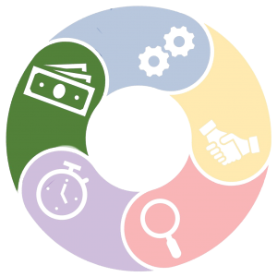
Capital Project Planning (CIP) and Validation
5 – 20+ years
High dollar projects “validated”
Energy efficiency should be considered in all future replacement projects
Notes:
All utilities need to replace assets at some point. It is important to plan for these replacements since capital projects can be extremely expensive. Ideally, the Capital Improvement Plan or CIP would cover at least 20 years but should cover a minimum of 5 years. The longer your plan, the better the utility can plan for its future.
For very expensive projects, a validation process, also called a business case evaluation, should be done. This process examines the project, the need for it, the benefits of doing it, the risk of not doing it, and any alternatives, to ensure that the project is needed and that the correct project is being done. Energy efficiency should be a consideration of any replacement project.

Slide 72
Tips for Capital Improvement Planning (CIP)
Stay realistic
5 year minimum
Justify need
Coordinate with other projects
Detail funding options
Discuss openly
Notes:
Here are a few tips for successful capital improvement planning:
Stay realistic in your planning. Consider what your community will look like in the long-term to not overburden your rate-payers with unnecessary costs.
A Capital Improvement Plan should be a minimum of 5 years. Ideally, it will be a 20-year CIP, but start where it makes sense for your utility and build from there.
Be sure that the CIP justifies the needs and evaluates alternatives. Add life-cycle costing information to show how the assets will be maintained and eventually replaced.
Coordinate with other projects and plans in your community. Often, street repair and utility repair can occur at the same time to avoid excess construction and save money.
Detail the various funding options for the CIP, including short- and long-term financing. Consider how funding may be allocated into various reserve accounts. Include why the funding sources are identified and how they will best serve the CIP and the community.
Discuss openly and often with decision makers, utility staff, and the community.

Slide 73
Capital Improvement Reserves
Covers upfront costs
Informed by CIP
Reduces debt burden
Depreciation → Reserve
Notes:
Capital Improvement Reserves are necessary to pay upfront costs, such as engineering services, land acquisition, surveys, legal costs, etc.
The Reserves are informed by the Capital Improvement Plan. It outlines the funding streams and how they will build the Capital Improvement Reserves.
Using reserves also helps to reduce the debt burden by providing funding for upfront costs before debt financing.
Best practices are to transfer most depreciation expenses to the Capital Improvement Reserves.

Slide 74
Rates & Revenue Sufficiency
Well-run water utility
Measure & know all costs
True cost of service
Notes:
Rates and revenue sufficiency is the cornerstone of a well-run utility. Having adequate and sufficient funds to complete necessary operations and maintenance as well as upgrades and improvements ensures that you are providing safe, clean, and reliable water to your community.
Utility system expenses, such as operations and maintenance should be covered by user rates and fees. It is imperative to understand all costs associated with operating the utility to be sure that your user rates are sufficient and that you are meeting regulations. The true cost of service should be reflected in your utility’s user rates and fees.

Slide 75
Revenue Sufficiency Factors
Revenue
Number of customers
Expenses
True expenses
Water Demand
Expenses to include
Notes:
Consider 2 main factors to revenue sufficiency: Revenue and Expenses
Revenue is determined by the number of customers and water demand. Minimum monthly fees for all users can provide reliable minimum revenue.
Water demand can fluctuate based on the weather, population changes, business and industry changes, and conservation practices. Consider these changes when budgeting and developing a Capital Improvement Plan. Look back to historical water demand to understand trends of usage in your community.
It is imperative to understand the true cost of operating your utility. Knowing the costs of equipment, labor, and other expenses help to ensure that you are setting rates at a level that will ensure efficient operation of your utility. Expenses to consider are operations, capital improvements, and fixed costs.
Note other revenues – connection fees, etc., which do exist but are typically minor

Slide 76
Rates & Rate Setting
Simple
Based on expenses
Cover full costs
Fair, affordable & equitable
Super-complicated
Frozen in time
Based on political desires
Based upon neighbors
Notes:
Note to User: Adapt this slide to reflect how rate setting operates locally or in your state
Rates and setting them should be simple to understand, implement, and change when necessary. Complex tier structures can be challenging, so try to keep them straight-forward so that utility staff and rate-payers and decision-makers all understand the process for setting and implementing rates.
Rates should be based on expenses to cover full costs of operations and should be fair, affordable, and equitable for all rate-payers.
Rates should not be frozen in time. Rates have to increase as costs increase in order to cover the cost of operating a utility. They should not be based on political desires or ambitions but rather on what is needed for the utility and the community. It is okay to consider what other similar communities’ rates are; however, it is important to understand that each utility is unique in its community and its needs. Use your own community’s information to make wise decisions about rates and setting them.

Slide 77
Financial Controls
Protect
Safeguards against theft and fraud
Separation of duties & bonding
Purchase
Rules for purchasing day-to-day items
Rules for purchasing high dollar items
Rules for hiring of services
Notes:
Boards adopt ordinances and policies to safeguard system funds. These are some of the minimum financial controls needed. Discuss in more depth if questions arise and refer to your board manual for greater details.

Slide 78
Access to Credit Markets
Why Finance?
What to do?
Credit is essential to finance large capital projects
Small systems often rely on mix of loans & grants
Larger systems typically rely on bond issuance
Proper financial management necessary
Debt covenants must be followed
Rates increases regularly
Notes:
You may ask yourself; do we have to finance and take on debt? There are benefits to taking on debt to finance improvements, upgrades, and expansions. Debt provides the utility with credit, just like individuals who get car loans or mortgages. Receiving and paying back loans is an appropriate way to build credit. You will have to finance larger projects, so ensuring that your utility has the credit to do so is important. Having your finances in order and operating smoothly is the best way to ensure that you can take on debt to provide your community with the level of service they expect from your utility.
Ensure your utility has proper financial management including, efficient and accurate recordkeeping, following covenants of existing debt, and raising rates regularly to ensure adequate revenue for expenses.
Note to User: Explain that lenders will not want to lend to individuals in a financial mess and it is no different for utilities.

Slide 79
Funding Sources
Taxes
Rates
Internal Funding
Fees
Grants
Bonds
External Funding
Loans
Notes:
Funding is needed for the general day-to-day operations of the plant and for capital expenditures related to rehabilitation or replacement of the assets. The funding for day-to-day operations is considered internal funding. This type of funding will come from the consumers in the form of customer rates, fees, taxes or similar.
The funding for capital can be internal or external funding. Generally, it is external funding in the form of grants, loans, special funds, or bonds. Except for grants, the utility will ultimately need to repay the external funds through utility rates.

Slide 80
Funding for Energy Efficiency
Energy savings may pay for the project over time
Energy Service Companies (ESCO)
Special sources, such as “Green Reserve” of the State Revolving Fund
Some energy projects may be justified by the goals of the energy efficiency program
Notes:
Note to User: Update this slide to include energy programs specific to your state.
Energy efficiency projects are somewhat unique in their funding. There may be additional sources available to fund this type of project. In some cases, the new asset may be so much more energy efficient that it is able to pay for itself. For example, if a new pump would cost $30,000 to install and would reduce energy costs by $5,000 per year, it would pay for itself in 6 years. If it was expected to last at least 6 years, the project would pay for itself.
Another option is ESCOs. ESCOs are Energy Service Companies. These companies pay the cost of installation up front and often guarantee an energy savings. The utility pays for the installation of the equipment over time through the energy savings.
There may also be other funding sources, such as the Green Reserve of the State Revolving Fund, that can be used for energy efficiency or “green” energy projects. Even though energy projects may often be justified by the cost savings, sometimes they can’t. There may be other compelling reasons to do an energy project anyway if it will meet the goals of energy efficiency or greenhouse gas reductions or meets regulatory requirements.

Slide 81
Final Thoughts on Financial Management
Financial management is continuous
Credit access
Understand finances
Ask questions
Make informed decisions
Notes:
Financial management is continuous and requires frequent assessment. Changes in operations and maintenance due to many variables, some predictable and some unpredictable, can impact expenses. Natural disasters, accidents, and impacts from climate change can affect Capital Improvement Plans, long- and short-term funding goals, and revenue from rate-payers.
When planning for larger projects, consider your credit-worthiness and what you need to do to maintain or improve your access to credit.
Understand the finances of day-to-day operations and long-term planning. Understand the various reserve funds and why they are important. Ask questions of utility staff, city leaders, and community members to ensure that you are making informed decisions.

Slide 82
Acknowledgements
Notes:
This presentation was developed with the support of these entities.

Slide 83
Disclaimer
This project has been funded wholly or in part by the United States Environmental Protection Agency under assistance agreement A18-0408-001 to the University of North Carolina at Chapel Hill. The contents of this document do not necessarily reflect the views and policies of the Environmental Protection Agency, nor does the EPA endorse trade names or recommend the use of commercial products mentioned in this document.

