Slide 1
Public Finance Professionals Lunch&Learn
Hai (David) Guo,
Regents Professor of Public Finance,
Feb 14th , 2025

Slide 2
Agenda for Today
GFOA Best Practice—Public Engagement in the Budget Process
GFOA Survey Results
Budget Simulation—Polco/Balancing Act
Plan

Slide 3
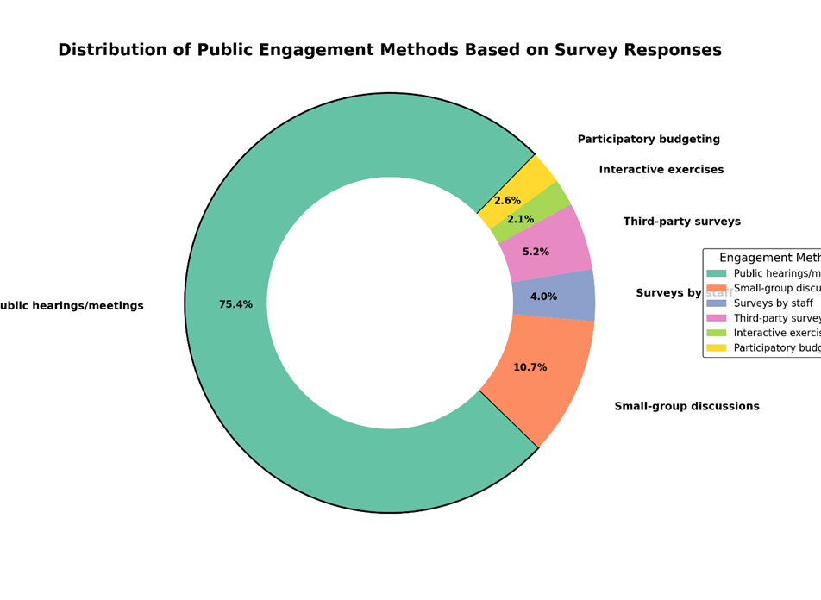
Public Engagement Methods

Slide 4
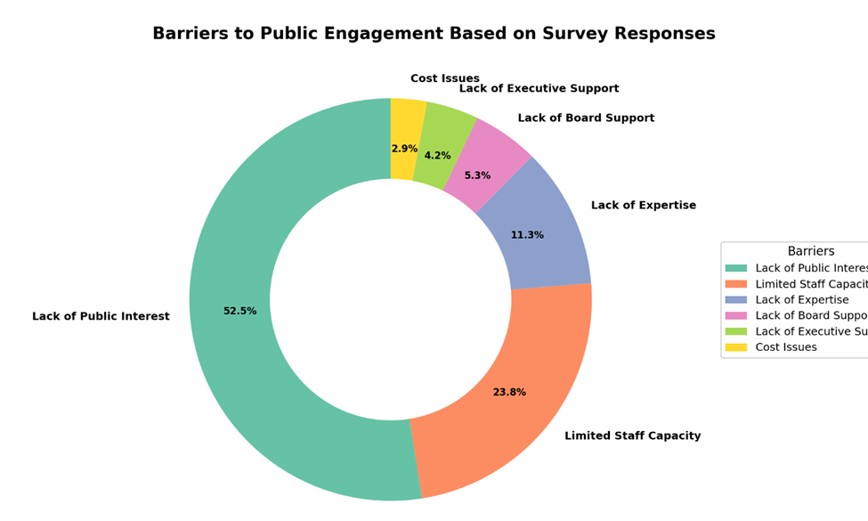
Common Barriers

Slide 5
Importance v.s. Perceived Performance
The average score of Performance is statistically lower than the Importance score

Slide 6
Budget Simulation
Speakers & Polco Overview
What is Rethinking Budgeting? GFOA
Who are the technology partners of Rethinking Budgeting?
Prominent members using these tools
Highlight and show simulation tool - Lawrence, KS
Where to begin with Rethinking Budgeting?
GFOAs Assessment
Polco's Solutions that tie directly to GFOAs Rethihnking Budgeting

Slide 7
Plan
Frequency—Bi-monthly
Location—Possible Rotation
Potential Topics
  Practices regarding unencumbered fund balance
  Implication of the Destination based sales tax
  Comparison of the fiscal conditions
  Fiscal implication of the inter-local government agreements
  State and local fiscal relationships (state legislative discussions regarding local finance)

