Slide 1
BSW Orientation
Amy Kalb, DSW, LMSW
BSW Program Director & Assistant Professor
School of Social Work
Wichita State University
amy.kalb@wichita.edu

Slide 2
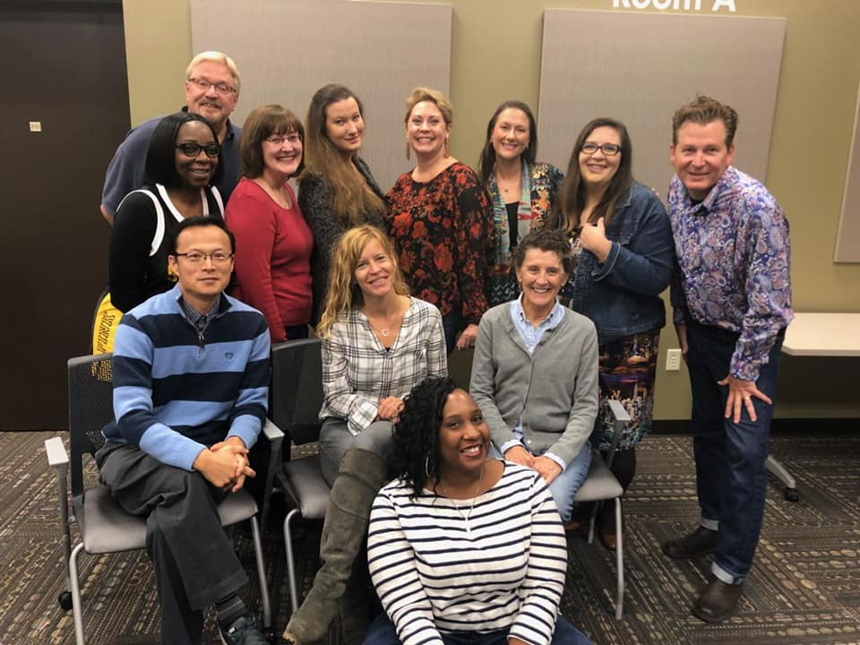
Social Work Faculty & Staff
Dr. Kyoung Lee Director of the School of Social Work
Dr. Amy Kalb BSW Program Director
Ms. Debbie Willsie Field Practicum Director, Child Welfare Certificate Program
Ms. BreAnn Gilkey Field Practicum Associate
Ms. Deah Davis Addiction Certificate Program
Ms. Shaunna Millar MSW Program Director
Dr. Fred Besthorn
Dr. Karen Countryman-Roswurm
Dr. Eveline Ndii Kalomo
Dr. Jeoung Min Lee
Ms. Stacey Popejoy
Dr. Dasha Shamrova
Ms. Trisha Wenrich, Senior Administrative Assistant
Mr. La’Rell Marion, Administrative Assistant

Slide 3
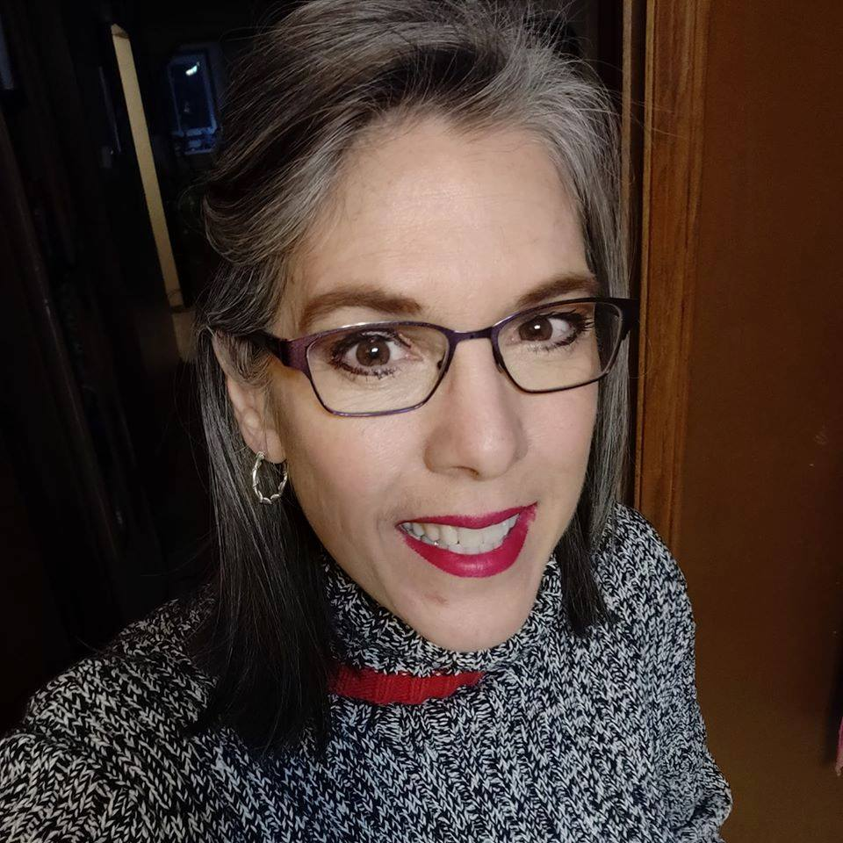
Student Success
Debbie Haslam Fairmount College Success Coach
Wichita State University
Lindquist Hall Room 302
Debra.Haslam@Wichita.edu
www.wichita.edu/student_life/resources/ofdss/

Slide 4
How We are Unique?

Slide 5
A Career in Social Work
What you bring with you…
Your empathy and care for others
An ability to accept and strive to understand all people
Your desire to improve the quality of life for others
Your Social Work Education
Service to Others
Belief in Worth and Dignity of All People
Commitment to Social Justice
Integrity—Code of Ethics
Importance of Human Relationships—Connect people to Others
Competence

Slide 6
Where We Work

Slide 7
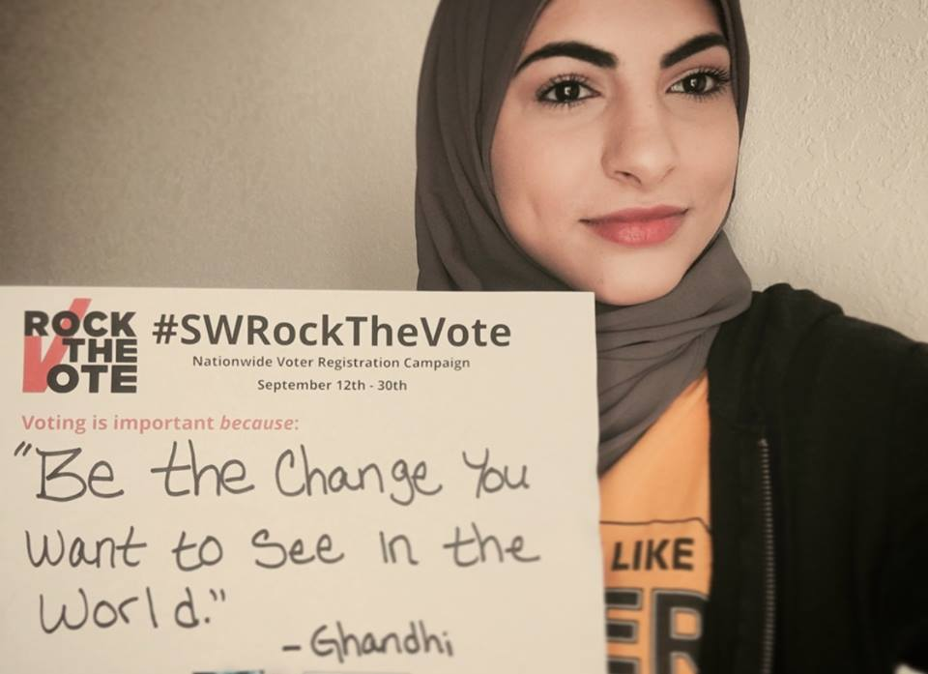
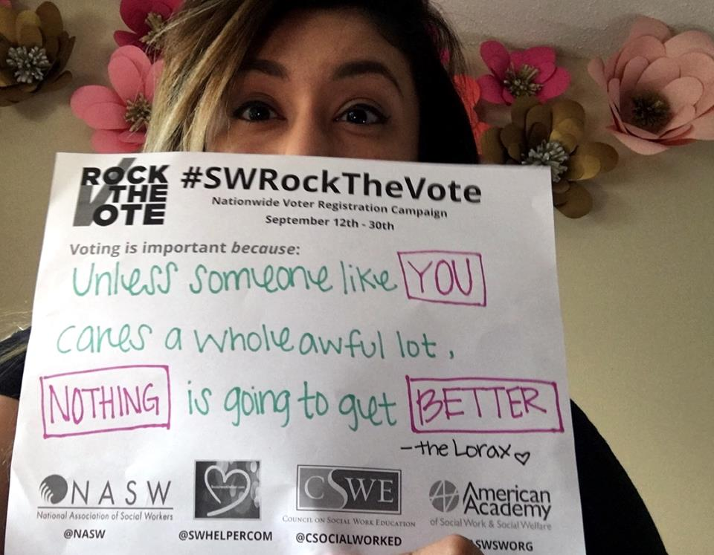
Dimensions in the definition of Generalist Practice
Generalist Practitioner of Social Work
Knowledge, Values, and Skills
Framework that allows a Social Worker to engage and intervene in all levels of practice
Individuals, Family (Micro)
Groups (Mezzo)
Policy, Community, State (Macro)
Assess Problems using a broad lens
Wide Range of Skills-Assess, Research, Organize, Intervene, Impact Change
Coordinate care with others to ensure continuity of care

Slide 8
Pre-program requirements and procedures for admission into the BSW Program:
Pre-program requirements and procedures for admission into the BSW Program:
1) Sophomore rank or above (at least 45 credit hours; but most students will have completed 3 semesters of full-time study).
2) Overall GPA of 2.0 or above ("C")
3) Attendance at a BSW Orientation session
Cont…

Slide 9
Pre-program requirements and procedures for admission into the BSW Program:
4) Completion of the following "basic skills" courses with a grade of "C" or better:
English 100 (English Composition) or English 101 (College English I)
English 102 (College English II)
Communications 111 (Public Speaking)
Math 111 (College Algebra), 131 (Contemporary Mathematics), or 112 (Pre-calculus)
5) Completion or in the process of completing the following Social Work pre-major courses:
Biology 106 (The Human Organism) or Human Biology equivalent
Lab in any Natural Science
Psychology 111 (General Psychology)
Sociology 111 (Introduction to Sociology)
Social Work 201 (Introduction to Social Work and Social Welfare) or equivalent course from another college

Slide 10
Pre-program requirements and procedures for admission into the BSW Program:
6) Submission of BSW application which includes
Completed BSW Application form
Personal narrative indicating interests/motivations/experiences to establish suitability for the social work profession
2 references
WSU Model (photo) Release
Copy of Transcript (unofficial)
Statements on computer technology competency, acknowledgement of the BSW manual, and acknowledgement of the NASW Code of Ethics (on website)
Practicum Statement, Liability Insurance Notification, Undergraduate Certificate in Social Work and Addiction OR Child Welfare

Slide 11
Application Review and Admission Decisions
Applications are reviewed after the submission deadline
Deadlines twice a year – Oct. 15th and March 15th
Admission decisions are made by the social work faculty following review of the applications.
Since the population of majors and the enrollment size of advanced practice courses must be balanced with program resources or available faculty, meeting the minimum requirements may not always guarantee admission.

Slide 12
Upper Division Classes
Admission to Program required for upper division (400 level) Social Work Practice and Practicum classes is restricted to social work students who have been formally admitted to the program.
You can enroll in upper division elective Social Work classes

Slide 13
Variety of class offerings
Undergraduate Certificate in Social Work and Addictions (UCSWA)—Must meet with Deah Davis
Social work and addictions
Pharmacology
Forensic social work
Practicum focused in addictions
Undergraduate Certificate in Social Work and Child Welfare (UCSWC)—Must meet with Debbie Willsie
Generalist practice with children and families
Forensic social work
Elective (DV, human trafficking, diverse families, more)
Practicum focused in child welfare
A variety of other electives year-round!

Slide 14
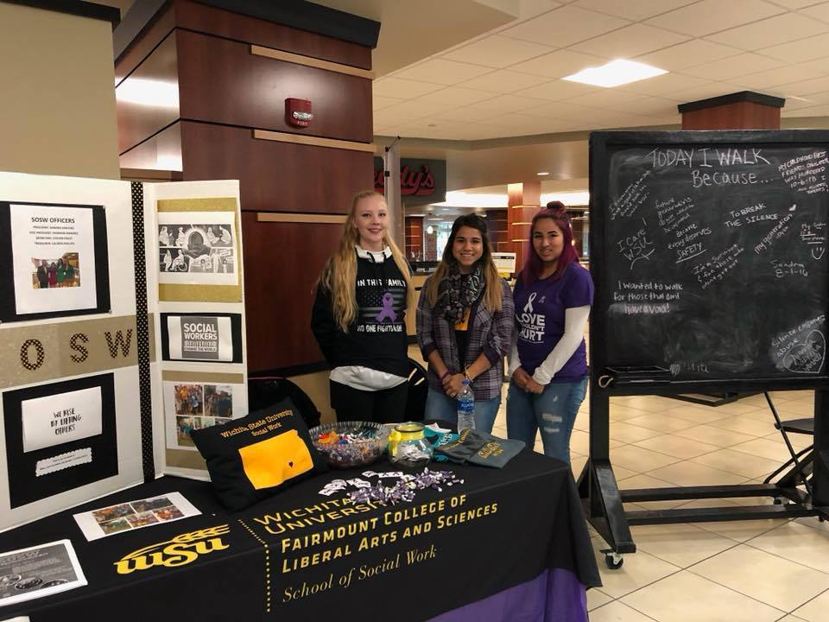
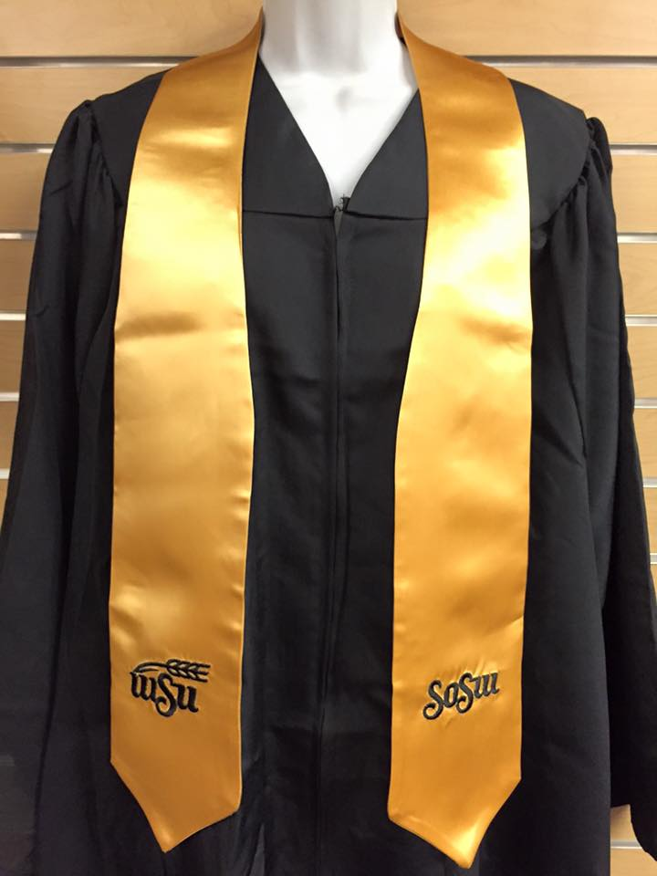
Student Organization of Social Work (SOSW)
https://www.facebook.com/groups/124308519973/

Slide 15
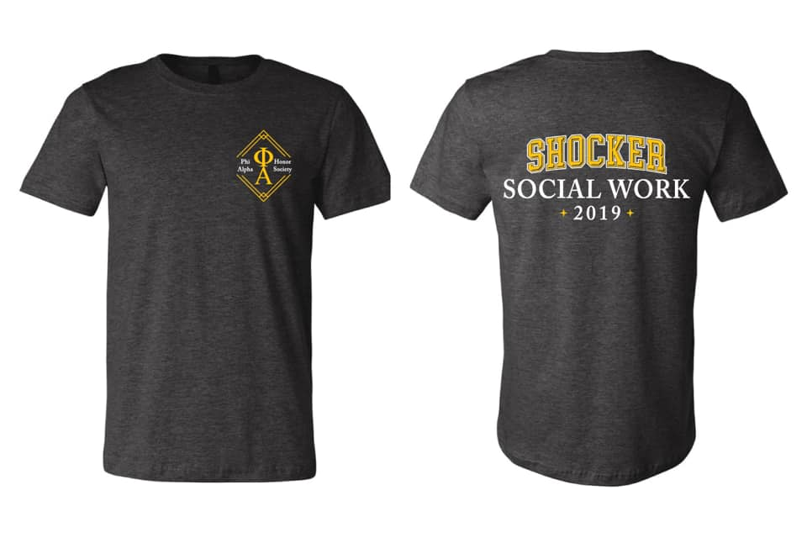
Phi Alpha Social Work Honor Society
“Like” the Facebook page – Phi Alpha
www.facebook.com/phialphawsu

Slide 16
School of Social Work Webpage
www.wichita.edu/socialwork
Provides current information on events and calendars
Links you to other social work resources
https://www.facebook.com/wsusw
https://twitter.com/wsusocialwork
www.pinterest.com/wsusocialwork
www.facebook.com/shockerworks

Slide 17
Mark Your Calendar!
BSW Application Deadlines
Oct 15th and March 15th
Available online at www.wichita.edu/socialwork
Practicum Inventory and Resume are also due on Dec. 1st for those going into field practicum on Fall of 2021.

Slide 18
Before You Go, So you Get Credit for Attendance
Please Complete this Survey before you leave
https://wichitastate.co1.qualtrics.com/jfe/form/SV_abzNGvtDkWhVnNz

Slide 19
School of Social Work Amy Kalb amy.kalb@wichita.edu
Questions?

