Slide 1

BSW Practicum Orientation
September 2020
Debbie Willsie, LSCSW, Director of Field Practicum
BreAnn Gilkey, LMSW, Associate Director of Field Practicum
Trisha Wenrich, Senior Administrative Assistant
La’Rell Marion, Administrative Assistant

Slide 2
Field Practicum
Practicum provides opportunities to apply classroom learning in the field setting.
Placements are based on our program objectives and the learning needs of each student.
Practicum gives you a chance to learn general social work skills which can be applied to any work setting – it is NOT job training or an apprenticeship in a specific area.
Be open to areas of practice you may not have thought about before!

Slide 3
Where might I do my practicum?
Addictions
Aging
Community work
Health care
Mental health
Military/veterans
Child welfare
Domestic Violence
Immigrants & refugees
Forensic
Environmental
Disability services
Emergency & economic supports
Women’s issues
Political action & advocacy
Schools
. . . And many others!

Slide 4
Practicum Hours and Practicum Seminar Class
Practicum Hours
240 hours/semester = 15-16 hours/week
You and the agency can negotiate your schedule – it could be two full days per week, or one full day and two half days, or any combination.
Practicum Seminar Class
The Practicum Seminar class (SCWK 402/404) is on Tuesdays, for 50 minutes approximately, every other week.

Slide 5
Practicum Information
You will be in the same agency both semesters.
  Why? You need the year to become proficient. The first semester is mostly learning and shadowing, and by the second semester, you are more often independently “doing” social work with your own small client caseload.
If you live out of town, we can place you in your home community, unless you prefer to be in Wichita.

Slide 6
Practicum Information
Most agencies require background checks, and some reject students with certain convictions/charges.
Some agencies may require students to carry liability insurance at student’s expense.
Practicum is not paid, however…
  Some jobs may qualify as Employment Situated Practicums if the agency can give you new duties that qualify as new learning – talk to one of the Practicum Directors to see if this is possible. The key is NEW LEARNING – you can’t just count your current job tasks as practicum.

Slide 7
Practicum Information
Practicum takes place during regular daytime hours.
It is not reasonable to work a full-time day job and try to fit practicum around it.
  Why? Because almost all agencies are open during the day, and true social work tasks, and contacts/meetings with other partner agencies, happen between 8-5.
Important: Practicum includes micro, mezzo, and macro components. All your work will not be direct work with clients. It is still considered “social work” even if you are not working directly with clients all, or even most of, the time.

Slide 8
Practicum Expectations
Treat practicum like a “real” job – these things are critical:
  Exhibit good work habits (dependability, be on time, etc.)
  Show initiative
  Get along with others
  Do not bring personal drama to the agency
  Show interest in learning
  You are establishing your professional social work reputation – and social workers all seem to know each other, even outside of Wichita!

Slide 9
Practicum Disruptions
If you are asked to leave your practicum, depending on the circumstances, we do not have to re-place you.
Without your practicum, you cannot graduate with your (a) BSW.
There may be rocky times at some practicums, but in almost all instances, you are expected to work through them with the help of your field instructor and practicum faculty. Ask for help if you need it!
You may not quit your assigned practicum to take a paid social service job that you hope will “count” because once we make a commitment to an agency, we honor that commitment.

Slide 10
Practicum Interviews
You will interview with one of the Practicum Directors, Debbie or BreAnn, to discuss ideas for practicum placement. The interview lasts about 30 minutes.
Interviews begin early in December and continue through February, either in person or remotely.
This interview is so we can get to know you and make a good match – we consider the agency and the kind of field instruction that will be best for you.
We are open to your placement preferences.
But remember, the practicum team (Debbie and BreAnn) makes the final practicum assignment.

Slide 11
Practicum Interviews
Later, you will also interview at the agency to which you are referred.
Agency interviews begin in early May and continue throughout the summer.
You will only be referred to one agency unless there is a need for an additional agency referral later.
TRUST THE PROCESS!

Slide 12
If you are starting practicum in August 2021:
Complete the online BSW Practicum Inventory at www.wichita.edu/socialwork/practicum/forms and submit that, along with a current resume, to trisha.wenrich@wichita.edu.
The Inventory and Resume are due to Trisha on or before December 1.
Trisha or La’Rell will then arrange for a phone or remote practicum interview with Debbie or BreAnn.
Interviews can be held during most of the holiday break – Debbie and BreAnn are working except during the university shut-down.

Slide 13
Remember to check your Shocker email regularly!
You will receive emails about practicum, including notice of your agency practicum interview, at your @shockers.wichita.edu (student) email address, so be sure and check it regularly!
BreAnn or Debbie will let you know where you have been referred, and what the next steps are to arrange your interview with the agency.
Once you get that referral email, let BreAnn or Debbie know how the process is going – how the agency interview went, if they accepted you, etc.
Also let BreAnn or Debbie know if there is a breakdown in communication with the agency.
You may begin your practicum as early as August 1, or you may start when school starts – it is up to you and your agency.

Slide 14
If you have questions…
About the Practicum Inventory, your resume, and setting up a practicum interview, email trisha.wenrich@wichita.edu
About anything else related to Practicum, email debbie.willsie@wichita.edu or breann.gilkey@wichita.edu

Slide 15
More Information
View the Practicum Manual at www.wichita.edu/socialwork/practicum/manual
Please review the manual because it has many of the answers about practicum that you are looking for.

Slide 16
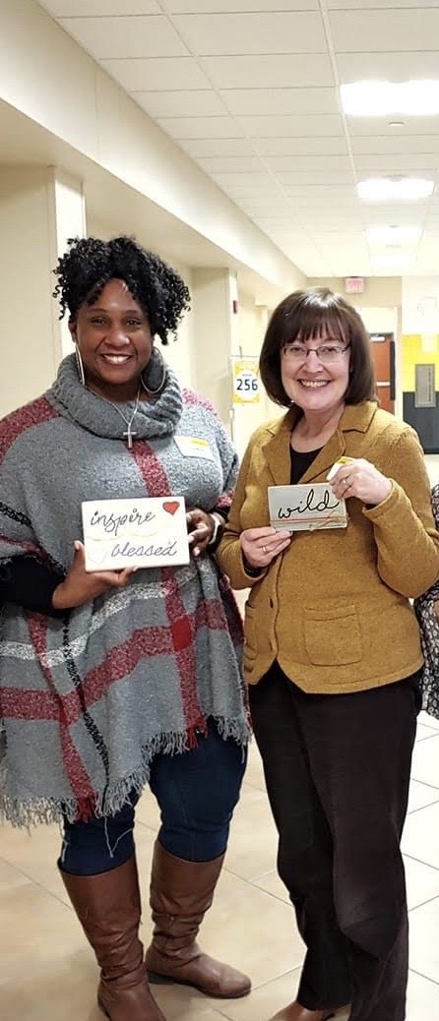
We look forward to working with you and having a great year in Practicum!
(Be sure and move to the next
slide for attendance credit!)

Slide 17
Last Step – Please Complete!
To get credit for attending BSW Practicum Orientation, please click on the link below:
https://wichitastate.co1.qualtrics.com/jfe/form/SV_8p5yVAOjTE0DId7

