Slide 1
Field Instructor Training
Debbie Willsie, LSCSW, and BreAnn Gilkey, LMSW
WSU School of Social Work
August 9, 2019

Slide 2
Field Instructor Training August 9, 2019
Agenda
8:00 am Registration and Breakfast
8:30 am Welcome & Introductions Announcements & Ice Breaker
9:30 am Field Instructor of the Year Awards
9:45 am Field Practicum Manual
Group Picture
Field Practicum Manual
11:15 am Wrap Up/Drawing/Evaluations
Notes:
On wall during registration

Slide 3
Welcome & Introductions
Dr. Kyoung Lee, School of Social Work Director
Shaunna Millar, MSW Program Director
Dr. Amy Kalb, BSW Program Director
Trisha Wenrich, Senior Administrative Assistant
Michelle Calhoun, Administrative Assistant
Field Liaisons
Debbie Willsie, Practicum Director
BreAnn Gilkey, Associate Practicum Director
Zane May, Adjunct/Practicum Liaison
Connie Mayes, Adjunct/Practicum Liaison
Notes:
Debbie

Slide 4
Practicum Advisory Committee
Meets once each semester
Representatives from agencies who host our students (10-12)
Updates from WSU and from member agencies
Advises BreAnn and Debbie about training topics, program suggestions
We appreciate you!
Notes:
Debbie

Slide 5
Announcements & Save the Date
All sign in; drawing tickets; evaluation at end
Help yourself to food and coffee anytime
Field Instructor Mini Trainings:
Friday, October 11, 2019, noon - 1:00 pm, Metroplex #138
Friday, March 13, 2020, noon - 1:00 pm, Metroplex #138
POWER Conference
March 5 & 6, 2019, Kansas Star Casino, Mulvane, KS
Notes:
Debbie/Shaunna

Slide 6
Ice Breaker
Purple: If you could live in any sitcom, which one would it be?
Yellow: If you could be an expert in something, what would it be?
Orange: What is one thing (bad habit) you would eliminate from your daily routine.
Red: You have to wear a t-shirt with one word on it for one year, what is that word?
Blue: If you could rid the world of one thing, what would it be?
Green: Would you rather go without internet or your
cell phone for a week?
Notes:
BreAnn

Slide 7
BSW and MSW Field Instructor of the Year Awards
In Recognition of Excellence in
Supervision and Continuous Partnership in
Social Work Field Education
Embodies the role of teacher and mentor
Fosters student learning and professional development
Demonstrates commitment to social justice and social work values
Notes:
Debbie
1. Friendliness and congeniality 2. A good personality 3. Deep knowledge and a great education 4. A good communicator 5. A good listener
6. A good sense of humor 7. Kindness

Slide 8
Online Resources
WSU Website – www.wichita.edu
WSU School of Social Work – www.wichita.edu/socialwork
Facebook: Wichita State University School of Social Work - https://www.facebook.com/wsusw
Facebook: Alumni of Wichita State University School of Social Work - https://www.facebook.com/swalumni
Facebook: Wichita State University Social Work Employment & Volunteerism – https://www.facebook.com/shockerworks/
Twitter - https://twitter.com/WSUSocialWork
Notes:
BreAnn

Slide 9
What do these terms mean?
Director of Field Practicum
Associate Director of Field Practicum
Field Instructor
LBSW, LMSW, or LSCSW (license must be at level of student or higher)
Supervises educational experience, usually 1 hr/week
On-Site Supervisor
Provides daily instruction but no social work degree or is not licensed as a social worker
Field Liaison
Faculty member who teaches practicum seminar and provides one on-site visit per semester
Notes:
Debbie

Slide 10
Field Instructor Quick Start Guide Just the Basics
Supervision
Learning Contract
Midterm Evaluation
Final Evaluation
Site Visit
Questions or Problems
Resources – let us know if you need help!
Notes:
Debbie

Slide 11
Addressing Challenges
Notes:
Debbie – notes on attachment

Slide 12
Addressing Challenges
Examples of situations in practicum that did not turn out well
Examples of difficult student situations that turned out well
Notes:
Debbie

Slide 13
Site Visits
Faculty liaison will visit the student in the agency 1 time each semester
If you have more than 1 student, you will likely have visits with different liaisons
Phone call if VERY far away
Liaison may schedule visit with you, or student may set this up
30 minutes
Time to review student’s progress and identify any problems
Liaison completes paperwork
Notes:
Debbie

Slide 14
Practicum Courses
Taught by faculty Field Liaison
Students attend every-other-week class to support practicum experience
Purpose is to process learning from practicum
Assignments include Learning Contract, Midterm Evaluation, Final Evaluation and other activities
Notes:
Debbie

Slide 15
Hours, Holidays, Absences, Training
Total hours per semester:
BSW / MSW Foundation: 240
MSW Advanced Generalist: 350
May start practicum as early as August 1 and January 2
Should continue until December 1 (Fall semester) and May 1 (Spring semester)
MSW Advanced Generalist
May take optional summer class for 100 hours
May begin spring semester hours in mid-December
Notes:
BreAnn

Slide 16
Hours, Holidays, Absences, Training
May take off school and agency holidays but are still responsible to complete total hours
Agency should report to Liaison if student misses 3 or more consecutive days, or 5 days in a semester
Training
May be live or online
Requires Field Instructor approval (YOU) to count toward practicum hours
Does not require Liaison (classroom instructor) approval unless training is more than 10% of total practicum hours
Notes:
BreAnn

Slide 17
Transition
Group picture!
Notes:
BreAnn

Slide 18
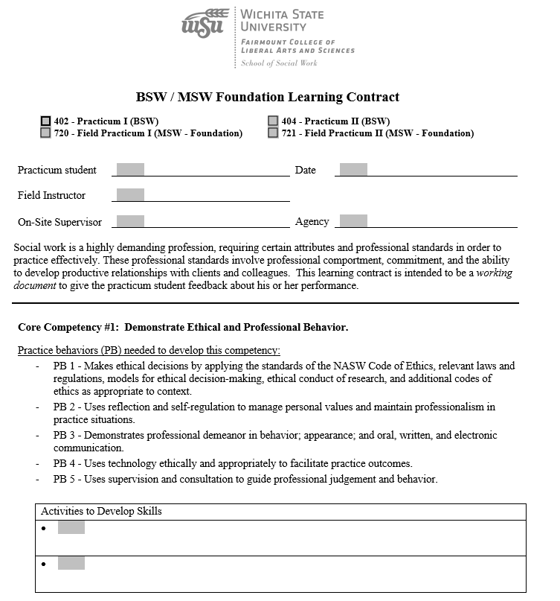
Learning Contracts
Notes:
BreAnn

Slide 19
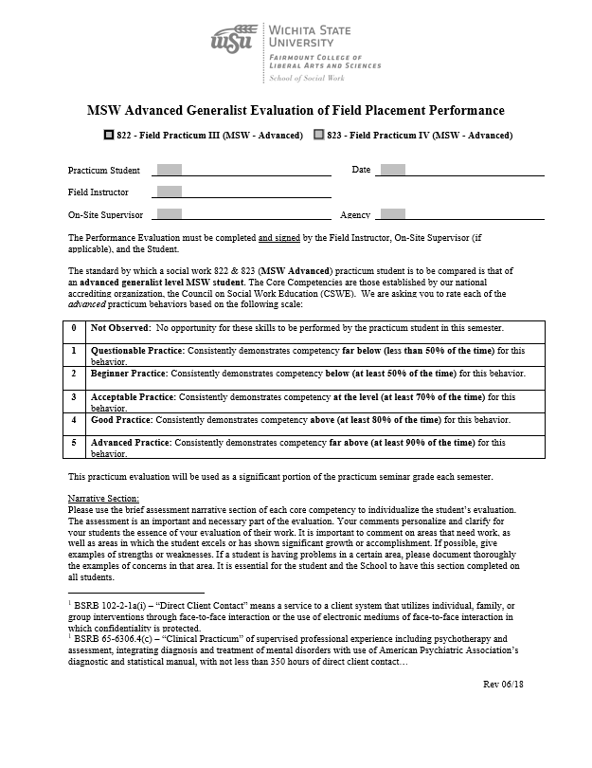
Evaluations
Midterm and end of each semester
Rating scale and comments
Joint evaluative process
Evaluation stays in permanent student record
Potential employers sometimes obtain
Notes:
BreAnn

Slide 20
Ratings of “Zero/Not Applicable”
Rating of “N/A” on Evaluation means:
Not applicable to student’s learning at this time.
Acceptable for first semester/midterm evaluation
Avoid on second semester Evaluation
Notes:
Debbie

Slide 21
Core Competency #4: Engage in Practice-Informed Research and Research-Informed Practice
Social work students must all develop this competency
Does not mean students must conduct research
Examples of activities to develop skills:
Learn about evidence-based practice and treatment
Research trauma-informed practices and present information to agency staff
Use agency assessment tools which were developed from research/best practices
Create a client survey
Notes:
Debbie

Slide 22
Wrap Up
Drawing for prizes
Please complete evaluations
Pick up CEUs at the door
Thank you for your service to WSU students!
Notes:
BreAnn and Debbie

