Slide 1

Honors General Assembly, Special Session
Kimberly Engber
Dean, Dorothy and Bill Cohen Honors College
11/8/2018

Slide 2

Agenda
Announcements
  Mortar Board Honor Society Colton Russell, President, Mortar Board
College Updates Kimberly Engber, Dean
  Student Survey Results
  Cohen Fund Updates
  College Expansion
Discussion: Student Fees Abby Jurgensmeier, Chair

Slide 3
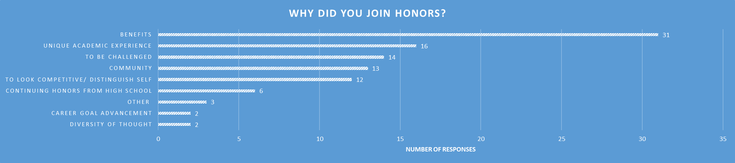

Student Survey Results: Motivation

Slide 4
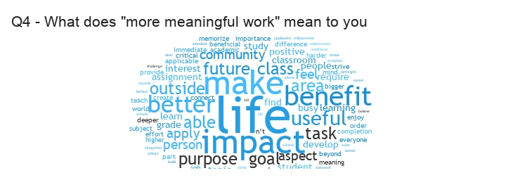
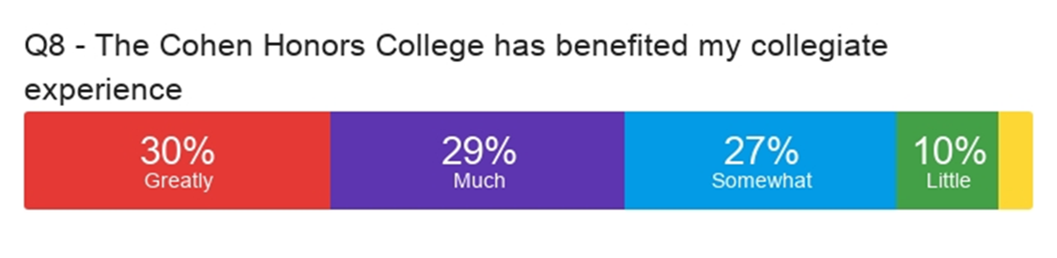
Student Survey Results: Benefits

Slide 5
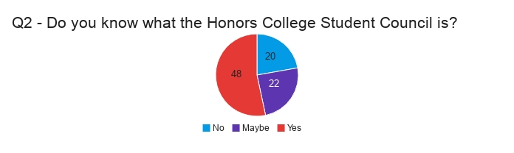
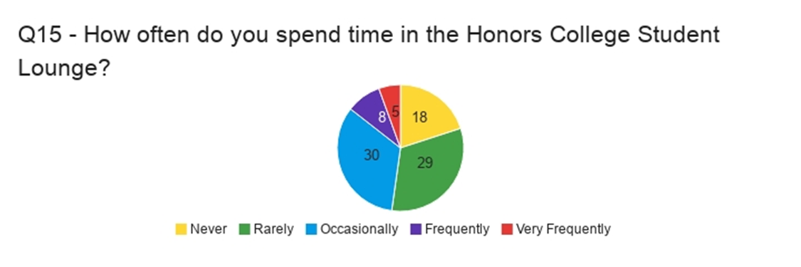
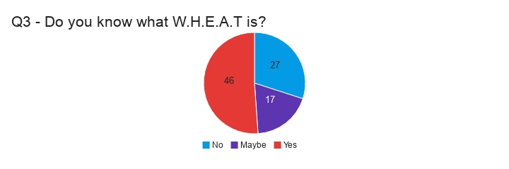
Student Survey Results: Community
5

Slide 6
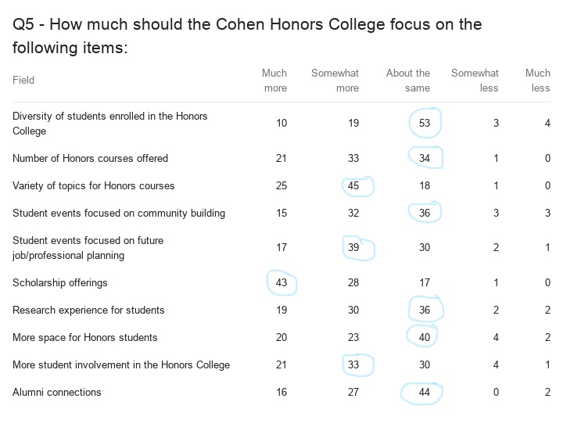
Student Survey Results: Priorities

Slide 7
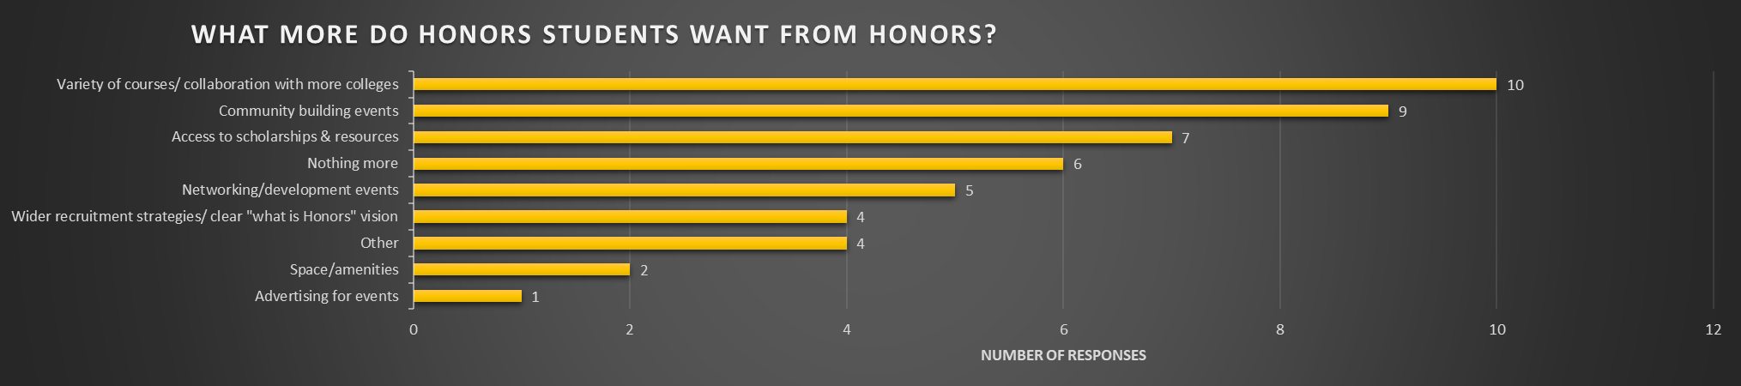
Student Survey Results: Additional Needs

Slide 8
Cohen Fund Updates: Developing as Scholar Citizens
31 Cohen Enhancement Scholarships 2017-18
$98,280
Internship
Study Abroad
$69,841
FY19
Research
Innovation Fellows
FY18
$39,680
FY17
FY16
$20,000
14 study abroad • 8 internships • 6 research • 3 innovation fellows

Slide 9
Cohen Fund Updates
New Cohen endowed gift pledge received
  Funds anticipated by 2021
  Approximately $60,000 annually in scholarships for financial need and underrepresented minority students
  Approximately $30,000 annually to pay faculty and staff engaged in Honors courses and programs and applied learning
  Approximately $10,000 annually to support Honors Student Council, WHEAT Student Organization, and Honors Ambassadors

Slide 10
Supporting First-Year Experiences and Bridge to College
First-Year Seminars linked to Honors Living Learning Community - Fall 2018
  Cohen Faculty Fellows Funds $11,000
First-Year Research Engagement (FYRE) program pilot – Spring 2019
  Frick Foundation Funds $6,500
  Cohen Faculty Fellows Funds $2500
  State Funds $1500
Bridge to College Research Program - Summer 2019
  LSAMP National Science Foundation grant $813,000 over 5 years
  Cohen Honors and College of Engineering awarded subaward with Kansas State grant: pipeline to STEM majors for underrepresented minority students, open to all incoming/admitted students

Slide 11
New: Honors Science Track proposed
CHEM 212H offered in Spring 2019! Thursdays 11:00-1:45
Additional Honors lab sections planned over next 2-3 years:
  General Chemistry I (CHEM 211H)
  General Chemistry II (CHEM 212H)
  General College Physics I (PHYS 213H) or Physics for Scientists I (PHYS 313H/315H)
  General College Physics II (PHYS 214H) or Physics for Scientists II (PHYS 314H/316H)
  General Geology (GEOL 111H)
  Historical Geology (GEOL 312H)
  Plus: Capstone Research Experience (CHEM 669/690, PHYS 600 or GEOL 698)

Slide 12
Why? Supporting a Growth Mindset
“Some environments lead students toward more of a fixed mindset, in which they believe that personal qualities like intelligence are relatively stable and unchanging. Other environments lead students toward more of a growth mindset, in which they believe that a person’s intelligence level can change and develop. In dozens of studies, encouraging more of a growth mindset consistently improves student outcomes.”¹⁹
19. Carol S. Dweck, Mindset: The New Psychology of Success (New York: Random House, 2006).
from Mesmin Destin “Leveraging Psychological Factors: A Necessary Component to Improving Student Outcomes” https://www.thirdway.org/report/leveraging-psychological-factors-a-necessary-component-to-improving-student-outcomes

Slide 13
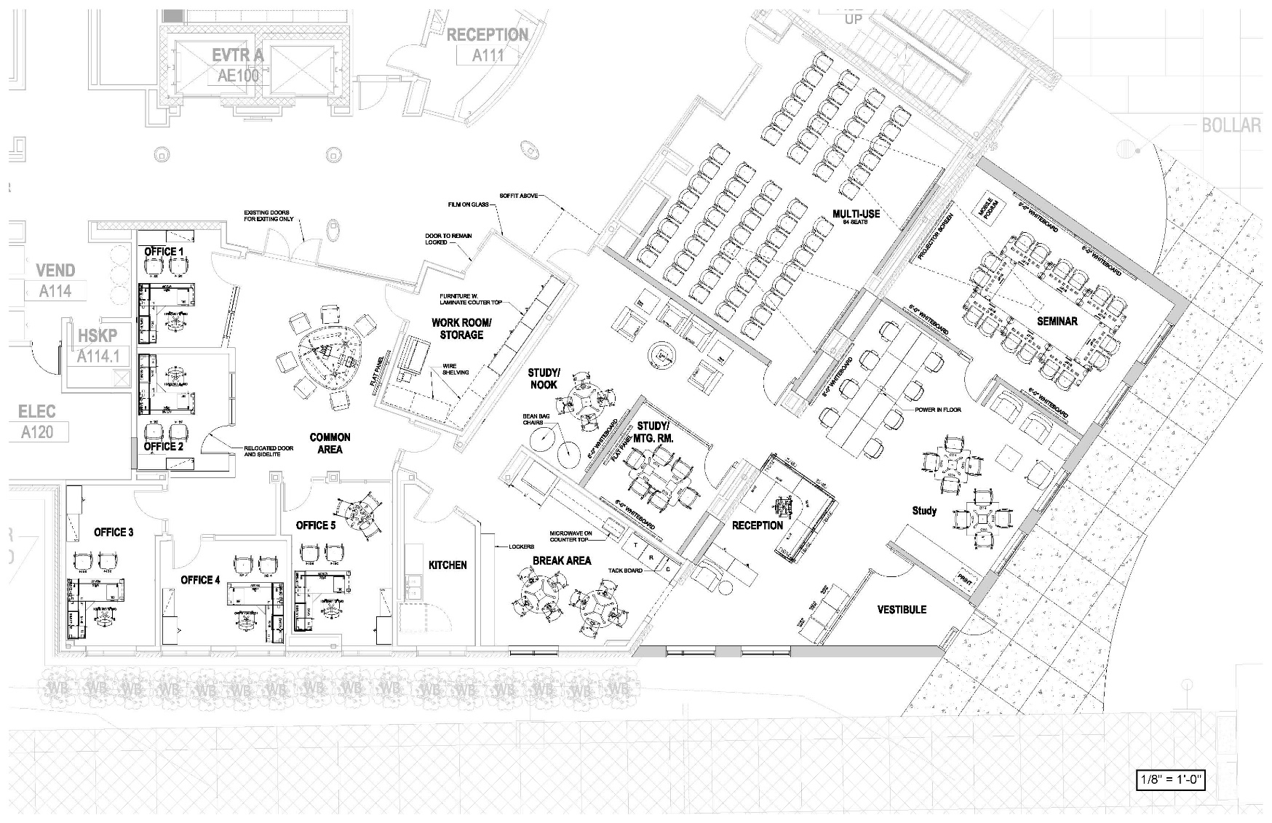
Planning to Increase Accessibility and Visibility:
A Front Door
Jabara Hall

Slide 14
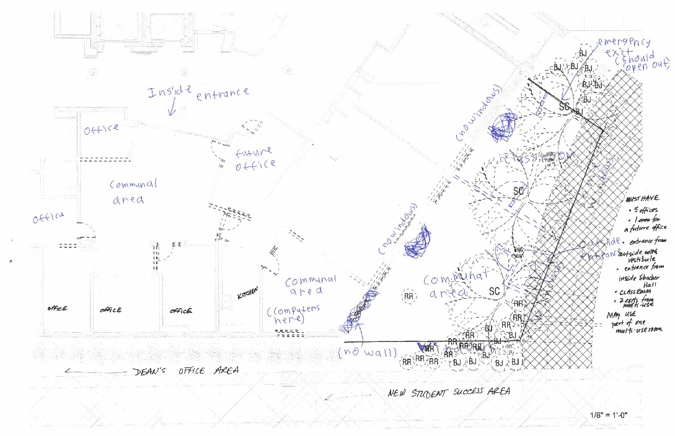
College Expansion:
Student Focus Group
14

Slide 15
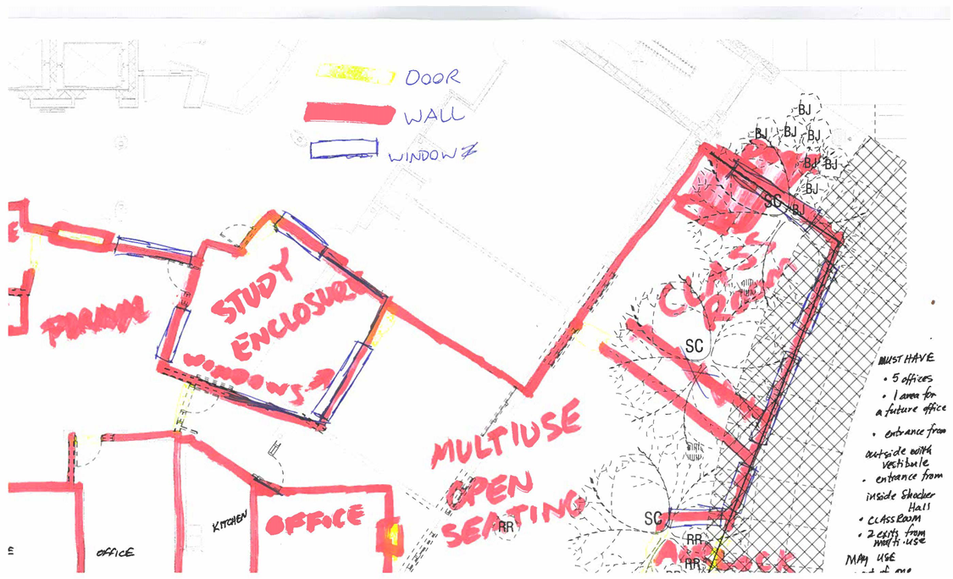
College Expansion:
Student Focus Group
15

Slide 16
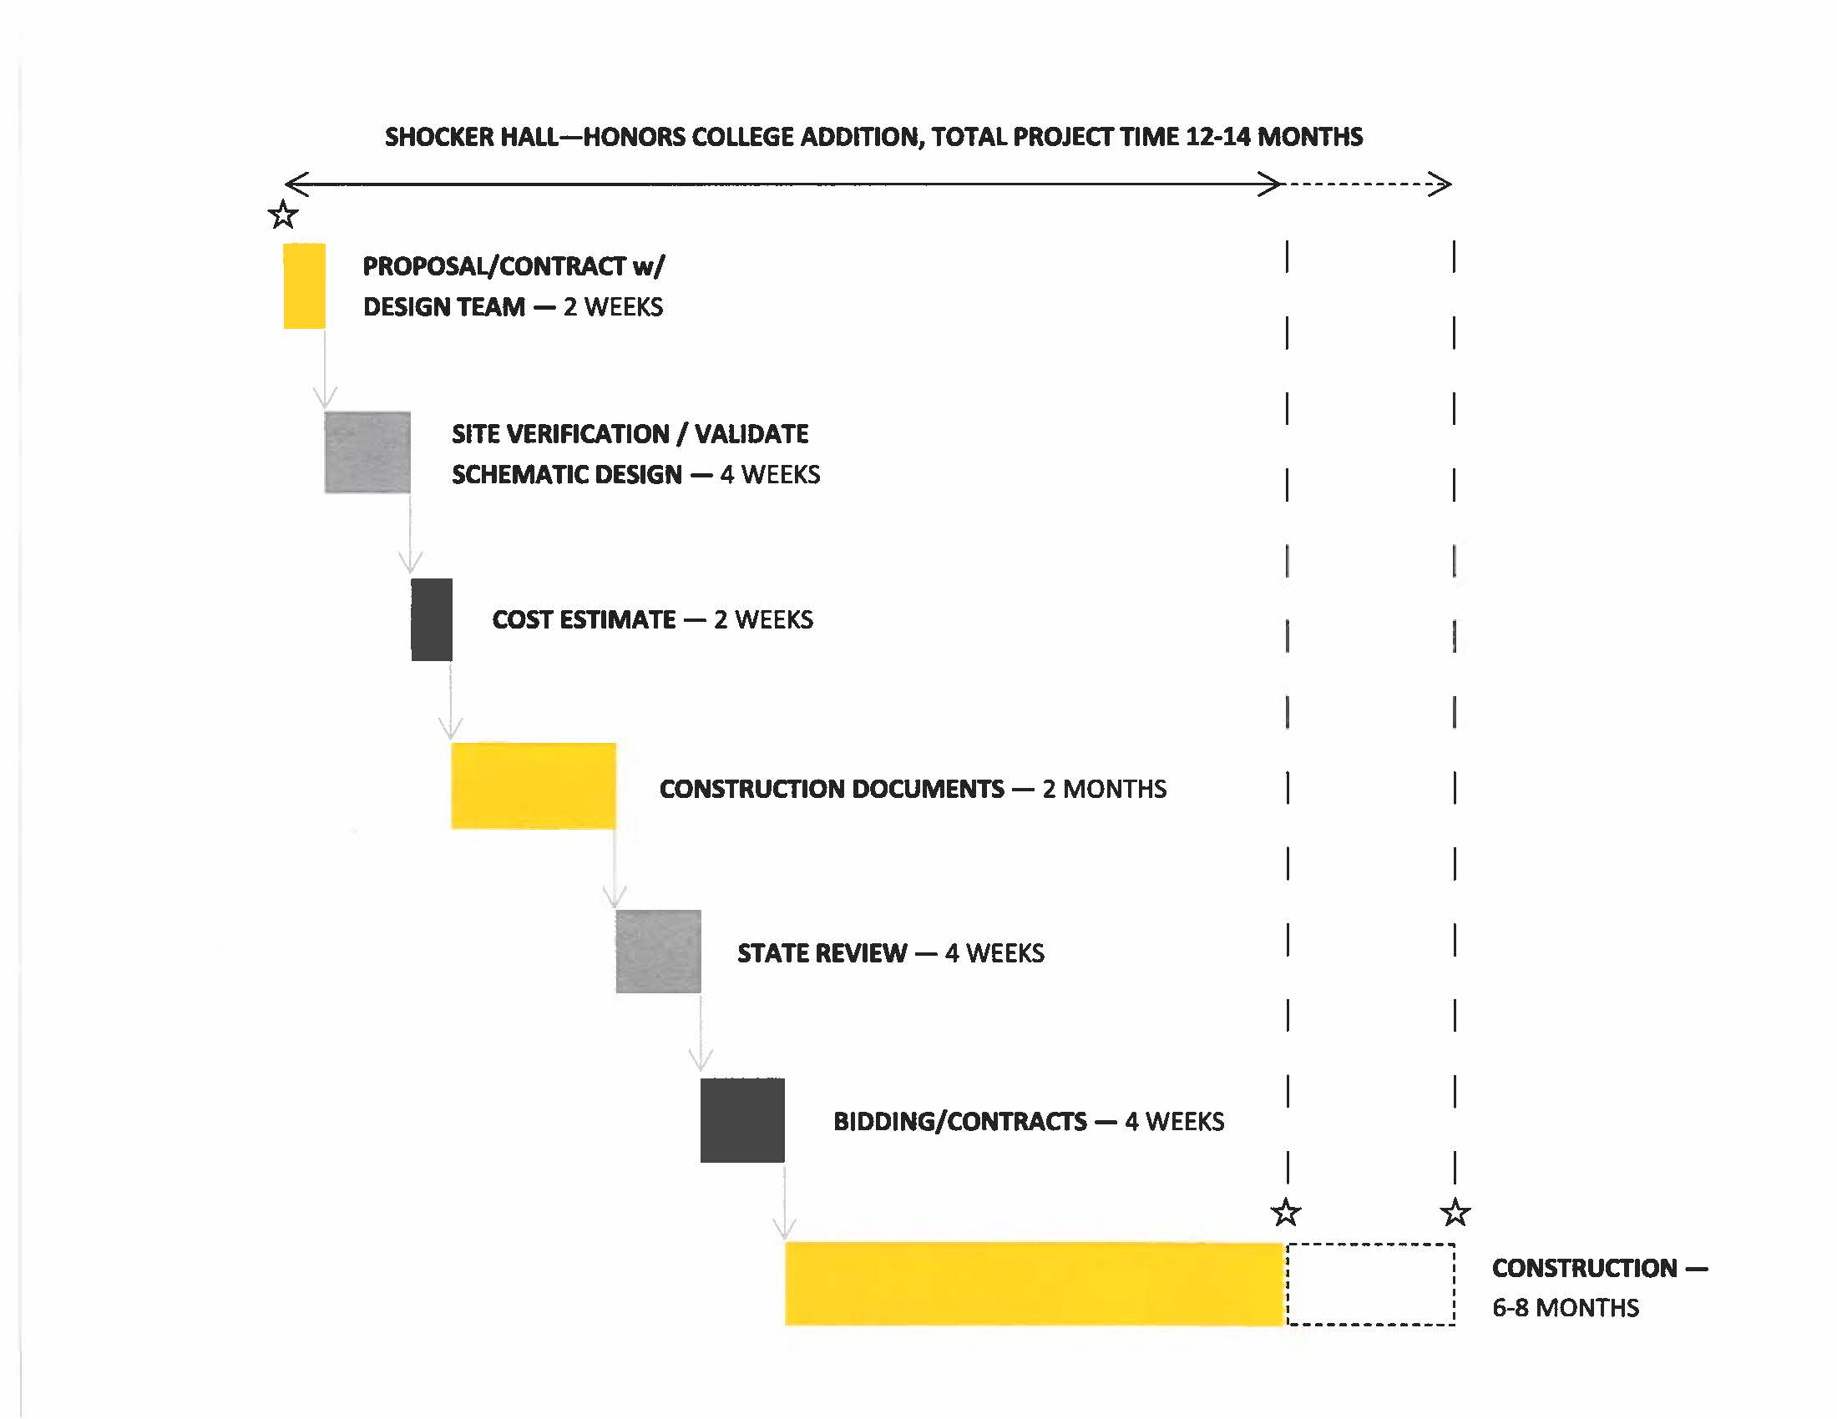
College Expansion

Slide 17
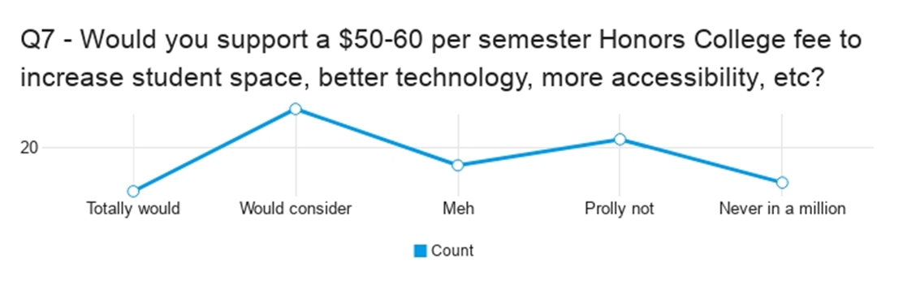
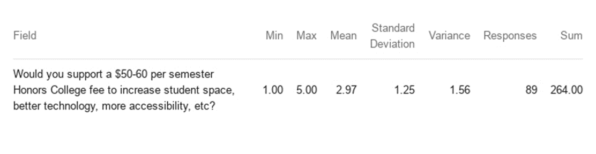
Discussion: Student Fees

