Slide 1
Online Student Satisfaction & Adult Student Perceptions
Academic Affairs Assessment Symposium
Research results and lessons learned

Slide 2
Agenda
Welcome / Opening Remarks
Adult Student Perceptions
Online Student Satisfaction
Discussion

Slide 3
Adult Student Perceptions
Hanover study of those who inquired, applied, or were accepted to WSU but did not matriculate.

Slide 4
Project Overview
Survey conducted during early months of 2015
Report presented in March of 2015
Population (258) – branching was used pertinent to individual sub- populations
Definition of adult learner – 25+ years old, domestic, undergraduate
Inquirers – requested information but did not apply
Partial applicants – began but did not finish application process
Non-matriculates – completed application, were admitted, but did not enroll

Slide 5
Areas of Inquiry
Awareness
Familiarity with WSU’s adult education programs, preferred sources of information and previous interactions with WSU
Quality
Factors they consider most important when evaluating adult education programs. Also asked about the effectiveness of WSU marketing and how to increase appeal to the population.
Choice
Preferences for adult education programs and their reasons for not choosing WSU

Slide 6
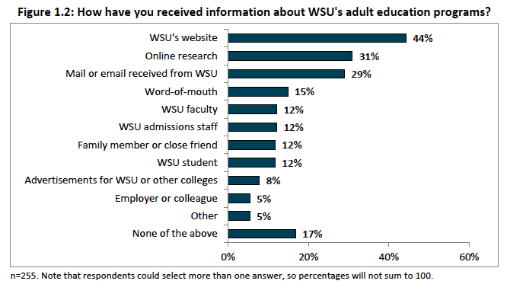
Awareness

Slide 7
Awareness
Just over ½ of respondents report being not at all familiar with WSU’s adult education options
Respondents who were dissatisfied or very dissatisfied with WSU interactions were asked to comment. Common themes were
Desire for more responsive communications with WSU
More personable customer service
Notes:
Refer to page 5 in the packet.
See page 19 for verbatim quotes on page 10

Slide 8
Quality
Addition of more program options and flexible formats
Need for flexible course options
More online courses
Additional program offerings
Better understanding of value of degree
Current marketing not very effective
Notes:
Page 11

Slide 9
Notes:
Page 11

Slide 10
Based on what you know about WSU how would you rate the University on the following characteristics?
Notes:
Top of page 13

Slide 11
Based on what you know about WSU how would you rate the University on the following characteristics?
Notes:
Bottom of page 13

Slide 12
Choice
Cost = most important influencing factor for an adult learner.
Notes:
Expanded online course options and improved customer service may also attract more adult students to WSU.

Slide 13
Reasons for not applying to WSU.
Value and Personal
Going to get my Associate’s first through Johnson County.
Have not made any plans yet.
Illness of a family member.
Not sure how much time it would take to get my degree.
Not the right time for me to pursue further education.
The need to take 30 hours at WSU.
Too much time with full-time job
Program and Process
Did not get the help I needed to apply.
Did not offer post masters in pediatrics.
Did not offer the requested discipline.
I never received an answer to my question.
No response from WSU.
Poor communication.
Notes:
Page 18 – Box Highlight
Talk first about: financial points
Then programattic
Our processes vresus the student’s needs/perceptions

Slide 14
Reasons for declining offer of admission to WSU.
Program and Process
Butler offered classes that would transfer to WSU that I need for my degree. I chose to do another semester there because it is much cheaper and smaller classes. I still plan to enroll in WSU next semester.
Lack of online courses.
Not enough credit for previous education.
Taking a course at HCC before enrolling at WSU.
Value and Personal
Butler offered classes that would transfer to WSU that I need for my degree. I chose to do another semester there because it is much cheaper and smaller classes. I still plan to enroll in WSU next semester.
Cannot attend classes with current work schedule (to erratic).
Financial situation.
Medical Issues.
My mother diagnosed with lung cancer, so I’m not sure I would be able to care for mother and keep up with classes while also working a full time job.
Money.
Time constraints due to being a single mom.
Notes:
Page 18 – Box Highlight
Talk first about: financial points
Then programattic
Our processes vresus the student’s needs/perceptions

Slide 15
Are you currently enrolled at another institution?
Notes:
Page 22

Slide 16
Lessons Learned
High usage of online materials for recruiting and exploration
Lack of familiarity of WSU’s academic options (+50%)
Need for initial point of contact for adults
Customer service, inquiries, “shopping” for an academic home
Need more program options, more flexibility
Adult students often put their education on hold
Need to reconnect after the initial inquiry/application has not been finalized

Slide 17
What are we doing with the data?
Office of Adult Learning opened in March 2015
Onsite advising for inquiry and navigation of the university
Rapid growth in online courses and programs
New initiative with admissions to reconnect with inquiries and admits that did not enroll
Calls through the Office of Adult Learning and the OneStop
Emails from Adult Learning
Development of ShockTalk and Shocker Next Steps

Slide 18
Online Student Satisfaction
Hanover study of ay14-15 students taking online courses

Slide 19
Who are our online students?
National Data*
WSU DATA
“traditional” students (34%)
Majority Female (71%)
Majority Caucasian (70%)
Mostly Bachelor’s (35%)
n=1,500
Majority 18-24 (59%)
Majority Female (74%)
Majority Caucasian (72%)
Majority UG (77%)
n=412
*Clinefelter, D. L., & Aslanian, C. B. (2015). Online college students 2015: Comprehensive data on demands and preferences. Louisville, KY: The Learning House.

Slide 20
How many students take online courses? Summer 2014-Spring 2015

Slide 21
Enrollment by College Summer 14 – Spring 15

Slide 22
| Online courses: Flexibility – highest factor

Slide 23
| Online Programs: Flexibility – highest factor

Slide 24
| Online Enrollment Factors Quality

Slide 25
| Perceptions of Online Learning

Slide 26
Top Online Majors Nationally
Undergraduate
Graduate
Business Administration | 19.8%
Nursing | 5.2
Computer science and engineering | 3.9
Information technology | 3.6
Engineering | 2.2
Sociology | 2.2
Networks, computer networking | 2.1
Elementary education | 2.1
Social work | 1.9
Criminal justice | 1.9
Accounting | 1.8
Counseling psychology, psychotherapy | 1.8
Early childhood education | 1.8
Computer security, cybersecurity | 1.6
Psychology | 1.6
Business Administration | 22.0%
Nursing | 5.5
Computer science and engineering | 3.0
Information technology | 2.8
Early childhood education | 2.5
Counseling psychology, psychotherapy | 2.3
Computer security, cybersecurity | 2.1
Networks, computer networking | 1.9
Technology management | 1.9
Social work | 1.7
Elementary education | 1.7
Engineering | 1.7
Software engineering | 1.5
Secondary education | 1.5
Other | 2.1
Notes:
Aslanian Report Page 11 and 12

Slide 27
| Online Course demand

Slide 28
| Future Online Course Plans

Slide 29
What we are doing with the data
Targeting recruiting and marketing
Faculty discussions about
High-demand programs and courses
Helping meet student needs
Planning better distribution of resources
Dedicated advisors
Retention specialist
Improve student engagement in courses and services

Slide 30
Online Student Satisfaction & Adult Student Perceptions
Academic Affairs Assessment Symposium
Research results and lessons learned

