Slide 1
We Will Effectively Promote Wichita State
Stanley E. Henderson
Senior AACRAO Consultant
October 13, 2016

Slide 2
Agenda for Today
Aphorisms, History, and Optics
Putting Yourself Out There
New Campus Resources for Messaging

Slide 3
To Recap from Last Month’s Workshop
Each has a role
Building consensus and messaging around what’s already there
Setting the campus apart from others
Incorporating messages into your roles
Living the message

Slide 4
Henderson-isms
You never know who your audience is
When a neighbor or someone in your church or in a community organization knows you work at WSU, you BECOME Wichita State
If you are seen as a positive person, it reflects on WSU
You never know whether a student who was excited to go to WSU gets turned off when you complain about the latest harebrained idea to come from wherever on campus out in the community
There’s more than one way to tell the truth
I handle parking complaints by saying parking is always the number one negative on student satisfaction surveys across the US (true)
Other negatives?

Slide 5
A Little WSU History
Part of Wichita State’s community and legacy is in the people who were here—the people who shaped the place
I use two of them as examples of how what we do promotes—or not—the university
Irene Feak, an associate registrar, often referred to as “Dean Feak”
Laura Cross, one of WSU’s grande dames and one of my beloved mentors

Slide 6
The Optics of Promoting WSU
Make sure you identify yourself as part of the WSU Community when you are on campus
Consider wearing Black and Gold at least on game days or when you know there will be many prospective students and parents on campus—like tomorrow!
At the least, wear a Shocker pin
There should be a requirement that everyone wear the common WSU nametag—people like to know who they’re talking to
Find a way to introduce something WSU—color, a WUShock image—into your offices, especially where students will be

Slide 7
Shockers: Not Just Sports but Your Community
WU is one of the most unique mascots in the country—play that up with images or on sweatshirts
Wear Shocker paraphernalia off campus
I have never caught a plane to Wichita in Minneapolis or Atlanta without seeing multiple people wearing Wichita State clothing
This is not just about sports—colors and logos carry a university’s brand and the more it’s seen, the more the university is seen
Michigan’s Block M is arguably the most recognizable college emblem in the world—you can’t wear it anywhere without someone yelling, “Go Blue!” at you.

Slide 8
Great Resources to Help Show Off WSU
Numbers video: https://vimeo.com/117913752
Shocker Street Speak: Shocker Hall: https://vimeo.com/112963947
Shocker Street Speak: Diversity on Campus: https://vimeo.com/128154696
Shocker Street Speak: Career Fair https://vimeo.com/122793192
Shocker Street Speak: Campus Safety https://vimeo.com/146924954
Shocker Street Speak: Once a Shocker, Always a Shocker https://vimeo.com/168084645
Innovation Campus: https://vimeo.com/174879340

Slide 9
Getting in Bed with the Media
Too many faculty do not work to explain their research to people in the community
There is a silo-ization of disciplines nationally where we talk about our work with colleagues from other campuses.
One professor in the Ross School of Business at the UM-Ann Arbor suggests that pursuing the research and getting it published are only the first two (admittedly, important) steps in the process
THEN you have to take the next step of publicizing it

Slide 10
Good Things Don’t Necessarily Sell
Now, I’ve had lots of experience with trying to get coverage for some—I think—terrific event on one of my campuses, only to have neither print nor electronic media show up
They come when a water pipe bursts in the residence hall and there’s no heat
Or when a student calls the Action Line to complain about how he’s been treated by some nasty administrator
The truth is that bad news sells more papers and TV ads than good news

Slide 11
Be Known and Be Ready
A news reporter will often call her campus contact and say, “I just got a CNN breaking news story about XYZ. Anybody on campus able to give the local perspective on that?”
You might be perfect for that kind of interview, but if you haven’t put yourself out there, Joe might not even know you are an expert in the area
Every time you are on the 10 o’clock news commenting knowledgeably on an issue with Wichita State University under your name, you burnish the university’s reputation

Slide 12
A Great New Vehicle for Putting Yourself Out There
John Jones of the MRC has another take on this issue of putting yourselves out there
In higher ed, John says, we pay so much attention to messages that go to prospective students, parents, community members—external communications—but we essentially ignore internal communication
People in a given department might know of great things from colleagues, but people on the same floor in another department might be completely unaware
John wanted a vehicle to facilitate breaking down communication barriers, and in collaboration with many, he’s created a great one

Slide 13
Using SEM to Build a One Team Approach
John sees SEM as a perfect initiative to help build a One Team approach to putting Wichita State out there with a culture change that puts the emphasis on consistent messaging that gets at the whole of the university’s identity rather than just talking about fragmented pieces.
John says, “The WSUONE site is a start on the effort to create that feeling of one team – a place where I hope to use social media and the power of storytelling to start making that cultural change.”
(Can we tell he has an MFA in Creative Writing, Fiction?)
Check out how you can contribute to WSUONE

Slide 14
Links to WSUONE, Changing a Culture, Building a SEM Team for WSU
Here’s a link to the blog site:
http://wichita.edu/wsuone
John’s put up a page with an invitation to contribute, and some guidance:
http://blogs.wichita.edu/sem/?page_id=46

Slide 15
Marketing: One of Higher Ed’s Best Examples of Flexibility
50 years ago marketing was a dirty word in academia
Marketing was conflated with sales, and that was inappropriate activity for colleges and universities
Then the Baby Boom went bust in the 1970s, and desperation became the mother of new approaches in higher education
My discipline of enrollment management grew from roots in marketing as a necessary tool to attract scarce students
Marketing is now highly technical with predictive modeling about who will and won’t come to a school

Slide 16
Making Marketing Effective
Marketing is very much about messages: what we say and how we say it to those we want in our community of higher education
Too often in higher education we have so many different messages that we fail to articulate who we are
Universities that are most effective at marketing are not the ones who spend millions of dollars on media buys
The ones that are most successful are those with a clear, consistent, concise way of describing themselves that everyone on the campus buys into—and those schools get much more bang for the bucks they do put into media buys

Slide 17
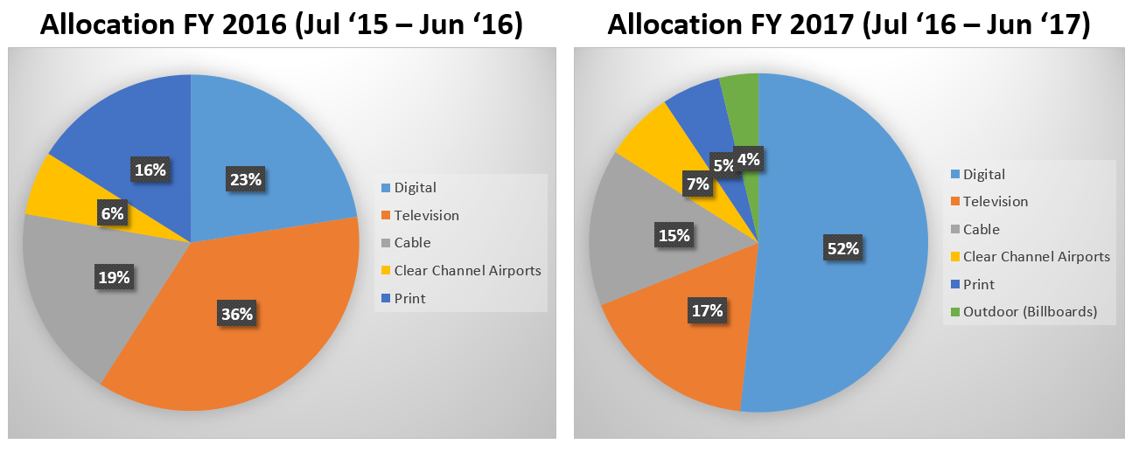
What will we get for the spend? Reallocation

Slide 18
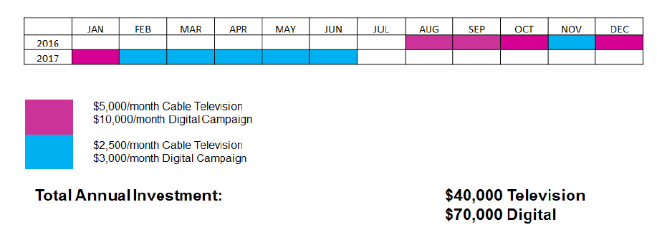
What will we get for the spend? More with less…
Higher partner expectations…

Slide 19
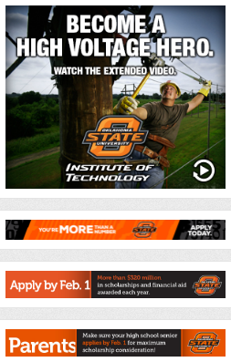
What will we get for the spend? Digital Differences
Competitive Analysis: Digital Ad Campaign
Enrollment Campaign – Digital Ads Current | Enrollment Campaign – Digital Ads Aspirational Peer Campaigns

Slide 20
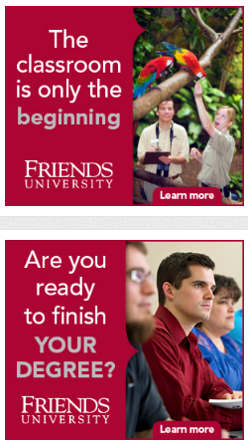
What will we get for the spend? Digital Differences
Competitive Analysis: Digital Ad Campaign
Enrollment Campaign – Digital Ads Current | Enrollment Campaign – Digital Ads Local Market Campaigns

Slide 21
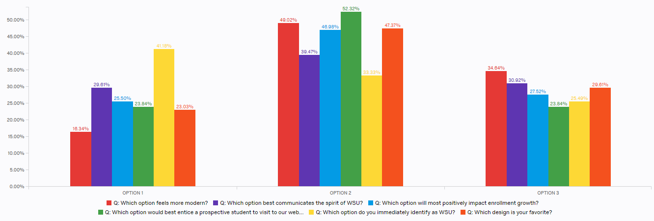
Insights into Actions…

Slide 22
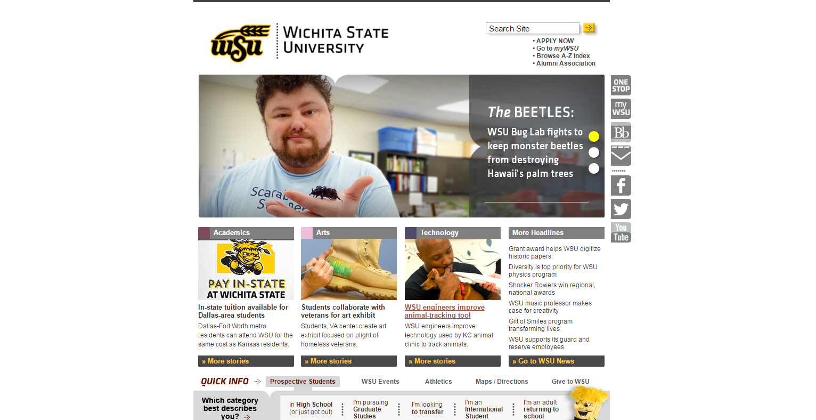
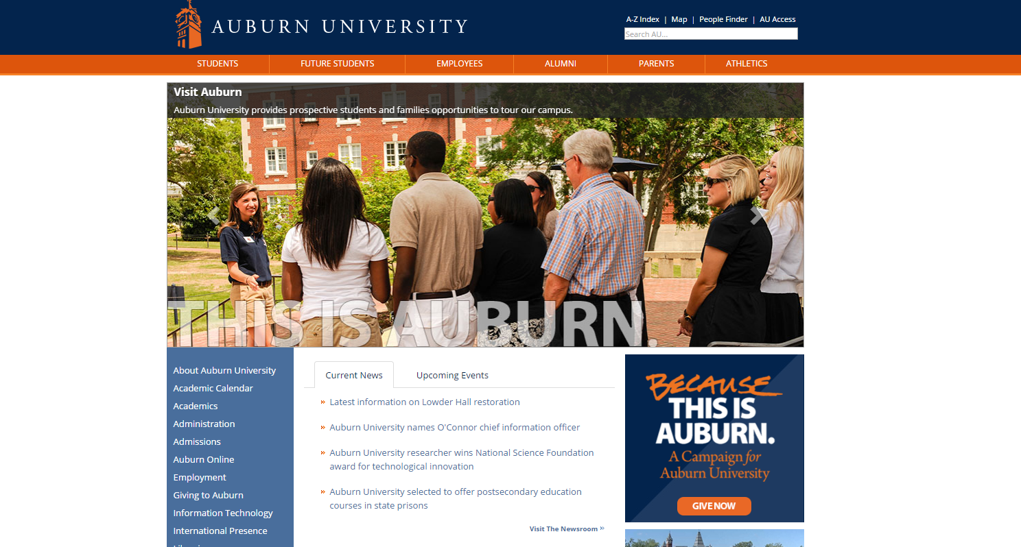
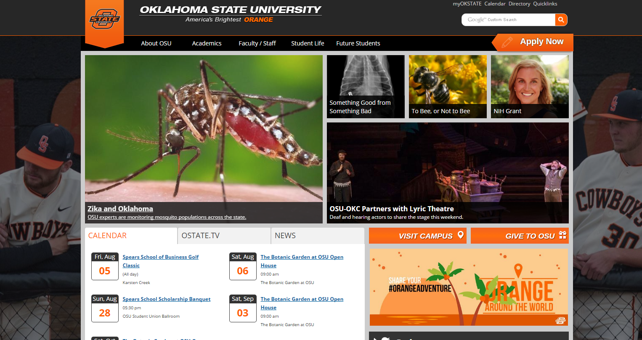
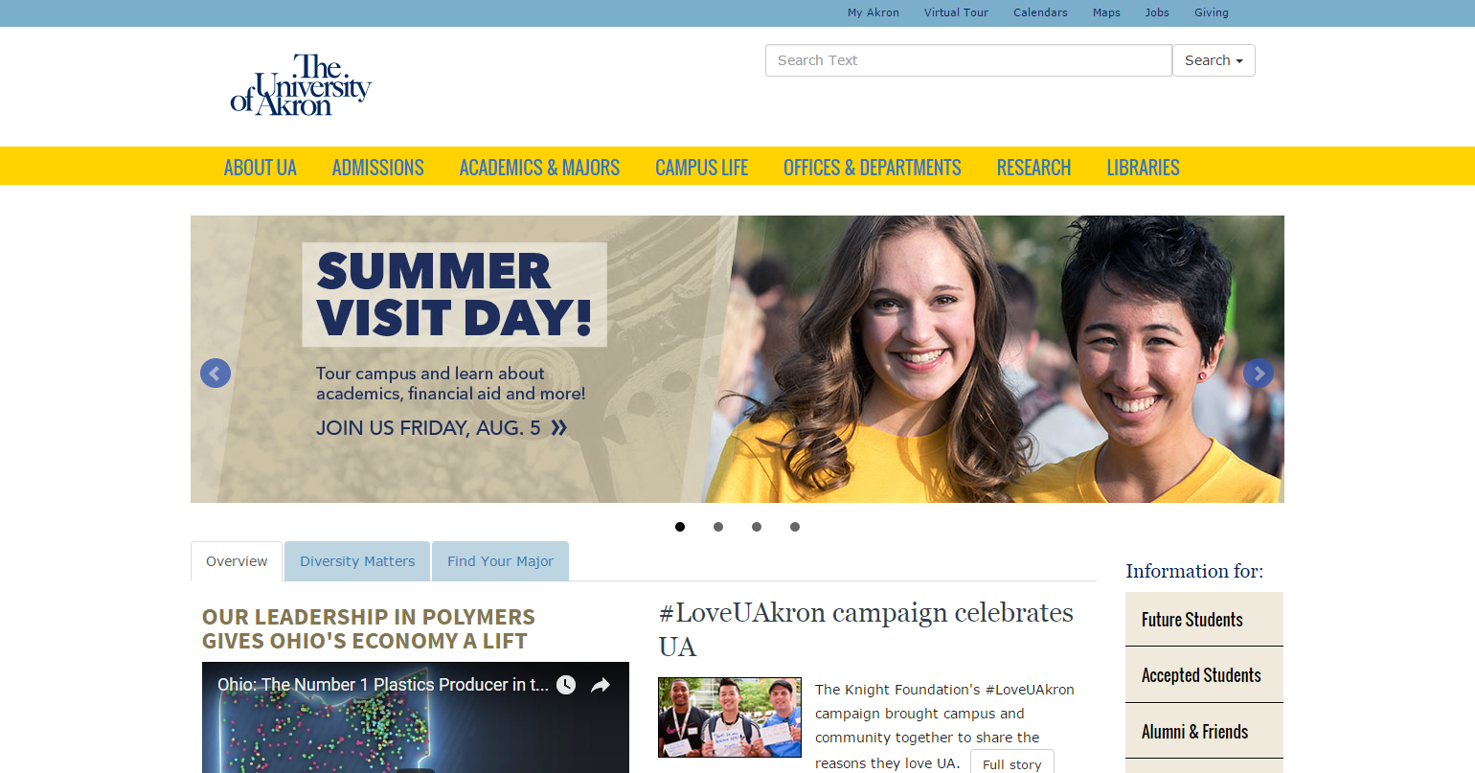
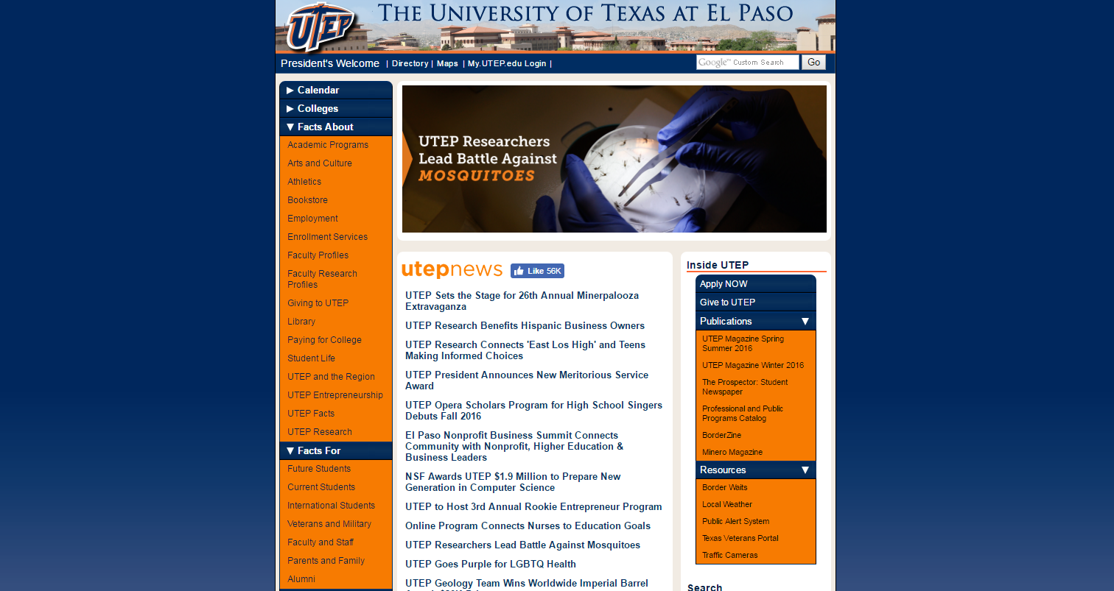
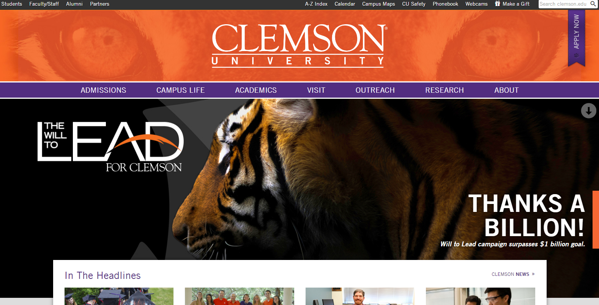
What will we get for the spend? Digital Differences
Competitive Analysis: Website
University Website - WSU Current | Website - Aspirational Peer Institutions

Slide 23
CURRENT STATE
DOMESTIC UNDERGRADUATE ADMISSIONS
INTERNATIONAL UNDERGRADUATE ADMISSIONS
ONLINE LEARNING
ADULT LEARNING
NON-CREDIT LEARNING
STRATEGIC COMMUNICATIONS

Slide 24
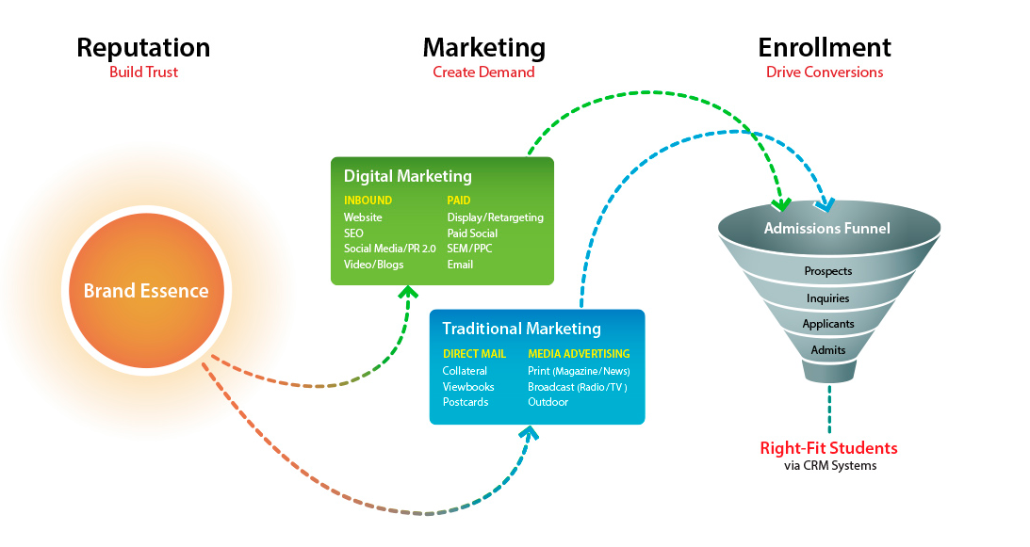
What will we get if we spend more?
What will it take to make a step change?
http://www.elliance.com/media/274472/higher_education_marketing.jpg

Slide 25
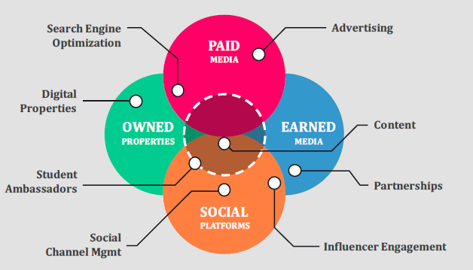
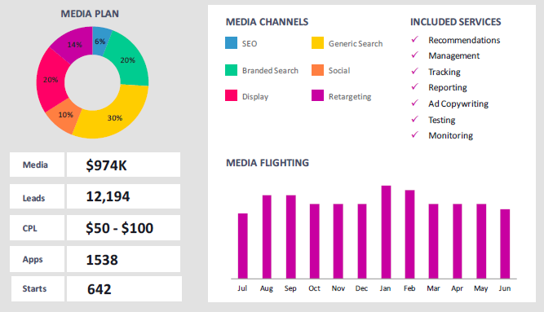
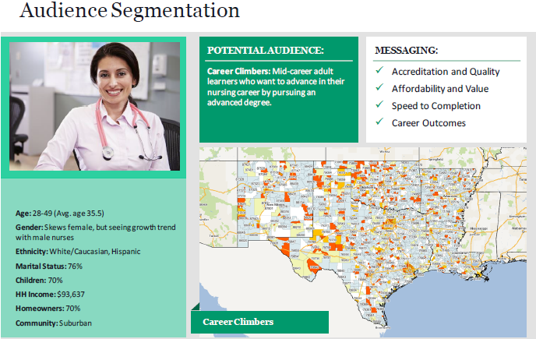
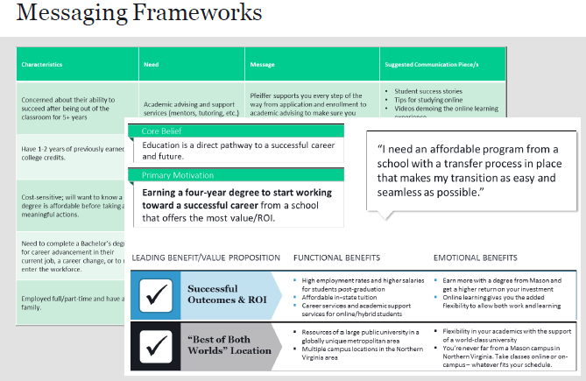
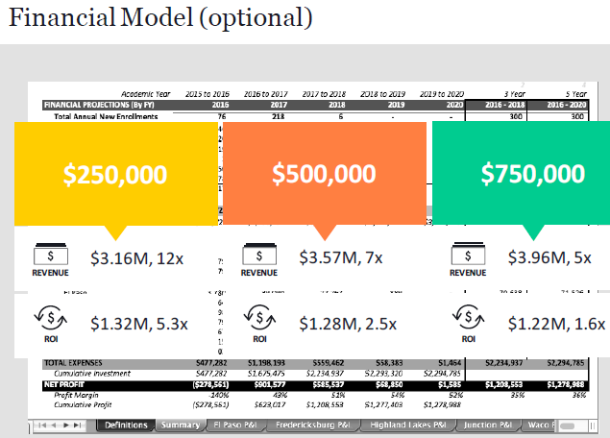
What will we get if we spend more?
What will it take to make a step change?

Slide 26
Living the Message
Have you noticed that walking across campus you can get people to acknowledge you with a nod if you engage them as you pass?
What if that became an expectation that in this community of higher education, you greet people on the sidewalk
Socialize new students to take the iPhone 7 airbuds out of their ears and LOOK at people as they pass them and at least smile
Consciously cultivating a sense of community grows retention and makes WSU more attractive as a college choice.

