Slide 1
We Will Enhance Every Student’s College Experience Wichita State University
Stanley E. Henderson
January 24, 2017

Slide 2
Agenda for Today
The Student Journey
Who’s on the Journey at WSU?
Value and Student Engagement
Introducing Dr. Teri Hall
Faculty Toolbox

Slide 3
Recapping the First Three Workshops: Growing Enrollment, Promoting WSU, Student Service
Each has a role in a Culture of Enrollment
Building relationships in a Community of Higher Education
“You never know who your audience is”
The optics of promoting Wichita State: putting yourself out there
Getting, and giving clear, consistent messages
Building a student-focused approach to service
Without the students, we wouldn’t be here

Slide 4
The Student Journey from the traditional hand-off approach to….
Traditional Enrollment Perspective
Recruitment / Marketing
Classroom experience
Co-curricular support
Degree/goal attainment
Orientation
Student’s Experiences
Admission
Financial support
Academic support
Retention
Alumni
Notes:
Stan
Numbers are often the beginning point in enrollment discussions, but in reality, the issue is enabling students to be successful. If you deliver on that goal, the numbers will take care of themselves.
Often EM structures are limited to admission and transition programs, and to me those functions are closely tied to academics. But in the culture of higher education – especially research universities -- that is not a widely held view.
Stretching
Oregon State – gain additional inroads into academics by increasing the number of points at which we address an explicitly academic agenda.
Importance
Recruitment: perceived academic quality
Retention: connections with faculty
Credibility: more than just student services

Slide 5
…a fully integrated student experience
The SEM Perspective
Recruitment / Marketing
Classroom experience
Co-curricular support
Degree/goal attainment
Orientation
Student’s Experiences
Admission
Financial support
Academic support
Retention
Alumni
Notes:
Stan
Numbers are often the beginning point in enrollment discussions, but in reality, the issue is enabling students to be successful. If you deliver on that goal, the numbers will take care of themselves.
Often EM structures are limited to admission and transition programs, and to me those functions are closely tied to academics. But in the culture of higher education – especially research universities -- that is not a widely held view.
Stretching
Oregon State – gain additional inroads into academics by increasing the number of points at which we address an explicitly academic agenda.
Importance
Recruitment: perceived academic quality
Retention: connections with faculty
Credibility: more than just student services

Slide 6
Who’s On the Journey at WSU? Data and Ramifications

Slide 7
The Wisdom in Students’ Words
“There is a difference between a teacher and a lecturer”
“The teacher brings everything together to enable understanding”
“A good teacher shows her professional interest in your personal interest”
“You have to get people involved, which makes them come back”
“He learned our names, and, in the process, we learned each other’s names”
“As a teacher, you need to step out of your technical side and into your human side”

Slide 8
Race/Ethnicity Trends at WSU
Last fall’s undergraduate enrollment included the following:
7225 white, non-Hispanic students , a decrease of 1.5% from 2015 and a decrease from 2000 of 10.2%
665 African-American students, an increase of 4% from 2015 and a decrease of 8.5% from 2000
1295 Hispanic students, an increase of 8% from 2015 and an increase of 172% from 2000
WSU Office of Planning and Analysis, 2016
WICHE projections call for continued growth of Hispanic high school graduates in Kansas high schools until about 2027 when the numbers will flatten; African-American and white numbers will be relatively flat.
WICHE, 2016

Slide 9
Student Expectations
Diverse students that the university has decided to target will be interested in the diversity at Wichita State before they decide to attend—or stay if they do come
In one focus group I did here, a most impressive young man told how he put #Shockers into Twitter to see what kind of diversity showed up in the pictures associated with postings for that hashtag
Of course, white faculty and staff can—and should—embrace and model diversity, but students of color also want to see folks who look like them; they will routinely look at college viewbooks to see how many faces like theirs they see

Slide 10
Faculty of Color at WSU
64 individuals (6.3%) of WSU faculty (all levels, tenure track and non-tenure track) are underrepresented minorities
16 (4.2%) of WSU tenure track faculty are underrepresented minorities
1 (.3%) American Indian/Alaska Native
9 (2.4%) African American
6 (1.6%) Hispanic
Only one tenure track faculty member identified as multi-race, non-Hispanic

Slide 11
First Generation Students
Many First Gen students—the first in their families to go to college (43% of undergrads, 44% of freshmen at WSU)—may have no framework that tells them how to ask for help or are afraid of being labeled dumb or a failure
There is an enormous body of research that points to the fact that First Gen students are at risk of dropping out, of not persisting to graduation
We can’t stereotype—I am a First Gen student—and I suspect many of you are also—but we have to recognize that First Gen students face a number of daunting barriers that present us with challenges as we think about how we connect with students

Slide 12
Academic Barriers and University Challenges
Barrier
Challenge
Report lower educational aspirations
More likely to enter college academically underprepared
Reading comprehension and critical thinking do not improve at as high a rate
Earn lower GPAs and take fewer academic hours
Avoid majors and courses in math, science, and humanities
Create an environment that affirms students’ strengths and encourages their educational pursuits
Provide opportunities for supplemental instruction, remedial instruction, and/or learning skill development
Demonstrate the value of liberal education

Slide 13
Financial Barriers and University Challenges
Barrier
Challenge
Uninformed about financial aid – forms, processes, etc.
More likely to have additional financial obligations
Have fewer resources to pay for college
Nature of and time allotted to work differ from that of second-generation students
More likely to meet employment obligations than academic obligations
Supply materials about financial aid and the financial aid process that are easy to access and easy to understand
Assist students in minimizing out-of-pocket costs
Provide ample opportunities for on-campus employment

Slide 14
Cultural Barriers and University Challenges
Barrier
Challenge
Less likely to identify college as necessary to achieving goals
Parents lack “college knowledge” related to navigating the college environment
Only 50% identify their parents as supportive of their decision to attend college
“[Live] simultaneously in two vastly different worlds while being fully accepted in neither”
Demonstrate the long-term benefits of a college education
Integrate with family to create “buy-in” when possible and/or appropriate; encourage autonomy as necessary
Assist students in recognizing and accepting their dual roles
Provide culturally-sensitive services that address the specific needs of first-generation students

Slide 15
Social Barriers and University Challenges
Barrier
Challenge
More likely to live off-campus
Less likely to participate in on-campus organizations/events
Identify their closest friends as full-time employees rather than college students
Report higher rates of isolation and discrimination
Perceive faculty as “distant” or unconcerned with them as individuals
Provide cost-effective housing options and/or ways to integrate with Housing programs and initiatives
Target first-generation students when advertising organizations and events
Foster a safe and inclusive campus community
Create opportunities for first-generation students to form relationships with faculty
M. Selby-Theut

Slide 16
Student Engagement and Value

Slide 17
Community, Engagement, and Learning
These challenges, perhaps more than any other facing our students today, require a shift in how we think about engagement in class and out of class
I suggest that the community concept on our campuses is a major vehicle for a more comprehensive look at how engagement can tie the curriculum and co-curriculum together to enhance learning across the board—for all students, First Gens or Fifth Gens

Slide 18
Look at the Entire Campus as a Learning Community
Our students are living Aha! moments every day on our campuses. In a student government meeting one will say, “Aha! That’s what Prof. Smith was talking about in American Government.” Or, a service club develops relationships with non-profit community groups and realizes, “Aha! That’s how networking from Management 301 works.”
Susan Borrego echoes what many have experienced when they marry what they are learning in class with a co-curricular involvement. These “Aha!” moments, she says, are more meaningful than serial coursework or serial activities. The total learning is greater than the sum of its parts, and we realize that “the entire campus is a learning community.” (2006)

Slide 19
The Value of Value
Increasingly, how we interact with students needs to look for those “Aha!” moments, how that experience ties them to the journey through our university, and how not having that experience can lead them to leave.
It is part of their hunt for value. Autopsy studies always show students leave for academic, financial, or personal reasons. Often these may be placeholders for students’ perceptions that they are not getting enough value for the time, money, effort they are investing in their learning.

Slide 20
Engagement as the New Retention
Build value and they will stay
Value provides a new definition of retention built around what motivates students. If students see how what they are doing outside of class extends and enhances what they are doing in class, they will be more to become involved on campus and be more likely to succeed and persist to graduation
In this sense, engagement may be the new retention

Slide 21
Introducing Dr. Teri Hall

Slide 22
Dr. Teri Hall Vice President for Student Affairs
A little about me…
First in my family to finish Bachelor’s, Master’s or Ph.D.
Worked in Higher Ed. for 30 years
Aside from Student Affairs work, coordinated HESA master’s at IU
Spent 18 years at Towson
Transfer student success and involvement
Increased student involvement
Assessment
Leadership development
Student advocacy

Slide 24
What does this mean for Student Affairs?
How do we help every student define and find their level of involvement?
Through student organizations
Through on campus employment
Through partnering with Academic Affairs to increase involvement
Through Greek life
Through Sport Clubs and Intramurals
Through creating places/spaces where students feel they matter!
A critical next step for Student Affairs is to create a strategic plan in line with WSU and with involvement/retention as a focus

Slide 25
The Faculty Toolbox A New Tool to Support Students
Kim Sandlin

Slide 26
Faculty Toolbox
www.wichita.edu/facultytoolbox
Notes:
The Faculty Toolbox was created as a tactic from the SEM plan and by a team from the SEM workgroup as well as faculty.
It is available in both electronic and paper copy.
Content will be added over the course of the semester and apply to faculty and students in face-to-face as well as online classes.
S/O to John Jones and his IDT team for putting it together online so quickly as well as Strat Comm who put together a professional set of materials under a tight deadline as well.
Show table of contents
Show Top 10 Tips - #2 (activity on first day or group projects), #6 (p/u assignment in office)
Show Making Referrals - #2 (refer to a name), #7 (walk person to the office)
Data
SEAS report – faculty tool

Slide 27
Weekly Messages
Blackboard announcements and PPT slides for faculty to use in classes
WSU Today, Shocker Blast, faculty emails
Department social media posts
Department programs
Guide app
Notes:
The toolbox is one part of a collection of weekly messages that include:
Bb announcements and PPT slides written for faculty to deliver to students in the classroom
WSU Today, Shocker Blast and faculty email messages on Mondays
Social media posts – depts. are connecting in this way with the messaging
Department programs – Transition Tuesday, Retention FF pizza w/ profs
Guide app – app available this spring to 2SEM SRs
Coordinated messaging is in the OSS weekly checklist, Parent Calendar and Guide

Slide 28
EXAMPLE: Week one – Blackboard announcement for faculty
If you haven’t yet made connections on campus, consider arriving early or staying after class to introduce yourself to other students and your professor. The more connections you make, the more comfortable you will be on campus and potentially more likely you will be to graduate. Ask what others are looking forward to this semester to strike up a conversation. If you aren’t sure how to approach your professors, you can find resources here.
Looking for scholarship for next year? Visit www.wichita.edu/scholarships to find a list of deadlines and opportunities for continuing students. If you don’t have a financial plan for future semesters, schedule an appointment to see a Peer Financial Coach in the Office of Student Money Management to get started. Go to www.wichita.edu/osmm to request an appointment.
Notes:
Example of what was written for faculty to copy/paste into announcement box in their Bb course.
(Give a minute to read)

Slide 29
Making strong connections each semester is key
Get to class early and stay after a few minutes to form relationships. Talk to two students you didn’t already know and introduce yourself to your professors.
Not sure what to say?
Ask other students where they are from, what they are studying, or what they are looking forward to this semester.
Simply say hello to your professor when you walk into class. (And take that empty seat in the front row!) Tell your professor you are excited to be in the class.
Other tips for speaking with your professors can be found here (www.wichita.edu/success).
Attend at least two Welcomefest activities (www.wichita.edu/involvement).
Notes:
This is the PPT slide faculty can use to either display as students are walking into the room or place in their Bb course.
There is a mix of information and relevant tips students can use right away.
Each week has one to three slides with unique information on each.

Slide 30
Week One Messaging Examples
30

Slide 31
Scholarships for next year
If you are applying for scholarships for next year, application deadlines are approaching quickly! Some application deadlines have already passed. Visit www.wichita.edu/scholarships for information.
Consider meeting with a Peer Financial Coach in OSMM (Office for Student Money Management) if you are unsure of how to manage your college finances. Visit www.wichita.edu/osmm to request an appointment.

Slide 32
EXAMPLE: Week one – WSU Today
Notes:
This look will remain consistent – the theme for each week will change in the gold bar.

Slide 33
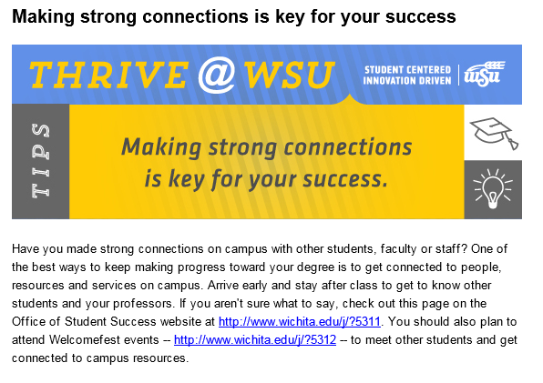
EXAMPLE: Week one – Shocker Blast
Notes:
Same theme, but written to apply to the student.

Slide 34
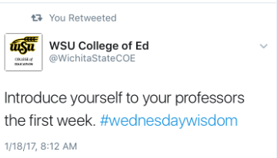
EXAMPLE: Week one – faculty email, college social media
Notes:
Each Monday, the faculty listserv will receive an email from Provost Vizzini with the same message for those who may not see WSU Today.
College of ED has chosen to push messages out on Twitter.

Slide 35
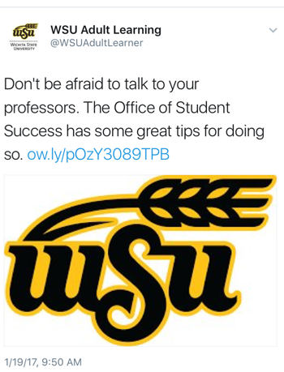
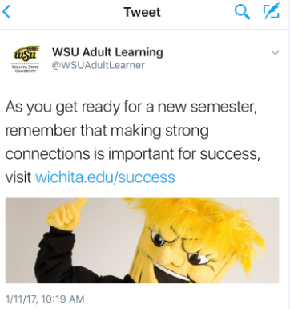
EXAMPLE: Week one – student service department social media
Notes:
Additionally, student service departments have also chosen to push messages through social media. Shown here: Adult Learning

Slide 36
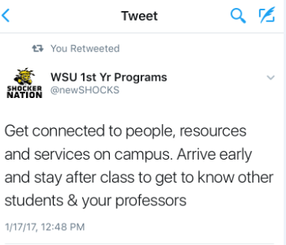
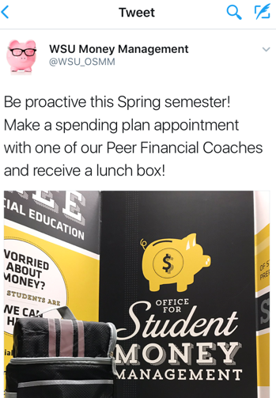
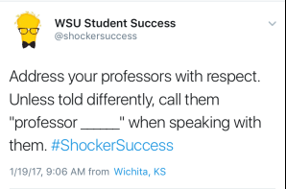
EXAMPLE: Week one – student service department social media
Notes:
Messaging doesn’t have to be the exact copy of message – it can contain a related tip or link.

Slide 37
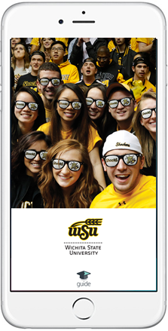
Guide app
Notes:
We are one of 5 campuses nationwide in a beta testing phase with EAB using the mobile app guide. Lisa Hansen is our lead on this project, but you can see images here.
Students log in with their campus credentials and receive personalized information.

Slide 38
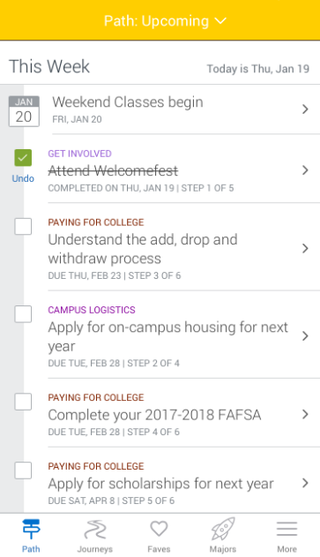
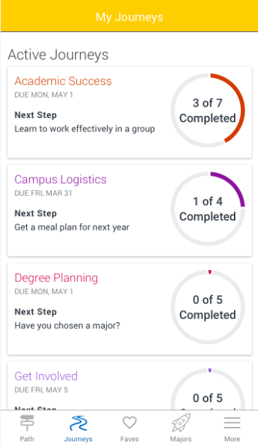
Guide app

Slide 39
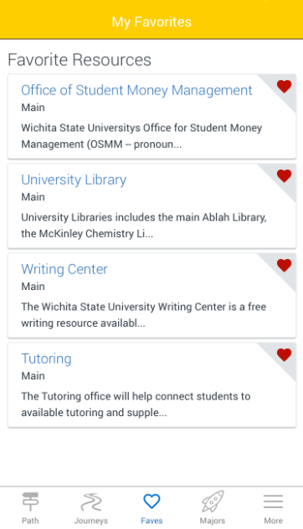
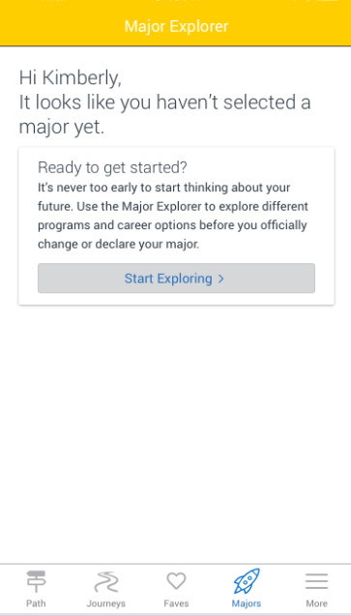
Guide app

Slide 40
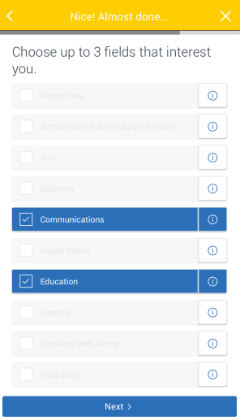
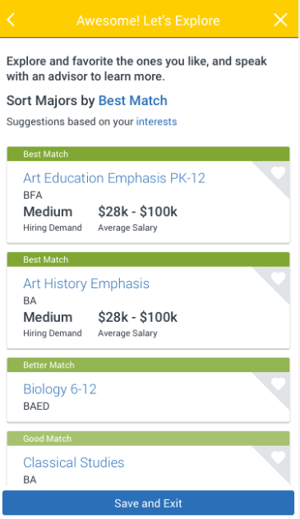
Guide app

Slide 41
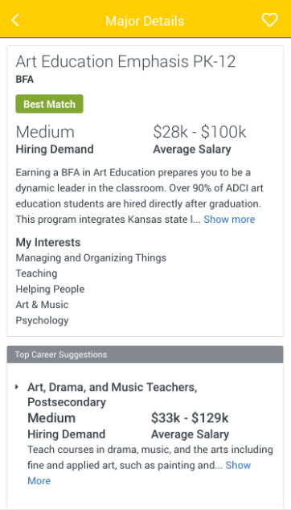
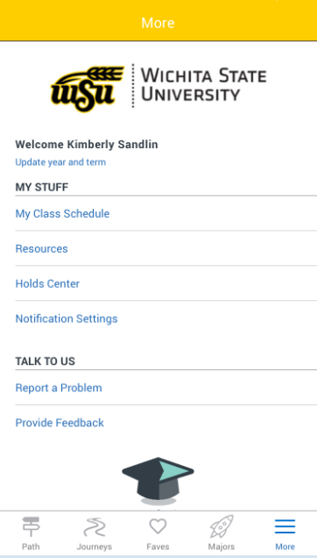
Guide app

Slide 42
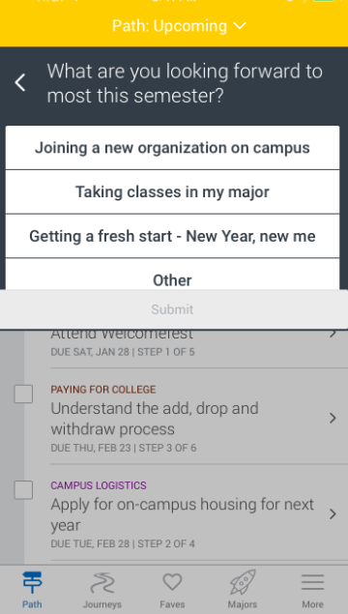
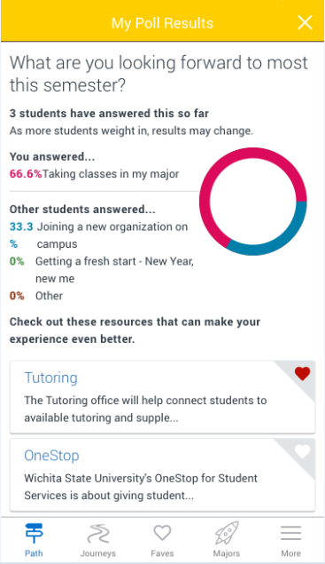
Guide app

Slide 43
Priming the Toolbox Pump
The first 10 departments (any department on campus) that submit a program or campaign enhancing the student experience with concepts in the Faculty Toolbox by March 1, 2017, will be entered into a drawing for a chance to win three department faculty/staff lunches
Submissions should come to: kim.sandlin@wichita.edu

Slide 44
Questions?

