Slide 1
We Will Help Grow Enrollment at Wichita State University
Stanley E. Henderson
September 22, 2016

Slide 2
Agenda for Today
Getting on the same page
Establishing enrollment goals
New faculty fellows program

Slide 3
What Does Growing Enrollment Mean for Me?
“I’m going to have to go out recruiting? I don’t have time to do that.”
In fact, you already work on enrollment every day—in front of the classroom, at the front desk, in an advising office
But you also work on enrollment in your own community where you live, where you worship, where you play
You never know who your audience is
How you interact with a student on campus can determine whether she stays; how you interact with a student off campus can determine whether he comes

Slide 4
The Essence of Enrollment
The relationships we develop with those who would be, or already are, our students
What we know about those students—the data about their backgrounds, their actions, their successes and their missteps
And each informs the other

Slide 5
Each Has a Role
Faculty teach and mentor
The professor chasing after a student
“My students tell me they like you. Why is that?”
Staff serve and develop
The groundskeeper stopping his mower
The custodians who volunteered to work a weekend for one of “their” student’s wedding
Administrators facilitate
The vice president as cheerleader
The dean who goes to student club meetings

Slide 6
But Each Must Have a Common Message
A culture of enrollment finds a common message that each component of the campus can use as it carries out its different role
It comes from what already defines the university, but it needs to be couched in a way that sets the place—and the experience—apart
It cannot be contrived
It forms a common way of communicating about the place and socializing students to it—building relationships that bring students and keep them here

Slide 7
Building Consensus and Messaging Around What’s Already There
Wichita has a community feel about it: it’s big enough to have all the amenities but you still feel as though you belong to something smaller
By extension, Wichita State has that same sense of community, whether it’s Shocker Nation or the camaraderie of students and faculty in one of the colleges or the vibrancy of interaction in one of the RSC offices
Your Consensus Message could be that WSU is not an institution of higher education but a COMMUNITY of higher education

Slide 8
Using Message to Set Expectations
In an institution, you are in a passive place where things happen to you, over which you may not have much influence
In a community, you are a member, a participant, a contributor, where you look out for others around you in the community—you’re all in it together, after all.
Faculty can use the community membership idea to set expectations for engagement in class—you don’t sit silent and disengaged in an academic community
Staff can use community to create a culture of service to others in the larger community, to engage students outside class

Slide 9
Living the Message
Have you noticed that walking across campus you can get people to acknowledge you with a nod if you engage them as you pass?
What if that became an expectation that in this community of higher education, you greet people on the sidewalk?
Socialize new students to take the iPhone 7 airbuds out of their ears and LOOK at people as they pass them and at least smile
Consciously cultivating a sense of community grows retention and makes WSU more attractive as a college choice.

Slide 10
Setting the Campus Apart from Others
Every university talks about how it prepares students for their career after graduation; WSU has excellent job placement rates
But if every school talks about job placement, no one has much of an advantage
Besides, a job four or five years away is not always top-of-mind to a freshman
What can make a more differentiating—and effective—message is to talk about the CAREER PATHWAY that students at WSU will follow, starting right away as a freshman, including gateway courses, clubs related to your major, internships, the Innovation Campus

Slide 11
Incorporating Messages into Your Roles
If everybody—faculty, staff, administrator—even other students—can articulate these kinds of consensus messages, the campus takes on more coherence, consistency
If those who are here model the language of community, new students will soon realize that they need to act like members of a community
It gives a foundation for engagement, which leads to persistence and success

Slide 12
THE DATA SIDE OF ENROLLMENT: Building a Culture of Goals to Drive Outcomes

Slide 13
Setting Goals
Each college is expected to set goals to affect fall 2017 enrollment and beyond by October 1, 2016
Goals are to be aligned with the 7 goals of the SEM plan

Slide 14
Why Goal Setting?
We can’t move on enrollment unless:
You know what the goals are
All key personnel know them
We all support them
The SEM plan began that work from a university perspective
It’s now time for colleges and departments to identify how they can help grow enrollment

Slide 15
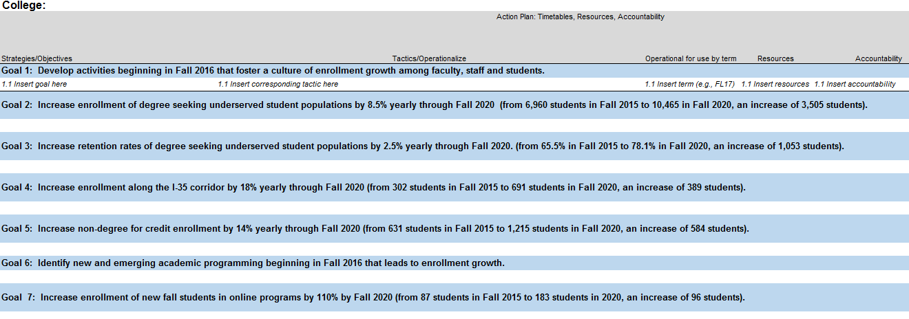
Goal Setting

Slide 16
Faculty Fellows Program: -Recruitment -Retention

