Slide 1

Office of civil rights, title IX & ADA compliance (CTAC)
Fall 2025
General Information and Processes

Slide 2

warning

Slide 3
What we do
CTAC reviews and responds to allegations of violation of university policies relating to Equal Opportunity law, Title IX regulations, and ensures compliance with ADA accessibility guidelines.

Slide 4
Areas ctac addresses
Discrimination
Harassment
Retaliation
Sexual Misconduct

Slide 5
Title VI & VII of the civil rights act of 1964
Title VI
Prohibits discrimination in activities and programs receiving federal funding.
Title VII
Prohibits discrimination for employees of institutions receiving federal funding.

Slide 6
Protected characteristics
Age
Ancestry
Color
Disability
Gender
Genetic Information
Marital Status
National Origin
Political Affiliation
Pregnancy
Race
Religion
Retaliation
Sex
Sexual Orientation
Veteran Status

Slide 7
Title IX of the Education Amendments of 1972
Prohibits Sex & Gender Based Discrimination
No person in the United States shall on the basis of sex be excluded from participation in be denied the benefits of or be subjected to discrimination under any educational program or activity receiving federal financial assistance.

Slide 8
Conduct Addressed under Title IX
Sexual Harassment
Sexual Misconduct
Sexual Assault
Sexual Exploitation
Dating/Domestic Violence
Stalking

Slide 9
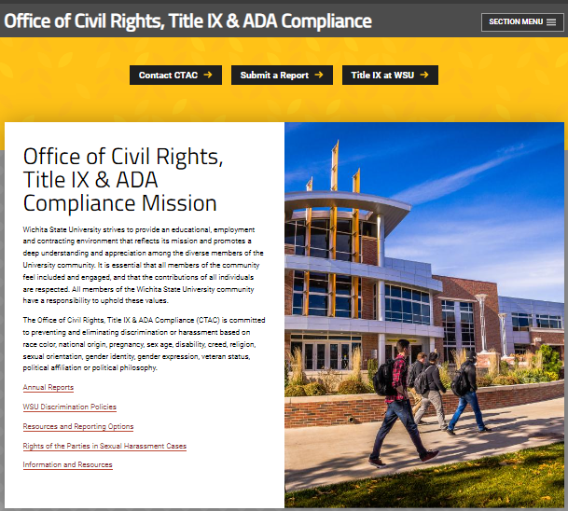
CTAC website for reporting

Slide 10
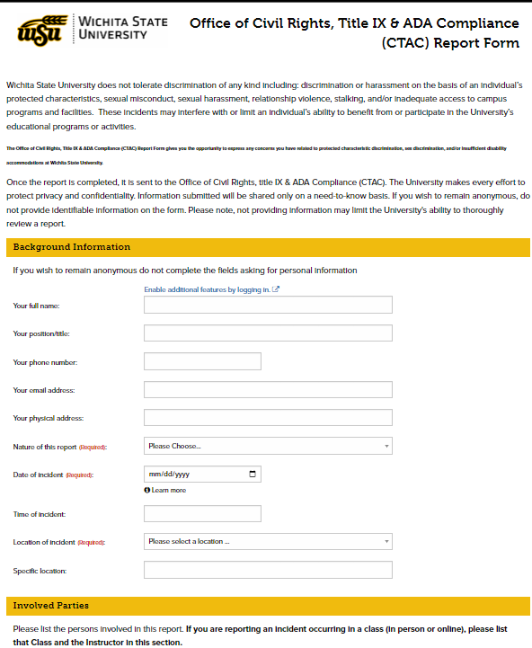
Initial report to CTAC
Complaints may be filed electronically, in person, or over the phone.
Online reporting form: Submit a Report on CTAC webpage

Slide 11
The Complaint process
Formal
Complaint
Signed
Initial
Assessment
Note to Respondent
Comprehensive Investigation
Parties
Review
Evidence
Live
Hearing
Finding
Appeal
Determine if ongoing threat to victim or campus
Determine jurisdiction
Parties interviewed
Evidence collected
Parties review all evidence collected and may respond
Hearing before a panel
Parties must submit to cross-examination
Panel renders decision
Both parties may appeal decision
Notes:
Formal Complaint signed
Initial assessment
Determine if ongoing threat to victim or campus
Determine jurisdiction
Note to Respondent
Comprehensive Investigation
Parties interviewed
Evidence collected
Parties Review Evidence
Parties review all evidence collected and may respond
Live Hearing
Hearing before a panel
Parties must submit to cross examination
Finding
Panel renders decision
Appeal
Both parties may appeal decision

Slide 12
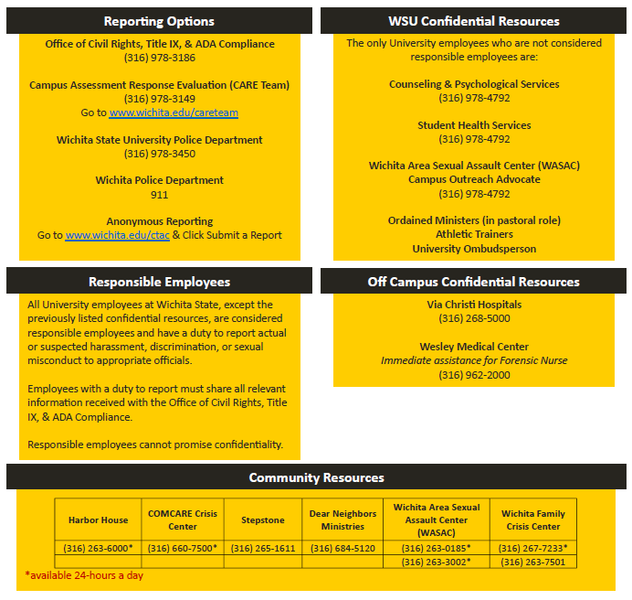
On Campus & Community resources

Slide 13
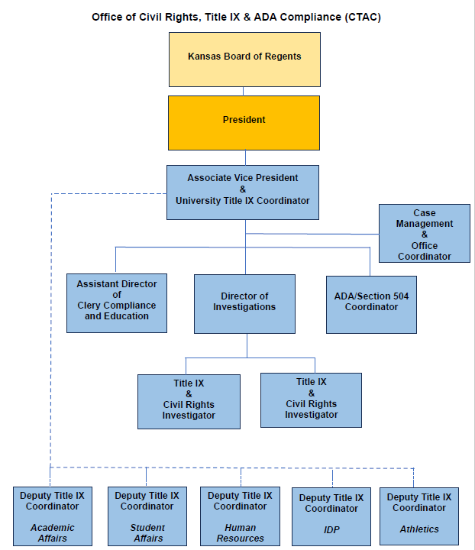
CTAC Organizational chart
Notes:
CTAC head is an Associate Vice President and Title IX Coordinator. This role reports directly to the President who reports to the Kansas Board of Regents.
Those reporting to the Title IX Coordinator include:
Assistant Director of Clery Compliance and Education
Case Management and Office Coordinator
Director of ADA & 504 Compliance (also handles ADA & 504 complaints)
Deputy Title IX Coordinators from Academic Affairs, Student Affairs, HR, IDP, and Athletics
Director of Investigation
Additionally, the Director of Investigations has two Title IX & Civil Rights Investigators who report to that role.

Slide 14
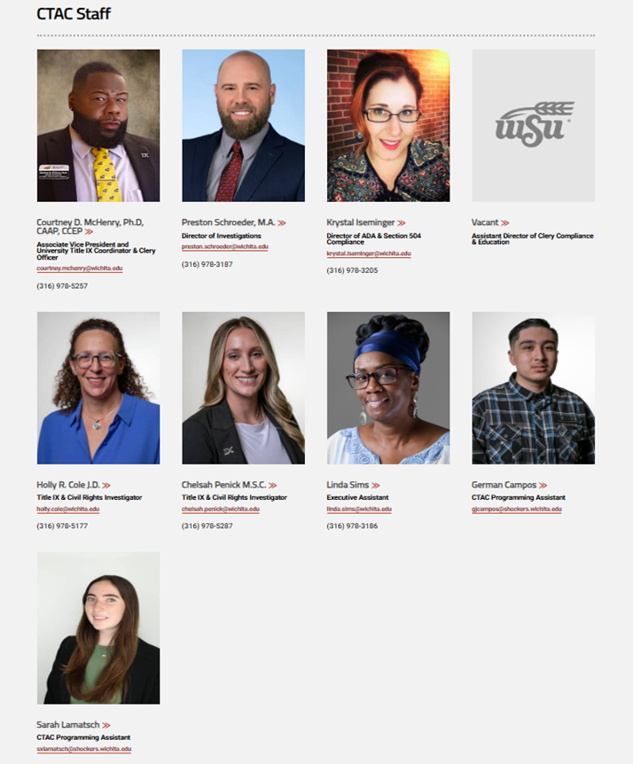
The Ctac staff
Shocker Success Center
Lower-Level, Suite 017

