Slide 1
Graduate Assistant Mandatory Reporter Training
Office of Civil Rights, Title IX & ADA Compliance (CTAC)

Slide 2

WARNING

Slide 3
Conduct Addressed
Discrimination
Harassment
Retaliation

Slide 4
Protected Characteristics
Age
Ancestry
Color
Disability
Gender
Genetic Information
Marital Status
National Origin
Political Affiliation
Pregnancy
Race
Religion
Sex
Sexual Orientation
Veteran Status
Retaliation

Slide 5

What is Title IX?

Slide 6
Policy 3.06
Sexual Harassment
(i.e., R-word, Fondling, Incest, Statutory R-word)
-Hostile Environment
-Quid Pro Quo
Gender Discrimination
Sexual Assault
Dating Violence
Domestic Violence
Stalking
Sexual Exploitation
Notes:
Unwelcome conduct of a sexual nature that is committed without consent between people regardless of sex or gender. Sexual misconduct can include both intentional conduct and conduct that results in negative effects, even if those negative effects were unintentional.

Slide 7

Your Responsibility

Slide 8
Mandatory Reporters
All university employees are required to report actual or suspected sexual harassment, discrimination or retaliation to appropriate officials.
This includes actual or suspected protected class discriminatory harassment.
Exception: Confidential employees do not need to report all the details but must report non-identifiable information regarding incidents disclosed to them.

Slide 9
Confidential Employees
Counseling & Psychological Services (CAPS)
Student Health Services
Wichita Area Sexual Assault Center (WASAC) Advocate
Ordained Ministers
Athletic Trainers
University Ombudsperson

Slide 10
Mandatory Reporters
Required to promptly report all relevant details to CTAC.
Report to University Police Department
Though many employees have mentoring and other relationships with colleagues and students, responsible employees cannot promise confidentiality.
If it appears that a person is about to disclose, employees should make sure that the person understand the mandatory reporting requirements.

Slide 11
Remember!
*Students are not considered mandatory reporters. However, GAs are considered mandatory reporters when operating in the capacity of a university employee.
If a student reports something to you that has the potential to be a policy violation, report it.
Please do not ask them probing questions.
Gather the information available to you and file the complaint.

Slide 12

Report & Process

Slide 13
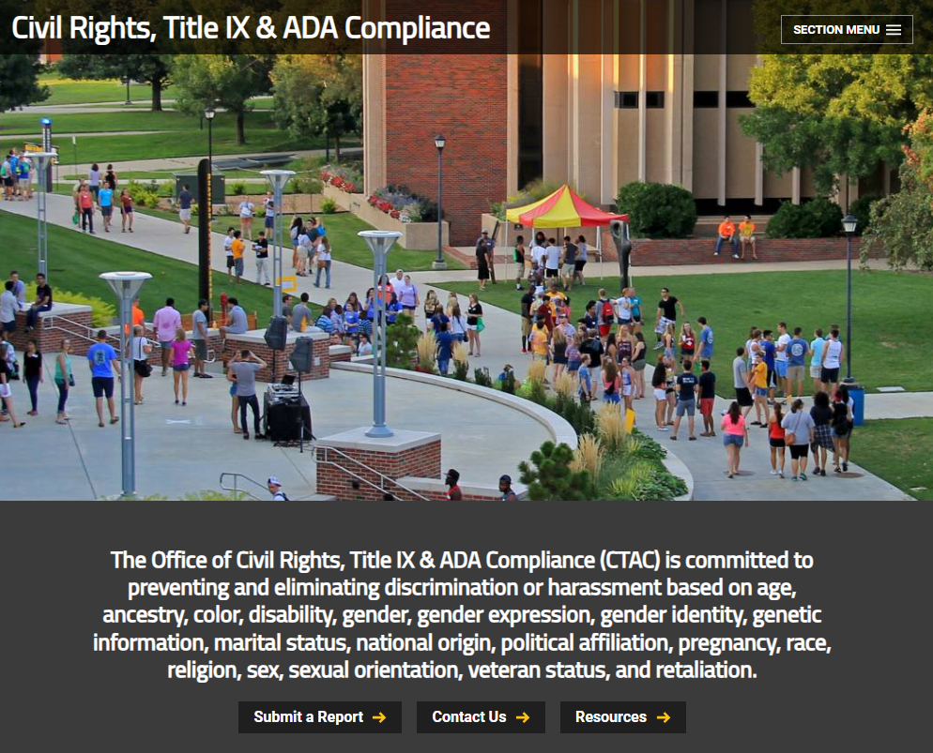
CTAC Webpage

Slide 14
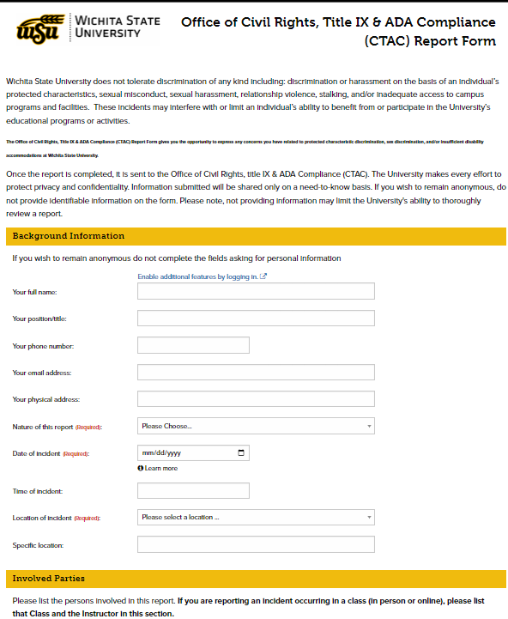
Initial Report to CTAC
CTAC Report form is accessible at Submit a Report
Individuals who wish to report to the University may also report to law enforcement, but they are not required to do so to receive assistance

Slide 15
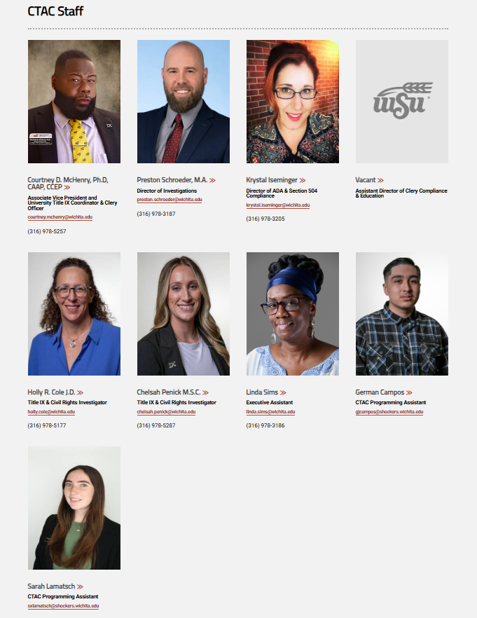
Thank You from your CTAC team!
Shocker Success Center
Lower-Level Suite #017

