Slide 1

Shocker relationships
2025-2026
Presented by:
The Office of Civil Rights, Title IX & ADA Compliance (CTAC)

Slide 2

Trigger Warning and Disclaimer!

Slide 3
Quick Story
“We were in a…SITUATIONSHIP!”

Slide 4
Help me out
“From what I understand, a SITUATIONSHIP is…”

Slide 5
Stages of Engagement
Talking
Dating
Relationship
Where should we place SITUATIONSHIP?

Slide 6
Question
When it comes to modern day dating, how are people meeting each other?

Slide 7

Is everyone using social media apps for the same thing? Does the app determine the expectations?

Slide 8
Are we on the same page?
Jace and Mauri met online.
They decided to meet up to “cuddle.”
Would you say they’re on the same page?

Slide 9
Issue
What seems to be the overall issue?
COMMUNICATION
How can we set boundaries if there is no communication?

Slide 10
Communication is key!
It’s ok to be INTENTIONAL about what you’re seeking.
Establish the nature of the relationship.
“No” is a complete sentence.
Their profile name should not be the only name you know.
It’s ok to listen to what people say but pay attention to how they move.

Slide 11
How does CTAC handle Title IX matters?

Slide 12
Title ix and policy 3.06
Sexual Misconduct (Assault, Harassment, Fondling, Etc.).
Exploitation
Stalking
Domestic Violence
Dating Violence

Slide 13
Multiple Choice #1
After ending the relationship, Stan blocked his ex’s phone number. He began receiving threatening text messages and phone calls from unknown numbers throughout the night into the early morning. The next day, his mom told him someone sent her explicit photos of him. These were pictures he had only shared with his ex.
What might CTAC investigate this for? Choose all that apply. (answers in notes)
Sexual Exploitation
Stalking
Gender Discrimination
Dating Violence
Notes:
A, B, & D

Slide 14
Multiple Choice #2
Reese and Desi work together in the same department. They hooked up a few times last year until Reese began dating someone else. Desi became upset and told Reese, “I’m up for promotion soon. I won’t approve time off for you to be with someone else. You might want to reconsider that relationship.”
What might CTAC investigate this for? Choose all that apply. (answers in notes)
Quid Pro Quo
Hostile Environment
Domestic Violence
Exploitation
Notes:
A & B

Slide 15
Multiple Choice #3
A student is engaging in a CTAC investigation, and the information shared is “criminal” in nature; in fact, the investigator can clearly see marks and bruises that may have resulted from the alleged behavior. However, the student has requested that CTAC not contact law enforcement.
What should CTAC do next?
Call UPD anyway
Refrain from contacting UPD
Call the student’s parents
None of the above

Slide 16
True or False
Title IX only pertains to students – this includes the hearing process.
True
False
The answer is B. False.
What is the hearing process?

Slide 17

What resources are there?

Slide 18
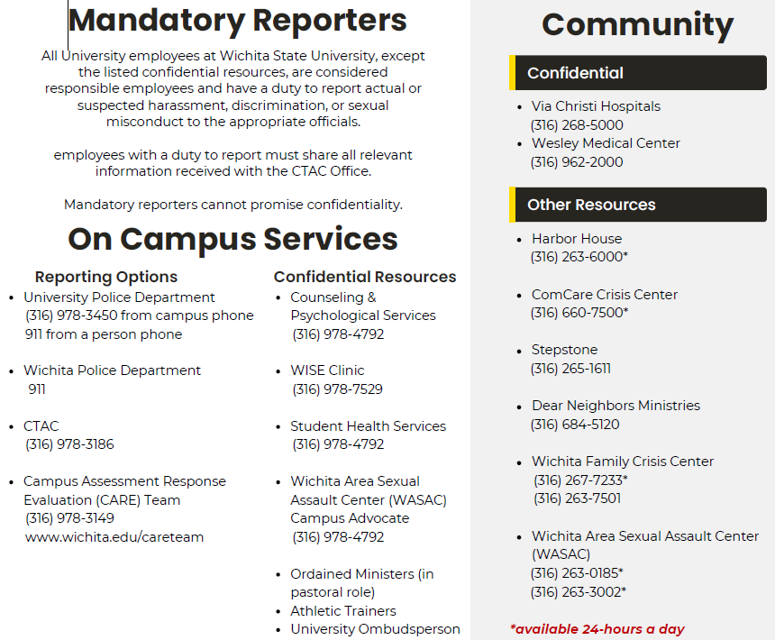
Control what you can, but when you need assistance don’t be afraid to ask for help.

Slide 19
What else does CTAC address?

Slide 20

Protected characteristics
Age
Ancestry
Color
Disability
Gender
Gender Expression
Gender Identity
Genetic Information
Marital Status
National Origin
Political Affiliation
Pregnancy
Race
Religion
Sex
Sexual Orientation
Veteran Status
Retaliation

Slide 21
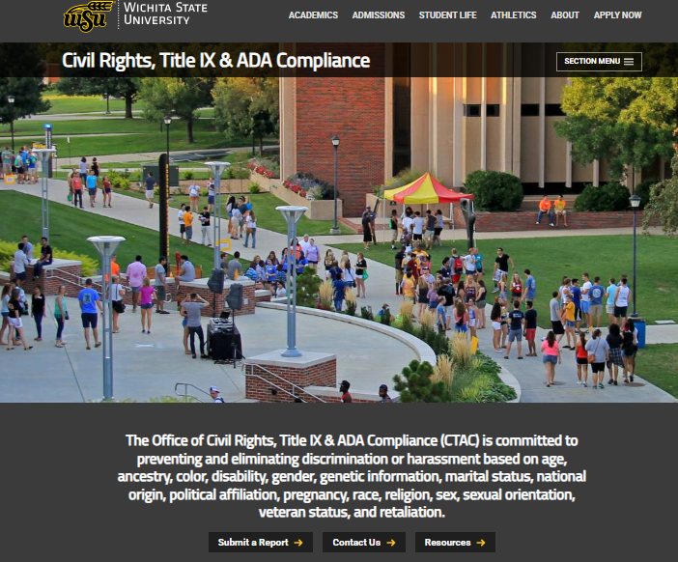

WICHITA.EDU/CTAC

Slide 22
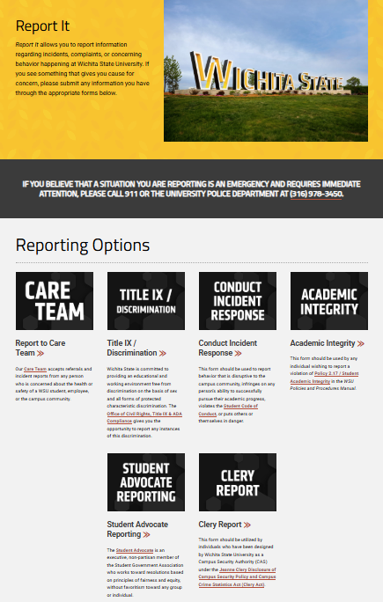
Wichita.edu/ReportIt

Slide 23
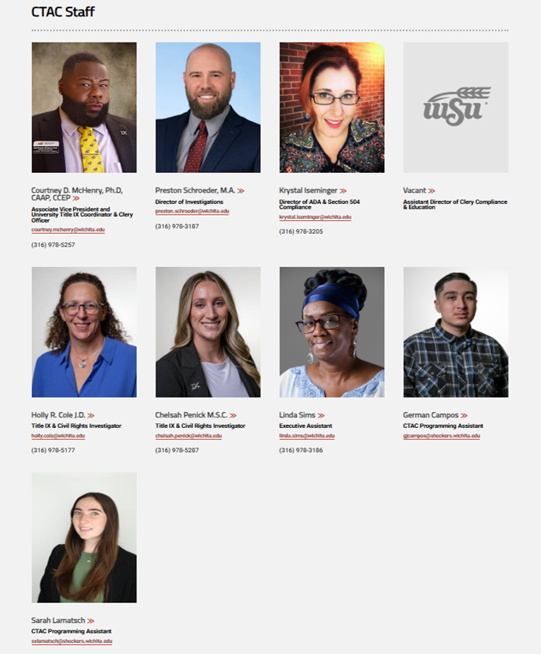
ctac@wichita.edu (316) 978-3186 Shocker success center 017

Slide 24
Questions?

Slide 25
Congratulations!
You will receive full credit towards this year’s annual Title IX & Civil Rights Compliance Training!

