Slide 1
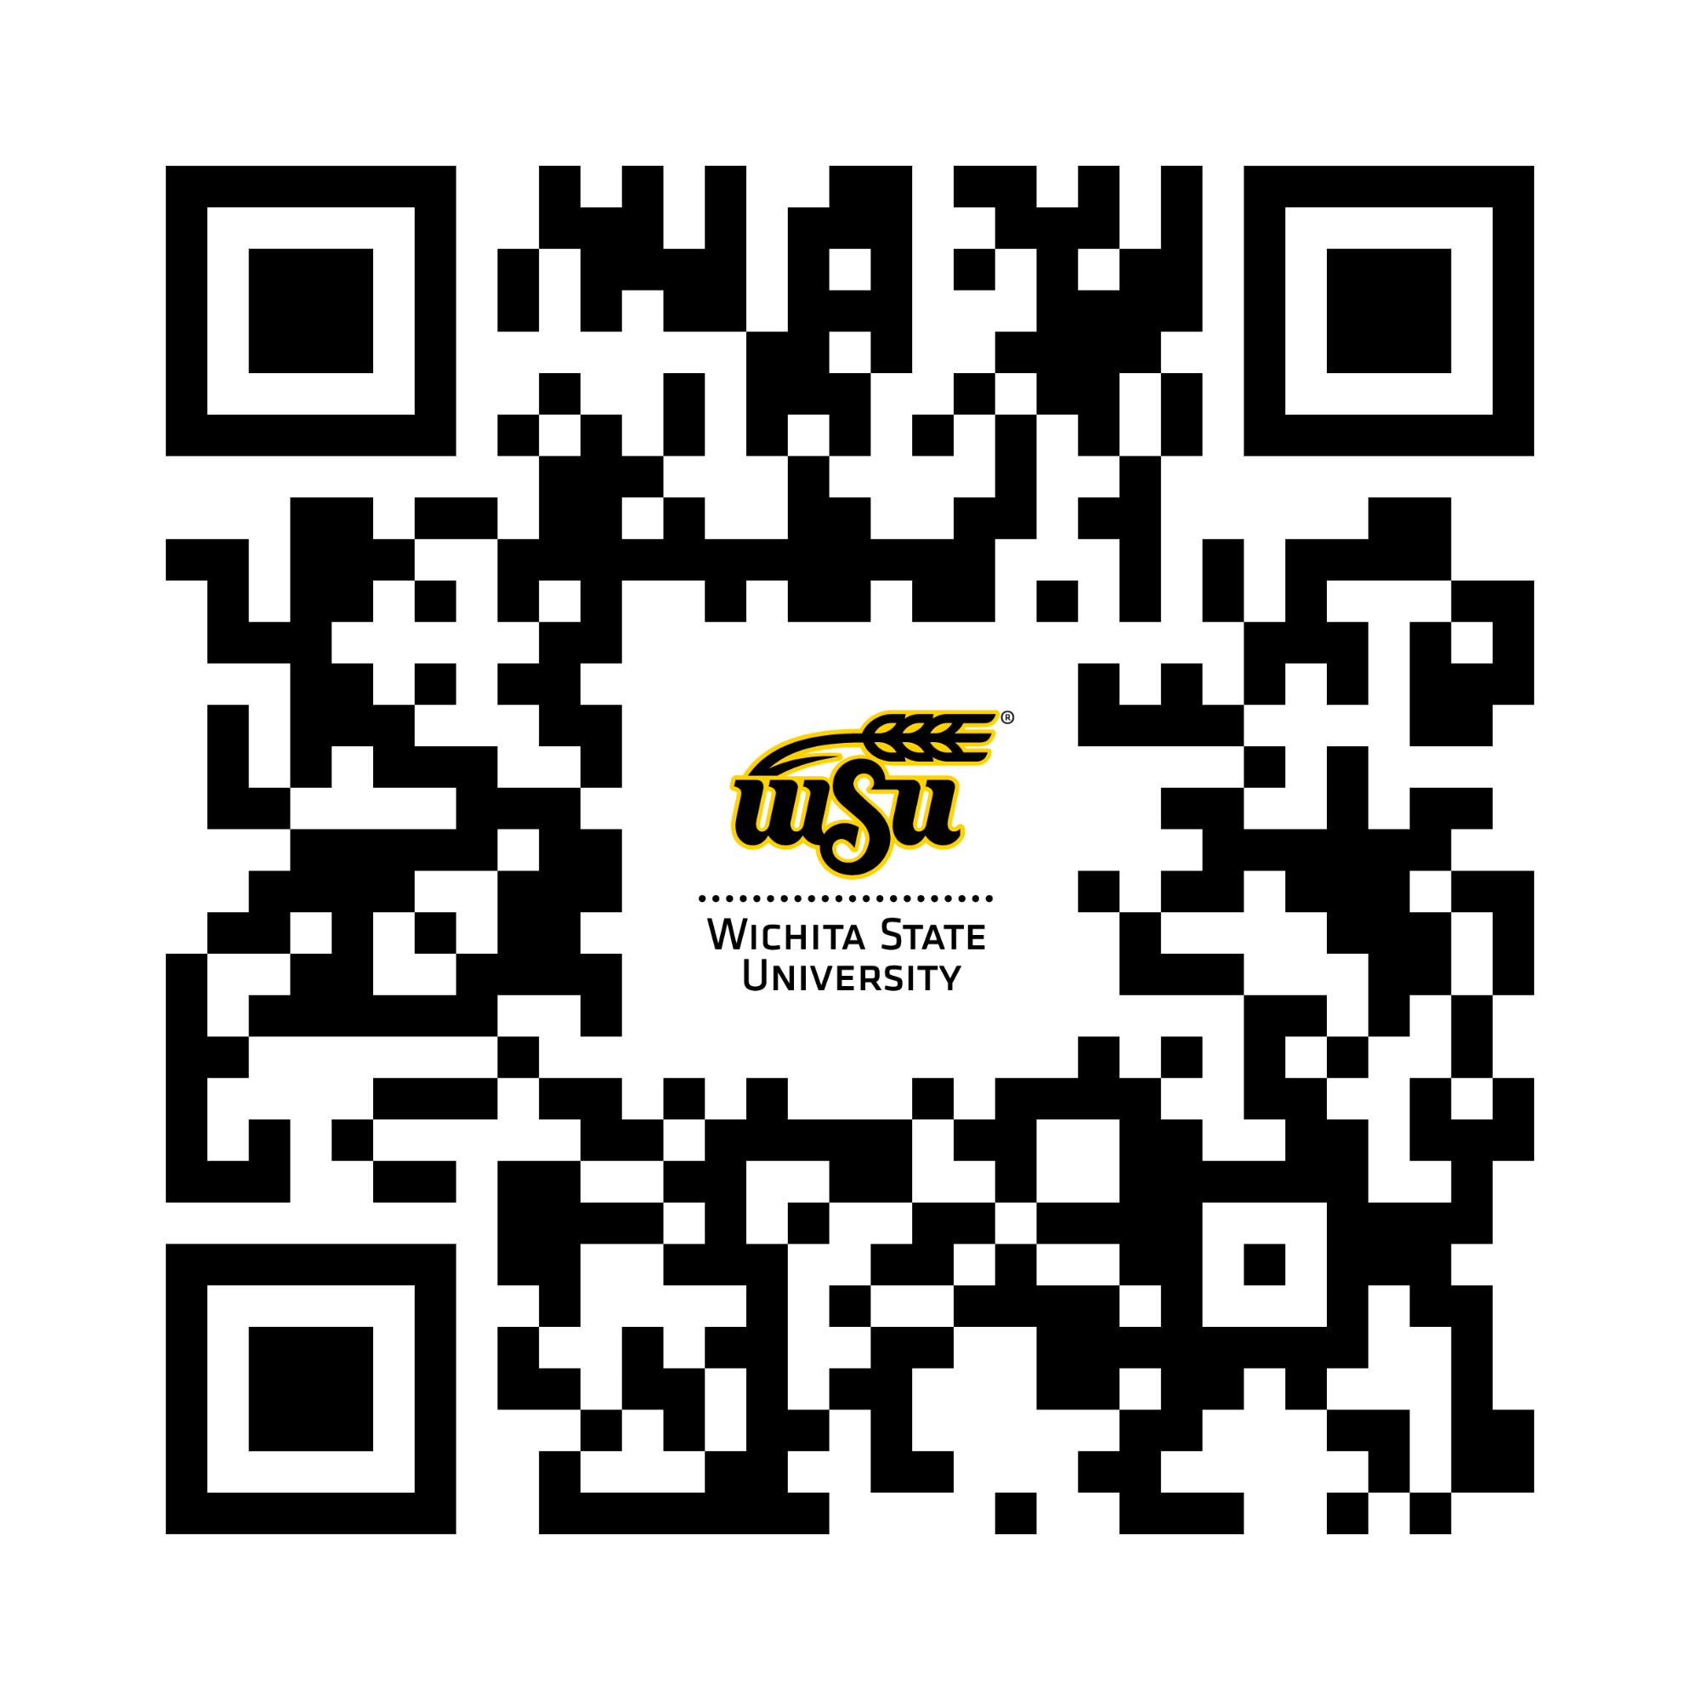
Wichita State University President Rick Muma shares the unvarnished, hard-fought transformation of a mid-sized public research university into a national model for applied learning, research, and industry collaboration.
Scan and use code 24STUDENT to get 30% off plus free shipping to addresses in the U.S.
wsu.news/mumabook
CODE EXPIRES 10/31/25

