Slide 1


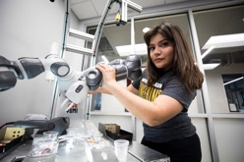

Creating a Shared Vision
Wichita State University
&
The New Decade
Dr. Jay Golden, President

Slide 2

  One of America’s most innovative research-intensive universities known for its impactful student experience and driving the prosperity for the people, communities and businesses of Kansas
Dr. Jay Golden, President

Slide 3
  OUR
  FIVE
  INSTITUTIONAL PRIORITIES
Dr. Jay Golden, President

Slide 4

  PRIORITY 1
Provide an
Accessible & Affordable EDUCATION
All Kansans provided an opportunity for economic mobility through a WSU education
No matter family income, GPA or test scores
Graduating on-time with lowest debt possible
Dr. Jay Golden, President

Slide 5

  PRIORITY 2
Deliver the
BEST STUDENT EXPERIENCE
Doing all we can for student success
  Offer and deliver highest quality 2 & 4-year academic programs to prepare students for the economy & societies of today & tomorrow
  Safe, inclusive and diverse campus
  Strong sense of community
  Expanded athletics & arts - a fun environment
Dr. Jay Golden, President

Slide 6
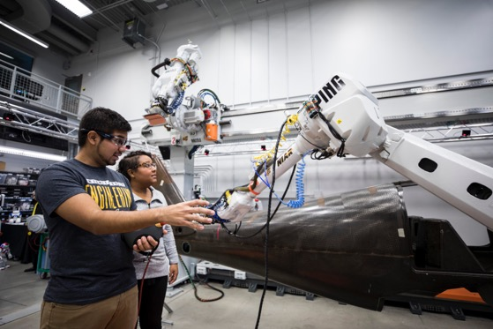
  PRIORITY 3
Recruit & retain talent
Continued Enrollment Growth – Focus on Reversing Millennial Migration out of Kansas
Aggressive & focused recruitment of students / talent from strategic cities outside of Kansas
Retaining students in Kansas after graduation
Strengthen our innovation programs & infrastructure
Partner with community on Shocker Microenterprise Ventures
Dr. Jay Golden, President

Slide 7

  PRIORITY 4
GROW & DIVERSIFY RESEARCH FOR OUR ECONOMY
Significantly increase number of faculty conducting funded research & expand agencies funding our research
Launch and grow Convergence Sciences
Expand paid Applied Learning opportunities for students
Diversify our research portfolio as we help to diversify the regional economy while continued growth of aerospace
Look to partner with Univ. of Kansas & Kansas State Univ.
Dr. Jay Golden, President

Slide 8

  PRIORITY 5
EMBRACE A MISSION OF SERVICE
Service to one another, our region & world
Enhanced Community + Regional Engagement
Research with an applied outcome
Prioritizing health, economic and education disparities
Dr. Jay Golden, President

