Slide 1


Exponential Talent

Slide 2

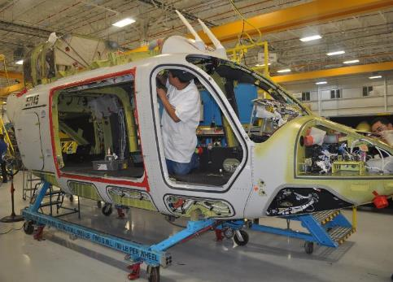





Chihuahua’s Highlights
Chihuahua’s Highlights
3.4 million inhabitants (average age of 25 years old).
One of the most important manufacturing centers in America.
High economic growth, 4.4% in the last 3 years (more than twice the national).
National leader in exports and employment for the manufacturing industry.
A preferred investment destination, $1.1bn USD of FDI a year (5th national place in 2017).

Slide 3
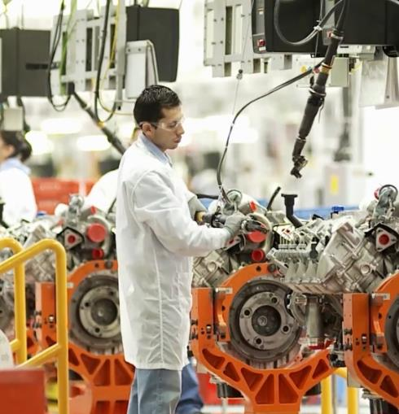





Chihuahua’s Competitive Advantages
Strategic Geographic Location and Connectivity to North America markets.
Talent and Industrial Culture.
Innovation and Technology Development in the Research and Engineering Centers.
World Class Infrastructure and Availability of Natural Gas for Industrial Projects.
Clusters and Industries with Advanced Integration and Cooperation.

Slide 4
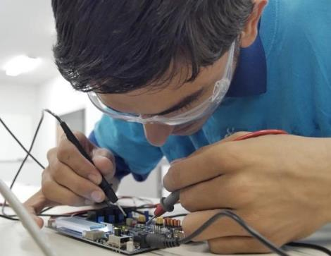




Talent and Industrial Culture
Large, union-free, highly qualified and stable labour force with an industrial culture over 3 generations.
More than 5k engineering graduates, 34k skilled trades graduates and 29% of science, technology, engineering and mathematics graduates (STEMs).
More than 98% of region industry engineers and technicians are local.
State-of-the-art training in the High-Technology Training Centre (CENALTEC) and in the 59 universities and 65 vocational/technical institutions of the state.

Slide 5
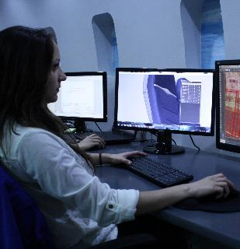
Talent and Industrial Culture
Available Talent!!
6,410 Science, Technology, Engineering and Mathematics (STEM) graduates per year.
Far more talent available than other locations such as Guadalajara or Bajio Region.
Technological Infrastructure
Telecom infrastructure and redundancy to ensure the smooth operation of your company’s day to day activities.
Large ecosystem
Suppliers of software services, research centers, IT Cluster, etc. are part of the ecosystem.
Expertise in Business Process Outsourcing
Companies such as Teleperformance and Data Zone are established in the state and operate successfully.

Slide 6

Talent and Industrial Culture
Skilled Trades
+62,000 Students.
+13,000 Graduates per year.
+26,000 New Enrollment.
Bachelors
+115,000 Students.
+17,000 Graduates per year.
+26,000 New Enrollment.

Slide 7

Talent and Industrial Culture
College Graduates per Year per Area:
+4,400 Engineering & IT.
+3,600 Administrative and Business.
+3,400 Social Sciences and Law.
+1,700 Health Sciences.
Masters & PhD Graduates per Year per Area:
1,000 Administrative and Business.
500 Social Sciences and Law.
+200 Engineering & IT.

Slide 8

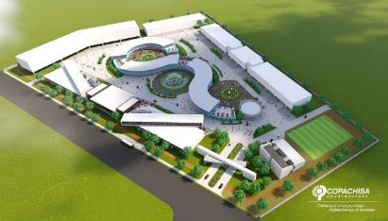




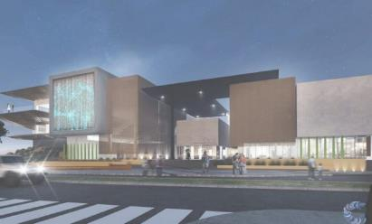


Innovation and Technology Development
5 Advanced Research and Engineering Centers, public and private, focused in design, product development and testing:
2 Innovation and Technology Development Centers in progress: SPARK (Chihuahua) & CIITA (Juarez).

Slide 9


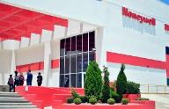
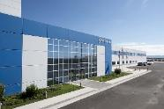
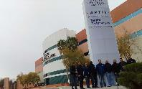
Design and engineering Success stories
Research and Development Center in Chihuahua City, focused in mechanical development, packaging, embedded software.
Started operations in 2006.
100 engineers.
Linked to 4 manufacturing plants in Chihuahua.
SAFRAN Engineering Services in Chihuahua City is focused in mechanical design, electrical design, systems design, manufacturing.
160 engineers.
Linked to 4 manufacturing plants in Chihuahua.
Design & Engineering services open to external suppliers with the SAFRAN Group knowledge & support.
Engineering Center in Juárez City, focused on the design, development, testing and validation of automotive components.
Started operations in 1995.
+2000 engineers.
+1,000 Invention Records.
+500 patents.
Linked to 1 manufacturing plant in Chihuahua.

Slide 10


































Electrical and electronic cluster
Chihuahua is the 3rd FDI destination nationally in electrical-electronics
industry with 126 companies and more than 94k employees

Slide 11























































Automotive Cluster
Chihuahua is #1 automotive employer in Mexico with more than
155k employees, 157 companies and 2 OEM’s (Ford and BRP)

Slide 12
























Aerospace Cluster
Aerospace cluster
Chihuahua accounts for 30% of the aerospace employment in Mexico with more than 17k employees, 40 certified suppliers
and 6 out of the 8 OEM´s operating in Mexico

Slide 13

















Medical Device Cluster
More than 29k employments and 53 companies producing state
of the art products in medical devices and pharmaceutical products

Slide 14
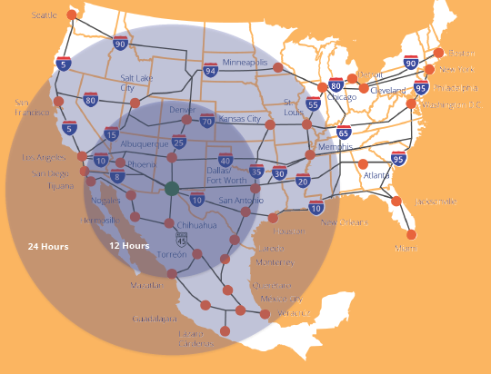
Strategic Logistics
The roads of Chihuahua are part of one of the main logistics network between Mexico and North America.
Chihuahua to: | Distance (kilometers) | Distance (miles) | Time (hours)
El Paso | 363 | 226 | 3.5 h
Los Angeles | 1,609 | 1,030 | 15.7 h
Detroit | 2,969 | 1,845 | 28 h
Wichita | 1,575 | 979 | 15 h
Boston | 4,010 | 2,492 | 38 h
San Francisco | 2,269 | 1,410 | 22 h
Montreal | 3,865 | 2,402 | 37 h

Slide 15
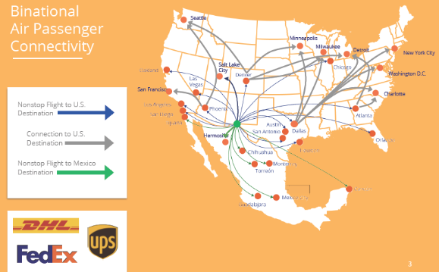
Air Connectivity
Strategic Logistics
An excellent hub for business, freight and tourism transportation through Chihuahua, Cd. Juárez and El Paso, Texas airports.
Chihuahua to: | Time (hours)
El Paso | 0.5 h
Austin | 5 h
Wichita | 5 h
Chicago | 6 h
Miami | 6 h
Minneapolis | 6 h
Detroit | 6.5 h
Los Ángeles | 7.5 h
Boston | 8 h
San Francisco | 8 h
Seattle | 8.5 h
Montreal | 9 h

Slide 16
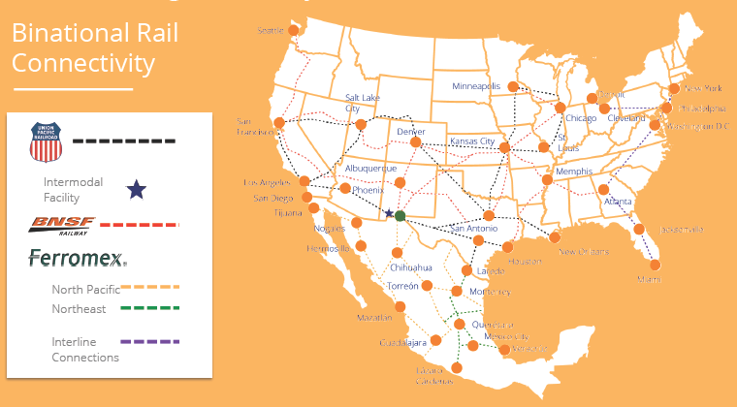
Strategic Logistics
The most efficient rail network for heavy load transportation to United States and Mexican ports.
Chihuahua to: | Distance (kilometers) | Distance (miles)
Los Ángeles | 1,657 | 1,030
Detroit | 2,969 | 1,845
Los Mochis | 651 | 405
Silao, Guanajuato | 1,221 | 759
Veracruz | 682 | 424

Slide 17








Quality of Life
Extensive leisure options: golf, shopping malls and museums.
Diversity of international gastronomy and regional wines.
Excellent bilingual schools.
World-class hospitals.
Low traffic and reduced transportation times.

Slide 18
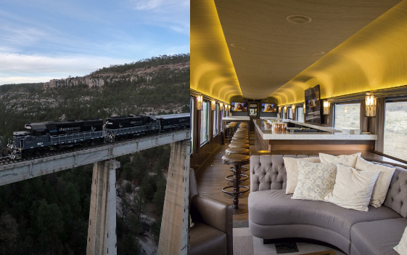
What else does Chihuahua has to offer?
CHEPE Train and Copper Canyon
You can travel by CHEPE Train, the only passenger train in Mexico.
Enjoy the sight of Copper Canyon, 4 times larger than the Colorado Canyon.
Visit Basaseachi Waterfall, the tallest permanent waterfall in Mexico.

Slide 19
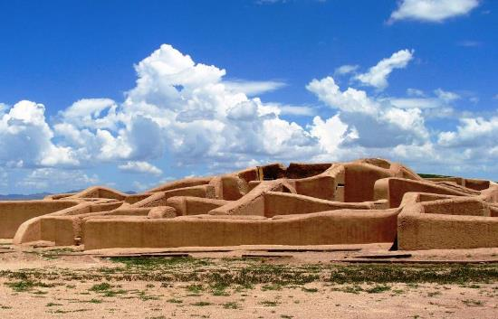
What else does Chihuahua has to offer?
Pueblos Mágicos
(Magic Towns)
Casas Grandes (Paquimé), with an amazing archeological zone.
Creel, where you can breathe the pure air of the forest.
Batopilas, with beautiful antique buildings and tropical climate.

Slide 20

What else does Chihuahua has to offer?
Samalayuca
Enjoy adventure sports in Samalayuca desert, such as:
Sand boarding.
ATVs.
Motocross.

Slide 21
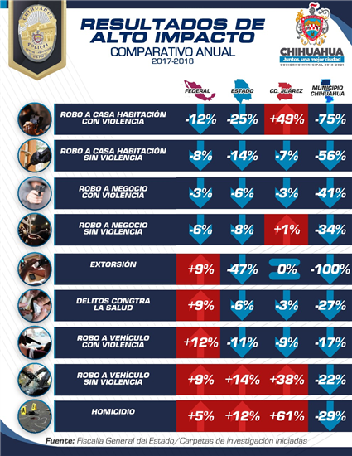
Safety
CRIME AND SAFETY
STATISTICS
Yearly Comparisson
2017-2018
HOME BURGLARY
WITH VIOLENCE
HOME BURGLARY
WITHOUT VIOLENCE
BUSINESS BURGLARY
WITH VIOLENCE
BUSINESS BURGLARY
WITHOUT VIOLENCE
EXTORTION
CRIME AGAINST
THE PERSON
GRAND THEFT AUTO
WITH VIOLENCE
GRAND THEFT AUTO
WITHOUT VIOLENCE
HOMICIDIES

Slide 22

Secretariat of Innovation and Economic Development
Alejandra de la Vega
Secretary
Fabián Santana
Head of Investment Promotion
fabian.santana@chihuahua.com.mx
Ph.+52 (614) 442-3302

