Slide 1

PARENT INFORMATION WORKSHOP

Slide 2

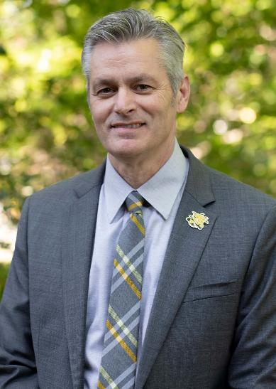
RICK MUMA, PRESIDENT
Dr. Richard (Rick) Muma was named the 15th president of Wichita State University on May 6, 2021.
He has more than 30 years of experience as a professor, administrator and physician assistant in internal medicine and infectious diseases.
Before assuming the presidency, Muma was executive vice president and provost of Wichita State, serving as the university's chief academic officer and providing academic leadership for the university's priorities — including enrollment, applied learning, funded research, and regional economic development. While at Wichita State, he has also served as senior associate vice president for Academic Affairs and Strategic Enrollment Management and chair and professor in the departments of Public Health Sciences and Physician Assistant.
PARENT INFORMATION WORKSHOP

Slide 3
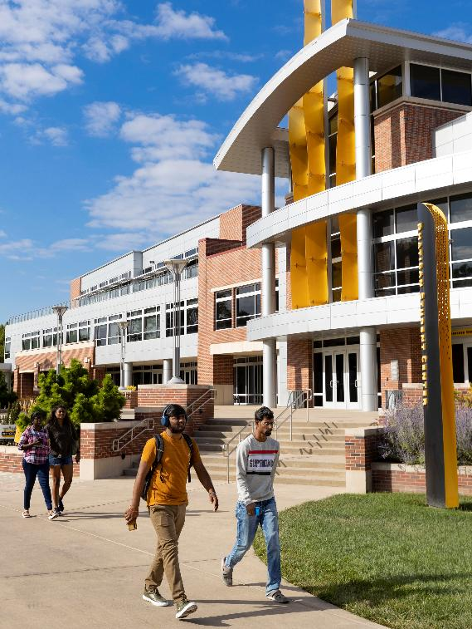

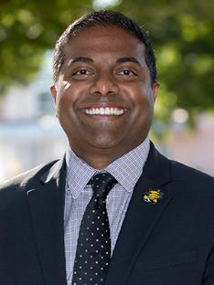
CAMPUS UPDATES
BOBBY GANDU
Associate Vice Provost and Director of Admissions
PARENT INFORMATION WORKSHOP

Slide 4




THE BEST TIME TO BE A SHOCKER
Fall 2021-2025: Five largest Freshman classes in the University’s 130-year history
#1 transfer destination in Kansas for 14 years in a row
$600 million campus infrastructure investment during the last 10 years
#1 most affordable research university in the region

Slide 5

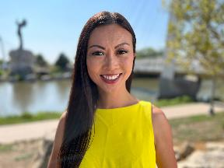
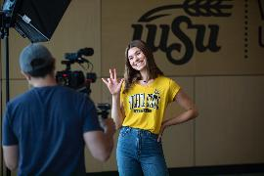
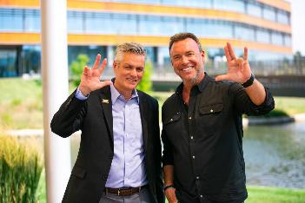
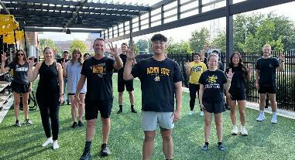
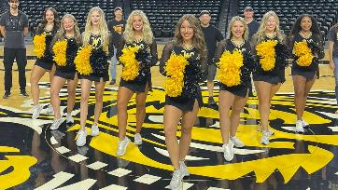
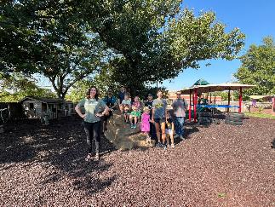
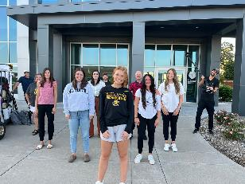
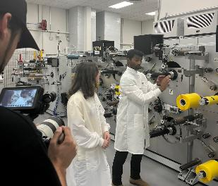
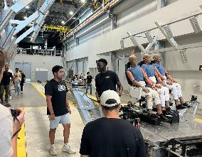
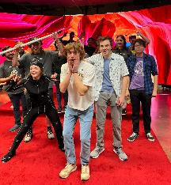
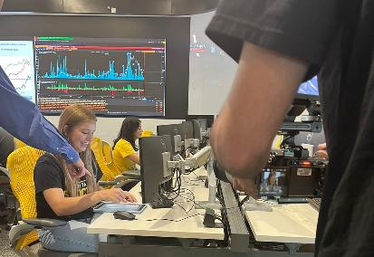
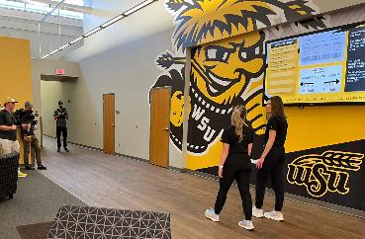
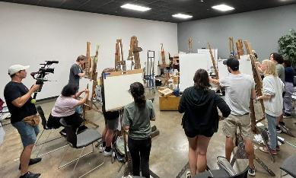


THE COLLEGE TOUR
AMAZON PRIME STREAMING SERIES | WICHITA.EDU/COLLEGETOUR
PRESENTATION TITLE GOES HERE

Slide 6




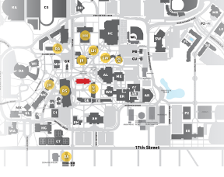
SHOCKER SUCCESS CENTER
18 student services in one location
Adult Learning
Care Team
Career Closet
Military and Veteran Services
Office of Student Accommodations & Testing
OneStop Student Services
Shocker Support Locker
Student Success
Tech Help
Testing Services
TRIO Services
Tutoring

Slide 7
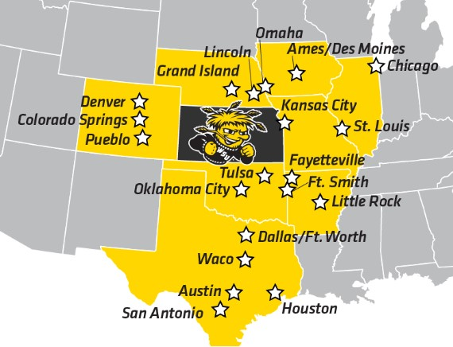

SHOCKER CITY PARTNERSHIP
Students from these areas benefit from a tuition discount and pay in-state tuition rates
Estimated tuition/fees of $9,947 per year
Shocker City students are also eligible for freshmen merit scholarships
Students save more than $42,500 over four years as compared to out-of-state tuition
ADDITIONAL DISCOUNTS AVAILABLE FOR OTHER STATES! VISIT WICHITA.EDU/SHOCKERSAVINGS FOR ELIGIBILITY AND MORE INFORMATION!

Slide 8


WICHITA STATE
COST OF ATTENDANCE
Tuition & fees estimate:
Based on 15 credit hours per semester (30 hours per year)
KS residents | Shocker City ~ $9,947 per year
Shocker Select | MSEP ~ $13,844 per year
Nonresidents ~ $20,613 per year
Wichita State is the MOST AFFORDABLE research university in Kansas and over 88% of our freshmen receive scholarships and/or federal aid.

Slide 9
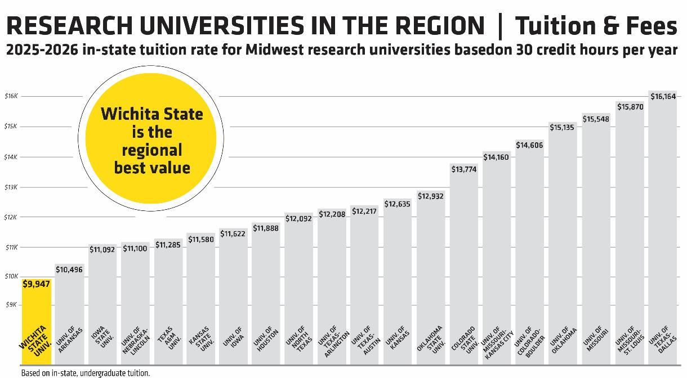
based on 30 credit hours per year

Slide 10

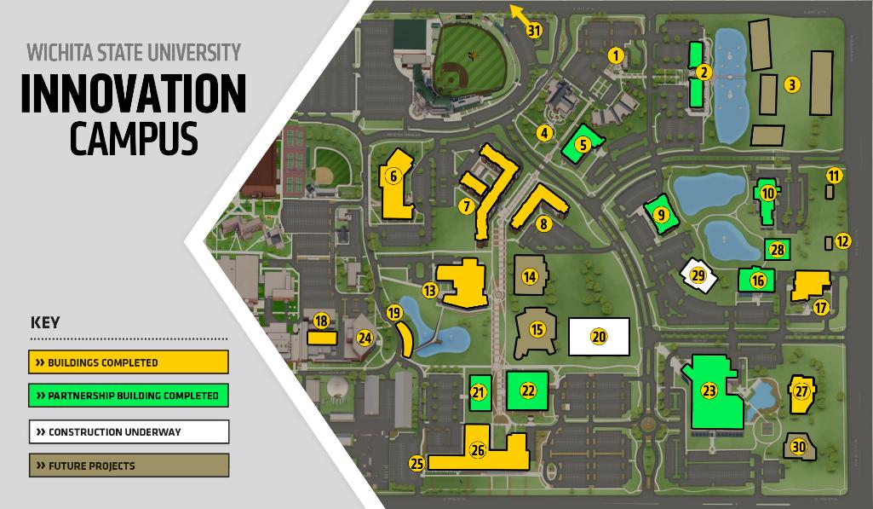





BRAEBURN SQUARE
CONNECTED NATIONAL INTERNET EXCHANGE POINT
STARBUCKS
PIZZA HUT MUSEUM
THE FLATS
LAW ENFORCEMENT TRAINING CENTER
HYATT PLACE HOTEL
SHOCKER SUITES
STEVE CLARK YMCA
DELOITTE SMART FACTORY
P11
FUTURE ATF
FORENSIC GUN LAB
WOOLSEY HALL
ATF NATIONAL CRIME GUN INTELLIGENCE
MORAN CENTER (CRASH LAB)
ATLAS
FOOD TRUCK
PLAZA
NIAR
FUTURE NATIONAL INSTITUTE FOR ADVANCED MANUFACTURING & RESEARCH
COLLEGE OF ENGINEERING, SPIRIT, TEXTRON AVIATION (P2)
AIRBUS & FIREPOINT
NETAPP
DIGITAL RESEARCH & TRANSFORMATION LAB
GOCREATE
JOHN BARDO CENTER
STEVE CLARK YMCA

Slide 11
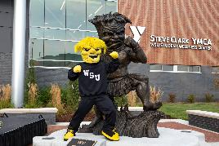
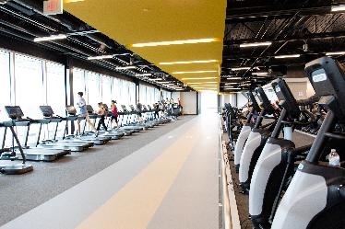

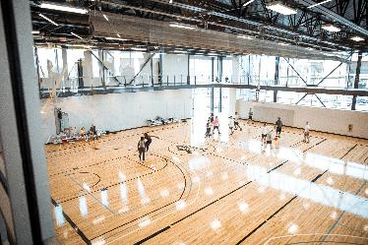
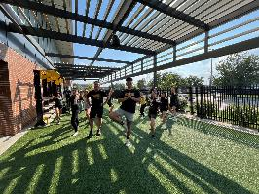
STEVE CLARK YMCA AND WELLNESS CENTER
Student Health Services
Student Counseling and Prevention Services
Wichita State students are automatically members of the Steve Clark WSU YMCA and all other TEN Wichita-area YMCA locations
PARENT INFORMATION WORKSHOP

Slide 12
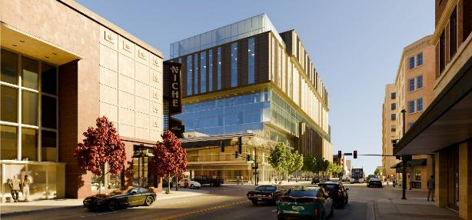
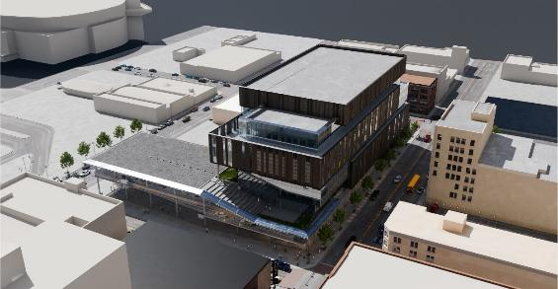

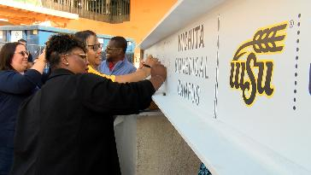
WICHITA BIOMEDICAL CAMPUS DOWNTOWN WICHITA
3,000 students | 470,000 square feet | $300+ million project
Projected Completion: Spring 2027
Combining Wichita State nursing, physical therapy, physician associate & more with KU Med Center’s medical and pharmacy programs
Improved patient outcomes for training in one space
Entering formal study phase for future dental school

Slide 13
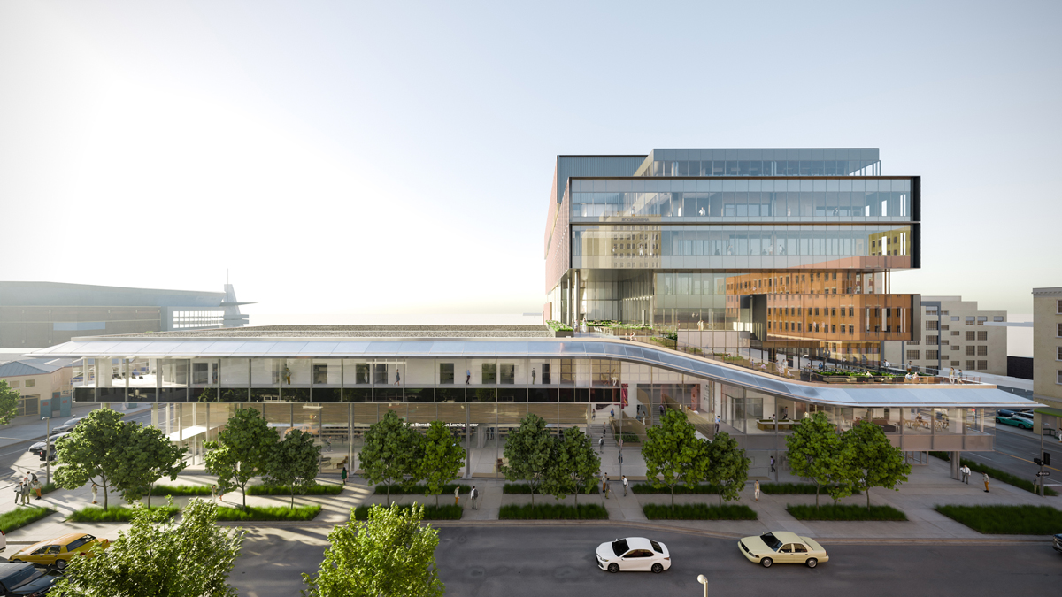
“This is a vote for optimism for the region, for Wichita State, for Wichita, Kansas… and what we can be in health care.”
- Matt All, Blue Cross and Blue Shield of Kansas president and CEO, on their $2.5 million gift to support the applied learning clinical component of the project

Slide 14
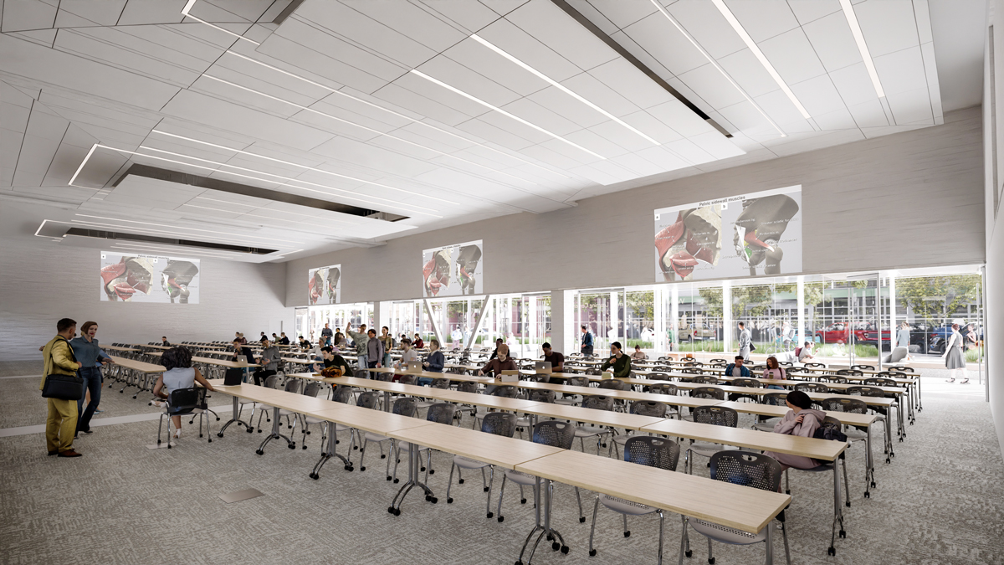

Slide 15


Slide 16



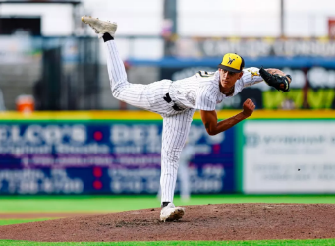
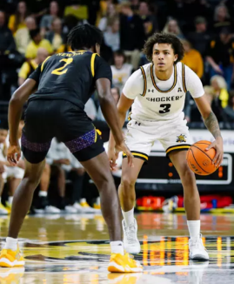
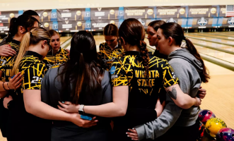
SHOCKER ATHLETICS
NCAA Div. I | American Conference
Baseball, Basketball, Bowling (W), Cross Country,
Golf, Softball, Tennis, Track and Field, Volleyball
Shocker Spirit Squad won the 2025 National Championship
Students get FREE athletic tickets
Shocker Women’s Bowling reached NCAA Final Four in 2025

Slide 17
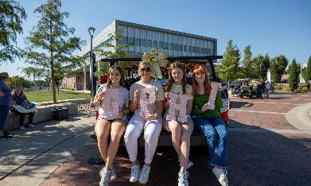
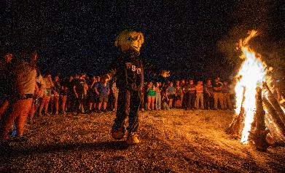


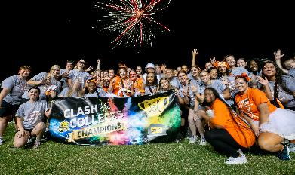
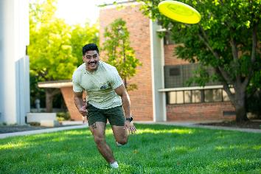
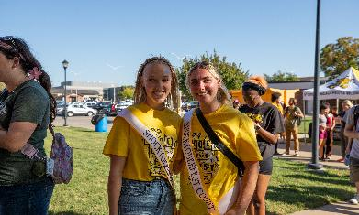

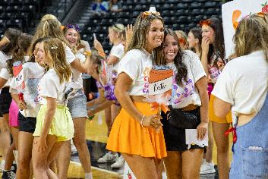
STUDENT LIFE

Slide 18

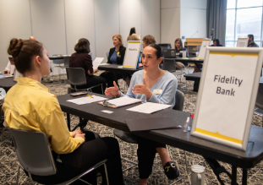
FINAL REMINDERS
Keep your student’s enrollment checklist moving forward | wichita.edu/seniorsteps
Enrollment questionnaire & orientation registration opens Feb. 1 | wichita.edu/orientation
Create a profile in Wichita State’s Scholarship Universe | wichita.edu/scholarshipuniverse
Schedule a Campus Visit | wichita.edu/visit
Upcoming Admitted Student Events | wichita.edu/admissionsevents
Oklahoma City (OK) – Thu., Feb. 12
Kansas City Metro – Thu., Feb. 19
Wichita – Sat., Feb. 21
Dallas Fort Worth (TX) – Mon., March 2
Virtual – Thurs., March 5
Slides from today’s event | wichita.edu/parentworkshop
SAVE THE DATE for W-S-YOU
SAT., MARCH 28 | WICHITA.EDU/WSYOU
Hired-Up: Applied Learning Interviews – March 27

Slide 19









PARENT INFORMATION WORKSHOP
@WICHITASTATEADMISSIONS
@FUTURESHOCKER
WICHITA.EDU/ZEEMEE
@WHEATWEET
@WICHITASTATEU
WICHITA.EDU/BLOG
WICHITA.EDU/PUBLICATIONS

