Slide 1

Wichita State University Police Department

Slide 2
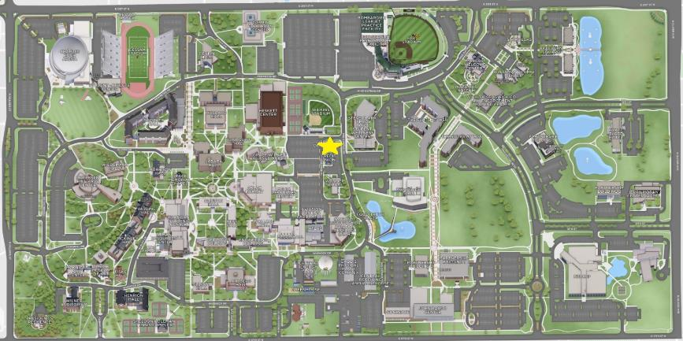
Our Location

Slide 3
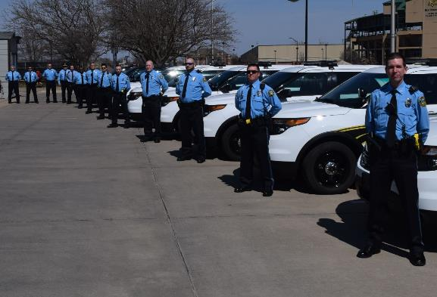
Who We Are
Your police department
4th largest agency in Sedgwick County
Two Divisions
Operations
Support

Slide 4
Operations Division
Commissioned law enforcement officers
Enforce State of Kansas laws and WSU polices
Jurisdiction – KSA 22-2401a(c), (h), and (i)
1st Shift (0600-1600)
2nd Shift (1400-0000)
3rd Shift (2100-0700)
“A” Side (Sun. – Wed.) & “B” Side (Wed. – Sat.)
Notes:
1 Chief
2 Captains
7 Sergeants
1 Detective
19 Officers (with 2 openings)

Slide 5
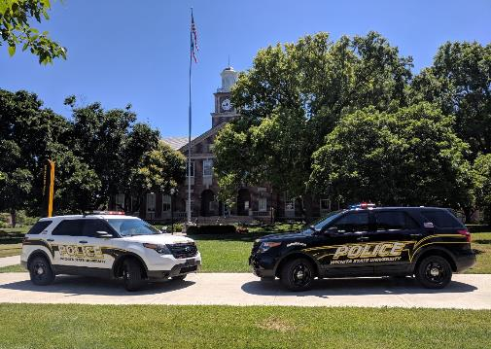
Primary Services
Criminal Investigations
Accident Investigations
Incident Documentation
Medical & Fire Emergencies
Special Event Services
Welfare Checks
Notes:
Explain welfare checks and missing persons reports

Slide 6
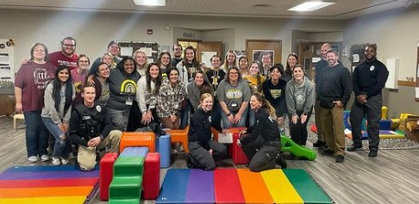
Other Services
Vehicle Unlocks
Jump Starts
Safety Escorts
After-hours Access
Lost & Found
Training
Notes:
Must be on campus

Slide 7
What Happens After a Case is Made?
Information Cases – WSUPD
Criminal Violations – District Attorney’s Office
WSU Policy Violations – Student Conduct and/or Human Resources
Notes:
Victims should prosecute

Slide 8
Privacy
Limited information may be released to parents/families based on two criteria (except in emergencies):
1. Family Educational Rights and Privacy Act
2. Being an Adult in the eyes of the law (18+)

Slide 9
Clery Act
Annual Security and Fire Safety Report
Daily Crime Log
Emergency Notifications
Timely Warnings
Notes:
For each calendar year, the statistics reflect the number of reported incidents of certain crimes, as defined by the Clery Act, which occurred within Wichita State University's Clery Geography.
These crimes include: homicide, manslaughter, sex offenses, domestic violence, dating violence, stalking, robbery, aggravated assault, burglary, motor vehicle theft, and arson that occurred on or near campus for the previous 3 calendar years.
Also included are arrests and disciplinary referrals for drug law violations, liquor violations, weapon violations, and bias-related crimes

Slide 10
Emergency Notifications
You will automatically receive ShockerAlerts through your WSU email accounts
alert.wichita.edu to sign up for texts (must “opt-in”)
RAVE Guardian App downloaded and set up an account

Slide 11

RAVE Guardian Mobile App
Safety Timer (duress code)
Send a Tip (text/picture)
Quick button to call WSUPD
Receive ShockerAlerts
Resource Links

Slide 12
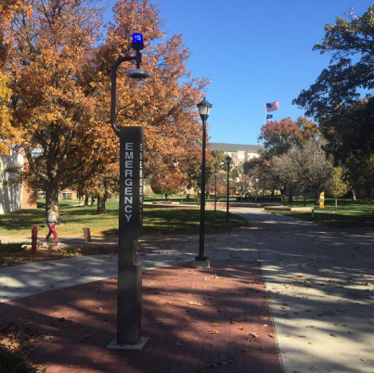
Blue Light Emergency Phones
Direct access to dispatch
Simple push button operation
360⁰ Camera View
Approximately 50 phones

Slide 13
Crime Prevention and Safety
Property Crimes
Don’t advertise and lock it up
Know what you have
Persons Crimes
You have a right to defend yourself
Use all your tools and resources
Notes:
Know where property is and what it is (make, model, serial number)
Victims should prosecute

Slide 14
WSU Weapons Policy – 11.19
What is allowed:
Concealed Carry Handguns (limitations; age/legal ability, must follow policy for concealed carry, must follow State Law)
Defensive items
What is NOT allowed:
Weapons/hazardous objects
Case-by-case list within the Weapons Policy

Slide 15
Personal Information You Need to Know
myWSU ID Number
Driver’s License Number
Social Security Number
Full Address (including room/apartment)
Phone Number
Vehicle Make, Model, and License Plate
Notes:
Update myWSU profile and emergency contacts
Student phone number NOT parent’s number
Don’t carry SSN card on your person

Slide 16
Police Questions?
Contact us:
police@wichita.edu
316-978-3450 from any phone
9-1-1 from a campus phone
www.wichita.edu/services/police

Slide 17
Support Division
24hr Dispatch Center – calls for Police/Fire/EMS
Records Division – KORA Requests
Parking Division
Permits and citations
Jump starts
Lot reservations
Traffic control (special events)
Notes:
1 Dispatch Supervisor/Records Manager
8 Dispatchers
1 Parking Manager
1 Parking Supervisor
4 Parking Officers (M-F; 1st 0700-1500, 2nd 1500-2300)

Slide 18
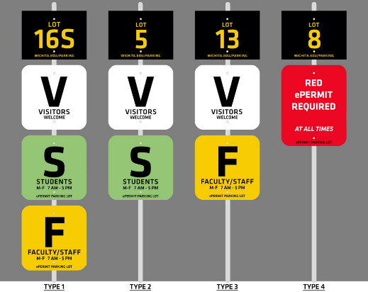
Parking Enforcement
MUST HAVE AN ePERMIT
Parking Lot/Stall Signage
License Plate Visibility
Special Events
Special Areas
Appeals

Slide 19
Parking Questions?
Contact:
wsuparking@wichita.edu
316-978-5526
www.wichita.edu/services/parking
Notes:
Parking Services building just south of station (unknown move date)

