Slide 1



WSU Counseling and Psychological Services
Christopher Leonard, Psy.D., LP
Director, CAPS
Wichita State University

Slide 2


What is Counseling and Psychological Services?
Counseling and Psychological Services (CAPS) engages with our campus and community through intervention and prevention to promote mental wellness
CAPS offers a variety of services, including therapy, consultation, trainings and outreach

Slide 3


Therapy Services
Counseling and Psychological Services (CAPS) offers confidential individual, couples and group therapy services to enrolled WSU students
Affordable services – no students are turned away
Hybrid in-person and telehealth options available since Fall ’21

Slide 4
Therapy Services
Services provided by licensed mental health providers or supervised by licensed providers
Students can schedule an appointment by calling 316-978-4792, first time clients can also schedule by visiting Wichita.edu/CAPS
Providers offer expert behavior and mental health consultation to campus and response to campus crises

Slide 5

Group Therapy
Free group therapy for currently enrolled students
Great way for students to connect with peers and work on mental health cooperatively
Students can join group therapy through speaking to their counselor or by setting up a consultation by calling 316-978-4792

Slide 6

Medication Services
Our therapists provide psychiatric medication referrals to Student Health Services primary care providers also located within the Student Wellness Center

Slide 7


Crisis Information
If a student is experiencing a mental health emergency, CAPS’ counselors can assist during regular business hours - call ahead if possible
Mental health crisis includes • safety emergencies including immediate threat to self or others • victim of recent assault • seeing or hearing things that are not real
Students can also seek help 24 hours a day via the Suicide Prevention Lifeline at 988 or 1-800-273-8255 and the Crisis Text Line at 741-741

Slide 8




HOPE Services
Is Dedicated to
Promoting Mental Wellness
Preventing Suicide
Preventing Sexual Violence
Preventing Substance Abuse
Both on Campus and in the Community

Slide 9

#WSUWeSupportU Suspenders4Hope Prevention Program
Developed as part of the SAMHSA Garret Lee Smith Campus Suicide Prevention Grant in 2015 -2018
A multifaceted approach designed to change the conversation around mental health and empower communities to support each other
Includes an awareness campaign, an on-line training, an advocate program and a mental wellness classroom curriculum
We train our campus to use the Share, Ask, Support method to help someone in distress

Slide 10

Suicide Prevention Training
Online trainings at Suspenders4Hope.com
Monthly in-person trainings
You can receive a free shirt by completing the training

Slide 11



Outreach and Social Media
CAPS offers campus updates and wellness tips along with weekly video content to support your mental health on social media
Follow us on Facebook, Twitter and Instagram at @ShockersCAPS and on YouTube at WSU CAPS
Connect with us for special events, often in the Rhatigan Student Center and in partnership with other Wellness Departments
Request a presentation at Wichita.edu/PreventionRequest

Slide 12
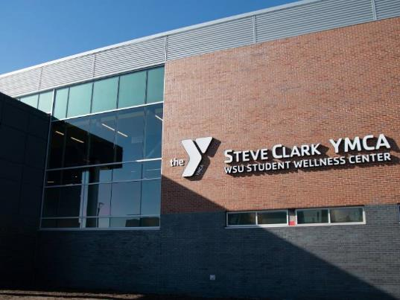
Contact Us
Counseling and Psychological Services
Student Wellness Center located in the YMCA at Wichita State
316-978-4792 | Wichita.edu/CAPS
counselingcenter@wichita.edu
@ShockersCAPS
#WeSupportU Suspenders4Hope
Suspenders4Hope.com
@Suspenders4Hope

