Slide 1


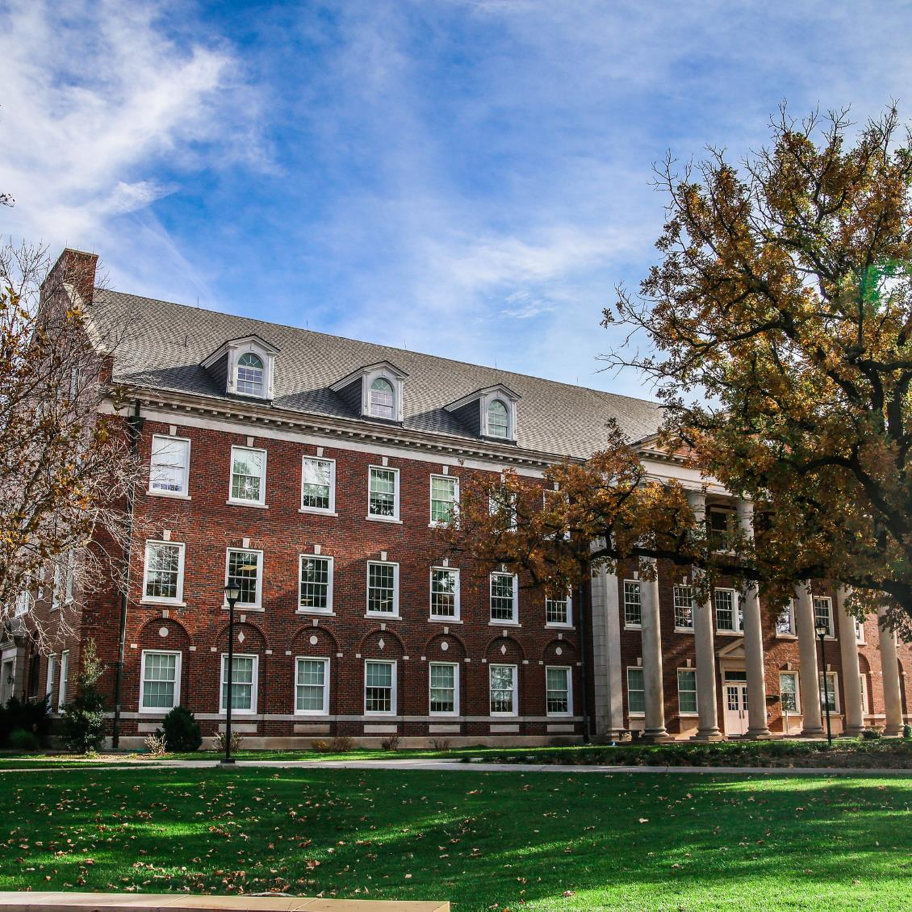








Your Financial Plan to Pay for College
Guest Presentation
wichita.edu/financialaid

Slide 2
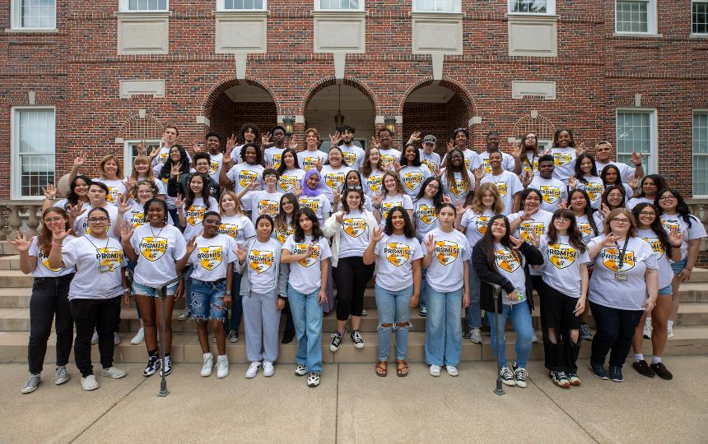

COSTS AT WICHITA STATE
WAYS TO PAY FOR COLLEGE
TYPES OF FINANCIAL AID
THE FAFSA
FAMILY ACTION PLAN
PRESENTATION OVERVIEW

Slide 3







What is Financial Aid?
Financial aid consists of funds provided to students and families to help pay for postsecondary educational expenses.
FAMILY
FAFSA
WICHITA STATE
Balance your costs with personal, federal, and college contributions

Slide 4
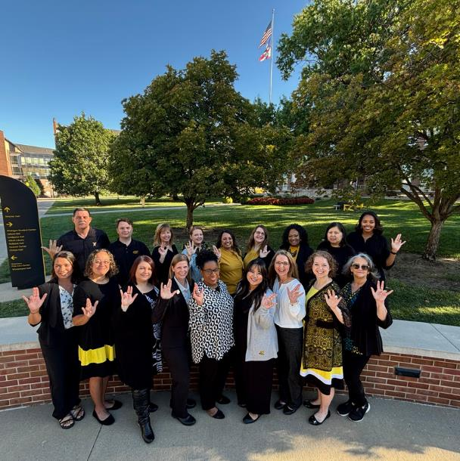

We are committed to investing in your success by providing access to education through financial aid resources and expertise.

Slide 5




OUR SERVICES
Specialized Advising
FAFSA Completion & More
Financial changes
Create a personal plan to pay for college
FAFSA support
Protect you from making errors on financial aid forms
Scholarship, Grants, and Loans
Financial Wellness
Scholarship Universe
Application support
Understanding student loans
Peer to peer financial coaching
Budgeting
Understanding finances

Slide 6


ESTIMATED COSTS AT WICHITA STATE
Disclaimer - this amount is subject to change for 2025-2026*
Tuition & Fees
$10,910
Books & Supplies
$1,250
Food & Housing
$14,080
Personal & Transportation
$3,560
Loan Fees
$60
Totaling about $29,860 annually for an undergrad resident living on campus*
MOST AFFORDABLE RESEARCH UNIVERSITY IN KANSAS
wichita.edu/tuition

Slide 7



WAYS TO PAY FOR COLLEGE
Scholarships & Grants
Work Study, Part-Time Work, Savings
Student & Parent Loans
Gift aid based on merit or financial need
Earned or saved money
Borrowed money that must be repaid

Slide 8





Scholarships
Grants
Loans
TYPES OF FINANCIAL AID
Work Study

Slide 9



SCHOLARSHIP OPPORTUNITIES
ScholarshipUniverse is our scholarship-matching tool for admitted and current Wichita State students. ScholarshipUniverse connects Shockers to millions of dollars in external scholarships. We search; Shockers apply!
For admitted students, submit your info starting on November 1!
wichita.edu/ScholarshipUniverse

Slide 10

SCHOLARSHIP OPPORTUNITIES
MERIT-BASED SCHOLARSHIP COMPETITIONS
Distinguished Scholarship Invitational
AGH, WISE, Klose, Koch, Passage Scholars
COLLEGE/DEPARTMENT OR OUTSIDE SCHOLARSHIPS
State of Kansas Scholarships
Community Organizations
Employers (Parents & Students)
Corporations/Foundations
$35+ MILLION

Slide 11




SCHOLARSHIP TIPS
APPLY FOR SCHOLARSHIPS
ACTIVITIES CHART/RESUME
SCHOLARSHIP ESSAYS
Complete 1-2 scholarship applications per week
Informs the scholarship committee how you spend your time and contribute to your community.
Passion, personality, and purpose! Market yourself and your story.

Slide 12
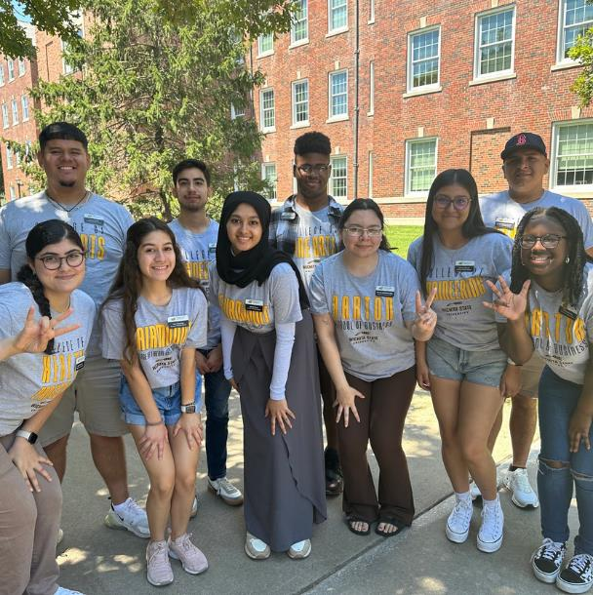
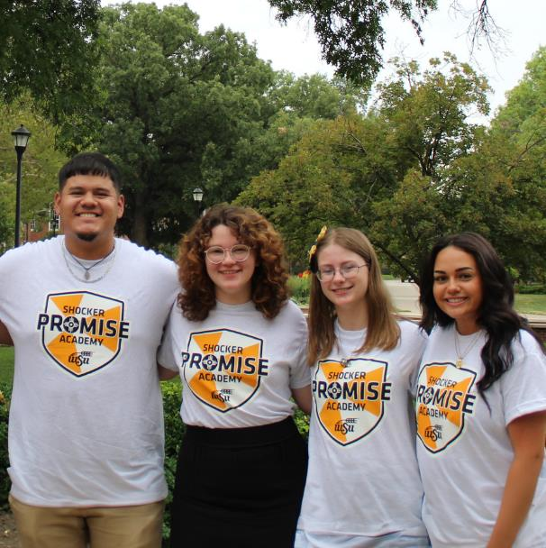

SHOCKER PROMISE SCHOLARSHIP
wichita.edu/shockerpromise
Our commitment to offer a quality, affordable education to incoming freshmen who come from limited-income families in Kansas.
The Shocker Promise Scholarships provide last-dollar funding to high school graduates from Kansas.
BE ADMITTED BY MARCH 1, COMPLETE FAFSA BY APRIL 1
QUALIFICATIONS ON WICHITA.EDU/SHOCKERPROMISE

Slide 13

FAFSA
Free Application for Federal Student Aid
The 2025-2026 FAFSA will launch on December 1, 2024
WSU priority date is April 1, 2025
Complete your FAFSA every year to be eligible for aid
Create your studentaid.gov account!
studentaid.gov

Slide 14




FAFSA
What Happens After You Click Submit?
Free Application for Federal Student Aid
FAFSA Results
More Info Needed*
If documents are requested, send to college ASAP
Check College Email Weekly

Slide 15
Life happens...
TALK TO THE OFFICE OF FINANCIAL AID & SCHOLARSHIPS ABOUT YOUR SPECIAL CIRCUMSTANCES
CHANGES IN EMPLOYMENT
ONE-TIME INCOME
BANKRUPTCY
CHANGES IN MARITAL STATUS
EXTRA MEDICAL EXPENSES
LOSS OF PARENT/SPOUSE
DEPENDENT CARE
LOSS OF BENEFITS

Slide 16

Get admitted
Apply for scholarships
Create studentaid.gov account
Complete FAFSA
Visit campuses
Check your email
Compare aid offers
Save money for books
Discuss finances
Send in transcript/scores
YOUR ACTION PLAN

Slide 17

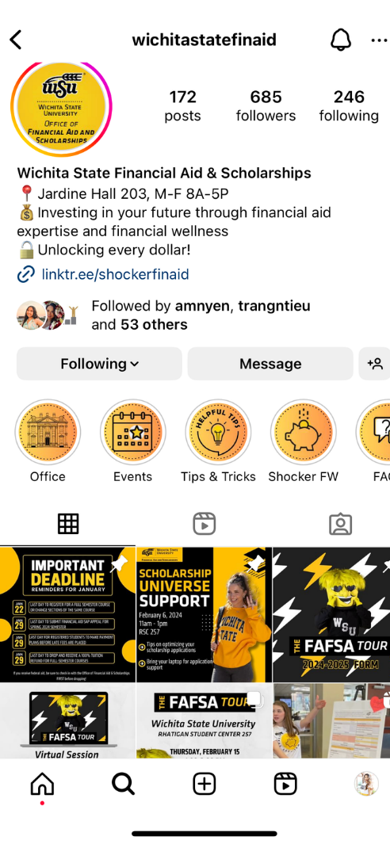




Contact Us
Office of Financial Aid & Scholarships
@wichitastatefinaid
316-978-3430 (24/7)
wichita.edu/financialaid
Jardine Hall, 203

