Slide 1

The First-Year Experience FY Advising FY Seminar FY Programs

Slide 2
OneStop Student Services and First-Year Advising

Slide 3
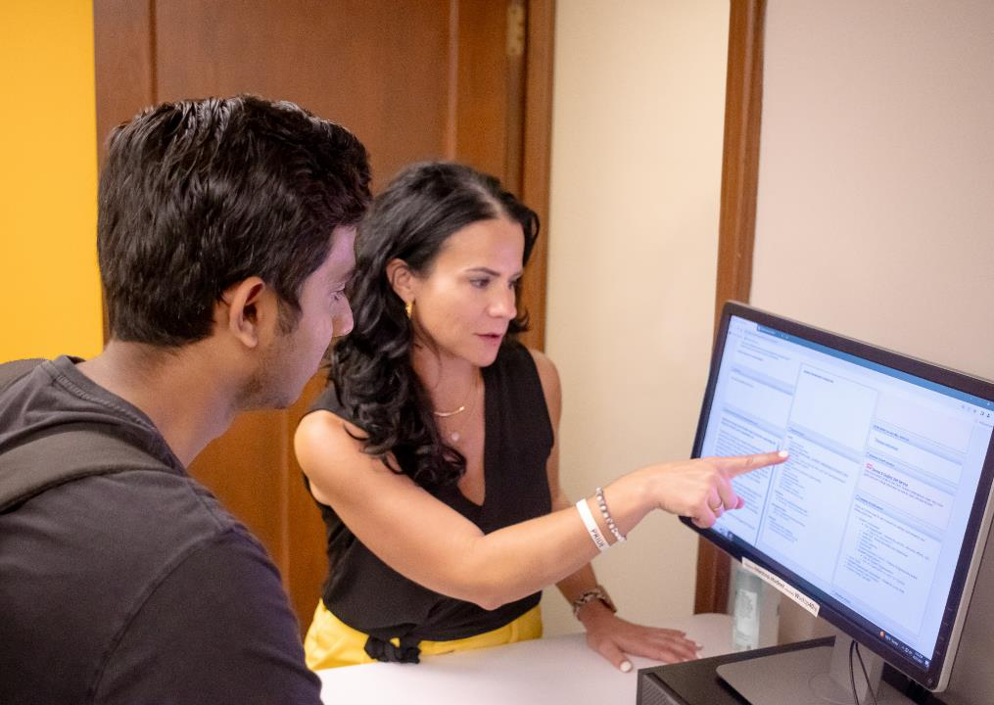
First-Year Advising Benefits
Provide all-in-one advising experience including:
Collaborate with students on their initial schedule
Initial set up of Student Education Plans
Reviewing and accepting financial aid
Understanding their student bill
Setting up payment plans
Discussing student success programs and academic support

Slide 4
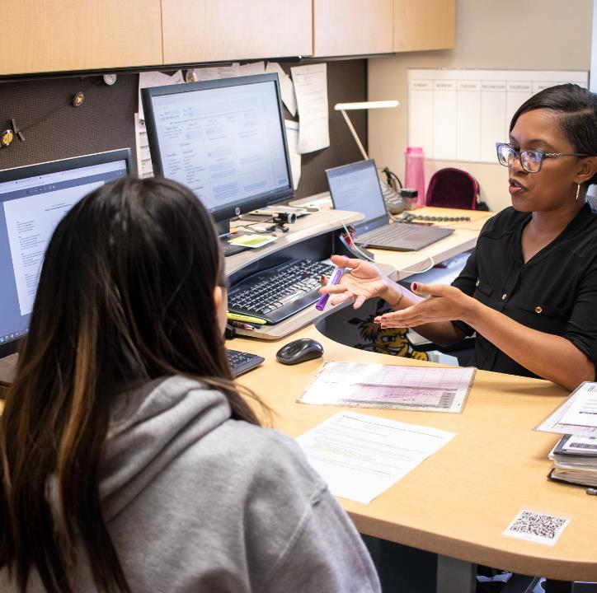
Who is Advised in First-Year Advising?
Domestic high school seniors
Students coming directly to WSU from high school (regardless of transfer work from high school)
First-Year International Students
No prior college credit
Stop out/gap year students
Students who have graduated in the last two years and have no college credit

Slide 5

First-Year Advisors
Name | Student Population
Kelsey Abendroth | Applied Studies (Education)
Michelle Ternes | Business
Vacant | Engineering – Last name A-L
Monica Bergkamp | Engineering – Last name M-Z
Brittany Ulmer | Fine Arts
Hannah Vanorsby | Health Professions
Elia Ortega | Liberal Arts and Science – Last name A-L
Kindra Brooks-Cobbins | Liberal Arts and Science – Last name M-Z

Slide 6


First-Year Advising Process
Fall Enrollment Process Begins March 1, 2024
RSVP for Orientation and complete Enrollment Questionnaire
Provide needed transcripts or test scores, etc. onestop@wichita.edu
Schedule built and enrolled based on preference, requirements and provided info
Email sent to student to view schedule
Log-in and review within 10 days and approve or ask questions
Notes
If a decision is not made overnight after enrollment – an email and text will be sent to the student to prompt log-in and decision.
If a decision is not made within 10-day time period – courses will be dropped, and the process will need to start over.
If questions exist regarding your student's schedule – advisors will be available to answer questions or make changes as needed.
Schedule changes can be made after accepting the schedule as well.
Please help us by encouraging your students to check their WSU email often!

Slide 7
Questions/Discussion
OneStop Student Services
Shocker Success Center, Suite 104
Monday-Friday: 8:00 a.m. –5:00 p.m.
(855) 978-1787
onestop@wichita.edu
Aaron Hamilton
Director
(316) 978-7456
aaron.hamilton@wichita.edu

Slide 8
Shocker Pre-Season Programs www.wichita.edu/preseason

Slide 9
What is a Shocker Pre-Season Program?
Shocker Pre-Season Programs are a collection of programs that help students warm up and get in the right mindset the week (or two) prior to the beginning of the fall semester.
Make new friends
Get to know some instructors
Learn your way around campus

Slide 10
Example Shocker Pre-Season Programs
Athletic Bands Camp (College of Fine Arts)
Barton School of Business Summer Engagement (Barton School of Business)
Honors Colloquium (Cohen Honors College)
Math Launch (Department of Mathematics, Statistics, & Physics)
Shocker Bridge to Math Success (College of Engineering)
Shocker Engineering Academy (College of Engineering)
Shocker Promise Academy (Office of Financial Aid & Scholarships)
When Everyone Leads...in Sport (Department of Sport & Leadership Studies)
Adult Learner Community & Connections (Office of Online & Adult Learning)
Immersive Leadership Institute (Office of Student Engagement & Belonging)
International First Year Experience (Office of Academic Affairs & Office of International Education)
Major & Career Path Workshop (Fairmount College of Liberal Arts & Sciences)
Passage 2 Success (Office of Student Engagement & Belonging)
Pre-Nursing Success Academy (Office of Student Success & College of Health Professions)
Rowing Camp (Shocker Rowing)
School of Performing Arts PreSeason Orientation (College of Fine Arts)

Slide 11
First-Year Seminar www.wichita.edu/fys

Slide 12
What is a First-Year Seminar?
Wichita State's First-Year Seminar offers students unique, small classes taught by fantastic faculty and instructors from across the university.
A First-Year Seminar lets you take a class in a specialized topic, taught by an expert in the field, while also learning about campus resources to help you have a more successful experience at and transition to WSU.

Slide 13
Example FYS Classes
Community & Cultural Connections
Connecting Generations
Creativity & Play
Criminalistic Methods: What Would Sherlock Holmes Do?
Critical Reasoning about Weird Things
Cross Cultural Communication
Exploring WSU in Photos & Words
Facts, Opinions, & Why They Both Matter
Global Business, Culture, & Etiquette
History & Rock ‘n’ Roll
Imagining Climate Change
Innovations of World War II
Introduction to Technology & Innovation
Latinos in the US & Midwest
Law
Leadership & Self-Discovery
Me & My Place in the World
Medical Laboratory Scientists: Healthcare Detectives
Music Really Does Make You Smarter
My Community & I
Myth Busting the Model Minority: Asian American Experiences
Powerful Narratives: Storytelling & Social Justice in the Hispanic World
Superheroes Go to School
The Marcussen, Wiedemann, & You
Uncommon Sense
World Cultures in Popular Media
World Food & Foodways
Wutopia: The 15-Minute City

Slide 14
First-Year Peer Mentoring Programs

Slide 15
Why Peer Mentoring?
Peer Mentoring programs within the academic colleges provide new first year students with the skills, resources, and support to help them succeed in their first year at Wichita State University.
One-on-one guidance and support from a peer student
Networking and building connections
Advice and resources
Events

Slide 16
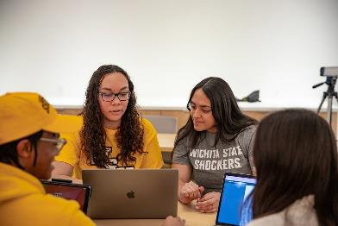
Academic College Peer Mentoring Programs
College of Applied Studies
Trailblazers Program
College of Engineering
ACE Mentoring Program
College of Fine Arts
You Belong Here: Peer-to-Peer Mentoring Program
Fairmount College of Liberal Arts & Sciences
Fairmount Engaged

Slide 17
Questions/Discussion
Dr. Brett Bruner
Assistant Vice President for Student Success & Persistence
(316) 978-3989
brett.bruner@wichita.edu
www.wichita.edu/fys
www.wichita.edu/preseason

Slide 18
Student Success
www.wichita.edu/success

Slide 19
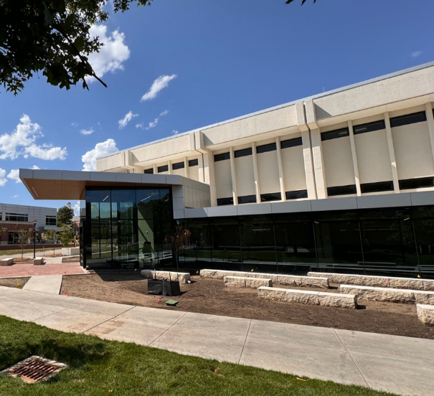
Student Success: Functional Areas
First-Year Programs (our focus today!)
Shocker Learning Center
Success Coaching

Slide 20
Shocker Transition Experience
Students will complete these steps after completing the Orientation RSVP and Enrollment Questionnaire.
Pre-Orientation Modules - required (May 1 – August 14)
2. Freshman Orientation - required (June – August)
3. Pre-Season Programs (August 4 – 14, depending on program)
4. SHOCKFEST (August 15 – 17)
5. New Shocker Toolkit Blackboard "Course" (August– December)

Slide 21
Orientation: What to expect
Program information is available at www.wichita.edu/orientation.
Pre-Orientation Modules are required and expected to be completed prior to attendance at Orientation.
Modules will open on May 1 and access will be given after the Orientation reservation has been placed.
One day Orientation programs are designed to be more experiential and will connect students to people and resources on campus.
Parent sessions are optional and SEPARATE from your student. Lunch is together.
Student Orientation fee = $150, guest fee = $30 per guest

Slide 22
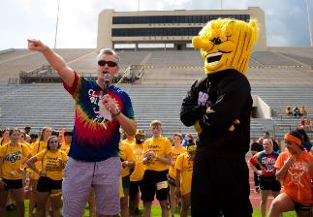
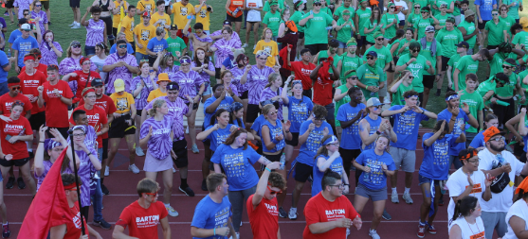
SHOCKFEST
Three fun-filled days of events, meals, meet ups and more the weekend before classes.
Tentative events include:
•First-Year Lunch
•NXT LVL Garage Party
•RecFest
•Classroom Crawl
•Plant the Seed for Your SUCCess
Visit www.wichita.edu/shockfest for more information.

Slide 23
New Shocker Toolkit "Course"
A toolkit available to new students in Blackboard throughout the fall semester. It is a supplement to all Orientation and transition information.
There is NO enrollment and NO FEE for this course.
Access to the course will be given to the course beginning in August.

Slide 24
Student Success: Other Functional Areas
Shocker Learning Center (www.wichita.edu/slc):
Supplemental Instruction
Tutoring
Success Coaches (www.wichita.edu/successcoach):
Professional, individual coaching and support for time/priority management, study skills, motivation and accountability, Success Plans, etc.

Slide 25
Questions/Discussion
Kim Sandlin
Director of Student Success
(316) 978-3209
kim.sandlin@wichita.edu
www.wichita.edu/success

