Slide 1

Housing and Residence Life and Student Health Services
Katie Austin
Director
Housing and Residence Life
Heather Stafford, BSN, RN
Director
Student Health Services

Slide 2

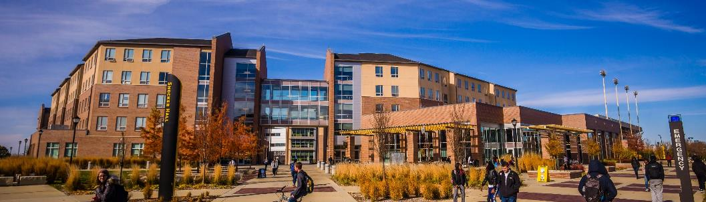
Housing at a Glance
1,450 Residents living within 3 Unique Communities
33 Student Staff members living on the floors
26 Full-Time Staff members
Residence Life, Business Operations, Facilities

Slide 3

Why live on?
Academic Performance
Convenience
Time Management
Social and Personal
Development
A Diverse Community
Safety and Security
Support

Slide 4

Where Shockers Live
Shocker Hall
First Year Students Only
820 bed spaces- each room
includes a bed, desk, chair,
and dresser.
1 or 2 bathrooms per suite
Dining Hall and Coffee Shop
Front Desk open 24 hours
Living Learning Communities

Slide 5
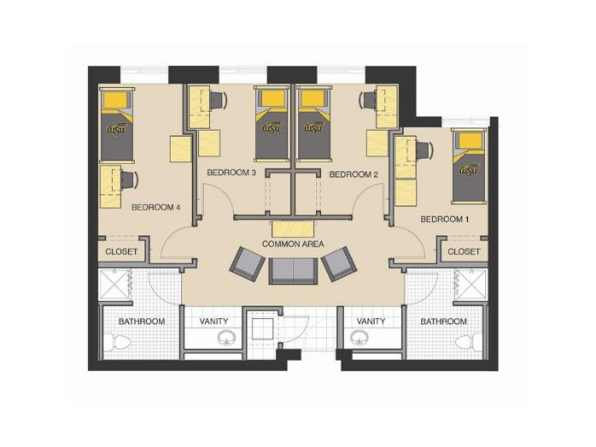
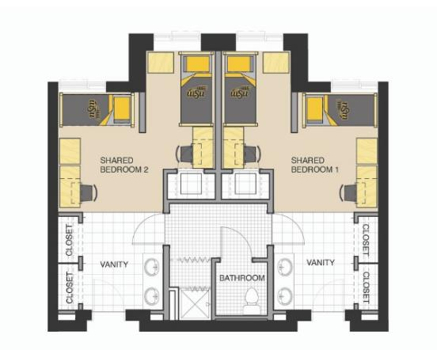
Shocker Hall room layouts
Double 2 Bedroom Suite | 1 Bathroom
Single 4 Bedroom Suite | 2 Bathrooms

Slide 6
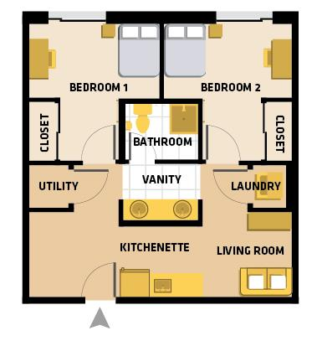
The Suites
Units include kitchenette, laundry, living room with couch, and kitchen table & chairs
Majority private bedrooms (limited shared rooms available)
Beds are full-size (not twin)
Open only to first-year students
Located next to The Flats
Desk open 24 hours

Slide 7

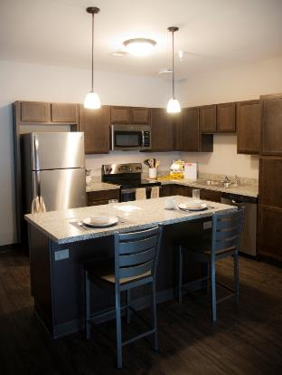
Where Shockers live
The Flats
Upperclassmen Only
430 beds- Each apartment includes a kitchen, laundry, & a private bathroom in each bedroom
Clubhouse recreation area
Underground or surface parking available

Slide 8

Living Learning Communities
Business
Latine
Engineering
Fine Arts
Health Professions
Honors
College of Applied Studies
Liberal Arts & Sciences

Slide 9





Where Shockers Eat
All first year students-
Unlimited Meal Plan
Plus Dining Dollars
Shocker Dining
Groundhouse
Shocker Grill and Lanes
Rhatigan Student Center

Slide 10



What Shockers Do
Hall Activity Councils
Floor programs
Living Learning Communities
Shocker Athletics
Intramurals
Student Organizations

Slide 11

Application Process
Application for 2025-26 is open!
Apply today via your myWSU portal
$75 Application fee + $200 prepayment
March 1st = Earlybird deadline #2
Apply before March 1 to be included in the 2nd batch of students that will go through room selection in April/May.
Drop by the Shocker Hall front desk or the Suites front desk any time for a tour!

Slide 12
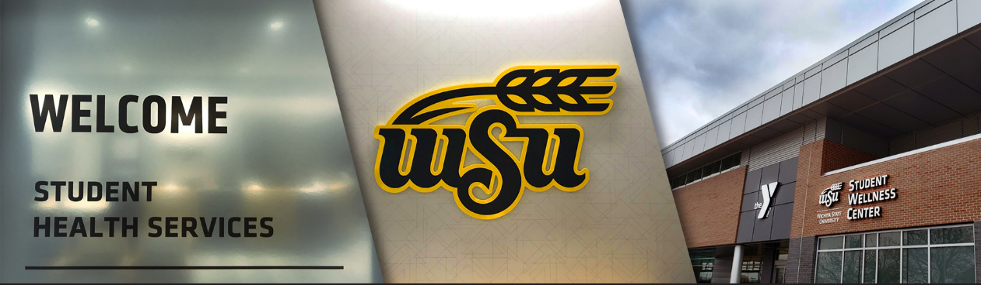
Student Wellness Center

Slide 13
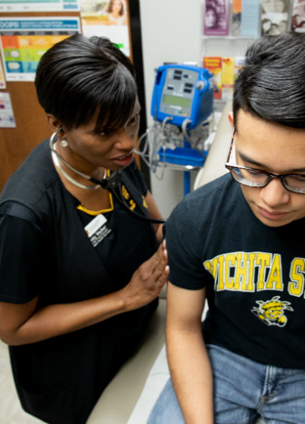
Student Health Services
College Health Specialists
Primary Care Services
Affordable
Convenient location
Acute and chronic healthcare
Accident/Injury visits
Preventative health
Gynecological services
Specialists: gynecologist, psychiatric NP, registered dietitian, physical therapy, chiropractor, hormone therapy & sexual health management
On-site laboratory
On-site x-ray & ultrasound
On-site pharmacy
Vaccinations
Tuberculosis screen & testing
Health Education
Patient Navigator
myShockerhealth Patient Portal – instant messaging & your providers, online appointment scheduling
Vending Machine in Heskett Center – covid tests, medications, bandage supplies, cold/cough treatments

Slide 14
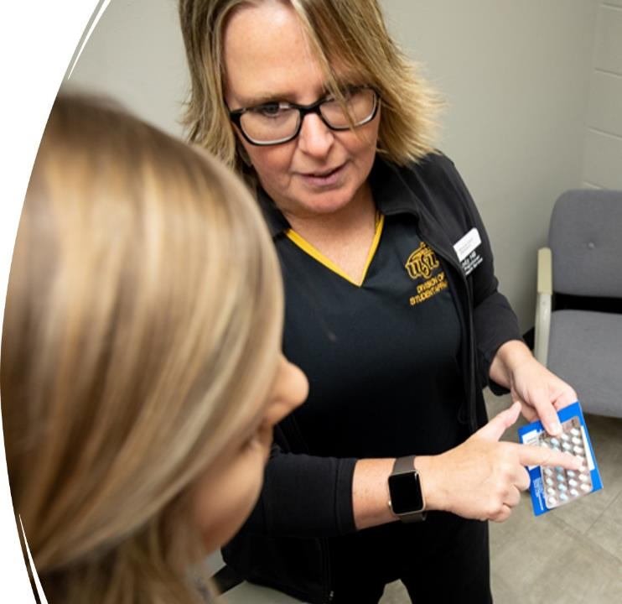
Medication Services
Prescription medication services are available when a Student Health provider sees the student.
No appointment necessary to purchase over-the-counter medications
Numerous options for Rx medications are available in our on-site pharmacy. Mental Health medications can be prescribed and purchased at SHS or e-scribed
ADHD medications may be prescribed after evaluation by our providers. Formal ADHD testing or documentation of a high school IEP is recommended.

Slide 15
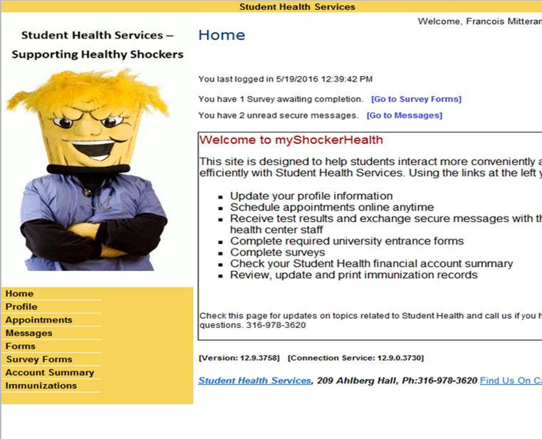
myShockerHealth
Schedule appointments online
Sign-up for text message reminders
Receive test results
Exchange secure messages with healthcare providers
Complete surveys and forms
Upload and Review immunization record
Upload medical history paperwork
Pay bills

Slide 16
Payment Options and Privacy
Payment options include:
Cash
Credit Card/HSA card in student’s name
Pay through the myShockerHealth patient portal
Apply charges to myWSU student account
Student can choose to make any visit a “self-pay” visit to avoid information on visit being on insurance claims.
Walk-out statements can be given to student to sent to insurance
Privacy!!!
Student Health Services provides confidential health services and is a HIPAA and FERPA covered entity.
Patients ages 18 and over are considered legal adults.
Information cannot be shared without written consent from the patient.
Emergencies – emergency contact will be notified if sent to ER if patient consents

Slide 17
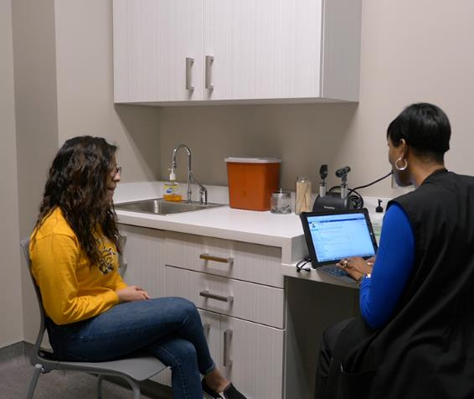
Health Insurance is NOT required to receive services at Student Health, but various plans are accepted.
Insurance Plans Accepted at SHS:
United Healthcare Student Resources
Blue Cross/Blue Shield
Aetna
Claims will be submitted to all out-of-network plans, coverage is dependent upon your plan.
State Medicaid and Military insurance plans are not accepted by most Kansas universities.
There is a Student Health Insurance plan offered by the Kansas Board of Regents for all state institutions: https://www.wichita.edu/services/studenthealth/HealthInsuranceGeneral.php

Slide 18

Tuberculosis Screening Requirement
All newly enrolled students are required to complete Tuberculosis screening questionnaire.
Students can access the questionnaire after registering for orientation.
Multiple emails will be sent to remind student to complete.

Slide 19
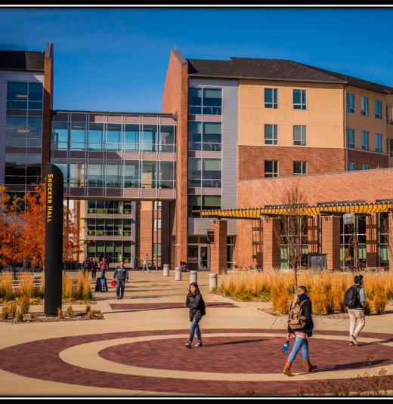
Meningitis Vaccine Requirement
WSU Housing Residents living on-campus are required to submit proof of a current meningitis vaccine or a waiver.
Acceptable Vaccines:
Meningococcal Type ACYW: Menveo, Menactra, Penbraya
Administered date AFTER the age of 16.
Meningitis B only does is not accepted.
Waiver can be found: https://www.wichita.edu/services/studenthealth/QuicklinksandForms.php
Instructions for uploading documents to portal: www.wichita.edu/uploadhealthdocs

Slide 20

QUESTIONS?
wichita.edu/housing (316) 978-3693 Housing.WSU@wichita.edu
wichita.edu/shs (316) 978-4792 student.health@wichita.edu

