Slide 1
Housing and Residence Life Creating a home where Shockers can live, learn, and grow

Slide 2
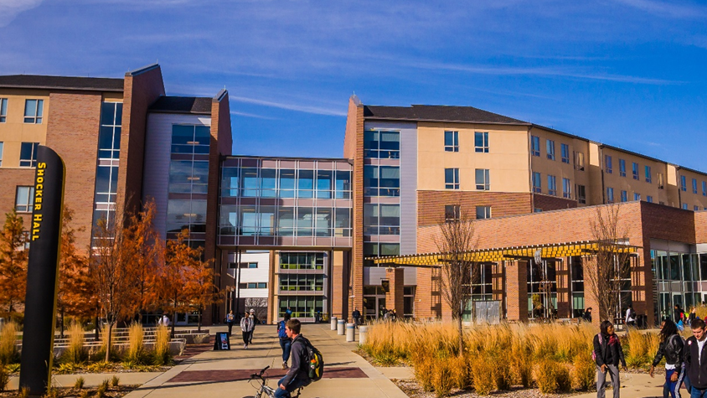
Housing at a Glance
Over 1,400 Residents living within 3 Unique Communities
40 Student Staff members living on the floors throughout the buildings
30 Full-time staff members
Residence Life, Business Operations, Facilities

Slide 3


Why Live on Campus?
Academic Performance
Convenience
Time Management
Social and Personal Development
A Diverse Community
Safety and Security
Support

Slide 4
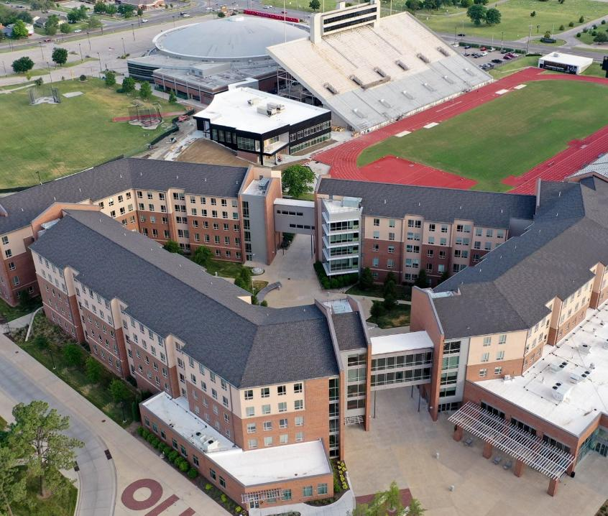
Where Shockers Live
Shocker Hall
First-Year Students Only
800 bed spaces
Each room is furnished with a bed, desk, chair, and dresser
1 or 2 bathrooms per suite
Community Laundry Rooms – Free!
Dining Hall and Coffee Shop
Front Desk open 24/7
Living Learning Communities are all located in Shocker Hall

Slide 5
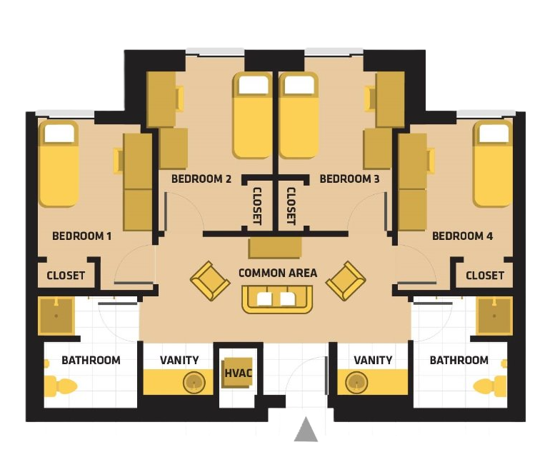
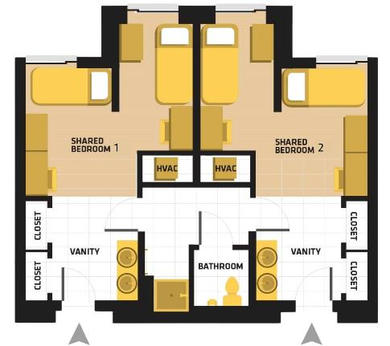
Shocker Hall Room Layouts
Double 2 Bedroom Suite 1 Bath
Single 4 Bedroom Suite 2 Bath

Slide 6
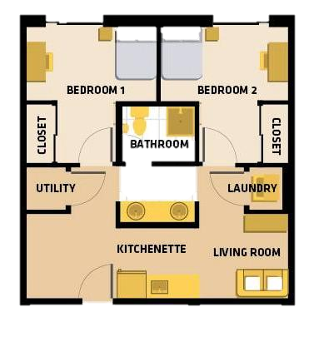
Where Shockers Live
The Suites
First-Year Students Only
220 bed spaces- 2-bedroom suites with private rooms
Each suite has a kitchenette, washer/dryer, bathroom
Beds are full-size, not Twin XL
Located next to The Flats (Innovation Campus)
Front Desk open 24/7

Slide 7
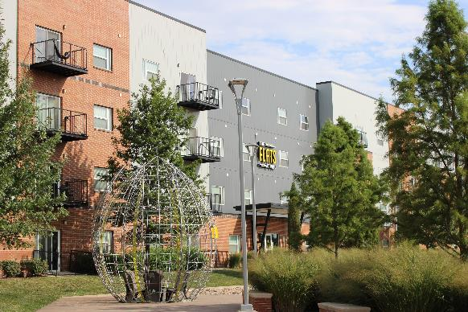
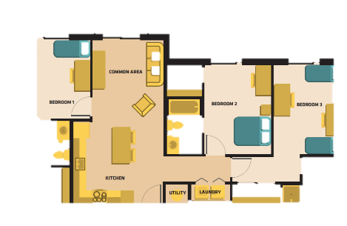
Where Shockers Live
The Flats
Upperclassmen Only- sophomores, juniors, seniors, & graduate students
400 beds- Each apartment includes a full kitchen, washer/dryer, & private bathroom for each bedroom
Clubhouse recreation area
Underground or surface parking available
Located on Innovation Campus

Slide 8
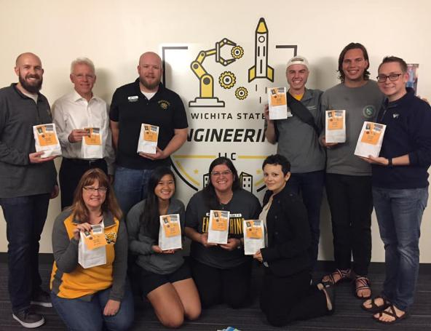

Living Learning Communities
$30 fee for the Academic Year
Civic Mind - Advocacy, Human Behavior, & Public Service
STEM Nation – Science, Technology, Engineering, Math
Grow Space- Education, Training, & Development
Pathways to Wellness- Health & Wellness
The Hive- Business, Entrepreneurship, & Leadership
Honors- Love of Learning
Voices and Visions- Arts, Humanities, & Media
Somos Shockers- Cultural Immersion
Benefits – connect to other students with similar interests, network with faculty members and community members, attend exclusive events for LLC students, and more!

Slide 9

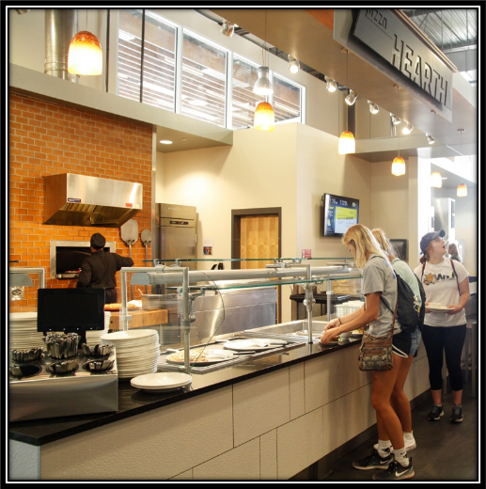



Where Shockers Eat
Shocker Dining Hall
Unlimited Meal Plans
Dining Dollars
Groundhouse
Coffee/Smoothie shop
Grab & Go items
Basic meds, toiletries
Rhatigan Student Center
Shocker Grill & Lanes
Cargill Café at Woolsey Hall

Slide 10


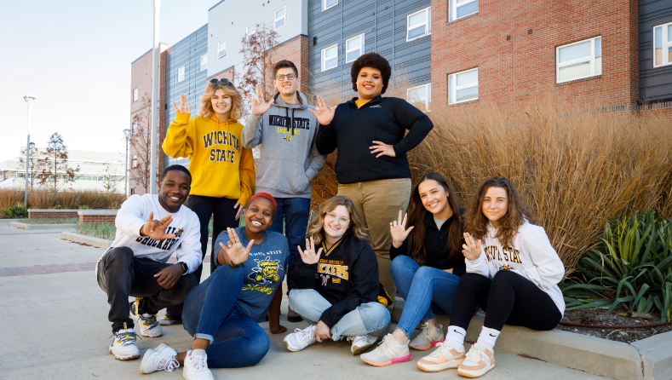
What Shockers Do
Residence Hall Wide Events
Floor Events
Living Learning Communities
Shocker Athletics
Intramural Sports
Student Organizations

Slide 11

Application Process
Application for 2026-2027 goes live October 1st!
Apply via your myWSU portal
$75 Application fee & $200 prepayment are required to be able to go through room selection
March 1st = Priority Deadline #2
Apply before March 1st to be in the second pool of students for room selection
February 15 – next phase of application opens
Enter personal information to your profile to be matched with potential roommates
Start creating roommate groups for room selection
Submit Meningitis Vaccine documentation on MyShockerHealth
Room Selection begins in April – watch student email for information

Slide 12
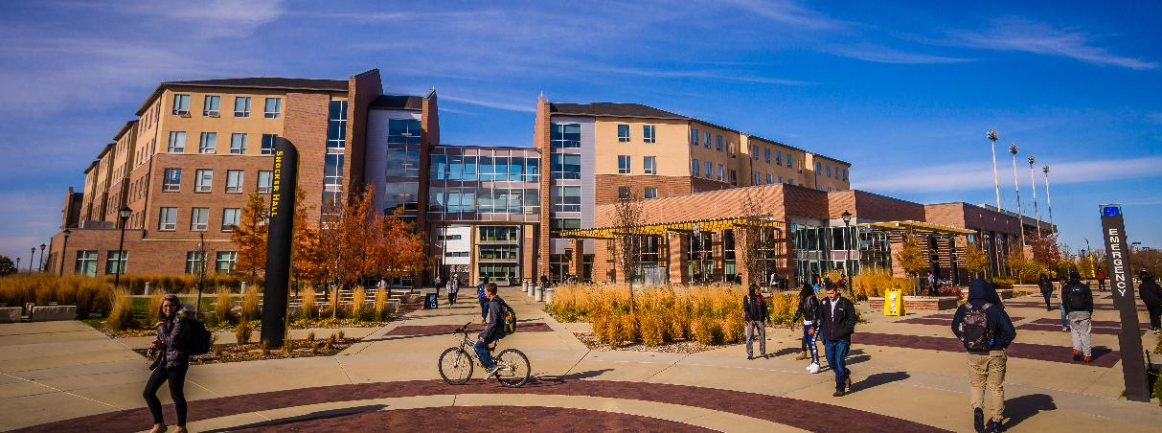
QUESTIONS?
wichita.edu/housing
(316) 978-3693
housing@wichita.edu

