Slide 1

Notes:
Welcome! My name is ______________ and I am a ____________________ in the Shocker Career Accelerator.
What do you think are some of the ways the Shocker Career Accelerator supports students in their career journeys?

Slide 2

Do you think a student’s major is the ONLY factor that determines their job choices?
Notes:
Ask parents what they think/ what do you think is important when consider a person’s job choices? Can have them raise their hands if they do (discuss with 1 or 2) and raise hands if they don’t believe this (discuss with 1 or 2)
Lead into that’s why we teach students through each phase because there are a lot of factors that go into job choice.

Slide 3

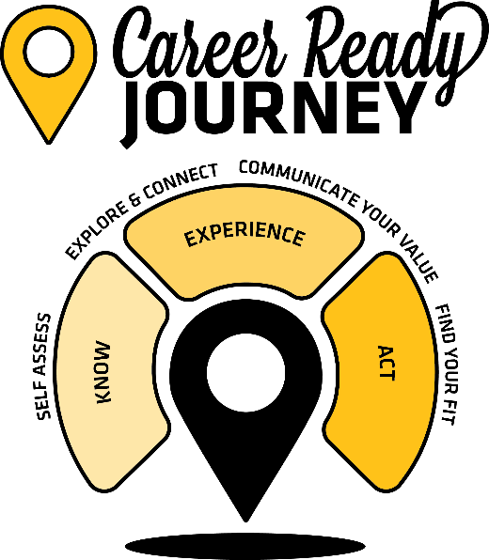



Learn more at wichita.edu/CRJourney
Notes:
We support a student’s Career Ready Journey and teach them these skills.
Today I’m going to discuss each phase and how we empower your Shocker to navigate their own journey.

Slide 4
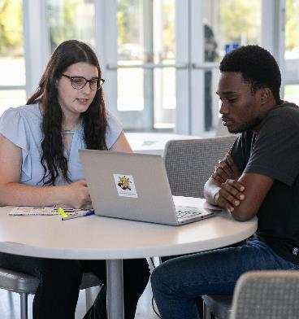
Need to KNOW
Does your student:
Have an idea of their career interests, things they might like to do?
Working with people
Working with their hands
Traveling
Know what subjects interest them?
Know how to describe themselves and their personality type?
Know what careers they can do with their major?
Know the knowledge, skills, and abilities needed to get into a certain career?
Notes:
Think about your student for a second.
Do they: (read the slide)
If you answered NO to any of these questions – your student is in the NEED TO KNOW phase of their journey.

Slide 5
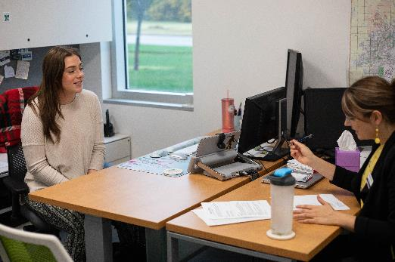
Need to KNOW
Career Ready Skills
We can help:
PathwayU Assessment
Career Exploration Appointment
Career Events - Networking & Informational Interviews
Notes:
In the KNOW or knowledge gathering phase of the journey. We want students to be self-assessing, learning more about themselves and exploring different majors and career paths.
Through self-assessment students will find out who they are – their personality and values, and what their interests are. Then they use that information to explore different career paths. We use a tool called PathwayU.
Additionally, we help students build they career-ready skills through 1-on-1 appointments and through various career events.
If your student needs help getting started or becomes stuck or wants to change their major – encourage them to set up a career exploration appointment with a career coach and we can walk them through their options and outline their next steps.

Slide 6
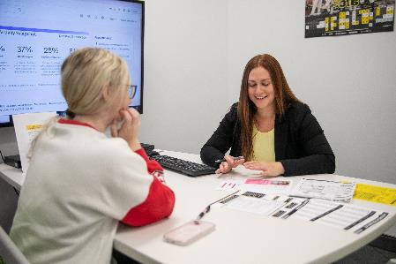

Get started on your journey today!
PathwayU is a FREE self-guided career assessment tool that helps you navigate a personalized career exploration process.
On PathwayU Students Can:
Take 4 assessments to learn more about career interests, personality, values, and workplace preferences.
Connect their assessment results to career and major matches.
Research and learn more about possible career matches.
Get started today at wichita.PathwayU.com
Notes:
PathwayU is a self-guided career assessment tool and after your student takes the 4 career assessments, they will be matched to different career paths based on purpose.
They can explore those career paths within the platform by looking at job descriptions, alternative job titles, average salary, job outlook, education requirements and the knowledge, skills, and abilities they need to be successful in the job. Additionally, they can look at majors that WSU offers that align with that career path.
It is a great starting place and gives a lot of our students confidence and clarity in the journey.
I highly recommend you encourage your student get into PathwayU now! It’s never too early to start building these skills and even if you feel your student knows what they want to do – this information can be reaffirming for them!
Visit Wichita.PathwayU.com to get started. (note, parents can also do this self-assessment if they are in this point in their own journey as this resource isn’t just for WSU students)

Slide 7
Do you think a student’s major will determine their career path?
Notes:
Again, ask this question and talk with a couple of different people about their perspectives. This is to help gauge the perspectives in the room.
There are many things that can alter a person’s career path and one of those is experiences. It’s different to hear about and read about a job vs experiencing it. A major also does not lock you into 1 specific career.
While majors help support that career path, there are many careers a student can pursue with a degree and that’s when we teach students about transferrable skills as they find their experiences.

Slide 8

Need to EXPERIENCE
Does your student:
Know professionals or employers in the career or industry they are interested in?
Have a part-time job or internship?
Know how to describe their skills and experiences in writing?
Know how to describe their strengths and weaknesses?
Have a resume or LinkedIn profile?
Notes:
Maybe you feel like your student is passed the KNOW phase of their journey. Then they are probably in the NEED TO EXPERIENCE phase of their journey.
[ASK THE QUESTIONS] Give parents time to think about these questions.

Slide 9
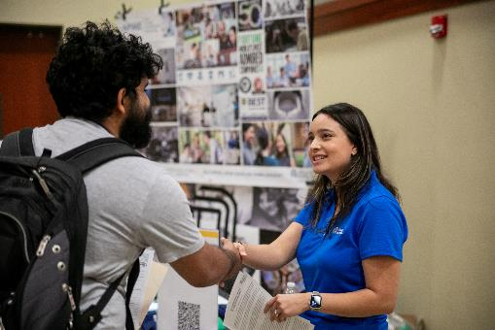
Need to EXPERIENCE
We can help:
Career Coaching Appointments
Job Search Appointments, Resume Building & Review Appointments, Mock Interview Appointment, LinkedIn Optimization Appointment
Career Fairs & Employer-Hosted Events
Shocker Central
Career Ready Skills:
Notes:
This is a general overview. We will go into a deep dive in a moment about Career Fairs, stats, and students’ stories.
In this phase, students continue to explore career paths and connect with employers and they are developing materials that help them communicate their value with confidence to an employer. This stage is where college students typically spend most of their time while in college.
Participating in multiple experiences while in college is crucial to building skills employers are looking for. Internships are not the only valuable experiences.
Participating in student organizations, volunteering, working a part-time job, taking a leadership role in a class project – all of these are examples of valuable experiences that allow students to grow and develop career-ready skills.
These are experiences they will put on a resume or talk about in an interview.
Ways we help students in this phase are through a lot of our career coaching appointments. We have appointments to help student build their resume and cover letter, practice their interviewing skills, optimize their LinkedIn profile and search for an on-campus job, internship, or part-time job.
When a student is ready to get work-related experience – we have a tool called Shocker Central to help them.
Students in this phase need to be thinking about the experiences they are participating in AND growing their network by making connections with employers.

Slide 10
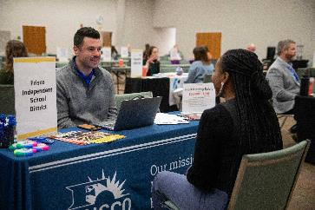
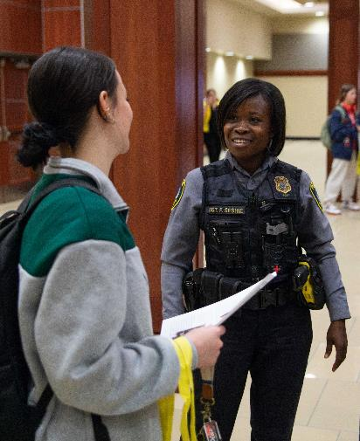
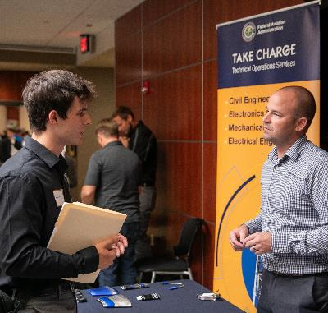
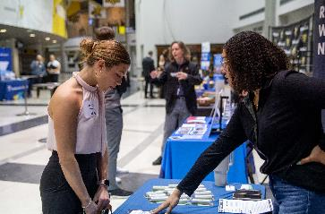
CAREER EVENTS
Notes:
We host many events throughout the school year and each of these are an opportunity for students to explore and connect with employers in their field of study.
Even if a student isn’t searching for a job or internships right now – these events are great ways to learn what's out there and what to expect when the time is right to search for a job.
This slide leads into discussing who they will see at these fairs to tie in the networking and employer aspect.

Slide 11














INDUSTRY CONNECTIONS AT WSU
Notes:
Here are just a few of the industry partners that WSU works with. And you will notice that the names of some of these partners on buildings here on campus. That is intentional, We want students to be able to go to class, walk across campus and go work for an industry partner in the same day. It is an experience that is unique to WSU and something we are really proud of here.

Slide 12
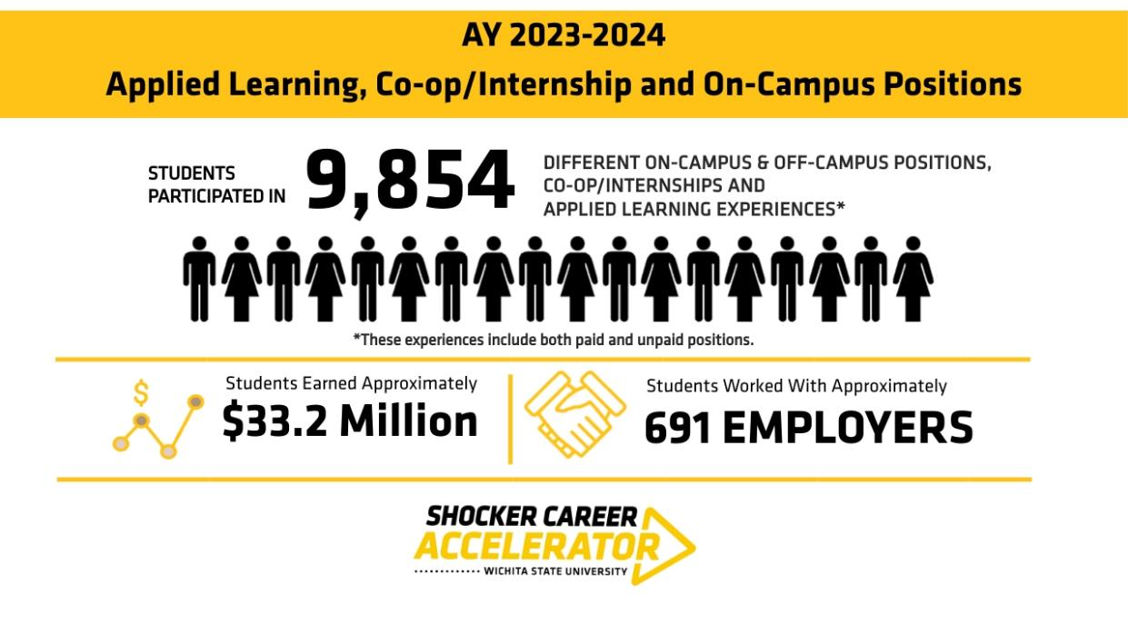
Notes:
The data supports this too
Emphasize multiple opportunities (internships, applied learning, etc.)

Slide 13
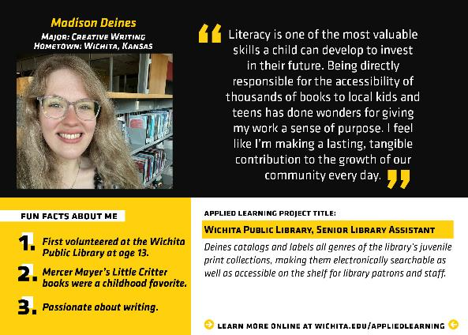
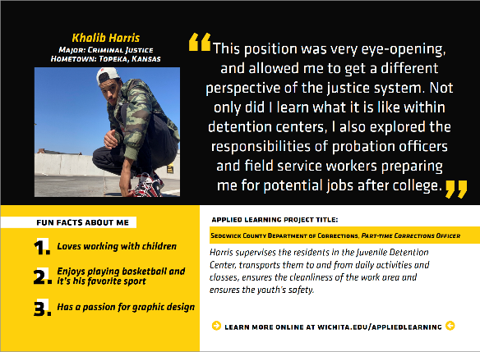
Hear these students stories
Check out what our students are doing at wichita.edu/Hero
Notes:
Don’t just take our word for it, see what actual WSU students are saying about their experiences.
Show multiple various opportunities (see what students are participating in)
Fix header wording later
Connect your student to applied learning opportunities and potential employers. Our students participate in a wide range of experiences and get the chance to work along-side industry professionals.
You can check out what our students are participating in by going to wichita.edu/hero

Slide 14
Do you think a student will only have 1 career in their life?
Notes:
Ask parents what they think/ what do you think is important when consider a person’s job choices?
Lead into that’s why we teach students through each phase because there are a lot of factors that go into job choice and the reason we spend time on each of these phases is because priorities can change, people can change, and we want them to feel confident through each phase. Note: even if someone stays in the same career, jobs are always changing and evolving and this all leads to helping students find the right fit for long-term happiness.

Slide 15


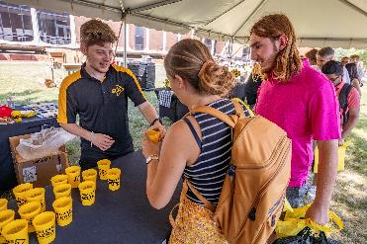

Ready TO ACT
Career Ready Skills:
We can help:
Job Search Appointment
Mock Interview Appointment
Career Fairs & Employer-Hosted Events
Notes:
The 3rd phase of the journey is the Ready to Act phase. This is where students take action on their career goals.
Students are continuing to refine how they communicate their value to employers, and developing skills to find their fit in the working world.
By the time your student graduates, we hope they feel confident in their ability to:
Execute a job search
Research organizations
Ask questions to gauge company culture
Network to gather information and make connections
Reflect on their personal goals and values and align
At the end of the day, we want students to not just find a job, but find their purpose and feel confident in their ability to make career decisions.

Slide 16
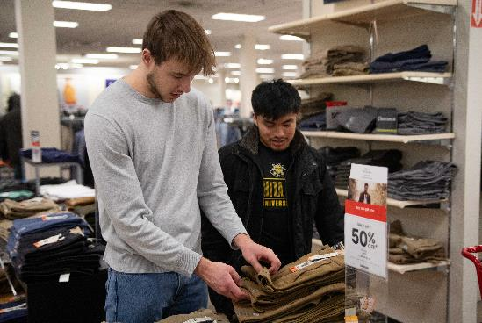
PREPPING THE PROFESSIONAL
JCPENNEY Suit-Up Event
Show your WSU ID and receive up to % off select professional dress apparel!
Career Closet
Visit our Career Closet to pick out one suit or any combination of top, bottom, shoes, and accessories
Professional Photos
Get your Professional Photo taken.
Notes:
A few additional ways we help your student prepare to be a professional is through:
JCPenney Suit Up Event
This event allows your student to receive a 50% discount on professional dress apparel.
Career Closet
Students can pick out up to 3 items of professional clothing FOR FREE!
Professional Photos
We will take and edit a professional photo for students to use on their LinkedIn Account.

Slide 17

HOW CAN YOU HELP YOUR STUDENT?
Remain open and receptive to ideas and possibilities.
Encourage them to explore different courses, clubs, and work experiences to learn more about their strengths, interests, and what excites them.
Remember, choosing a major is not equal to choosing a career. Many paths can lead to the same destination.
Encourage them to visit us!
Notes:
We’ve talked a lot about how WSU and our office supports students, but we also wanted to talk about how you can too.
The first point is good to emphasize they are already doing this by being here today and learning about the resources available which is so important.

Slide 18
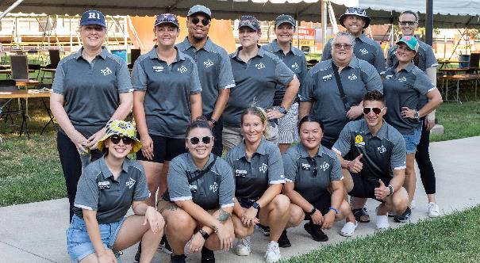





Connect with us!
Students can schedule an in-person or virtual appointment with us!
Email SCA@wichita.edu
Call (316) 978-3688
Online at wichita.edu/ShockerCentral
Find us in Marcus Welcome Center, Suite 139
Visit us online at wichita.edu/Career
Check out our Career Events at wichita.edu/CareerEvents
Let’s get social
@ShockerCareerAccelerator
Notes:
This is a great area to emphasize what connecting with us even means: making appointments, asking for help, sharing their success. Our team is here to help people feel empowered in their career.

Slide 19
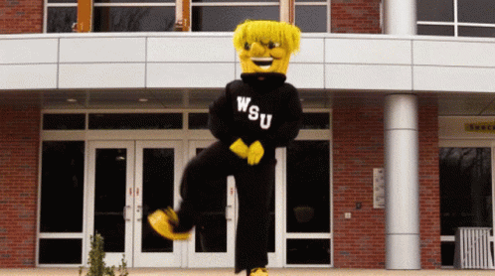
QUESTIONS?

