Slide 1
Student Success
From Orientation to Graduation

Slide 2
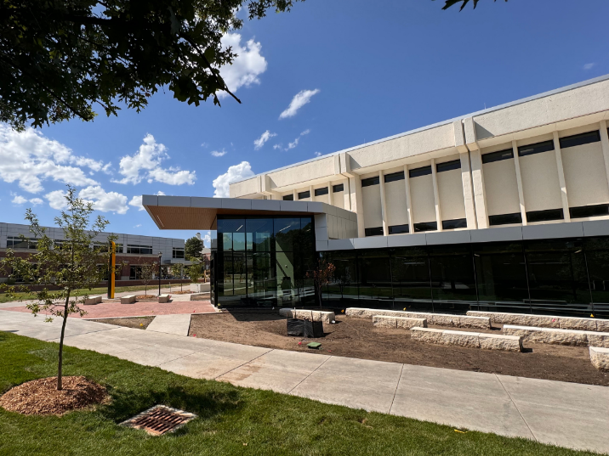
Shocker Success Center (wichita.edu/shockersuccesscenter)
Opened in the Summer of 2024.
Co-locates student services in one building.
Located between the Rhatigan Student Center and Ablah Library.

Slide 3
Student Success
FIRST - YEAR PROGRAMS
ACADEMIC SUCCESS PROGRAMS | Shocker Learning Center
SUCCESS COACHING
Notes:
Student Success is comprised of three different unique, but related functional areas:
First-Year Programs
Academic Success Programs
Success Coaching
We’ll cover each of these in a little more detail throughout the presentation.
Our goal is to help students maximize their potential and reach their personal goals through a range of support and services.
Your students’ success is our success.

Slide 4
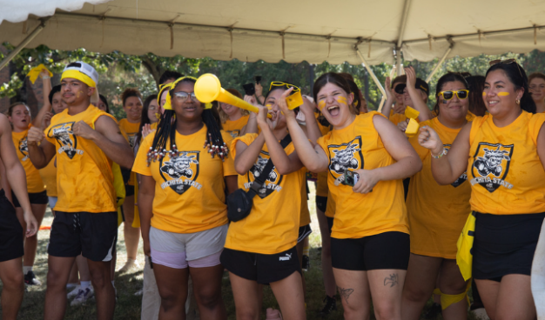
First-Year Experience (wichita.edu/fye)
Three Pillars of FYE:
First-Year Programs
Orientation and transition programs
First-Year Advising
Enrollment + degree planning
First-Year Seminar
Required for freshmen
FYE process for traditional freshmen starts March 1.
Notes:
First-Year Experience at Wichita State has three pillars:
First-Year Programs: resources, services and events that help students make a successful transition into college life at Wichita State.
First-Year Advising: provides academic support in helping your student get enrolled and understand their degree program, or help your student find a degree program that is right for them.
First-Year Seminar: a required course for all new freshmen, taught in a way that is interesting, but also supportive with small class discussions, activities, projects, with a focus on making a successful academic transition.

Slide 5
Freshman Enrollment Process
RSVP for Orientation and complete Enrollment Questionnaire.
Provide needed transcripts or test scores, etc.
Schedule built based on preference, requirements and provided info.
Email sent to view schedule.
Login and review within 10 days and approve or ask questions.
This experience applies to all students coming to Wichita State directly out of high school.
If schedule is not approved within 10 days, classes will be dropped and student will have to start over.
Students can ALWAYS ask for changes and request an appointment with an advisor.
Students should check their @shockers email often.

Slide 6


First-Year Programs (wichita.edu/firstyear)
Orientation (March - December)
Pre-Orientation: Blackboard (online) modules
Freshman Orientation: in person, one day
Pre-Season Programs
SHOCKFEST: weekend prior to classes
New Shocker Toolkit: Blackboard modules
Transition Programs
CLASH of the Colleges
First-Year Social
Mentor Meet-Ups (Shocker State Fair)
Syllabus Party
Winter Welcome
Notes:
The process to begin the Orientation and Enrollment process does not start until March 1. We will send information to your through the mail beginning in late February, but you will not be able to start the process until March 1.
Highlight the other transition events.

Slide 7

Parent Connections (wichita.edu/family)
Parent and Guest Orientation
wichita.edu/orientation
Programs for Spanish speaking families
Shocker Family Table Talks
wichita.edu/sftt
Virtual sessions to help families transition to college life
Shocker Family Programs
wichita.edu/family
Monthly newsletters
Family Weekend information

Slide 8
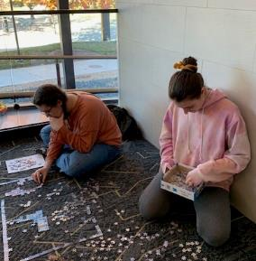
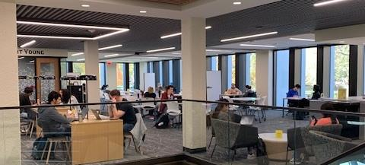
Academic Success Programs – Shocker Learning Center (wichita.edu/slc)
FREE tutoring
CRLA Level II tutor certification
Students schedule or request a tutor from the Navigate Student App
SLC: tutoring, SI, Math Lab, Writing Center, Physics Help Room
Supplemental Instruction
Only accredited program in Kansas
Supports historically difficult courses
Focus is on how to learn
Sessions driven by student needs
Sessions start the second week of each semester
Notes:
The Shocker Learning Center houses two main programs: tutoring and Supplemental Instruction
Tutoring is FREE!
Our tutors are certified, which means we take a lot of time to train them to be more than just a tutor. As we know, class content may not be the problems students are having in a class. Our tutors are trained to look for other signs of academic struggles like learning disabilities and/or time management issues that may be getting in the way of student learning.
Students can easily schedule a tutoring session with a tutor we already have on staff, or if we need to find a tutor for a subject we don’t currently have, they can request a tutor in that same place.
WE WILL BE MOVING TO THE SHOCKER SUCCESS CENTER this summer, which is EXITING for YOUR STUDENTS! They will have a nice, new, large collaborative space to study for classes and receive any help they need academically!
Supplemental Instruction is a more robust tutoring program that embeds a tutor in a specific class, who holds free, weekly review sessions outside of class. SI supports historically difficult classes for students.
We are the only accredited program in Kansas, which again speaks to the time we take to be sure our student leaders are well trained
The focus of the students is HOW to learn. SI leaders do not re-lecture, they focus on skills to apply the information learned in class in many different ways
Each SI session is driven by what the students need – lesson plans are developed by the SI leader, however the students are the ones leading the learning
Because these course are historically difficult, it is important that support for the class starts early, so review sessions will typically start week two of each semseter

Slide 9
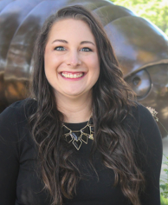
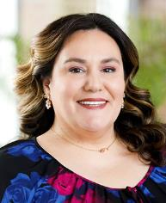
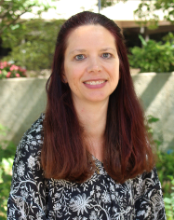


Success Coaching (wichita.edu/successcoach)
Coaches help students create individual plans for success
Strengthen academic/study skills, time management, motivation, etc.
Navigate academic challenges with classes, professors, etc.
Success Teams = coordinated and connected care
Notes:
Success Coaches help students individually reach their academic goals or address any academic concerns they have. Mostly, coaches help students strengthen their study skills and time management, which is the largest issue we see among the students we serve at every level. Coaches can help students address issues they are having with professors, or connect students to other resources or people on campus that can help them thrive.
Success Coaches lead success teams in each college. These teams are made up of coaches, advisors, career experts, CARE Team members, and others who are all connected in the ways they serve students in each academic college. We spend a lot of time and energy creating these coordinated care networks to ensure that students have the help then need, when they need it. Coaching is free, and it is optional, however some programs do require meeting with a coach regularly to ensure success.

Slide 10

Success Teams (wichita.edu/successteam)
Led by a Success Coach
Introduced at Orientation
Outreach and programming throughout the semester
Each college’s team consists of:
Success Coach
Advisors (First-Year and college)
Financial Aid Counselor
SOS team member (CARE Team)
Librarians
Shocker Career Accelerator team member

Slide 11
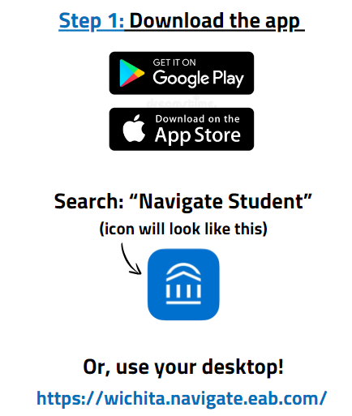
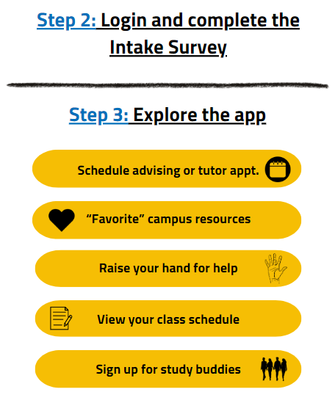
NAVIGATE360 Student App

Slide 12
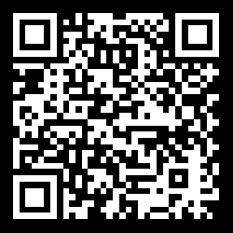
Questions? Student Success Kim Sandlin, Director
316-978-3209 | student.success@wichita.edu | wichita.edu/success

