Slide 1
Chrome River Basics
Kristie Courtney
&
Sonya Emmart

Slide 2
Agenda
What is Chrome River
Chrome River Benefits
Training Resources
Pre-Approval Walkthrough
Expense Report Walkthrough
Pcard Reconciliation Walkthrough
Questions

Slide 3
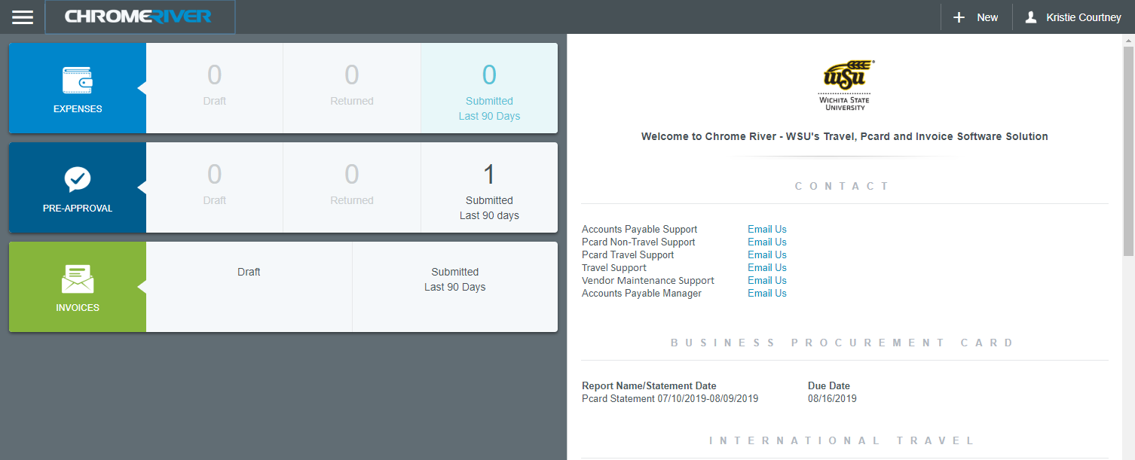
What is Chrome River?
Online Travel, Pcard Expense, and Invoice Software Solution

Slide 4
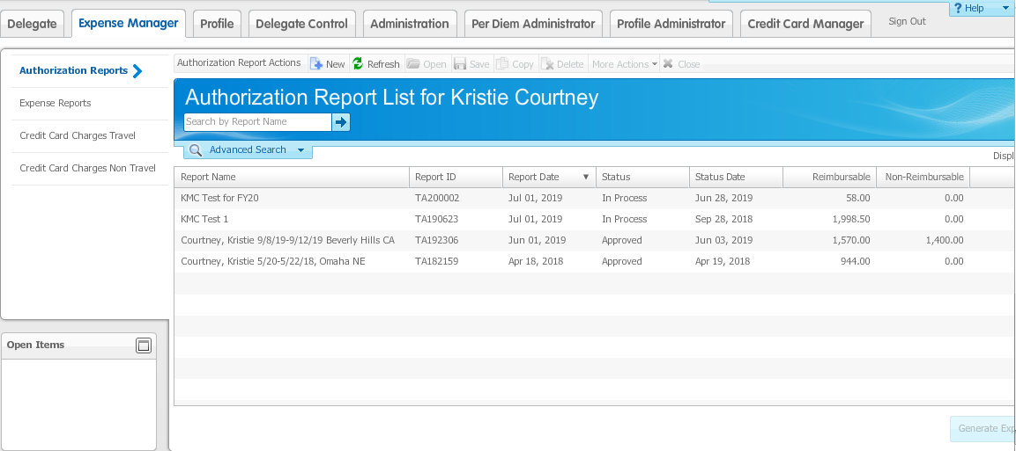
What has Chrome River replaced?
Travel & Expense Management (TEM) System

Slide 5
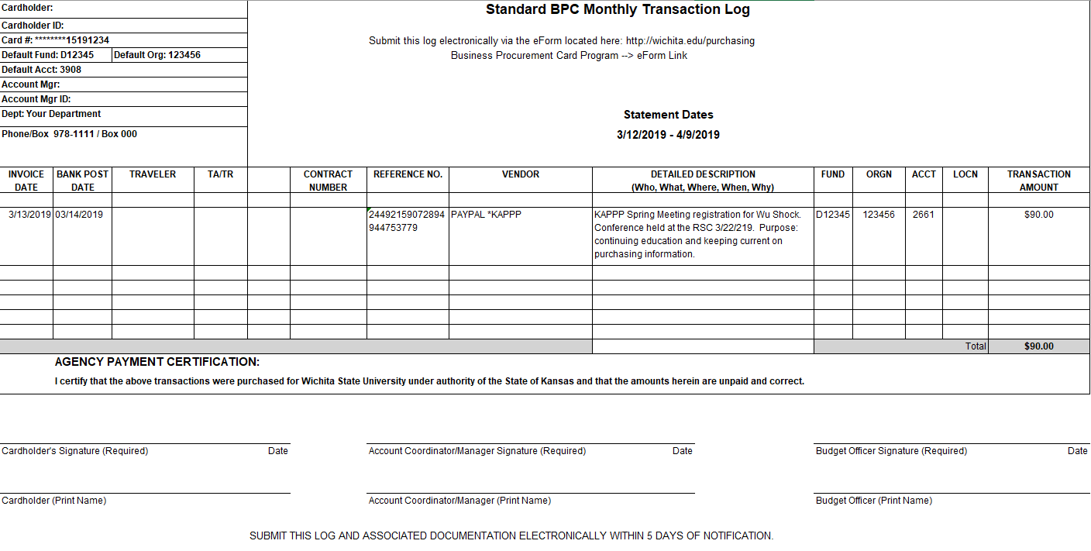
What has Chrome River replaced?
Procurement Card Logs

Slide 6
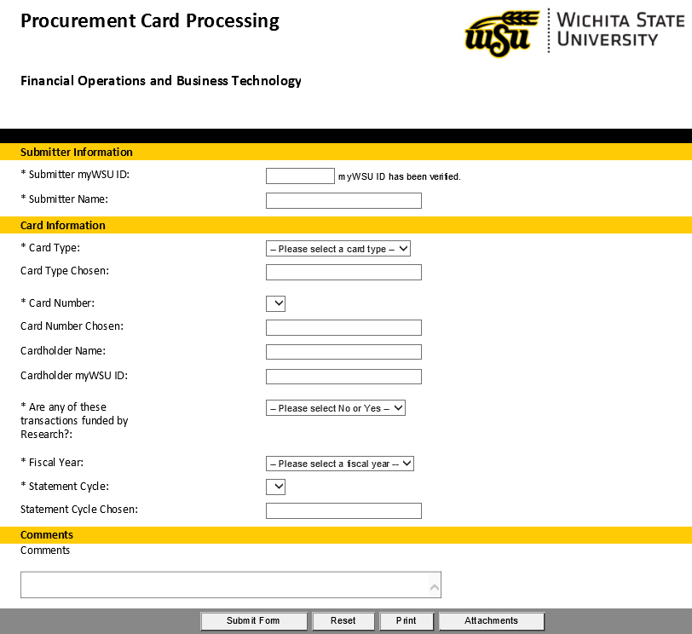
What has Chrome River replaced?
eForm process

Slide 7
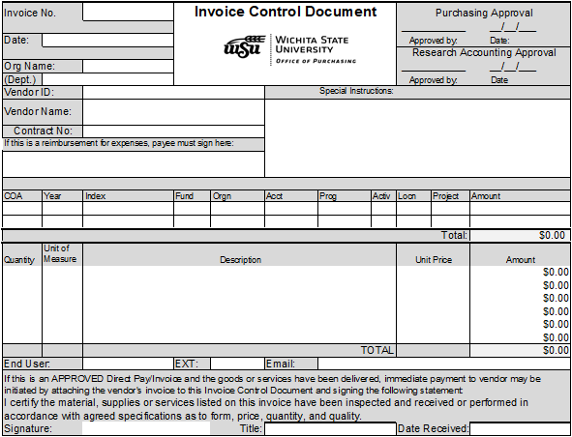
What has Chrome River replaced?
Invoice Control Document (ICD) Process

Slide 8
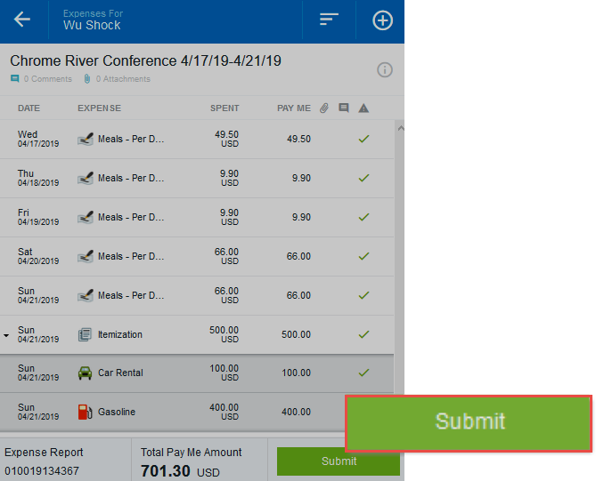
Chrome River Benefits
Automated electronic submission, review and approvals
Users can follow their report through the approval process.
Approvers receive automatic notification of reports in their queue and can approve or return quickly

Slide 9
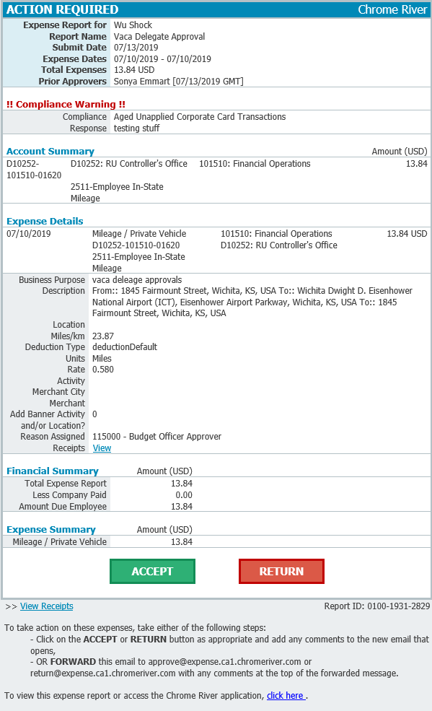
Approval Email
Approvers can:
Review detailed information
Accept (Approve)
Return (Deny)
View Receipts
Open the report in the Chrome River software

Slide 10
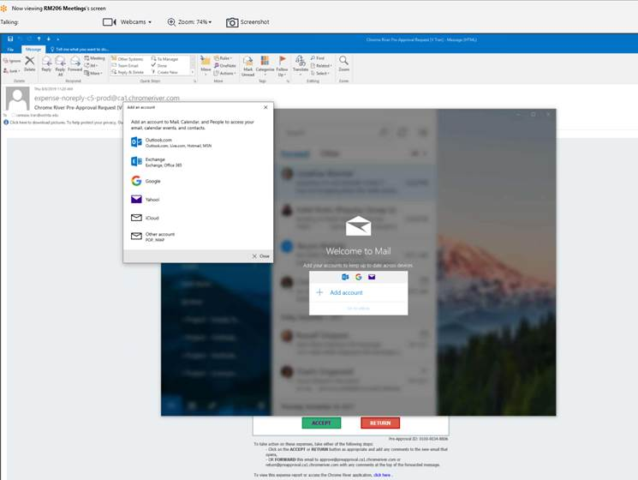
Windows Default App Settings
If you are approving by email and are redirected to the “Welcome to Mail” window, review the Email Issue help document.

Slide 11
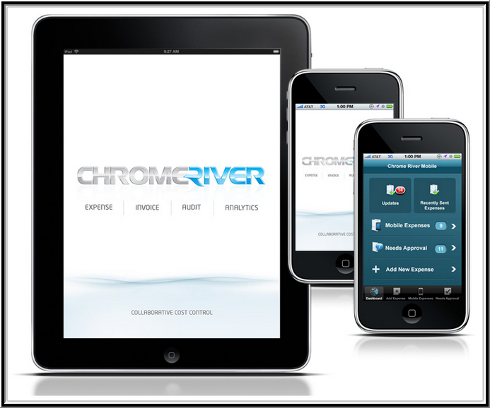
Chrome River Benefits
Chrome River software can be accessed any time on any device allowing for real time recording of expenses as they occur.
Built in compliance rules take the guess work out of policy interpretation.
Provides the ability to submit electronic receipts

Slide 12
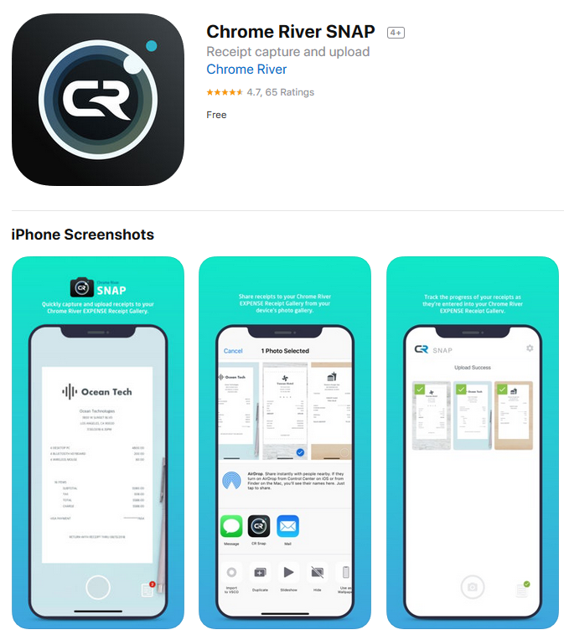
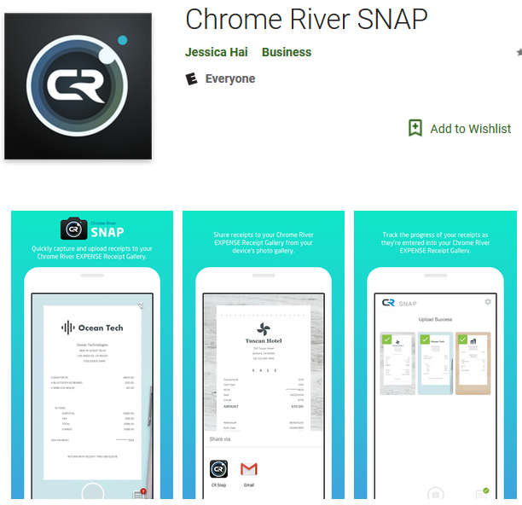
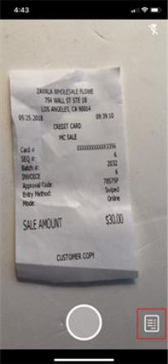
Chrome River Benefits
Chrome River SNAP app – Available for
Apple and Android

Slide 13
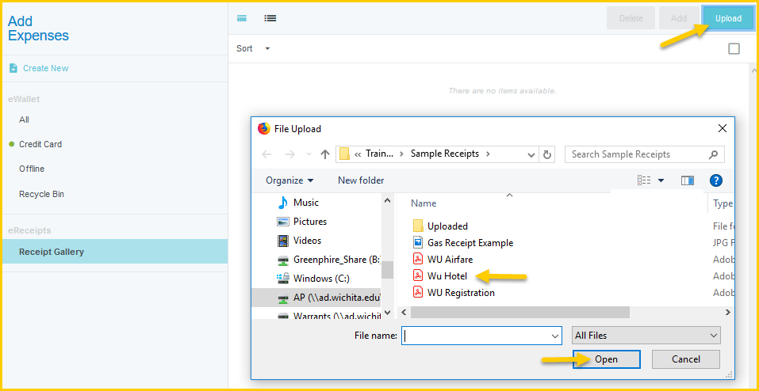
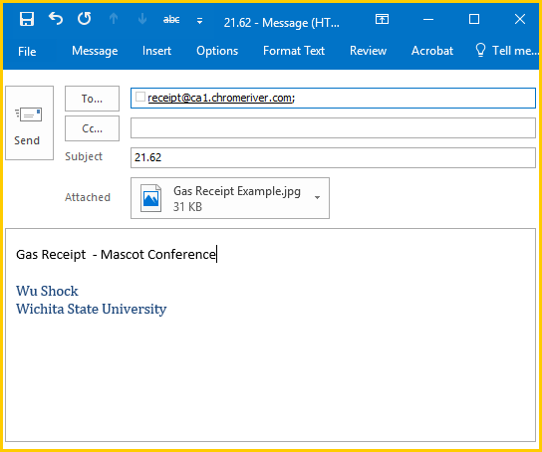
Upload & Attach Options
Several options available:
Attach via email
Attach via scanning
Drag and Drop
Upload Images
SNAP app

Slide 14
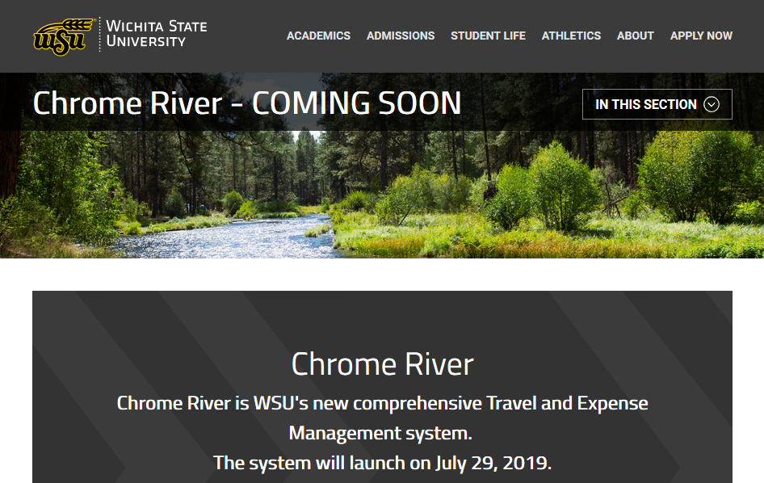
Resources
Visit our webpage at wichita.edu/CR for:
Important announcements
Contact information
Training resources

Slide 15
Chrome River - Walkthrough

